Slide 1


Slide 3
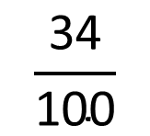
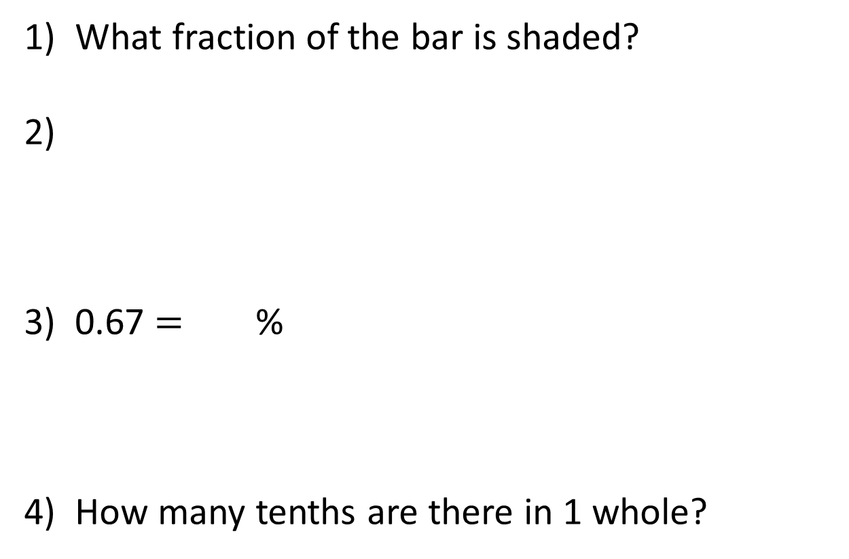
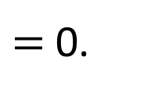
1) What fraction of the bar is shaded?
2)
3) 0.67 $=$ %
4) How many tenths are there in 1 whole?
v
$$\frac{\text{34}}{\text{100}}$$
$\text{=}$ 0.

Slide 4
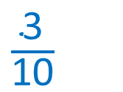
1) What fraction of the bar is shaded?
2)
3) 0.67 $=$ %
4) How many tenths are there in 1 whole?
v
$$\frac{\text{34}}{\text{100}}$$
$\frac{\text{3}}{\text{10}}$
34
$\text{=}$ 0.
67
10

Slide 6


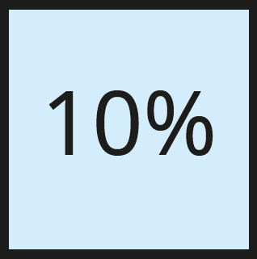

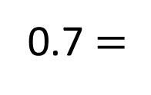
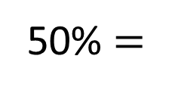
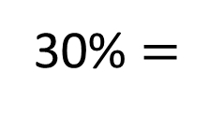
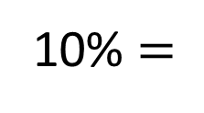
Use the models to complete the statements.
100%
10% $=$
0.1
50% $=$
0.5
30% $=$
0.3
0.7 $=$
70%
Have a think

Slide 7


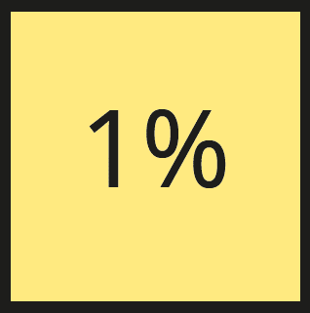
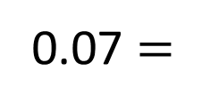
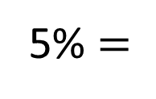
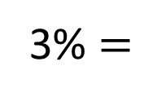
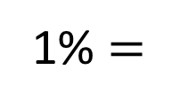
Use the models to complete the statements.
10%
1% $=$
0.01
5% $=$
0.05
3% $=$
0.03
0.07 $=$
7%
Have a think

Slide 8
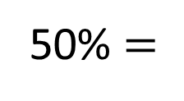
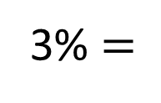
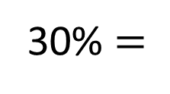
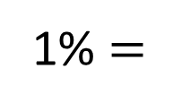
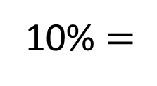
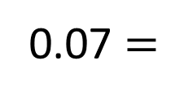
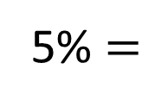
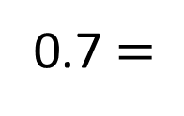
10% $=$
0.1
50% $=$
0.5
30% $=$
0.3
0.7 $=$
70%
1% $=$
0.01
5% $=$
0.05
3% $=$
0.03
0.07 $=$
7%
What is the same?
What is different?

Slide 9
Have a go at questions 1 – 2 on the worksheet.

Slide 10

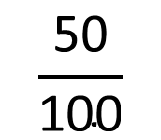


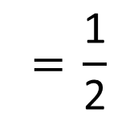
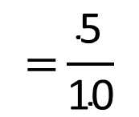
50 out of 100 squares are shaded.
Percent means ‘out of a hundred’
$$\frac{\text{50}}{\text{100}}$$
$$\text{=}\frac{\text{5}}{\text{10}}$$
$$\text{= }\frac{\text{1}}{\text{2}}$$
$$\text{=}$$
$$\text{50\%}$$
$$\text{=}$$
0.5

Slide 11

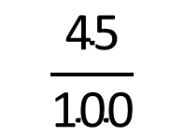

45 out of 100
$$\frac{\text{45}}{\text{100}}$$
45%
$$\text{=}$$
$$\text{=}$$
0.45

Slide 12
The rekenrek represents 1 whole.
What decimal has been represented?
0.59
What percentage has been represented?
59%
Have a think

Slide 13
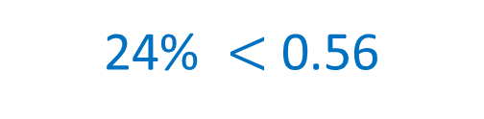
Is 24% or 0.56 greater?
24 out of 100
24%
0.24
56 out of 100
0.56
56%
24% $<$ 0.56

Slide 14

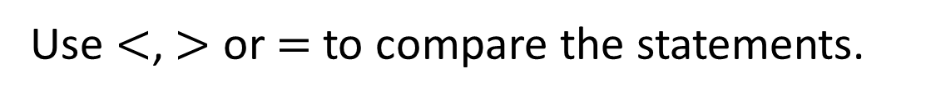



Use $<$, $>$ or $=$to compare the statements.
$$<$$
$$=$$
0.34 87%
0.34 34%
$$<$$
$$>$$
0.8 87%
0.9 87%
Have a think

Slide 15
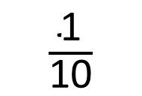
Put the following numbers in order.
Start with the smallest.
Have a think
Ascending
Have a think
0.18
9%
$\frac{\text{1}}{\text{10}}$
0.2
18%
9%
10%
20%

Slide 16
Have a go at questions 3 - 6 on the worksheet.

Slide 17
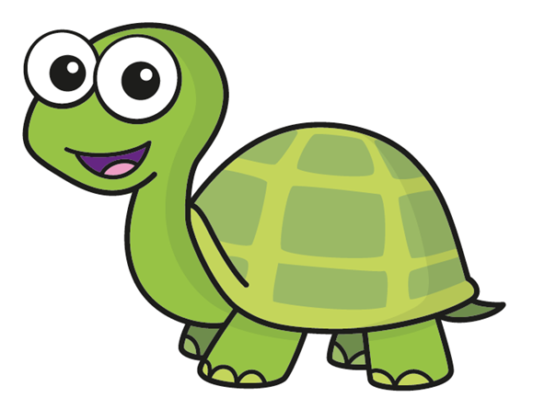
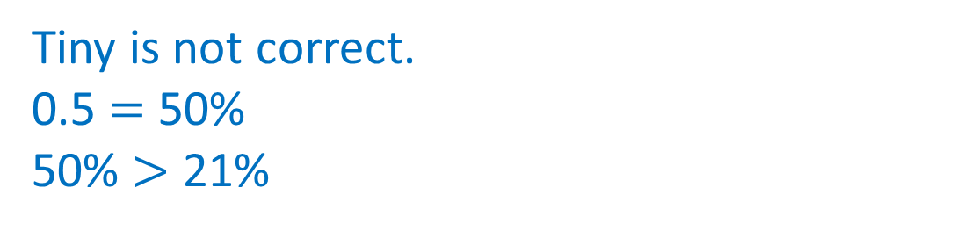
Tiny is comparing decimals and percentages.
21% is greater than 0.5 because 21 is greater than 5
Is Tiny correct? Explain why
Tiny is not correct.
0.5 $=$ 50%
50% $>$ 21%
Have a think

Slide 18
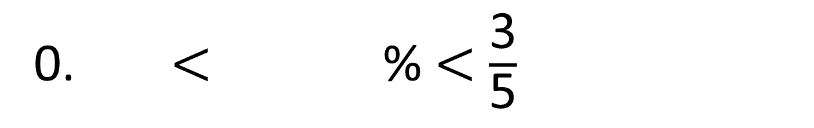
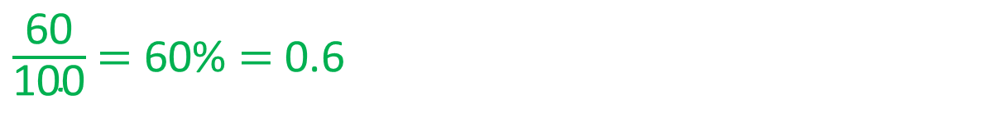
Using the digit cards only once to complete the comparison.
3
4
5
6
7
0. $<$ % $<$ $\frac{\text{3}}{\text{5}}$
$\frac{\text{60}}{\text{100}}$ $=$ 60% $=$ 0.6
Which card do you think is the most important?
How many possibilities can you find?
Have a think

Slide 19
Have a go at the rest of the worksheet

Slide 20



Slide 21
I do
You do

Slide 22
















Rosie
Alex
Amir
Whitney
Ron
Dexter
Annie
Tommy
Mo
Jack
Eva
Teddy
Max
Kim
Jo
Sam

Slide 23


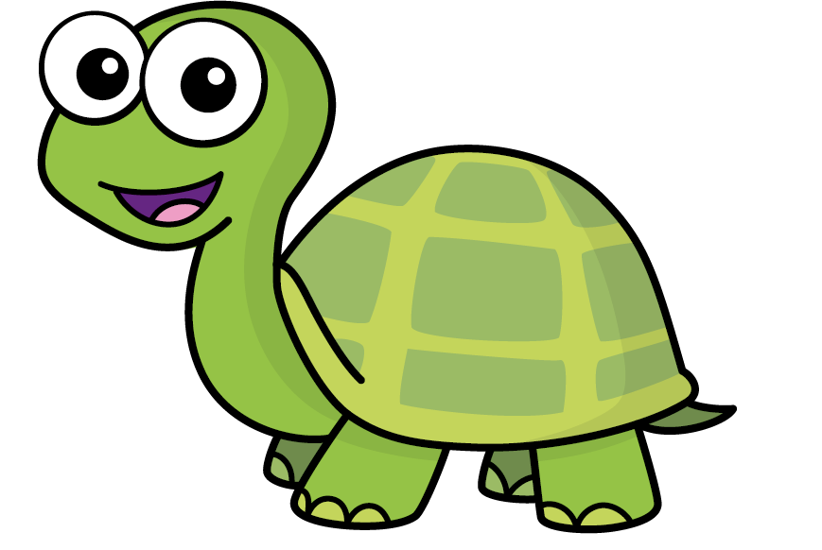
Speech bubble text – replace with any character head.
Speech bubble text – replace with any character head.
Bee
Diddy
Tiny

Slide 24
27
342
300
2
20
7
40
M | HTh | Tth | Th | H | T | O

Slide 25


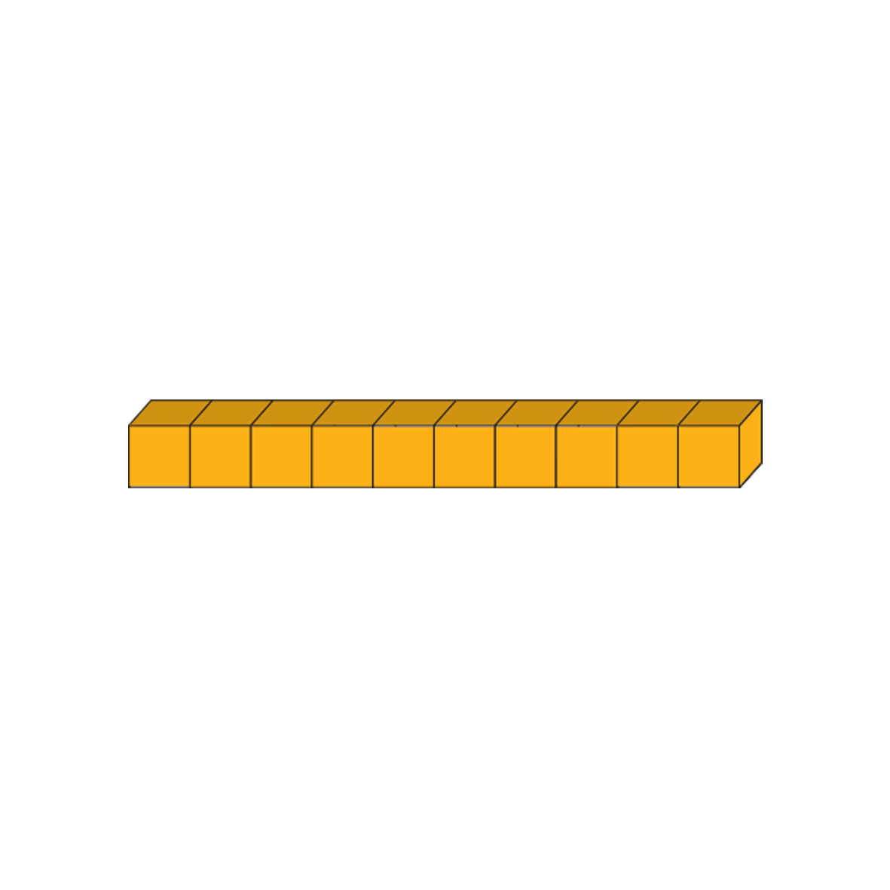


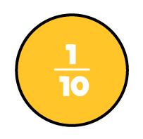

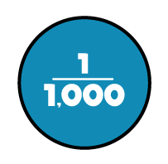
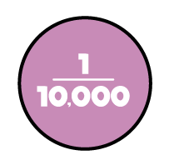






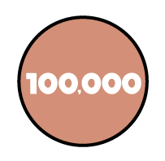
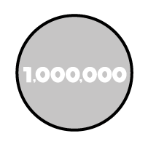
















Slide 26


























































