Slide 2
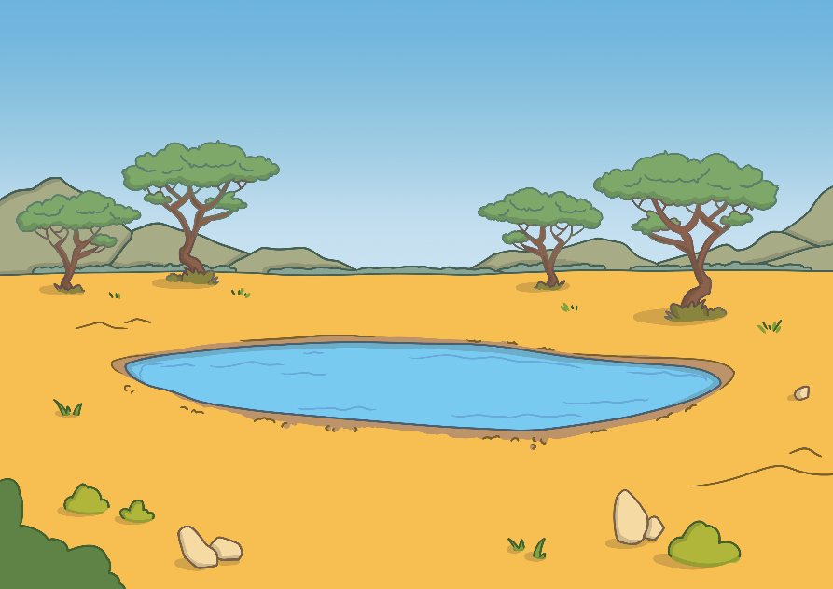
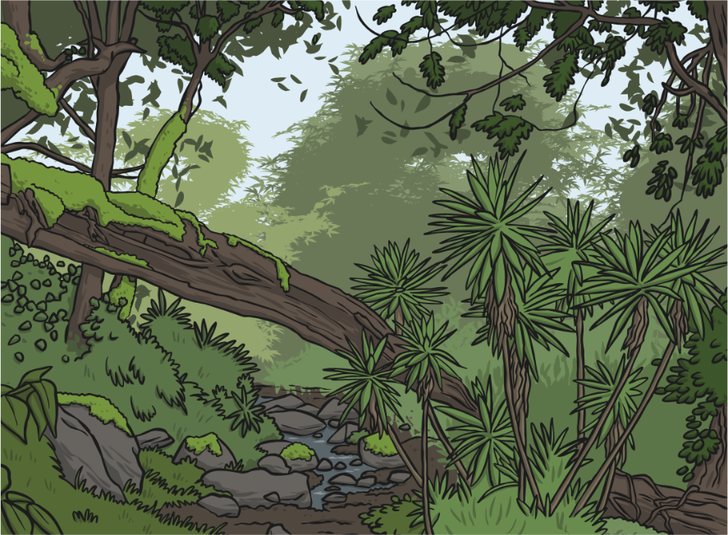
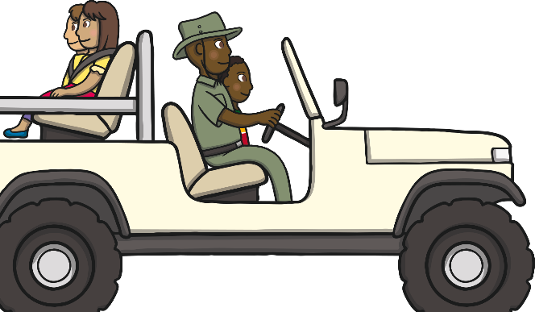
Amazing Africa
Africa is an amazing place. It is made up of a lot of countries that form the second largest continent in the world.
Africa has many different regions, including the Sahara desert, grasslands (known as savannahs) and highlands.

Slide 3
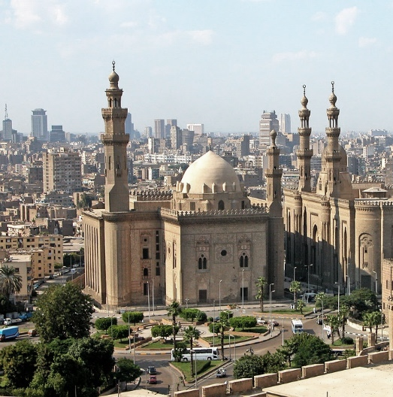
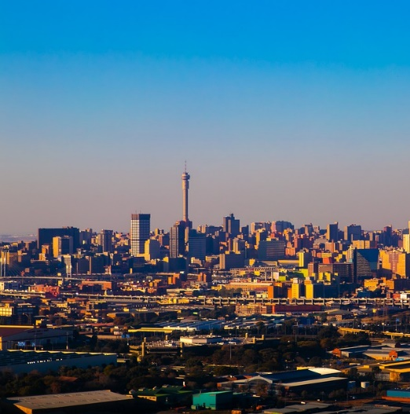
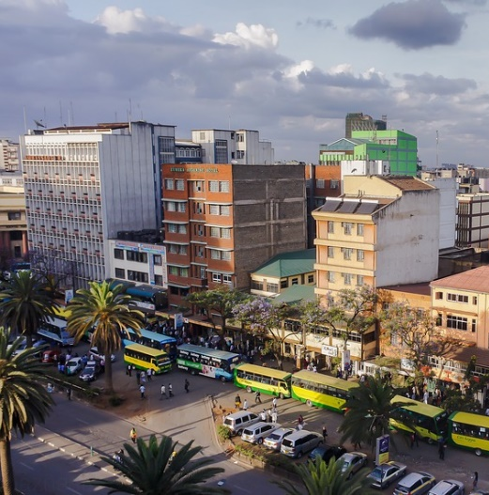
African Cities
There are also many big, bustling cities in African countries.
Cairo is the capital city of Egypt.
Johannesburg is
the biggest city in
South Africa.
Nairobi is the capital city in Kenya.

Slide 4
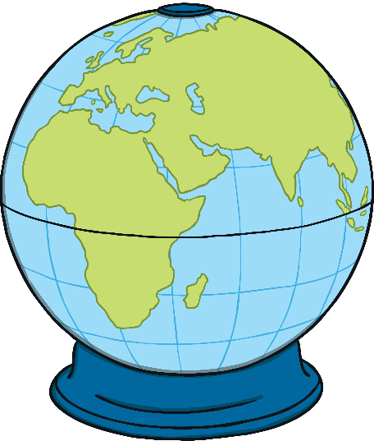
Fascinating Facts
There are 54 countries in Africa.
There are well over 1000 languages spoken in Africa.
South Africa hosted the 2010 football World Cup tournament and was the first African country to do so.
Morocco, in North Africa, is very close to Spain, which is in Europe.
Africa is the hottest continent in the world.
Glaciers are found up some mountains in Africa.

Slide 5
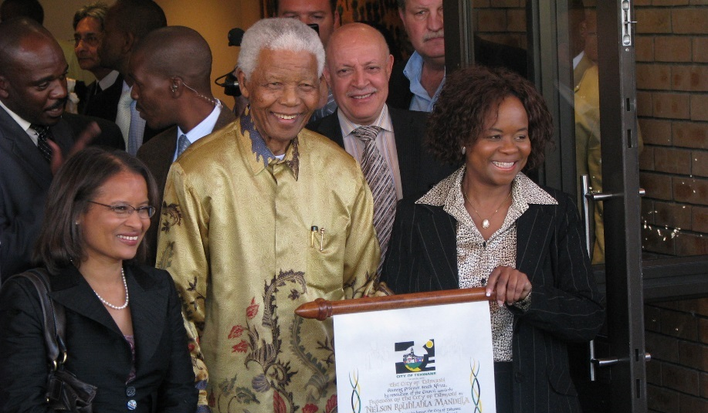
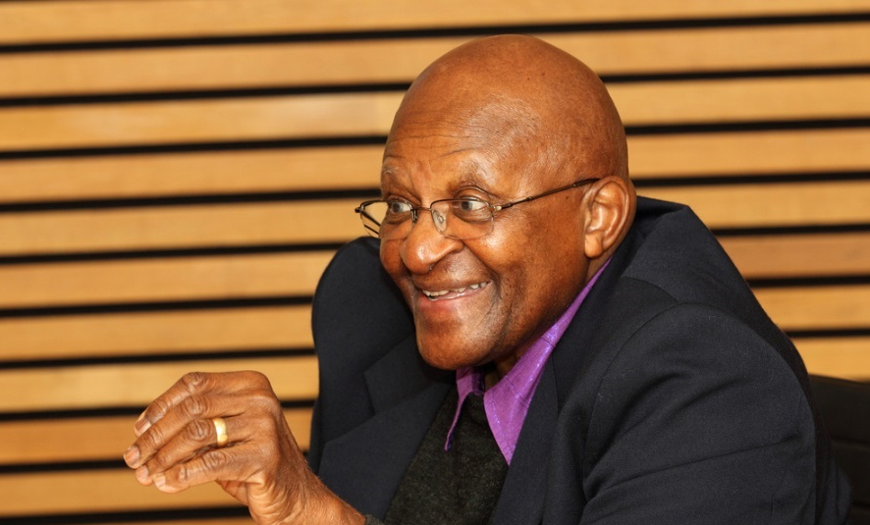
Famous African People
Nelson Mandela
Mandela was a man who stood up against apartheid. This was a time when Black people were not treated as well as White people. There was a lot of unfairness. Mandela was kept in prison for 27 years because he tried to make things fairer in Africa for Black people.
Archbishop Desmond Tutu
Tutu was an important man who also stood up against apartheid and tried to make life better for Black people.
Photo courtesy of South Africa The Good News and Skoll World Forum (@flickr.com) - granted under creative commons licence - attribution

Slide 6
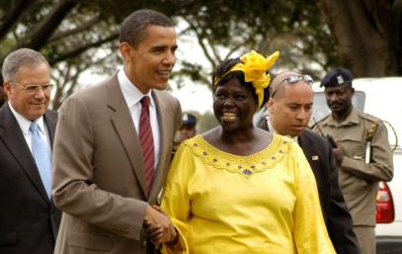
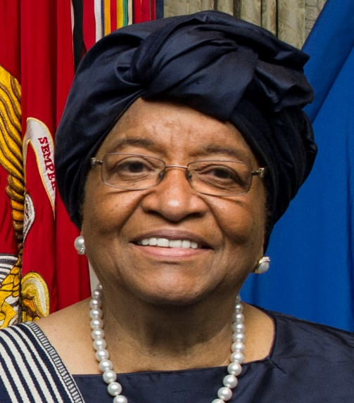
Famous African People
Wangari Maathai
Maathai, a Kenyan environmentalist and activist, founded the Green Belt Movement in 1977 which encourages people to plant trees to help the environment. She won the Nobel Peace Prize in 2004 for the work she did for the environment and human rights.
President Ellen Johnson Sirleaf
Sirleaf became the African continent's first female president in 2006. She was the President of Liberia until 2018 and received the Nobel Peace Prize in 2011 for her work in improving women’s rights.
Photo courtesy of Fredrick Onyango and Sean Hurt (@Wikimedia.com) - granted under creative commons licence - attribution

Slide 7
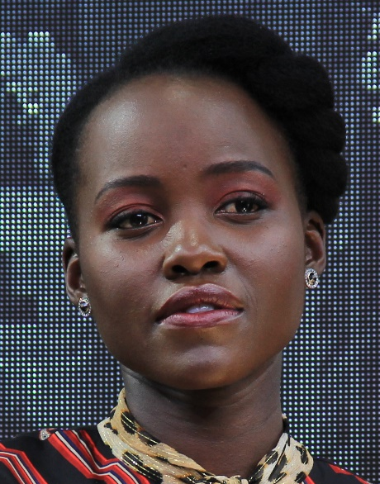
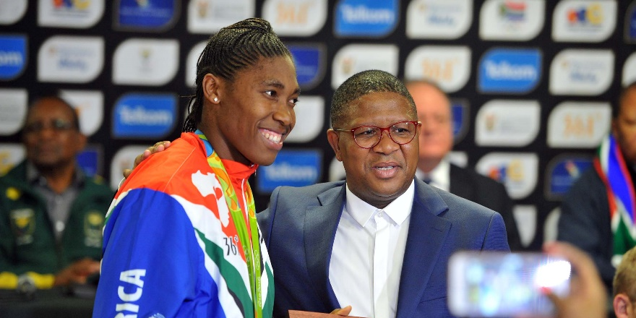
Famous African People
Caster Semenya
Semenya is a South African athlete who won a gold medal at the 2012 and 2016 Olympics. She was chosen to carry the country’s flag during the opening ceremony of the 2012 Summer Olympics. In 2016, she became the first person to win all three of the 400m, 800m and 1500m race titles.
Lupita Nyong’o
Nyong’o is the daughter of a Kenyan politician. She was born in Mexico but raised in Kenya. She has performed in several Hollywood films, including 12 Years a Slave and more recently, Black Panther. She is very vocal about women and animal rights and has even written a children’s book called ‘Sulwe’.
Photo courtesy of Daniel Benavides from Austin and GovernmentZA (@Wikimedia.com) - granted under creative commons licence - attribution

Slide 8
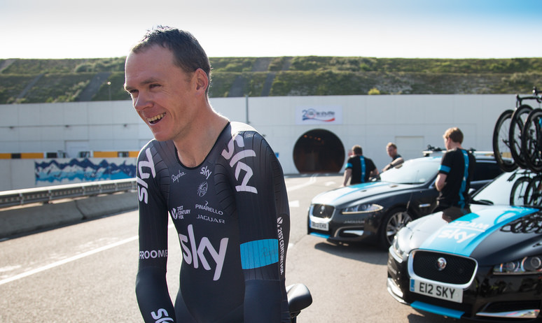
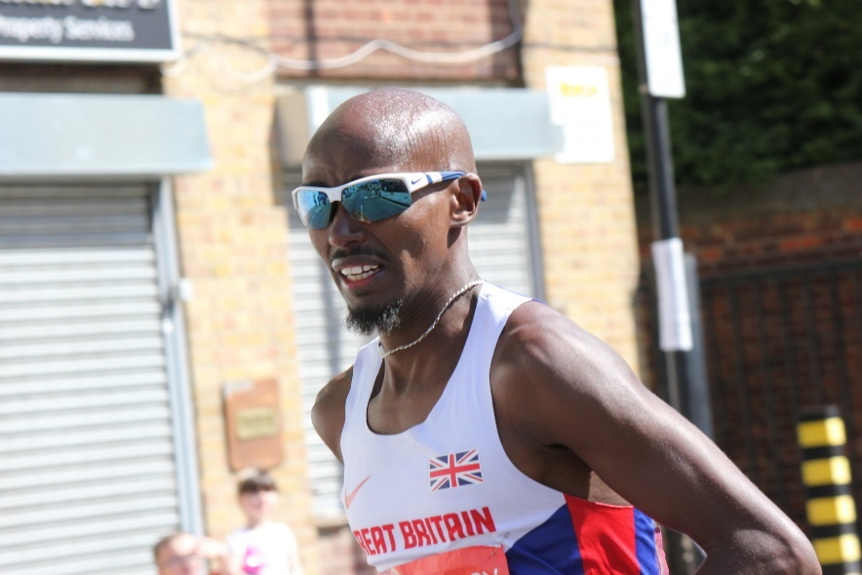
Famous African People
Chris Froome
Froome was born in Nairobi, Kenya and was brought up in Kenya and South Africa, where he learned to cycle. He competed for Kenya until 2008. In 2008, he decided to ride for Britain because he had a British passport and his father and grandparents were born in Britain. Froome won the Tour de France in 2013.
Sir Mo Farah
Mo Farah was born in Somalia and moved to England as a child. He became a double Olympic champion after winning gold in two events at the 2012 Olympics. Farah was knighted
in 2017 for his services to athletics.
Photo courtesy NH53 and jaguarmena (@flickr.com) - granted under creative commons licence - attribution

Slide 9
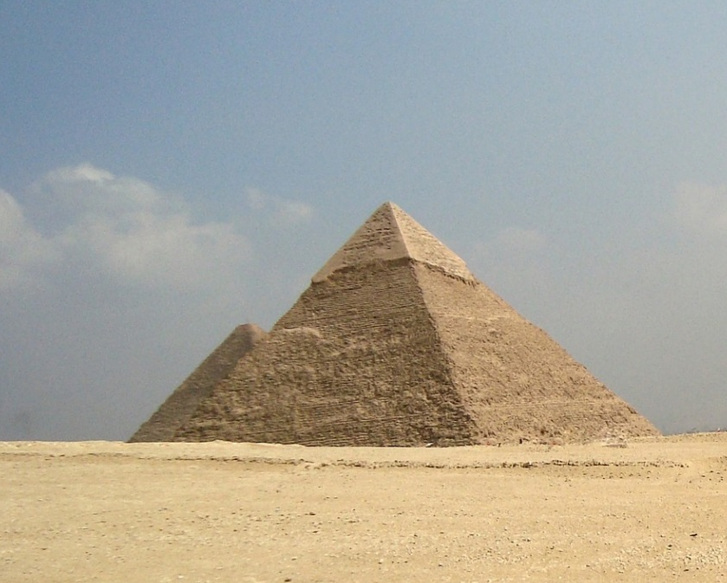
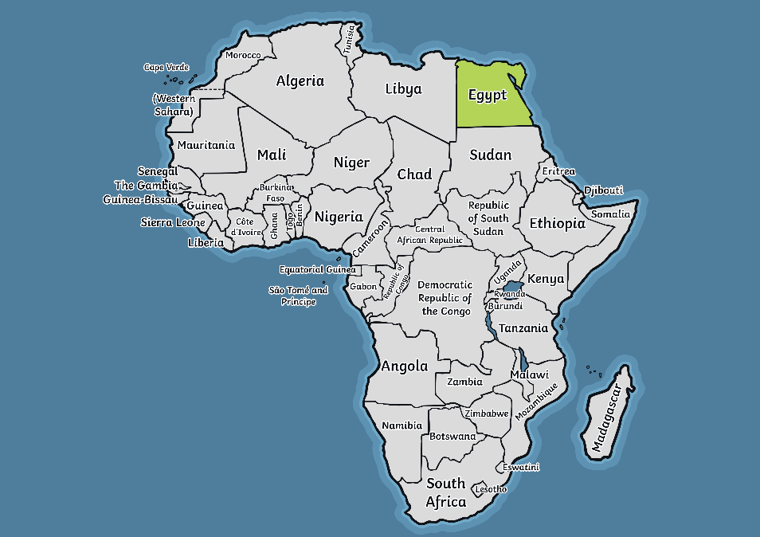
Landmarks
There are many magnificent landmarks in Africa.
The Egyptian Pyramids
These are in Egypt and were built over 4000 years ago.
The most famous of these pyramids are found in Giza, near Cairo.
They were built as tombs for the pharaohs.

Slide 10
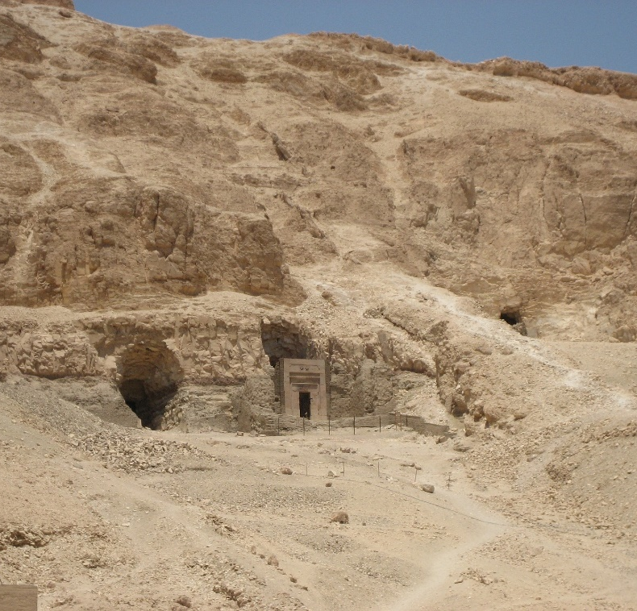

Landmarks
The Valley of the Kings
This landmark is also in Egypt and was another place where kings and pharaohs were buried. The tomb of King Tutankhamun was discovered here in 1922 by Howard Carter.

Slide 11
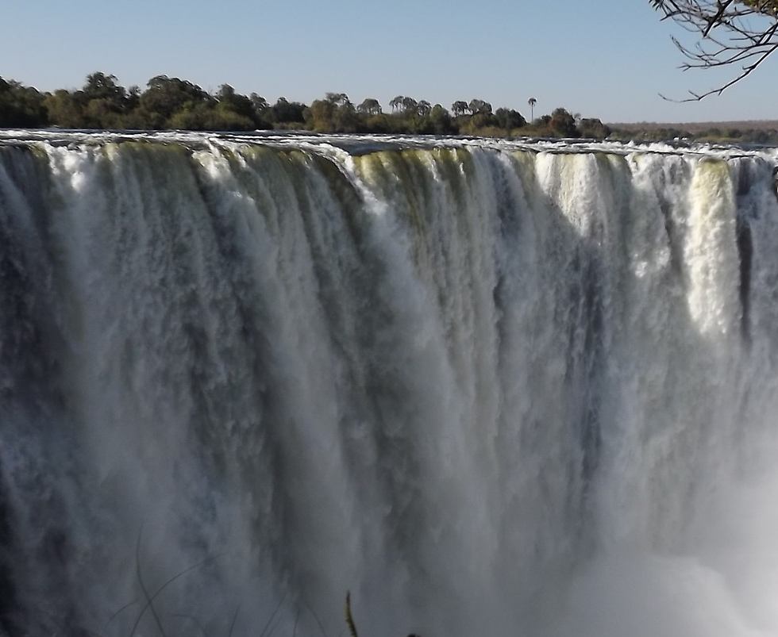
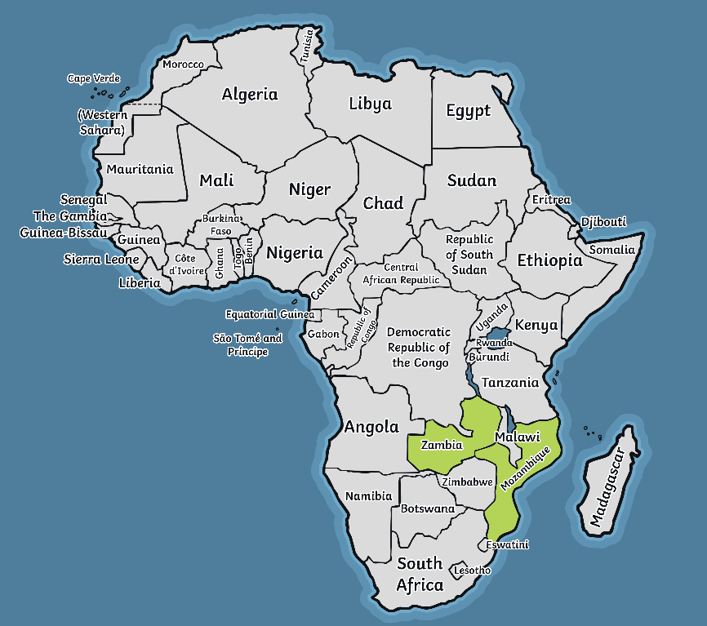
Landmarks
Victoria Falls
These amazing waterfalls are found between two countries - Zambia and Zimbabwe. Although they are not the highest or widest waterfalls in the world, they are considered some of the most impressive.

Slide 12
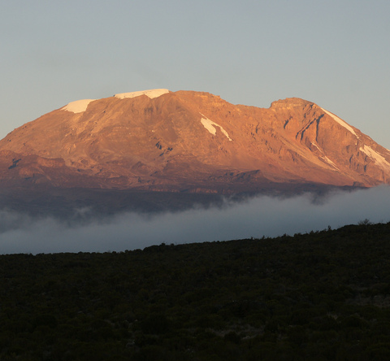
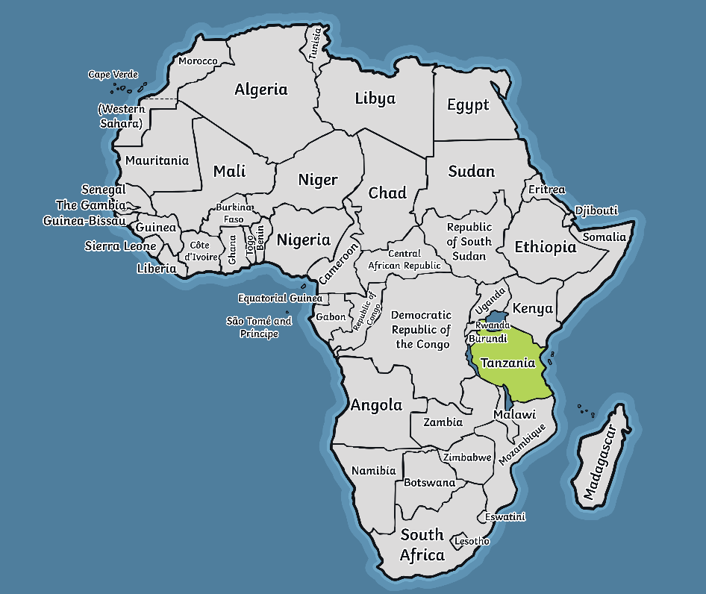
Landmarks
Mount Kilimanjaro
This mountain is in Tanzania. It is the highest mountain in Africa and stands at 5895 metres above sea level. You can see amazing glaciers all around. Many people have enjoyed climbing it.
Photo courtesy mitchpa1984 (@flickr.com) - granted under creative commons licence - attribution

Slide 13
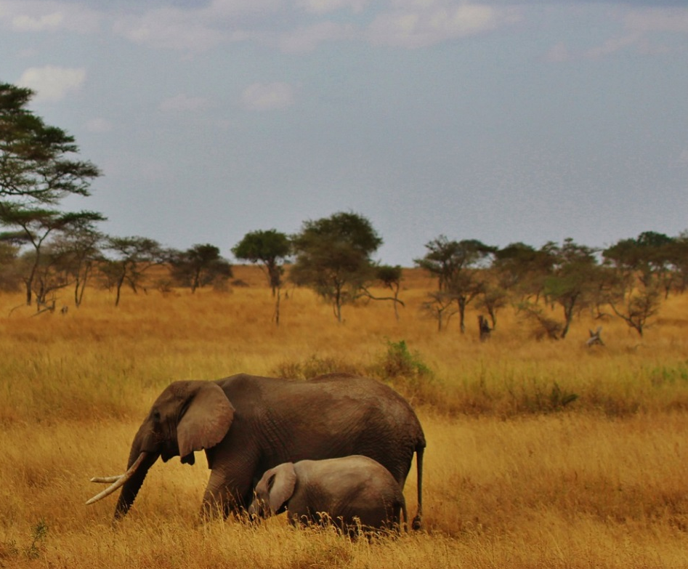

Landmarks
Serengeti National Park, Tanzania
350,000 people visit this beautiful park each year. It covers a huge area of nearly 15,000km² and is home to millions of animals, including lions, zebras, elephants and giraffes.

Slide 14
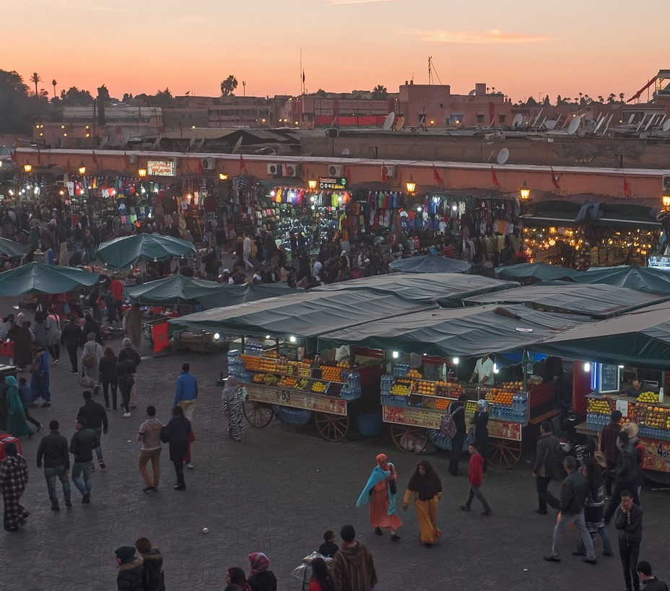

Landmarks
Jemaa el Fna, Morocco
The Jemaa el-Fna square has been one of Marrakesh’s symbols of the city since the 11th century. There are plenty of popular Moroccan cultural traditions to see in the busy market, including art, religious practices and musical performances.

Slide 15
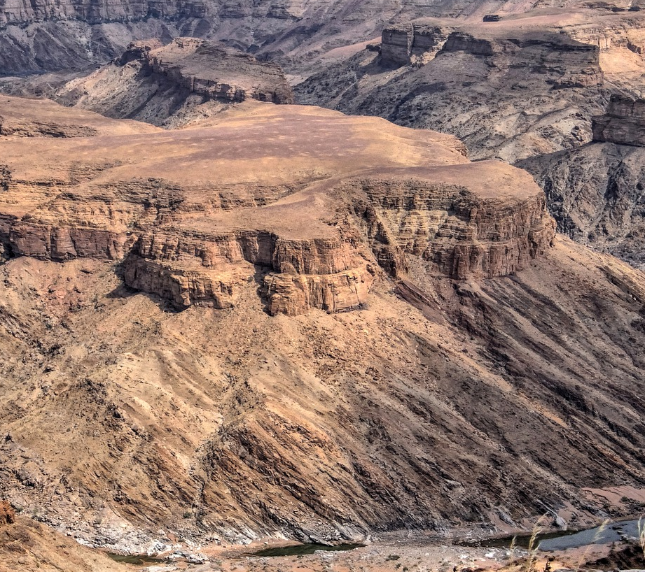
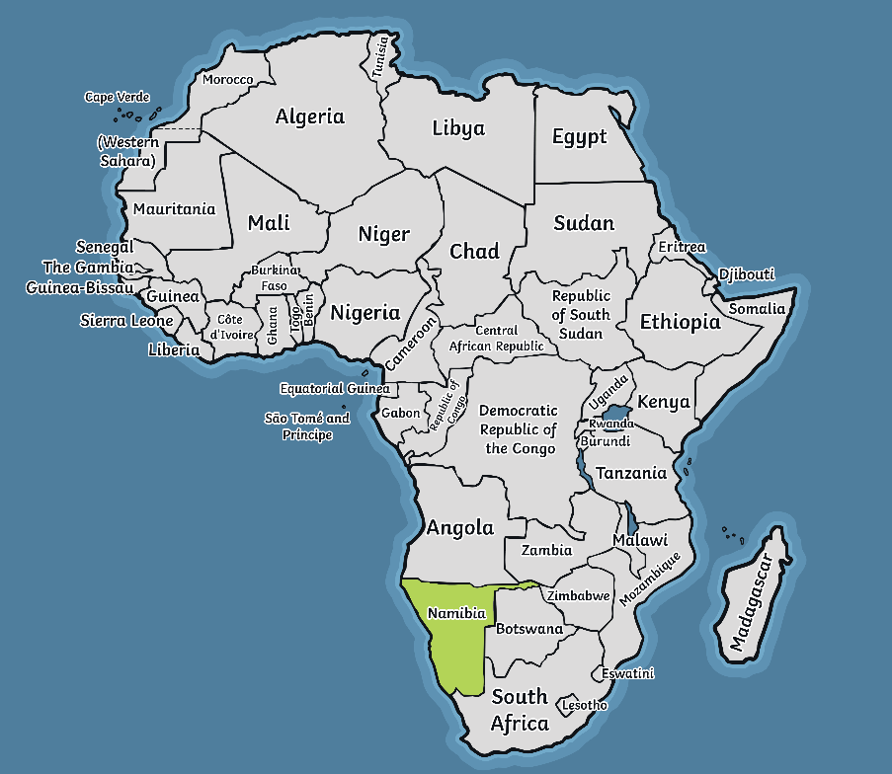
Landmarks
Fish River Canyon, Namibia
The Fish River Canyon is the second largest canyon in the world. The canyon forms part of Ais-Ais Richtersveld Transfontier Park, a peace park that lies on the border of South Africa and Namibia. The entrance to the park is 10Km from the canyon’s view point of Hell’s Bend.

Slide 16


Landmarks
The Nairobi National Museum, Kenya
The Nairobi National Museum is in the heart of Kenya’s Capital, Nairobi. It showcases Kenya’s culture, nature and history. The museum collects, preserves and studies Kenya’s past and present, keeping the history up to date.

Slide 17
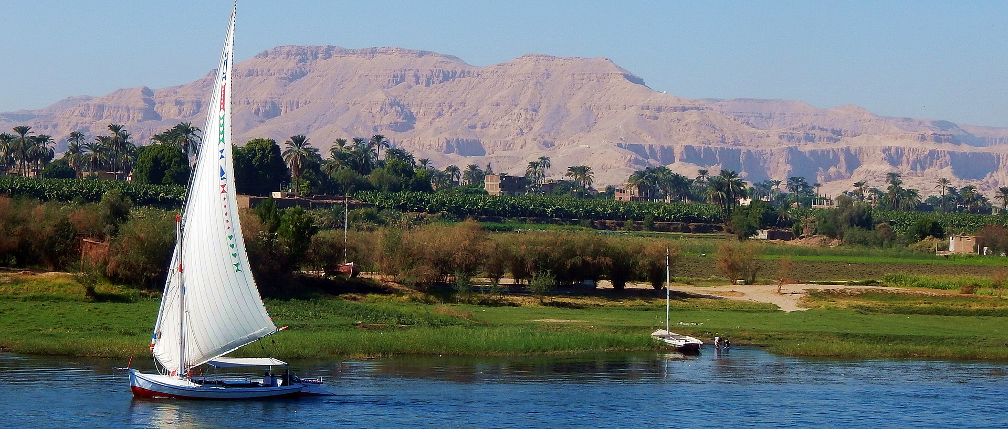
Landmarks
The Nile River
The Nile River is believed to be the longest river in the world, running through parts of Tanzania, Democratic Republic of Congo, Kenya, Uganda, South Sudan, Ethiopia, Sudan and Egypt. It has a length of about 4132 miles.

Slide 18
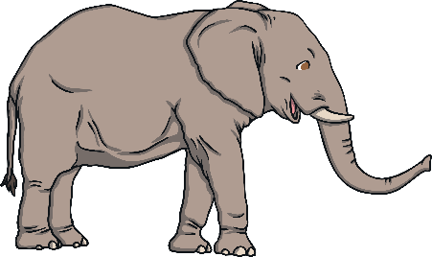
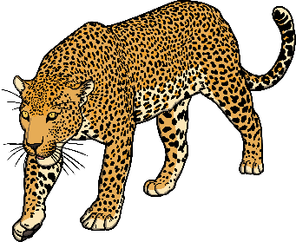
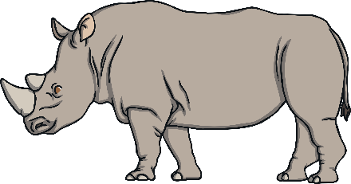
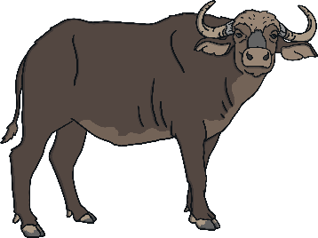
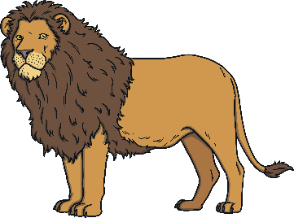
Africa’s Animals
African countries are well known for their wonderful animals. Here you can see the animals in their natural habitats.
People often go to African countries to see the big 5.
elephant
leopard
rhino
buffalo
lion

Slide 19
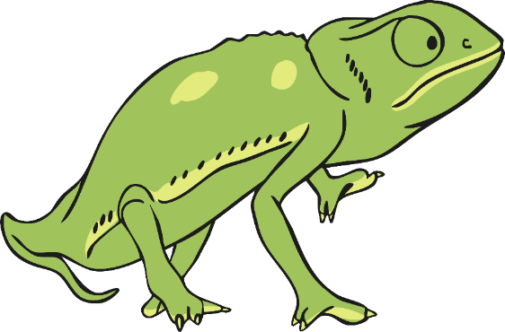
Animal Facts
There are over 2,600 different types of bird that live in Africa.
Four out of five of the fastest animals in the world can be found in African countries:
The cheetah, which can reach speeds of 70mph.
The wildebeest, Thomson’s gazelle and lion, all of which can reach
speeds of 50mph.
There are penguins living in a colony in South Africa.
The African continent is also home to gorillas, Nile crocodiles and the world’s largest chameleons.

Slide 20
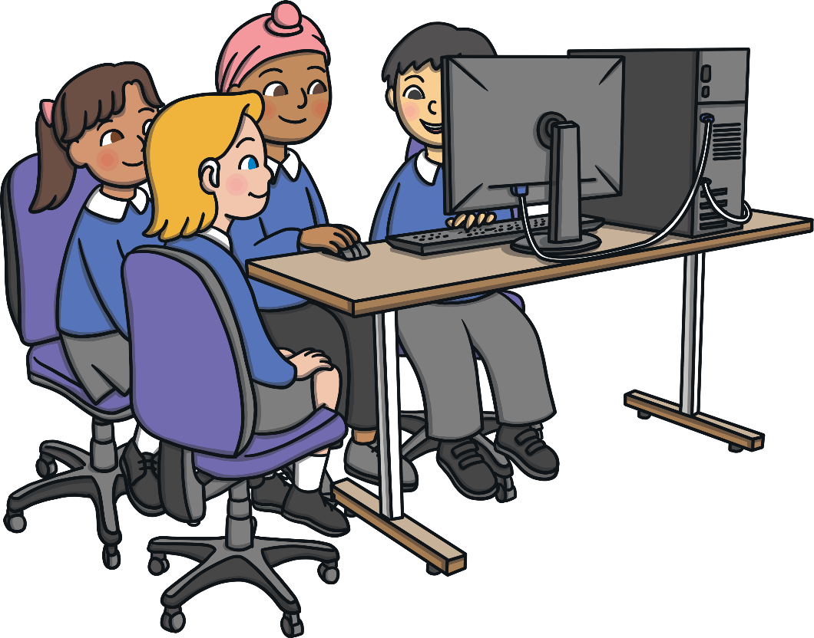
Find Out More!
There is a lot more to find out about the African continent.
Why not try to find out more in a non-fiction book or on the Internet?
As we are suggesting research:
The nature of this resource requires independent, child-led research. It is advisable to use only pre-selected, child-appropriate sources of information and websites that are appropriate to their age. Please also be aware that there may be aspects of a topic or individual’s life which may be controversial or upsetting to some. Due to this, we highly recommend that you carefully consider all research activities before undertaking them with children.

