Slide 1
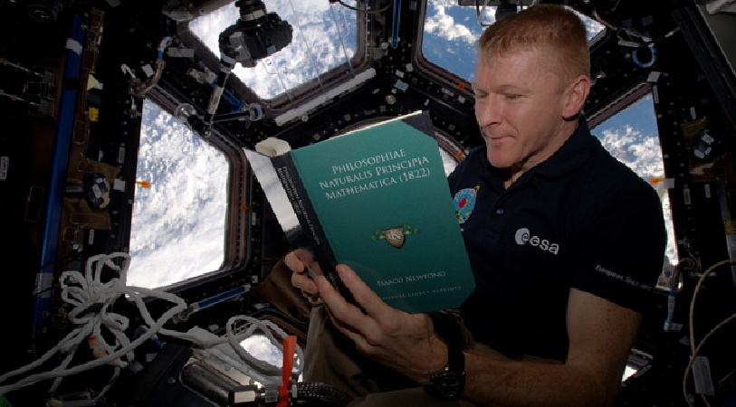
Reading

Slide 2
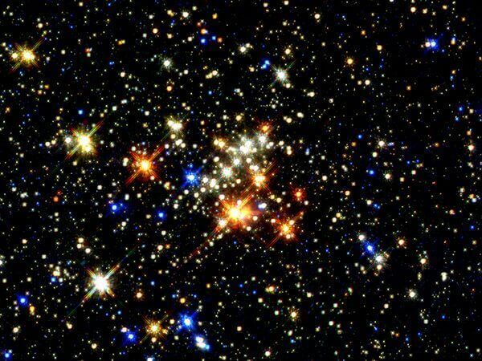
You might think that stars are all the same, but each star is a different colour depending on their temperature.
Notes:
The surface temperature of a star determines the color of light it emits. Blue stars are hotter than yellow stars, which are hotter than red stars.

Slide 3
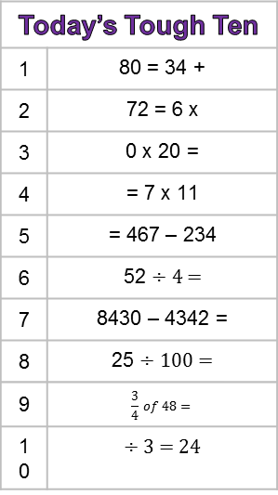
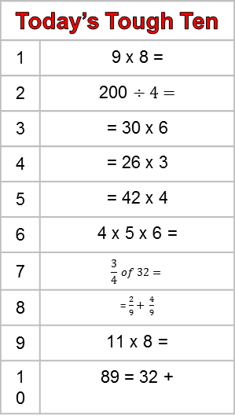
Today’s Tough Ten
1 | 9 x 8 =
2 | 200 ÷ 4 =
3 | = 30 x 6
4 | = 26 x 3
5 | = 42 x 4
6 | 4 x 5 x 6 =
7 | $$\frac{3}{4} of 32=$$
8 | = $\frac{2}{9}+ \frac{4}{9}$
9 | 11 x 8 =
10 | 89 = 32 +
Today’s Tough Ten
1 | 80 = 34 +
2 | 72 = 6 x
3 | 0 x 20 =
4 | = 7 x 11
5 | = 467 – 234
6 | 52 ÷ 4 =
7 | 8430 – 4342 =
8 | 25 ÷ 100 =
9 | $$\frac{3}{4} of 48=$$
10 | ÷ 3 = 24

Slide 4
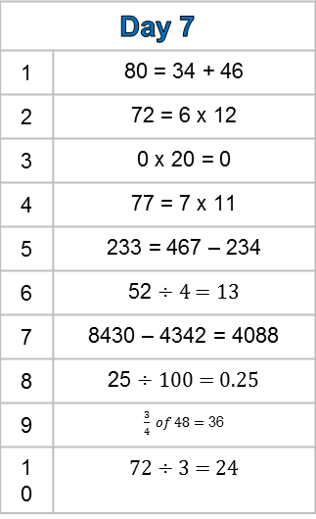
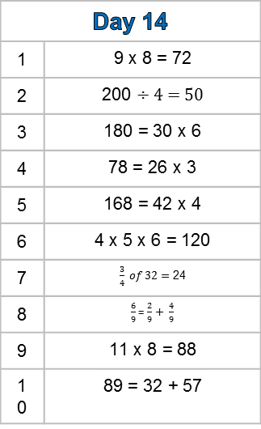
Day 14
1 | 9 x 8 = 72
2 | 200 ÷ 4 = 50
3 | 180 = 30 x 6
4 | 78 = 26 x 3
5 | 168 = 42 x 4
6 | 4 x 5 x 6 = 120
7 | $\frac{3}{4} of 32=$ 24
8 | $\frac{6}{9}$= $\frac{2}{9}+ \frac{4}{9}$
9 | 11 x 8 = 88
10 | 89 = 32 + 57
Day 7
1 | 80 = 34 + 46
2 | 72 = 6 x 12
3 | 0 x 20 = 0
4 | 77 = 7 x 11
5 | 233 = 467 – 234
6 | 52 ÷ 4 = 13
7 | 8430 – 4342 = 4088
8 | 25 ÷ 100 = 0.25
9 | $\frac{3}{4} of 48=$ 36
10 | 72 ÷ 3 = 24

Slide 5

Pronouns
5
Pronouns
5
Pronouns
5
Replace the underlined noun with a pronoun:
I am really proud of Jason.
Grandad gave my sister a hug.
The food was delicious.
My brother was running late.
I passed my mum the milk.
I gave my brothers a gift.
I put the clothes in the washing machine.
My family always go to France in the holidays.
Auntie Linda is arriving soon.
The girls will win the match.
Replace the underlined noun with a pronoun:
I am really proud of Jason.
Grandad gave my sister a hug.
The food was delicious.
My brother was running late.
I passed my mum the milk.
I gave my brothers a gift.
I put the clothes in the washing machine.
My family always go to France in the holidays.
Auntie Linda is arriving soon.
The girls will win the match.
Replace the underlined noun with a pronoun:
I am really proud of Jason.
Grandad gave my sister a hug.
The food was delicious.
My brother was running late.
I passed my mum the milk.
I gave my brothers a gift.
I put the clothes in the washing machine.
My family always go to France in the holidays.
Auntie Linda is arriving soon.
The girls will win the match.
Pronouns
5
Pronouns
5
Pronouns
5
Replace the underlined noun with a pronoun:
I am really proud of Jason.
Grandad gave my sister a hug.
The food was delicious.
My brother was running late.
I passed my mum the milk.
I gave my brothers a gift.
I put the clothes in the washing machine.
My family always go to France in the holidays.
Auntie Linda is arriving soon.
The girls will win the match.
Replace the underlined noun with a pronoun:
I am really proud of Jason.
Grandad gave my sister a hug.
The food was delicious.
My brother was running late.
I passed my mum the milk.
I gave my brothers a gift.
I put the clothes in the washing machine.
My family always go to France in the holidays.
Auntie Linda is arriving soon.
The girls will win the match.
Replace the underlined noun with a pronoun:
I am really proud of Jason.
Grandad gave my sister a hug.
The food was delicious.
My brother was running late.
I passed my mum the milk.
I gave my brothers a gift.
I put the clothes in the washing machine.
My family always go to France in the holidays.
Auntie Linda is arriving soon.
The girls will win the match.

Slide 6
Pronouns
5
Replace the underlined noun with a pronoun:
I am really proud of him.
Grandad gave her a hug.
It was delicious.
He was running late.
I passed her the milk.
I gave them a gift.
I put them in the washing machine.
We always go to France in the holidays.
She is arriving soon.
They will win the match.

