Slide 1

Lesson 1:
Computing Scheme of Work
Unit 4.3 - Spreadsheets
Formula Wizard and Formatting Cells
Notes:
Resources
Unless otherwise stated, all resources can be found on the main unit 4.3 page. From here, click on the icon to set a resource as a 2Do for your class. Use the links below to preview the resources; right-click on the link and ‘open in new tab’ so you do not lose this page.
Sample file - Spelling Scores; set this as a 2Do for your class.

Slide 2


Aims
Slide 2
To explore how the numbers entered into cells can be set to either currency or decimal.
To explore the use of the display of decimal places.
To find out how to add formulae to a cell.
Need more support? Contact us:
Tel: +44(0)208 203 1781 | Email: support@2simple.com | Twitter: @2simplesoftware
Notes:
Outline the lesson aims.

Slide 3
Success Criteria
Slide 3
Children can use the number formatting tools within 2Calculate to appropriately format numbers.
Children can add a formula to a cell to automatically make a calculation in that cell.
Need more support? Contact us:
Tel: +44(0)208 203 1781 | Email: support@2simple.com | Twitter: @2simplesoftware
Notes:
Outline the success criteria.

Slide 4


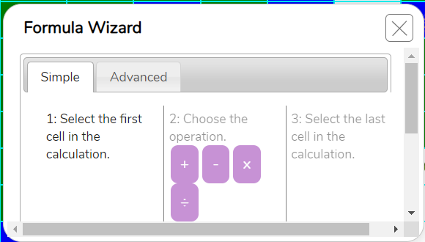




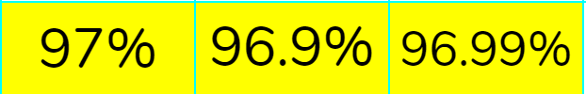
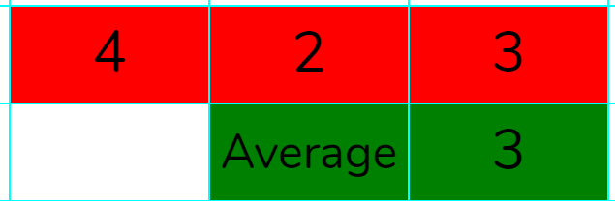
Background: Formula Wizard & Formatting Cells
Slide 4
We are going to be exploring a spelling scores spreadsheet for a class.
There are lots of powerful calculations and formatting features that spreadsheets have that can help users.
Key vocabulary & tools
Formula Wizard: The formula wizard helps a user create formulas which perform calculations on selected cells. For example adding, multiplying, average, total.
Percentages: ‘per’ ‘cent’ means number of parts per hundred. For example, in a class of 10 pupils:
10 pupils = 100%, 5 pupils = 50%.
Format Cell: The way that data is displayed in a cell. For example, using units such as £ or $.
Decimal Place: The position of a digit to the right of a decimal point. In 2Calculate, the number of decimal places to be displayed can be chosen.
Average: A number expressing the typical value in a set of data. Also known as the mean. It is calculated by dividing the sum of the values in the set by their number.
Copy, cutting & pasting: Contents of cells can be copied & pasted or cut & pasted. Can you remember how to do this?
Need more support? Contact us:
Tel: +44(0)208 203 1781 | Email: support@2simple.com | Twitter: @2simplesoftware
Notes:
Reveal with the children the key vocabulary and tools that they will need for this lesson. You might need to adapt mathematical terms to suit ability of children within the class.

Slide 5
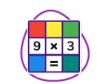


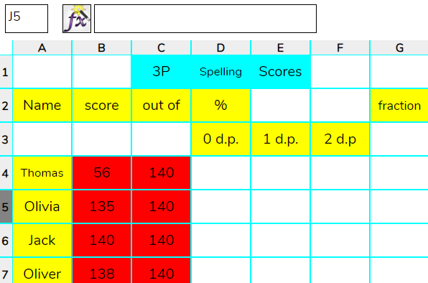
Spelling Scores
Slide 5
Let’s open the Spelling Scores 2Calculate file for class 3CP.
Firstly, switch to advance mode.
Spelling Scores
What is the score out of?
What is the least you can get as a percentage?
What does percentage mean?
What percentage would mean you got half correct?
What is the most you can get as a percentage?
Need more support? Contact us:
Tel: +44(0)208 203 1781 | Email: support@2simple.com | Twitter: @2simplesoftware
Notes:
Ask children to open the sample spreadsheet; Spelling Scores on their devices. Reveal the questions on the slide to discuss as a class.

Slide 6
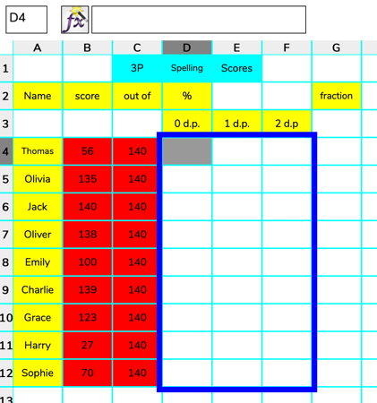
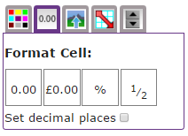
Activity 1: Formatting cells (%)
Slide 6
On your copy of the spelling scores, can you format the cells to get them ready to show percentages?
Follow the steps:
2. Find the ‘Format Cell’ toolbox and locate % and click.
1. Highlight (select) the percentage area.
You might notice ‘Set decimal places’ we will look at this a little later.
Need more support? Contact us:
Tel: +44(0)208 203 1781 | Email: support@2simple.com | Twitter: @2simplesoftware
Notes:
Support children with selecting all cells which require percentages format and use formatting tool to change it to this format.

Slide 7

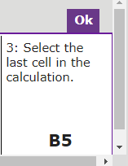
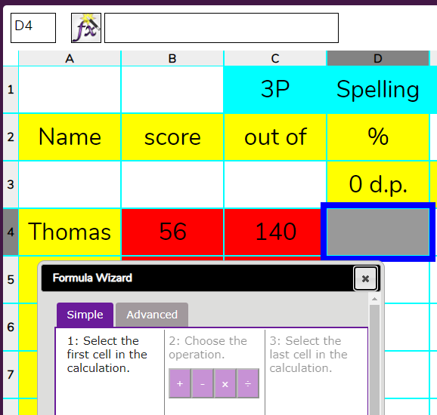
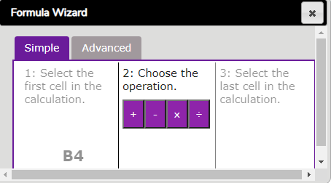
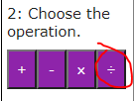
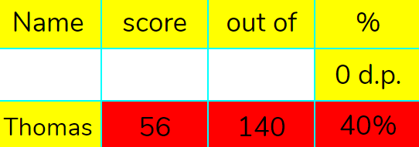
Activity 2: Formula Wizard (Calculating Percentages)
Slide 7
Now we have formatted our cells for percentages, we need to calculate them.
We are going to work out what percentage Thomas got correct.
1. Select cell D4 then click on Formula Wizard.
2. Click on cell B4 (Thomas’ score). This will appear in the wizard.
3. Choose the divide operation.
4. Then click on C4 followed by ‘Ok’.
It should look like this:
Need more support? Contact us:
Tel: +44(0)208 203 1781 | Email: support@2simple.com | Twitter: @2simplesoftware
Notes:
Working with the children, solve calculating percentages for ‘Thomas’.

Slide 8
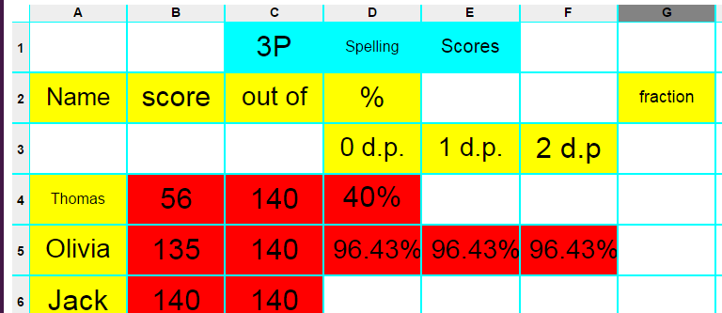
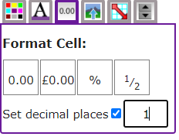
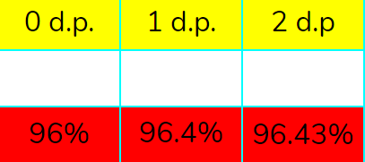
Activity 2: Formula Wizard (calculating percentages)
Slide 8
Your turn to try now – Work out the percentage that Olivia got correct.
Challenge: Can you change the format of cells: D5, E5 & F5 to show correct decimal places?
Can you calculate the result for cells E5 and F5 as well?
Need more support? Contact us:
Tel: +44(0)208 203 1781 | Email: support@2simple.com | Twitter: @2simplesoftware
Notes:
Children have a go at working out percentages for ‘Olivia’ independently. Challenge to set decimal places. *You might choose to leave this out and just focus on 0 d.p.

Slide 9
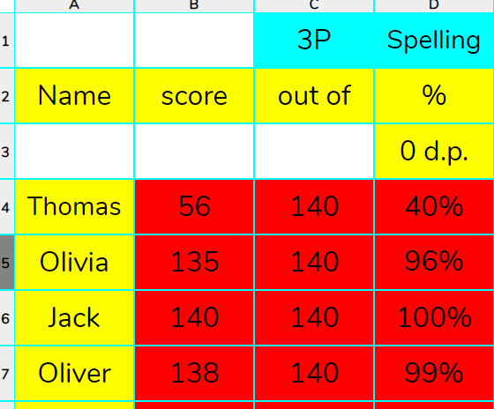
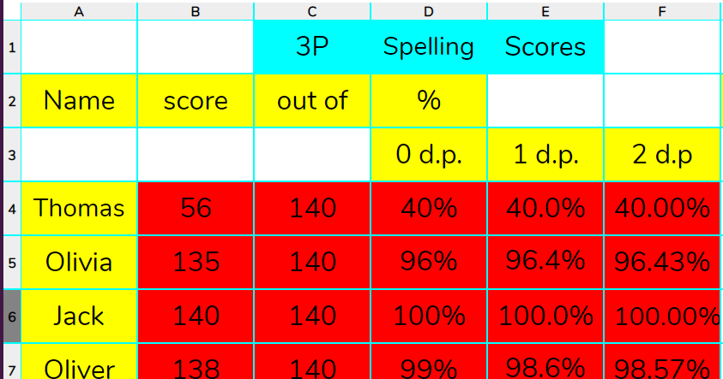
Activity 3: Copying and Pasting Formula for Efficiency.
Slide 9
Now we have calculated Thomas and Olivia’s scores, we can use copying and pasting to complete the others.
We can use Ctrl + and C to copy the formula from cell D4.
We can do the same for columns E and F.
Next, we can paste into cells D5 to D12 by selecting those cells and pressing Ctrl + V.
Need more support? Contact us:
Tel: +44(0)208 203 1781 | Email: support@2simple.com | Twitter: @2simplesoftware
Notes:
Children copy and paste formula to complete the percentages. Be aware copy and pasting of formula is only possible column at a time.
*iPads - This is possible using a tablet (iPad) if you press and hold cell D4 until a blue border appears around the cell, press on the bottom blue border and then drag down through D5, D6 all the way to D12.

Slide 10

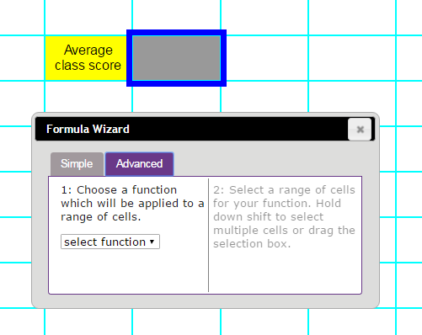
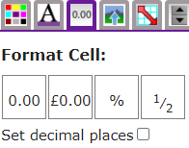

Activity 4: Averages
Slide 10
Let’s look at our spelling sheets and calculate the average scores for the class.
1. Into cell I5, enter the text ‘average class score’ then click on cell J5.
Who got the highest score?
2. Format the cell as a %.
3. Click on ‘Advanced’ tab on the Formula Wizard and choose function ‘Average’.
Who got the lowest score?
4. Choose the cells that you want to calculate the average of.
Need more support? Contact us:
Tel: +44(0)208 203 1781 | Email: support@2simple.com | Twitter: @2simplesoftware
Notes:
Children calculate average score use ‘Average’ function in the Formula Wizard.
*iPad -Dragging down from the first to the last cells that are going to be used to calculate the average is possible on a tablet (iPad).

Slide 11
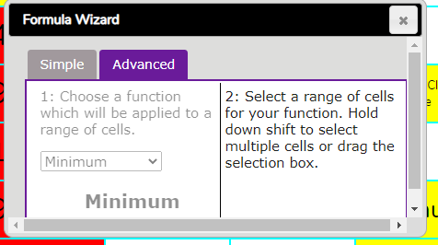
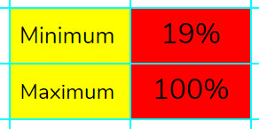
Activity 5: Extension
Slide 11
Explore the minimum and maximum function in the advanced formula wizard.
What does minimum do?
What does maximum do?
How are they useful?
Need more support? Contact us:
Tel: +44(0)208 203 1781 | Email: support@2simple.com | Twitter: @2simplesoftware
Notes:
Children explore the minimum and maximum function in the advanced formula wizard.

Slide 12
New Vocabulary Overview
Slide 12
Percentages: ‘per’ ‘cent’ means number of parts per hundred. For example, in a class of 10 pupils:
10 pupils = 100%, 5 pupils = 50%.
Formula Wizard: The formula wizard helps a user create formulas which perform calculations on selected cells. For example adding, multiplying, average, total.
Percentage
Format Cell: The way that data is displayed in a cell. For example, using units such as £ or $.
Formula Wizard
Format Cell
Average: A number expressing the typical value in a set of data. Also known as the mean. It is calculated by dividing the sum of the values in the set by their number.
Decimal place: The position of a digit to the right of a decimal point. In 2Calculate, the number of decimal places to be displayed can be chosen.
Average
Decimal place
Need more support? Contact us:
Tel: +44(0)208 203 1781 | Email: support@2simple.com | Twitter: @2simplesoftware
Notes:
The slide can be used to review new vocabulary. Click on the words to reveal the definitions.

Slide 13
Review Success Criteria
Slide 13
I can use the number formatting tools within 2Calculate to appropriately format numbers.
I can add a formula to a cell to automatically make a calculation in that cell.
Need more support? Contact us:
Tel: +44(0)208 203 1781 | Email: support@2simple.com | Twitter: @2simplesoftware
Notes:
Review the success criteria from slide 3. Children could rate how well they achieved this using a show of hands.

