Slide 1
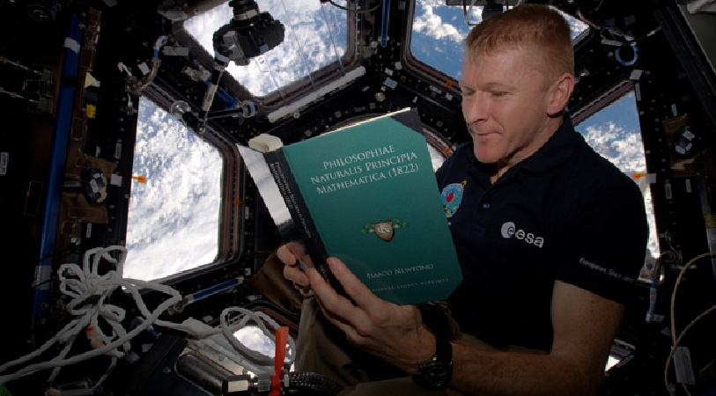
Reading

Slide 2
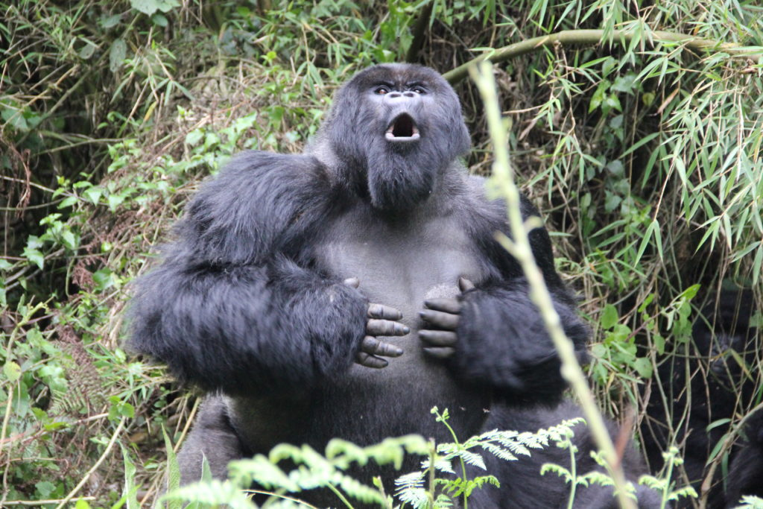
Gorilla’s burp when they are happy.
Notes:
Gorillas make contentment sounds when they are happy. This is often called "singing." The burp or belch is one of these sounds.

Slide 3
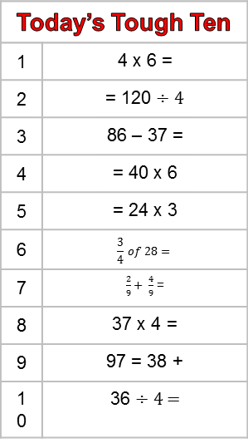
Today’s Tough Ten
1 | 4 x 6 =
2 | = 120 ÷ 4
3 | 86 – 37 =
4 | = 40 x 6
5 | = 24 x 3
6 | $$\frac{3}{4} of 28=$$
7 | $\frac{2}{9}+ \frac{4}{9}$ =
8 | 37 x 4 =
9 | 97 = 38 +
10 | 36 ÷ 4 =
Today’s Tough Ten
1 | 58 ÷ 1 =
2 | 70 x 9 =
3 | = 48 ÷ 12
4 | = 9 x 1
5 | 63 = 7 x
6 | 300 x 7 =
7 | 37 = 89 -
8 | 5683 + 2594 =
9 | 5 ÷ 10 =
10 | 8140 – 3462 =

Slide 4
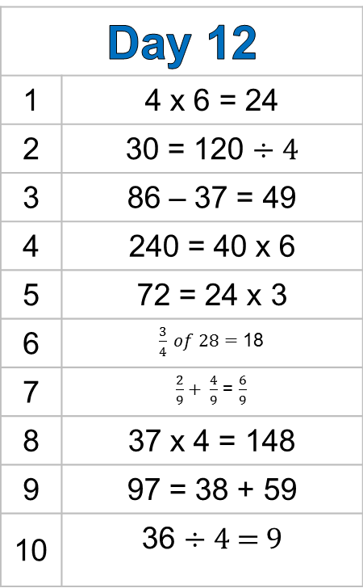
Day 12
1 | 4 x 6 = 24
2 | 30 = 120 ÷ 4
3 | 86 – 37 = 49
4 | 240 = 40 x 6
5 | 72 = 24 x 3
6 | $\frac{3}{4} of 28=$ 18
7 | $\frac{2}{9}+ \frac{4}{9}$ = $\frac{6}{9}$
8 | 37 x 4 = 148
9 | 97 = 38 + 59
10 | 36 ÷ 4 = 9
Day 5
1 | 58 ÷ 1 = 58
2 | 70 x 9 = 630
3 | 4 = 48 ÷ 12
4 | 9 = 9 x 1
5 | 63 = 7 x 9
6 | 300 x 7 = 2100
7 | 37 = 89 – 52
8 | 5683 + 2594 = 8277
9 | 5 ÷ 10 = 0.5
10 | 8140 – 3462 = 4678

