Slide 2



Diving into Mastery Guidance for Educators
Each activity sheet is split into three sections, diving, deeper and deepest, which are represented by the following icons:
These carefully designed activities take your children through a learning journey, initially ensuring they are fluent with the key concept being taught; then applying this to a range of reasoning and problem-solving activities.
These sheets might not necessarily be used in a linear way. Some children might begin at the ‘Deeper’ section and in fact, others may ‘dive straight in’ to the ‘Deepest’ section if they have already mastered the skill and are applying this to show their depth of understanding.
Diving
Deeper
Deepest

Slide 3
Aim
Add and subtract fractions with the same denominator and denominators that are multiples of the same number.

Slide 4
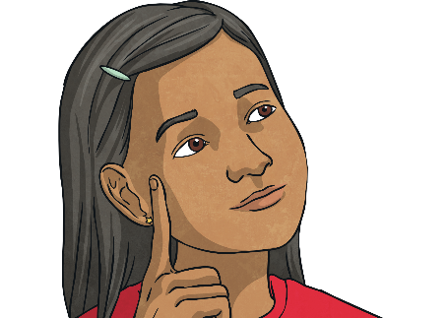
Subtract Fractions
Diving
Kemi is subtracting fractions. She has drawn a bar model to help.
Use the bar model to complete Kemi’s calculation.
4
5
1
10
7
10
−
=
Now, use Kemi’s bar model method to solve this calculation. Give your answer in its simplest form.
9
10
−
2
5
5
10
1
2
=
=

Slide 5
Subtract Fractions
Diving
Jude is subtracting fractions by finding the difference. He has drawn a number line to help. Use the number line to complete Jude’s calculation.
+
1
6
4
6
+
5
3
−
5
6
=
5
6
5
6
1
5
3
10
6
=
Use Jude’s number line method to solve these calculations.
+
4
9
2
3
2
9
4
9
−
=
2
9
2
3
6
9
=

Slide 6
Subtract Fractions
Diving
Jude is subtracting fractions by finding the difference. He has drawn a number line to help. Use the number line to complete Jude’s calculation.
+
1
6
4
6
+
5
3
−
5
6
=
5
6
5
6
1
5
3
10
6
=
Use Jude’s number line method to solve these calculations.
+
2
10
+
2
10
6
5
8
10
2
5
−
=
2
10
+
2
10
4
10
2
5
8
10
=
=
1
6
5
12
10
=

Slide 7

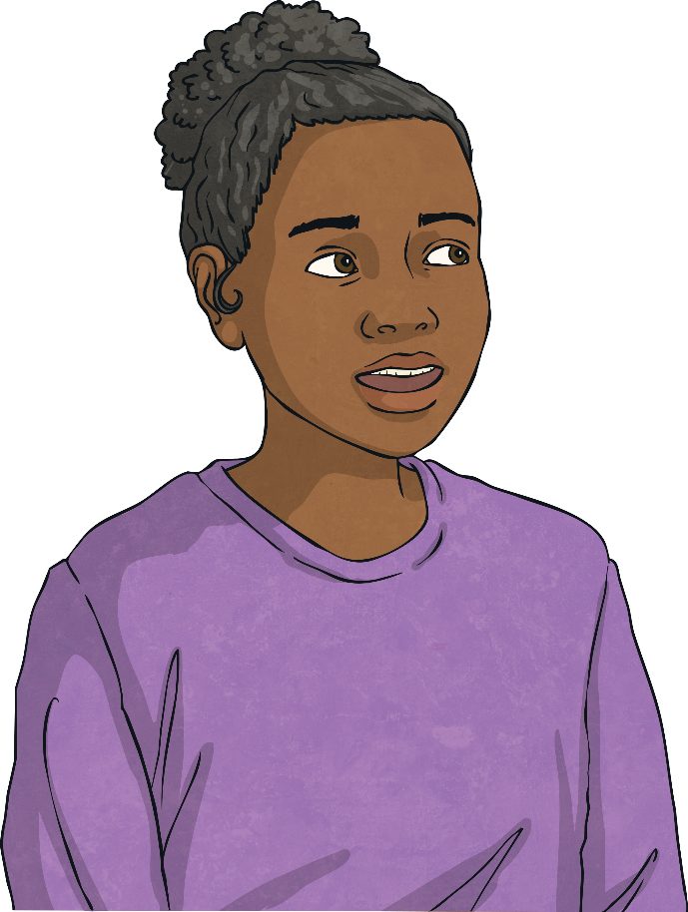
Subtract Fractions
Deeper
Is Sophia’s statement always, sometimes or never true?
Explain how you know.
When you subtract one fraction from another, the answer will be smaller.
This is always true. You cannot subtract any positive number from another and end up with a larger answer.

Slide 8
Subtract Fractions
Deeper
13
10
Afzol used a number line to find the difference between and .
Here is his working out:
1
5
+
8
10
+
3
10
1
5
2
10
1
13
10
=
8
10
3
10
11
20
1
5
13
10
11
20
+
=
The difference between and is .
What mistake did he make?
Afzol has added the fractions incorrectly. The denominators should stay the same, so the difference between and is .
1
5
13
10
11
10

Slide 9

Subtract Fractions
Deepest
Fill in the missing numbers.
5
7
3
−
=
6
12
12

Slide 10

Subtract Fractions
Deepest
Clara is thinking of two fractions.
They have a difference of .
Each fraction is less than one whole.
One of the fractions has a numerator of 1.
The fractions are in their simplest form.
1
2
Which two fractions could she be thinking of?
and
and
1
4
3
4
1
3
5
6
Did you find a different answer?

Slide 11


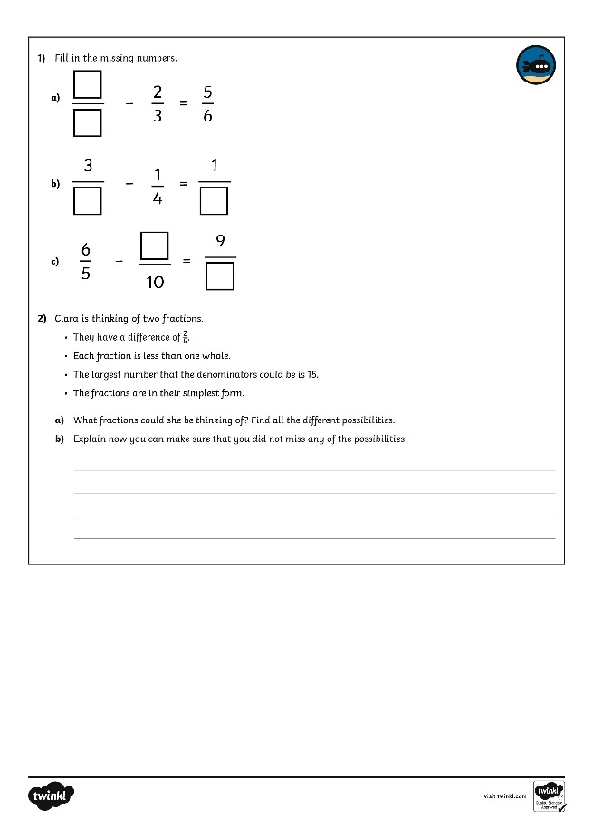
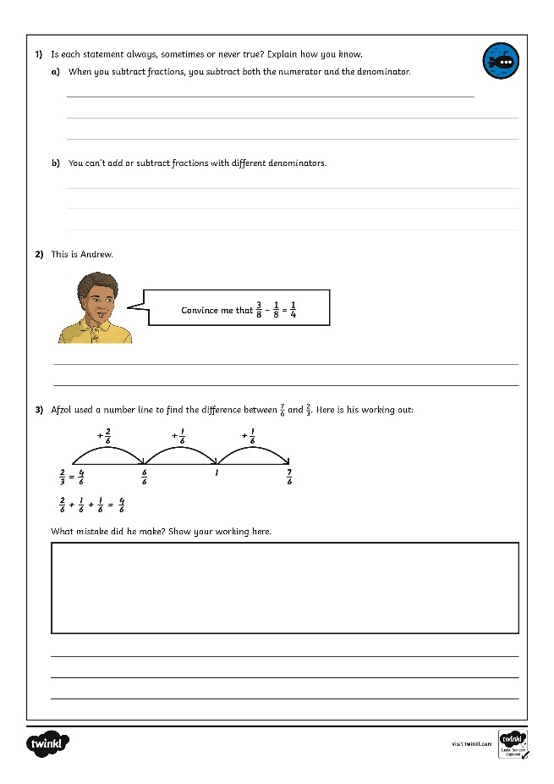
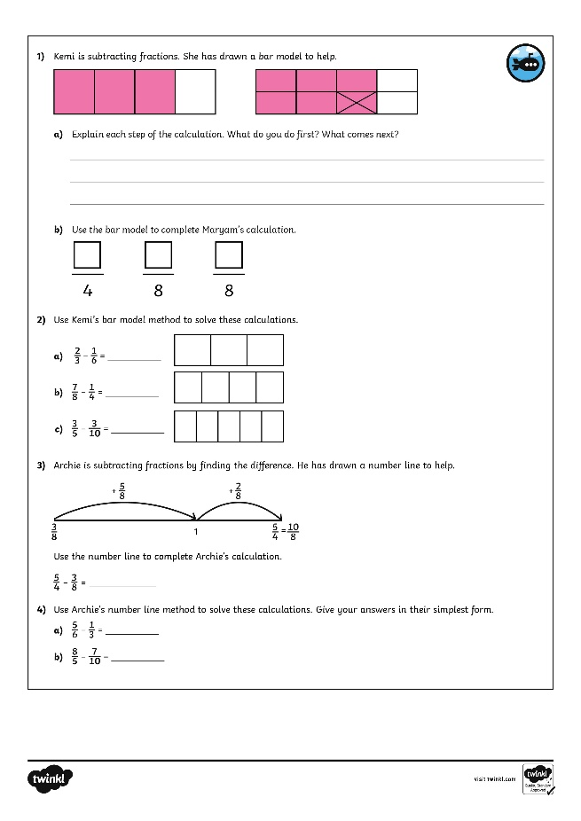
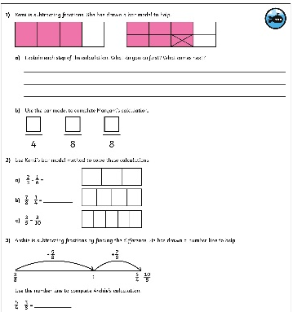
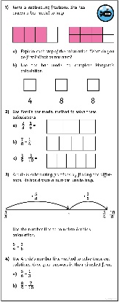
Subtract Fractions
Dive in by completing your own activity!

Slide 12
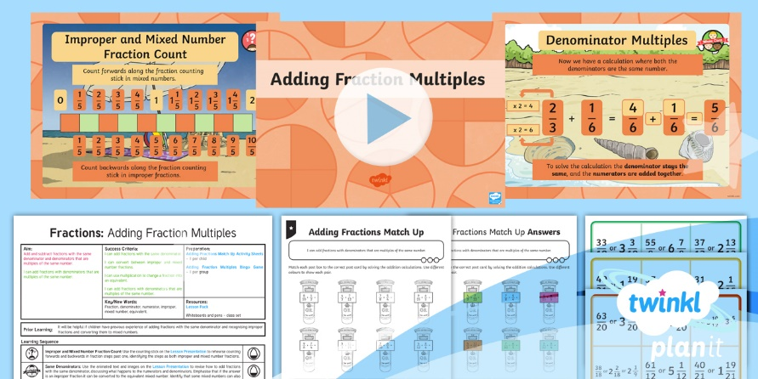
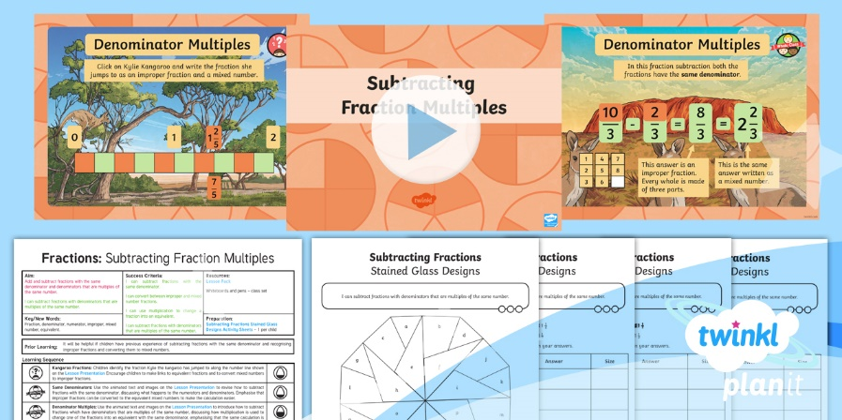

Need Planning to Complement this Resource?
National Curriculum Aim
Add and subtract fractions with the same denominator and denominators that are multiples of the same number.
For more planning resources to support this aim, click here.
Twinkl PlanIt is our award-winning scheme of work
with over 4000 resources.

