Slide 1
Week 7 – The Great Lakes

Slide 2
This week we are heading north again, having followed the Mississippi north all the way to the Great Lakes.

Slide 3
What do you know about the Great Lakes?
Why would they be Great?

Slide 4
LO: To understand the location and names of the Great Lakes.
SC: A correctly annotated map of the Great Lakes and its settlements.

Slide 5
Great Lakes 101 Video
https://youtu.be/sHjwfneXRsU

Slide 6
What is the Rust Belt?

Slide 7
The Rust Belt
The Rust Belt refers to an area of the northern United States. The area is mostly the states near the Great Lakes. This area was once known for steel production and heavy industry. That industry has greatly decreased since the middle of the 20th century. Much of this decrease is because of the United States using manufacturers from other countries.
Most Rust Belt cities, for example, Pittsburgh, Pennsylvania and Youngstown, Ohio, have had very large decrease in population since the 1950s and 1960s.

Slide 8
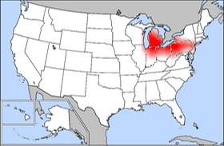
The Rust Belt

Slide 9
Globalisation
Many people blame Globalisation for the loss of jobs in the Rust Belt.
Globalisation is the name given to companies working on a global scale, moving jobs to areas where people can be employed cheaply or with few safety/environmental regulations so costs can be cut.

Slide 10
Task
Name in pen and then lightly shade in the Great Lakes in blue pencil crayon.
Names of the States
Names of the major cities.
Highlight the cities that are part of the Rust Belt.
Cities to find and plot:
  Rochester, NY
  Pittsburgh, PA
  Cleveland, OH
  Detroit, MI
  Indianapolis, IN
  Chicago, IL
  Milwaukee, WI
There is a map on the next slide to help you ☺

Slide 11
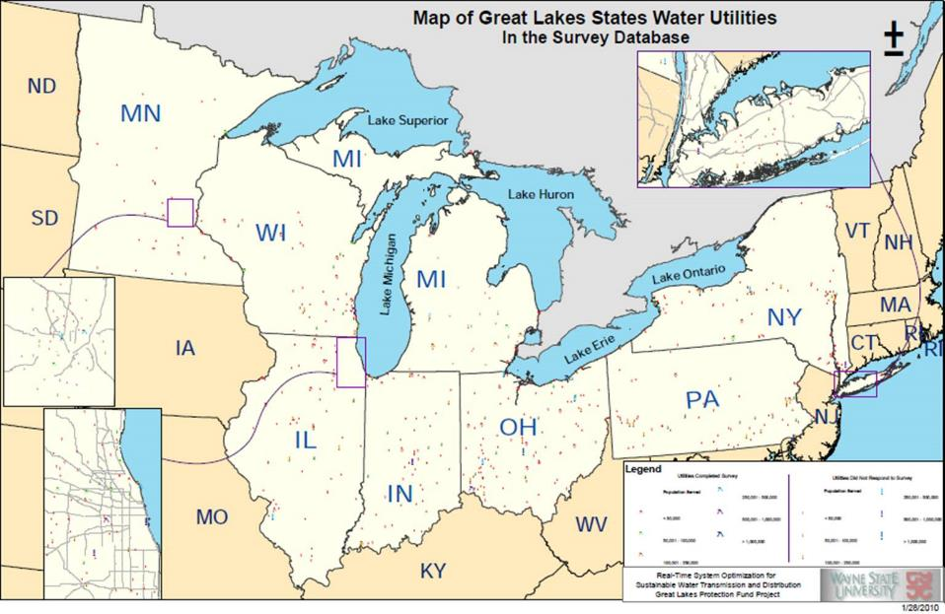

Slide 12
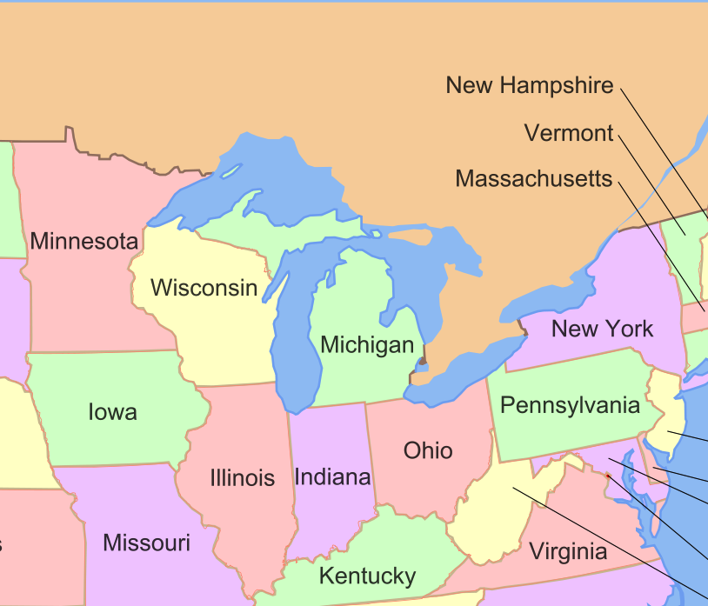

Slide 13
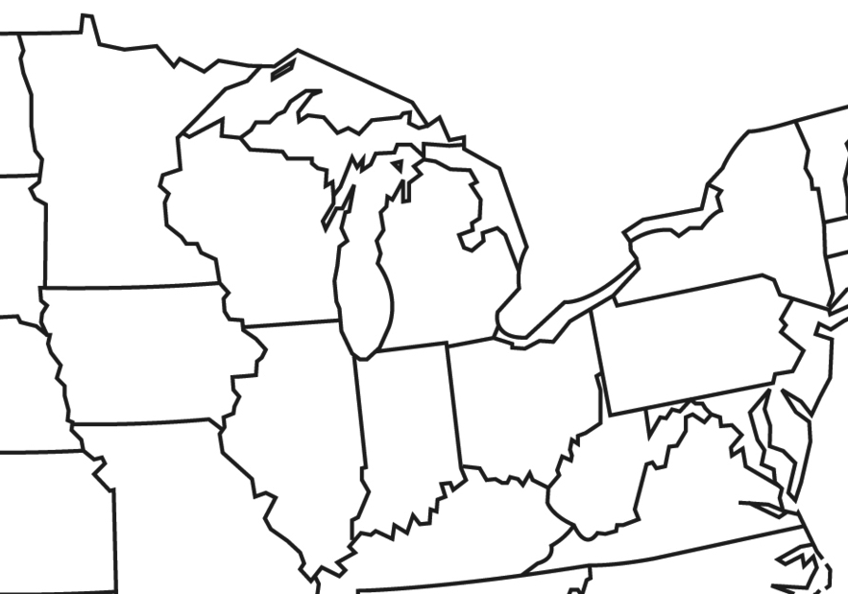

Slide 14
Chicago
Site seeing in Chicago – like the NY lesson from week 1

Slide 15
What do you think of as from Chicago?
Do you know anything about the biggest city on the shores of the Great Lakes?

Slide 16
LO: To investigate and describe a location in North America.
* To find given locations in Chicago using Google Maps and Streetview,
** and describe the key human features of the area,
*** and to describe your personal reaction to these features.

Slide 17
Chicago - Expedia
https://www.youtube.com/watch?v=QSwvg9Rv2EI

Slide 18
Chicago Top 7
Navy Pier Ferris Wheel
Cloud Gate (or the Bean), Millennium Park.
Wrigley Field
The 606 Park
Willis Tower Skydeck
“Sue” the T-Rex (Field Museum, Level 1, in the middle of the building)
Lincoln Memorial – Lincoln Park

Slide 19
Task
What have you found out about Chicago?
Present your findings in any way you choose:
PowerPoint
Poster
Leaflet
Video

