Slide 1
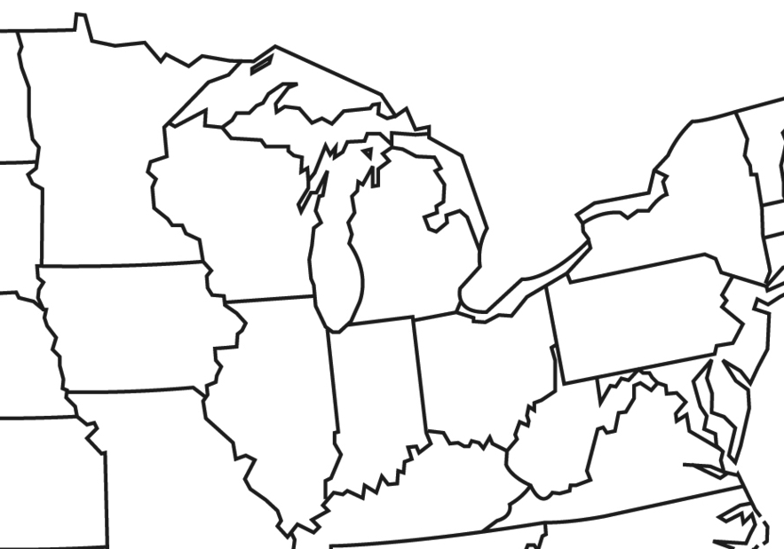
The Great Lakes

Slide 2
✪
✪
✪
✪
✪
✪
✪

