Slide 2



Diving into Mastery Guidance for Educators
Each activity sheet is split into three sections, diving, deeper and deepest, which are represented by the following icons:
These carefully designed activities take your children through a learning journey, initially ensuring they are fluent with the key concept being taught; then applying this to a range of reasoning and problem-solving activities.
These sheets might not necessarily be used in a linear way. Some children might begin at the ‘Deeper’ section and in fact, others may ‘dive straight in’ to the ‘Deepest’ section if they have already mastered the skill and are applying this to show their depth of understanding.
Diving
Deeper
Deepest

Slide 3
Aim
Add and subtract fractions with the same denominator and denominators that are multiples of the same number.

Slide 4

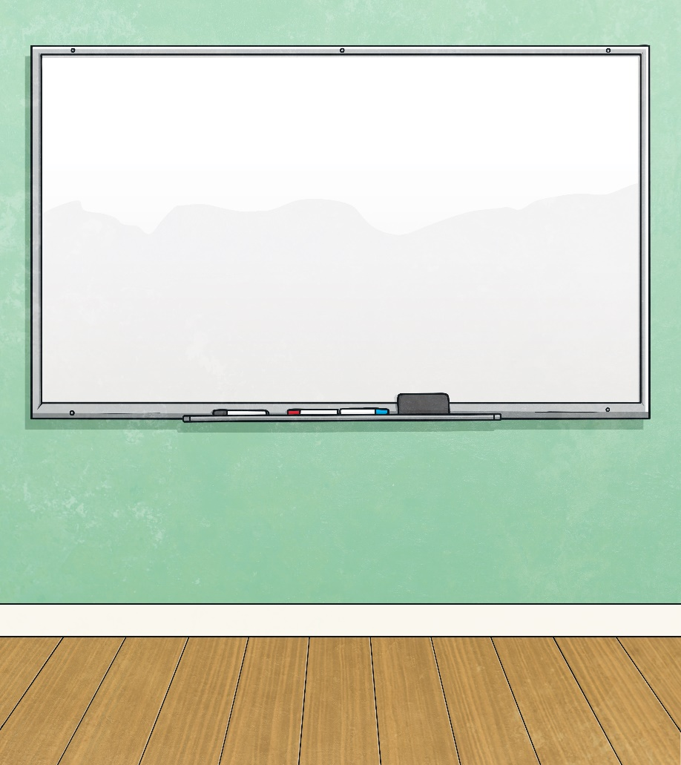
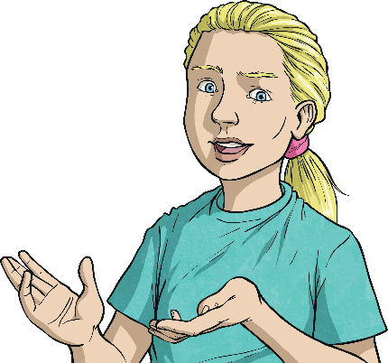



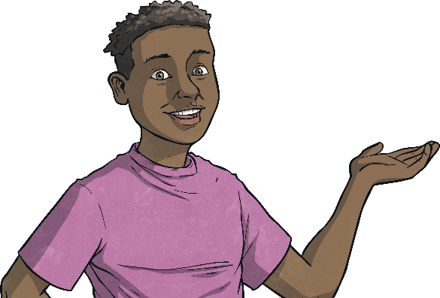
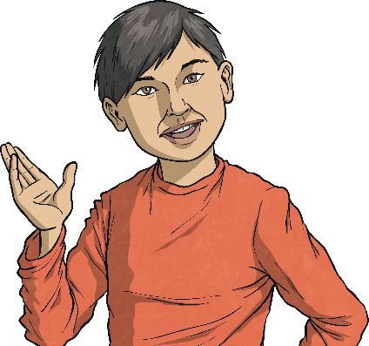
Add Fractions within 1
Diving
Use the bar models to find a common denominator and then complete the sum.
1
4
3
8
2
8
3
8
5
8
+
=
+
=

Slide 5
Add Fractions within 1
Diving
Use the bar models to find a common denominator and then complete the sum.
1
3
3
6
2
6
3
6
5
6
+
=
+
=

Slide 6
Add Fractions within 1
Diving
Use the bar models to find a common denominator and then complete the sum.
2
5
3
10
4
10
3
10
7
10
+
=
+
=
Now complete these sums. Draw your own bar models to help, if needed.
3
4
1
8
7
8
3
5
3
10
9
10
1
3
4
9
7
9
Find a common denominator.
+
=
+
=
+
=
Click for a top tip.

Slide 7



Add Fractions within 1
Deeper
Are these statements true or false? Prove it!
True
False
5
8
1
4
7
8
2
7
2
14
4
14
+
=
+
=
5
8
2
8
7
8
4
14
2
14
6
14
+
=
+
=
True
False
3
5
1
15
10
15
2
3
1
6
3
9
+
=
+
=
9
15
1
15
10
15
4
6
1
6
5
6
+
=
+
=

Slide 8
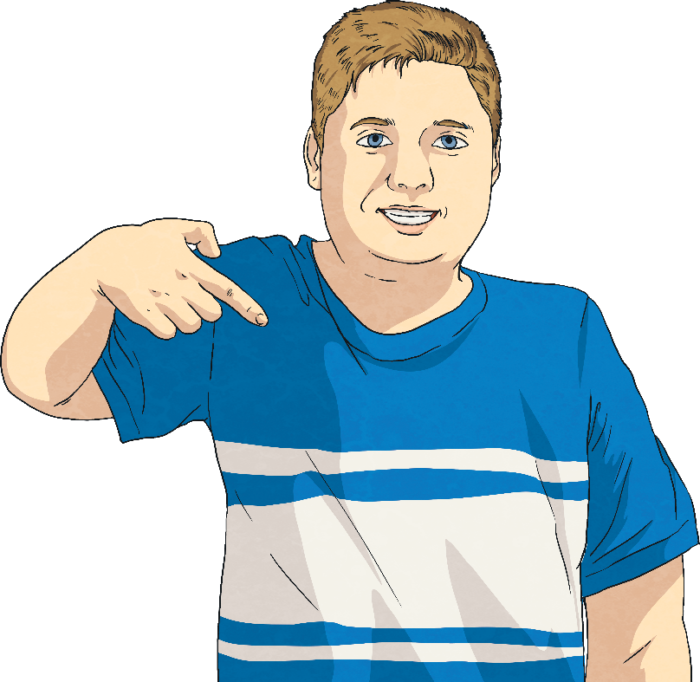
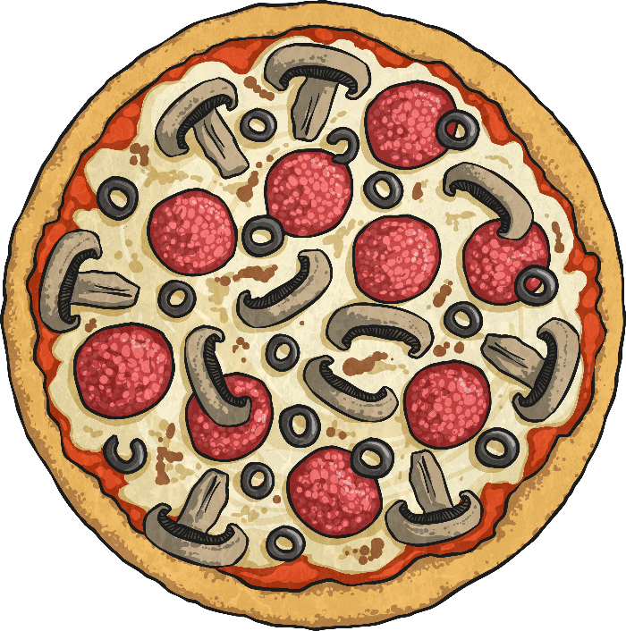
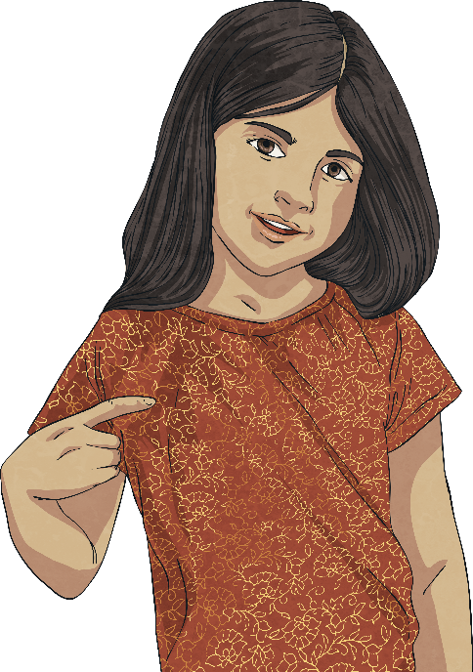
Add Fractions within 1
Deeper
Hugo and Millie are eating a pizza which is cut into 15 slices.
Hugo eats and Millie eats .
1
5
4
30
How many slices of the pizza did they each eat and who ate the most?
Hugo ate which is equivalent to , so he ate 3 slices.
Millie ate which is equivalent to , so she ate 2 slices.
Therefore, Hugo ate the most.
1
5
3
15
4
30
2
15

Slide 9




Add Fractions within 1
Deepest
Ali is sorting her tin of marbles.
The remainder of the marbles are red and yellow.
3
16
1
4
2
8
are green.
are blue.
are white.
What fraction could be red and what fraction could be yellow?
Find all the possibilities.
3
16
1
4
4
16
are green.
are blue, which is equivalent to .
3
16
4
16
4
16
11
16
+
+
=
2
8
4
16
are white, which is equivalent to .
5
16
4
16
3
16
2
16
1
16
This leaves which are red and yellow.
Red
Yellow
There are 4 possibilities:
1
16
2
16
3
16
4
16

Slide 10


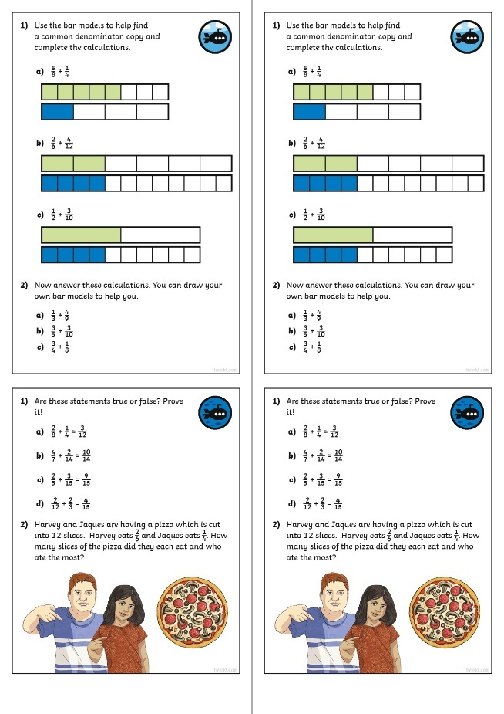
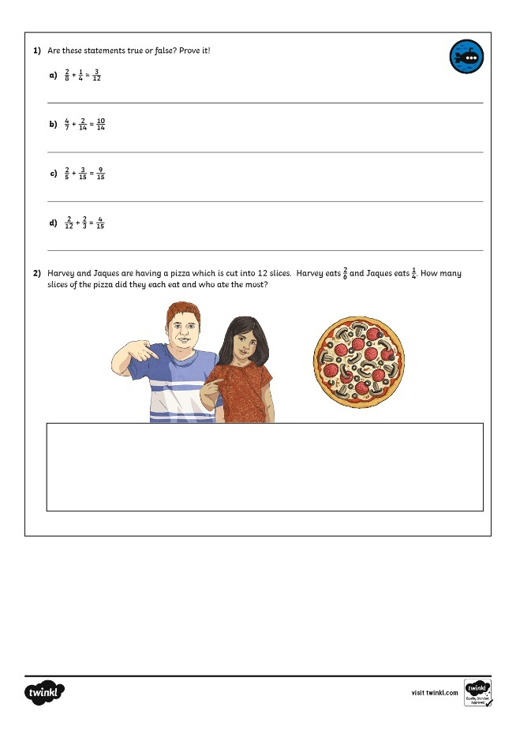
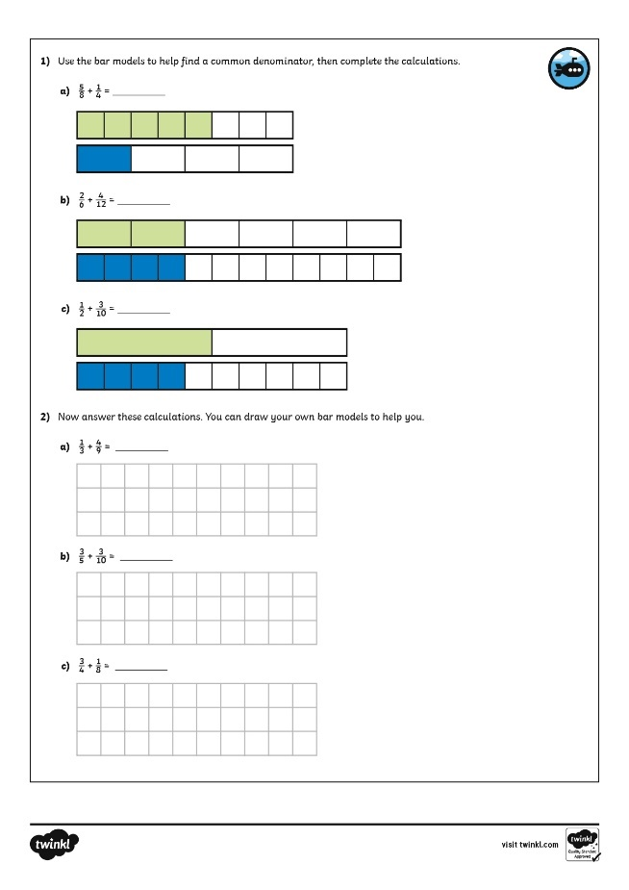
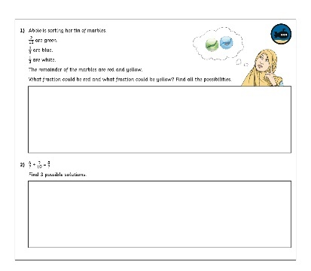
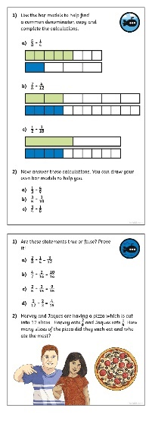
Add Fractions within 1
Dive in by completing your own activity!

Slide 11
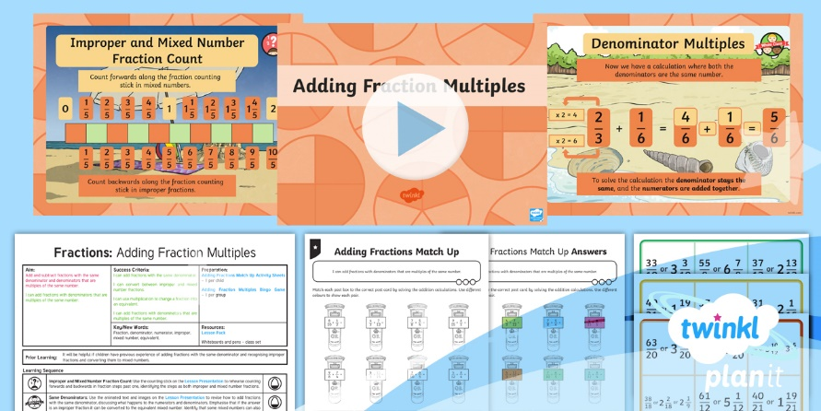
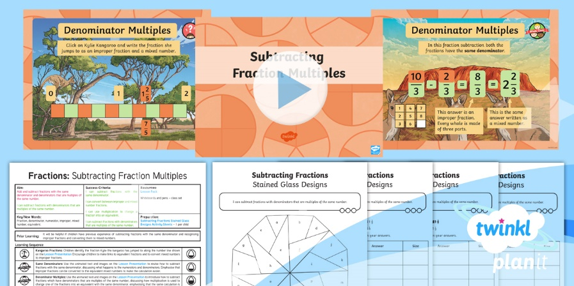

Need Planning to Complement this Resource?
National Curriculum Aim
Add and subtract fractions with the same denominator and denominators that are multiples of the same number.
For more planning resources to support this aim, click here.
Twinkl PlanIt is our award-winning scheme of work
with over 4000 resources.

