Slide 1
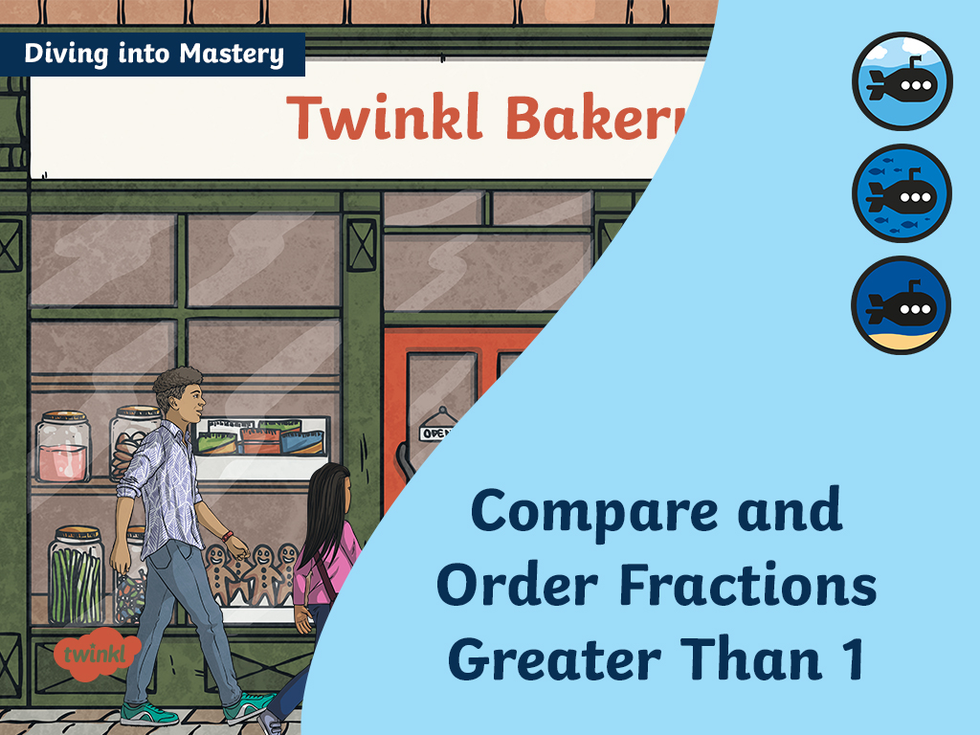

Slide 2



Diving into Mastery Guidance for Educators
Each activity sheet is split into three sections, diving, deeper and deepest, which are represented by the following icons:
These carefully designed activities take your children through a learning journey, initially ensuring they are fluent with the key concept being taught; then applying this to a range of reasoning and problem-solving activities.
These sheets might not necessarily be used in a linear way. Some children might begin at the ‘Deeper’ section and in fact, others may ‘dive straight in’ to the ‘Deepest’ section if they have already mastered the skill and are applying this to show their depth of understanding.
Diving
Deeper
Deepest

Slide 3
Aim
Compare and order fractions whose denominators are all multiples of the same number.

Slide 4




Compare and Order Fractions Greater Than 1
Diving
Use these bar models to compare $\frac{\text{11}}{\text{6}}$ and $\frac{\text{5}}{\text{3}}$.
$$\frac{\text{5}}{\text{3}}$$
$$\frac{\text{11}}{\text{6}}$$
<
Draw bar models to compare $\frac{\text{6}}{\text{4}}$ and $\frac{\text{14}}{\text{8}}$.
$$\frac{\text{14}}{\text{8}}$$
$$\frac{\text{6}}{\text{4}}$$
>

Slide 5
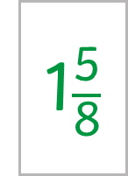
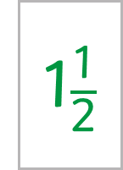
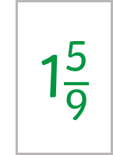
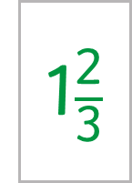
Compare and Order Fractions Greater Than 1
Diving
Use these bar models to compare 1$\frac{\text{2}}{\text{3}}$ and 1$\frac{\text{5}}{\text{9}}$.
1$\frac{\text{2}}{\text{3}}$
1$\frac{\text{5}}{\text{9}}$
>
Draw bar models to compare 1$\frac{\text{5}}{\text{8}}$ and 1$\frac{\text{1}}{\text{2}}$.
1$\frac{\text{1}}{\text{2}}$
1$\frac{\text{5}}{\text{8}}$
<

Slide 6












Compare and Order Fractions Greater Than 1
Diving
Use your knowledge of common denominators to order these fractions from smallest to greatest.
$$\frac{\text{7}}{\text{4}}$$
$$\frac{\text{10}}{\text{16}}$$
$$\frac{\text{13}}{\text{8}}$$
× 4
× 2
$$\frac{\text{28}}{\text{16}}$$
$$\frac{\text{10}}{\text{16}}$$
$$\frac{\text{26}}{\text{16}}$$
$$\frac{\text{10}}{\text{16}}$$
$$\frac{\text{10}}{\text{16}}$$
$$\frac{\text{26}}{\text{16}}$$
$$\frac{\text{13}}{\text{8}}$$
$$\frac{\text{7}}{\text{4}}$$
$$\frac{\text{28}}{\text{16}}$$

Slide 7

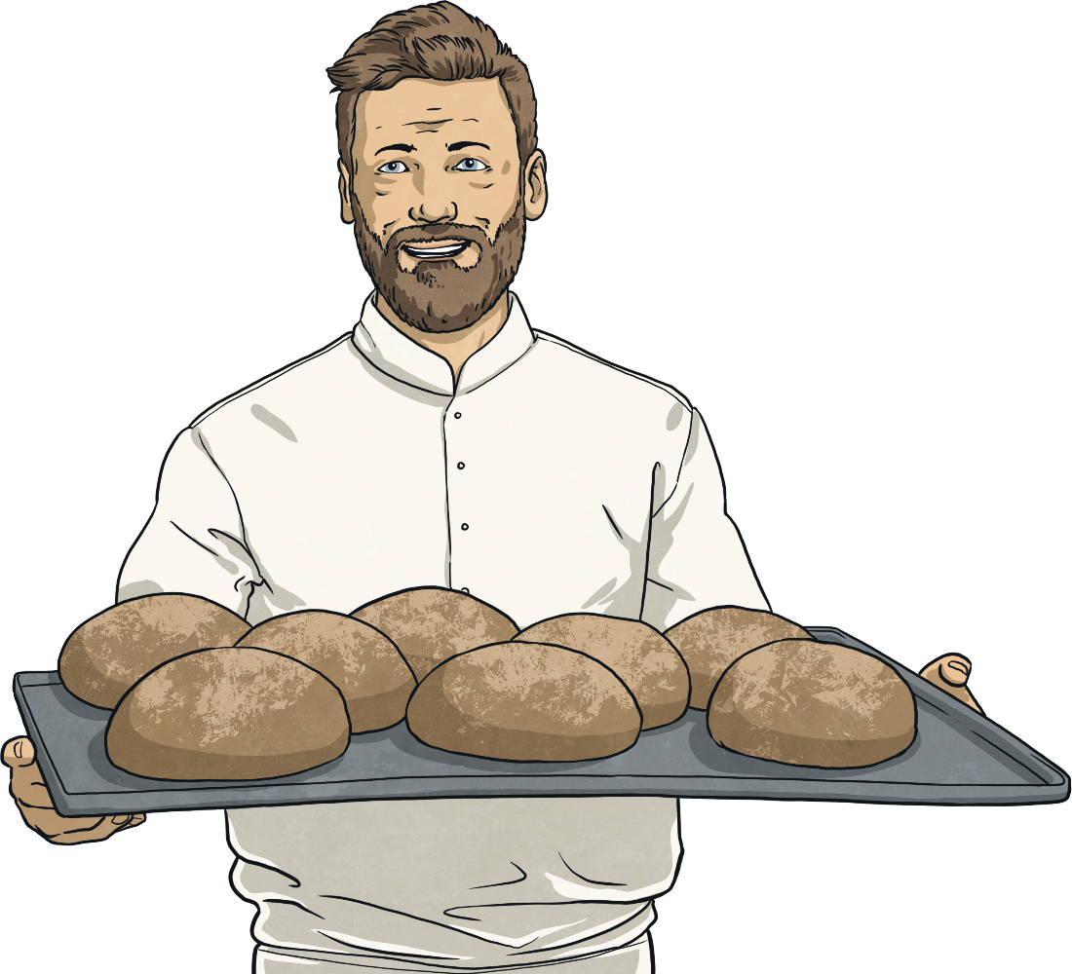
Compare and Order Fractions Greater Than 1
Deeper
Archie has drawn two bar models to compare 1$\frac{\text{1}}{\text{3}}$ and 1$\frac{\text{5}}{\text{6}}$
What has Archie done wrong?
In the parts of the bar model that represent the fractions, he has not drawn the rest of the whole.
What advice would you give Archie to improve his understanding of fractions?

Slide 8





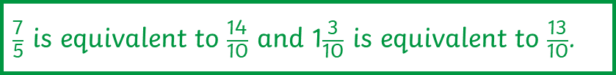

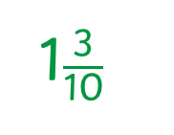
Compare and Order Fractions Greater Than 1
Deeper
Hailey has ordered these improper fractions and mixed numbers from smallest to greatest.
$$\frac{\text{7}}{\text{5}}$$
$$\frac{\text{3}}{\text{10}}$$
$$\frac{\text{19}}{\text{10}}$$
1
Spot her mistake and then write the numbers in the correct order.
$\frac{\text{7}}{\text{5}}$ is equivalent to $\frac{\text{14}}{\text{10}}$ and 1$\frac{\text{3}}{\text{10}}$ is equivalent to $\frac{\text{13}}{\text{10}}$.
1$\frac{\text{3}}{\text{10}}$
$$\frac{\text{7}}{\text{5}}$$
$$\frac{\text{19}}{\text{10}}$$

Slide 9

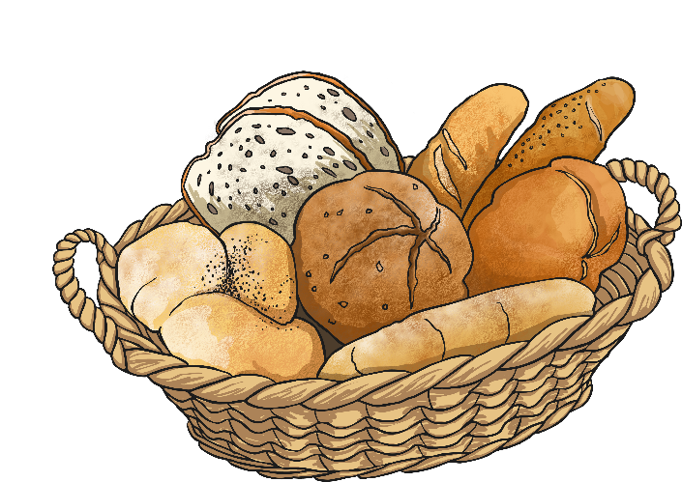
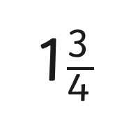




Compare and Order Fractions Greater Than 1
Deepest
Fill in the missing numbers.
1
$$\frac{\text{13}}{\text{10}}$$
1$\frac{}{\text{5}}$
<
$$\frac{\text{21}}{\text{12}}$$
2 $\frac{\text{3}}{\text{4}}$
1$\frac{\text{3}}{\text{4}}$
<
2
or

Slide 10
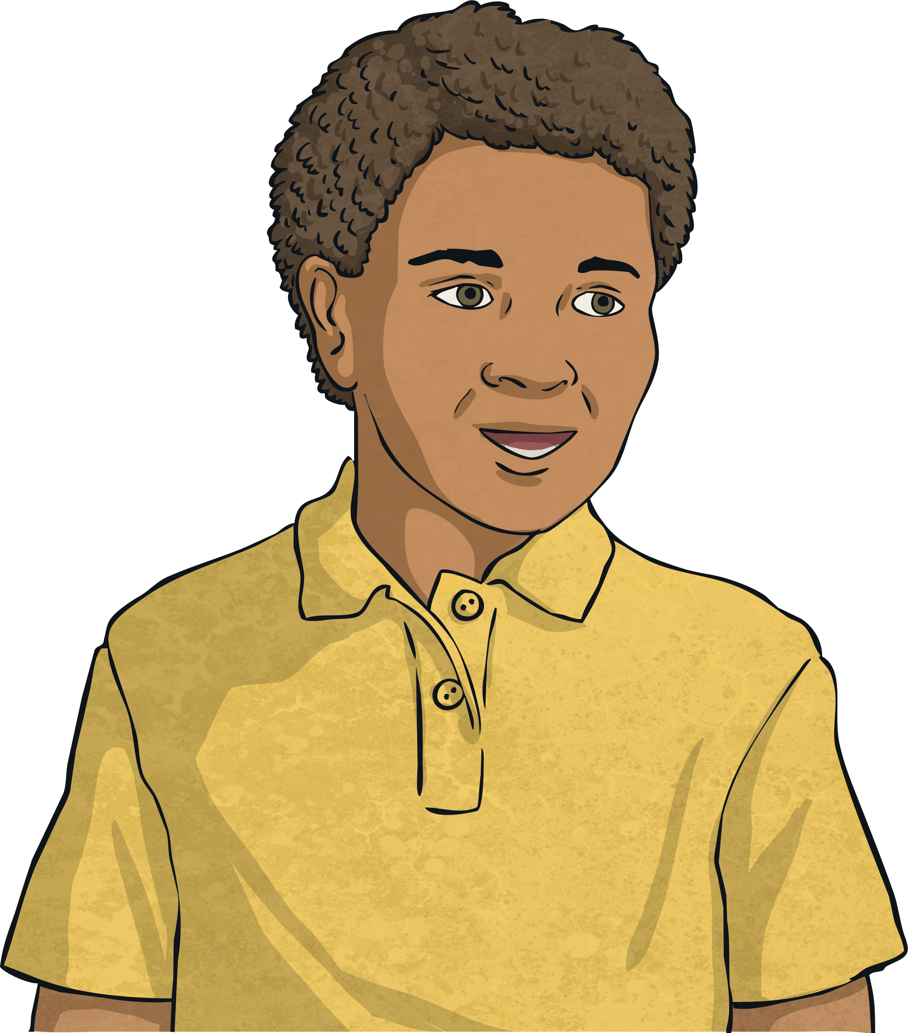
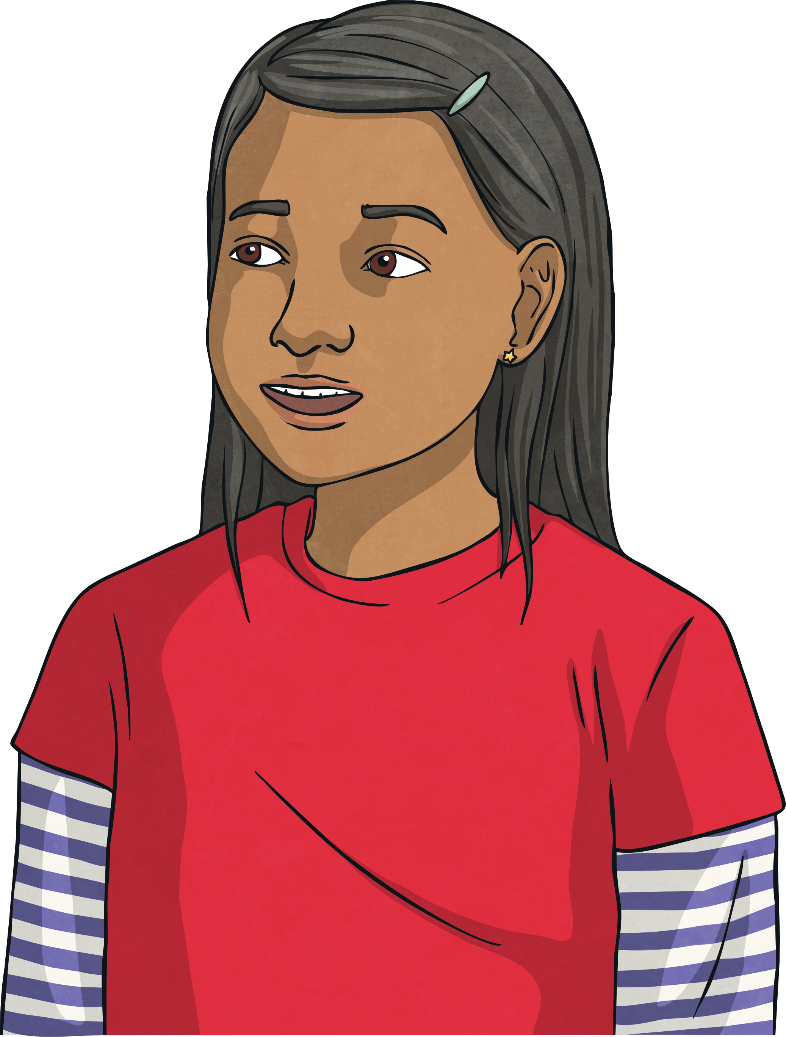
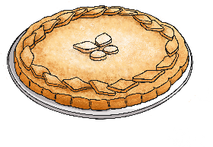
Compare and Order Fractions Greater Than 1
Deepest
Usman and Saira have 2 pies each.
I cut each of my pies into 3 equal pieces. I have eaten 4 pieces of pie overall.
I cut each of my pies into 6 equal pieces. I have eaten 11 pieces of pie overall.
Usman
Saira
Who ate the most pie overall? Complete the bar models to solve the problem.

Slide 11
Compare and Order Fractions Greater Than 1
Deepest
Usman and Saira have two pies each.
I cut each of my pies into 3 equal pieces. I have eaten 4 pieces of pie overall.
Saira ate the most pie overall.
Usman
I cut each of my pies into 6 equal pieces. I have eaten 11 pieces of pie overall.
Saira

Slide 12


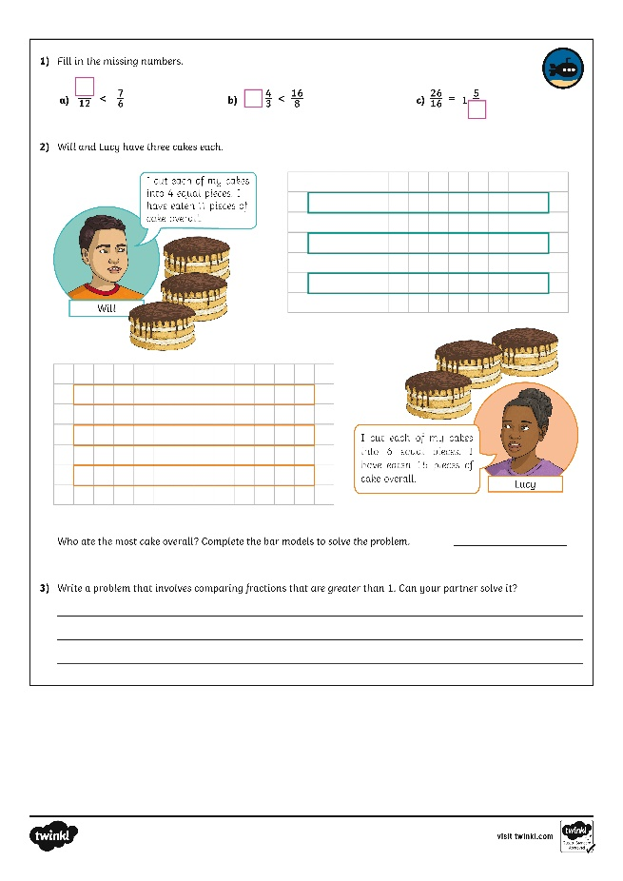
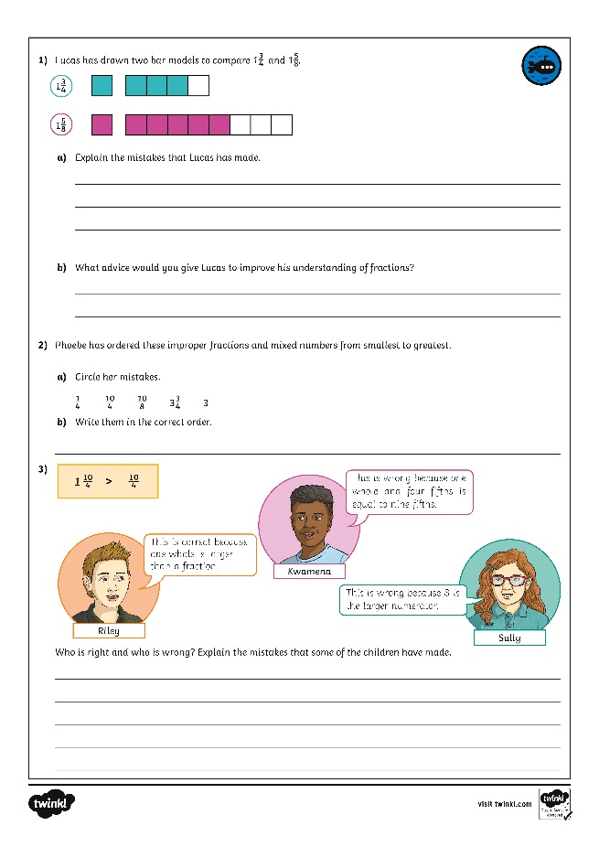
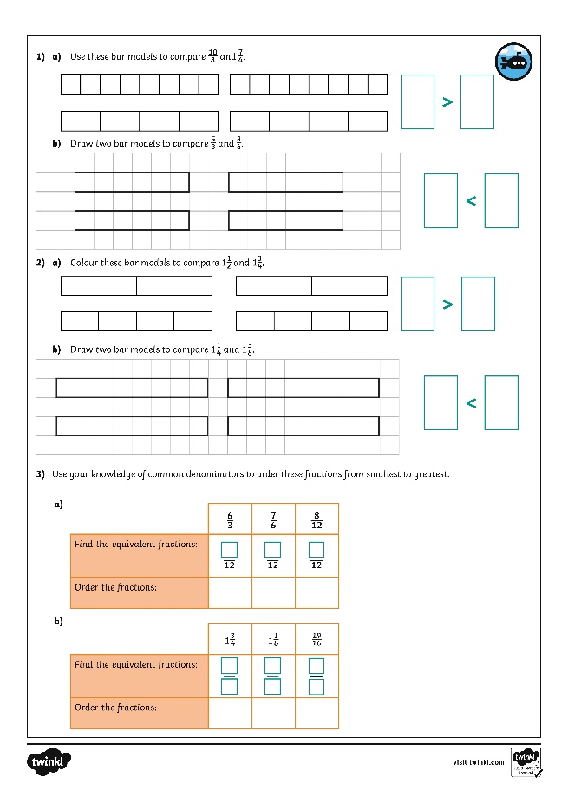
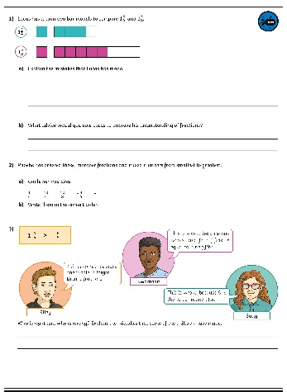
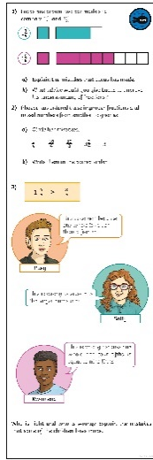
Compare and Order Fractions Greater Than 1
Dive in by completing your own activity!
Right preview - Right click and replace existing images with horizontal and vertical version jpgs of the activity sheet to keep shadow settings.
Left preview - hide the image of the child, drag in your jpgs, crop to just around the black strokes. Width should be 4cm for the horizontal, 2cm for vertical. Drag and rotate into place. Doesn’t have to be too neat as meant to look like the child stuck it in ☺

Slide 13
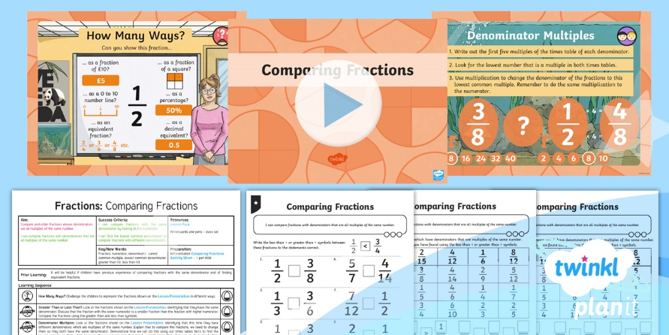
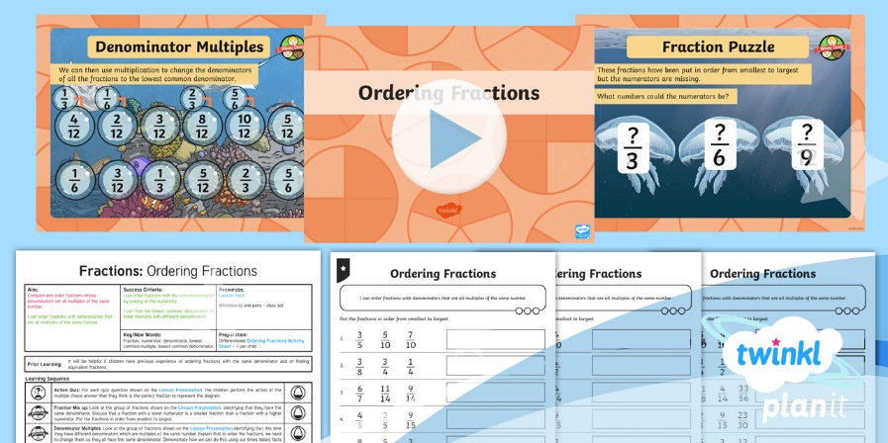

Need Planning to Complement this Resource?
National Curriculum Aim
Compare and order fractions whose denominators are all multiples of the same number.
For more planning resources to support this aim, click here.
Twinkl PlanIt is our award-winning scheme of work
with over 4000 resources.

