Slide 2



Diving into Mastery Guidance for Educators
Each activity sheet is split into three sections, diving, deeper and deepest, which are represented by the following icons:
These carefully designed activities take your children through a learning journey, initially ensuring they are fluent with the key concept being taught; then applying this to a range of reasoning and problem-solving activities.
These sheets might not necessarily be used in a linear way. Some children might begin at the ‘Deeper’ section and in fact, others may ‘dive straight in’ to the ‘Deepest’ section if they have already mastered the skill and are applying this to show their depth of understanding.
Diving
Deeper
Deepest

Slide 3
Aim
Compare and order fractions whose denominators are all multiples of the same number.

Slide 4




Compare and Order Fractions Less Than 1
Diving
Use these bar models to compare $\frac{\text{4}}{\text{5}}$ and $\frac{\text{7}}{\text{10}}$.
$$\frac{\text{7}}{\text{10}}$$
$$\frac{\text{4}}{\text{5}}$$
<
Draw two bar models to compare $\frac{\text{2}}{\text{3}}$ and $\frac{\text{5}}{\text{6}}$.
$$\frac{\text{5}}{\text{6}}$$
$$\frac{\text{2}}{\text{3}}$$
>

Slide 5




Compare and Order Fractions Less Than 1
Diving
Use common numerators to help you compare $\frac{\text{2}}{\text{5}}$ and $\frac{\text{2}}{\text{7}}$.
$$\frac{\text{2}}{\text{5}}$$
$$\frac{\text{2}}{\text{7}}$$
>
We can see from the bar model that fifths are bigger than sevenths.
Draw two bar models to compare $\frac{\text{3}}{\text{5}}$ and $\frac{\text{3}}{\text{4}}$.
$$\frac{\text{5}}{\text{6}}$$
is smaller than
$$\frac{\text{3}}{\text{4}}$$

Slide 6

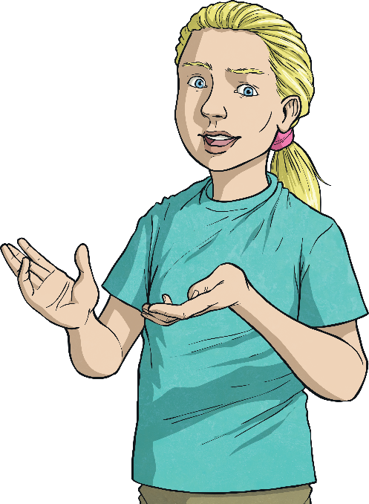



Compare and Order Fractions Less Than 1
Diving
Compare these fractions by finding a common numerator.
4
2
4
>
5
8
16
2
× 2
4
=
8
16
× 2

Slide 7
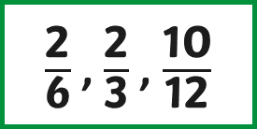
Compare and Order Fractions Less Than 1
Diving
Use the boxes given to write equivalent fractions with a common denominator to help you compare the three fractions.
Then, order the fractions from smallest to largest.
2
10
2
6
12
3
× 2
4
10
8
× 4
12
12
12
$\frac{\text{2}}{\text{6}}$ , $\frac{\text{2}}{\text{3}}$, $\frac{\text{10}}{\text{12}}$

Slide 8



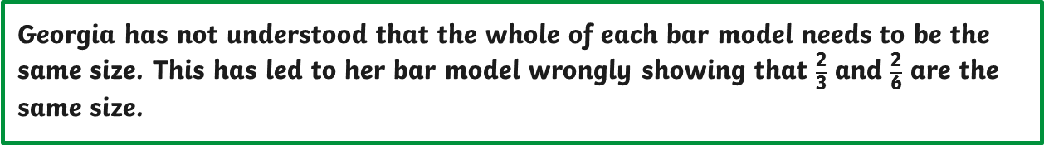
Compare and Order Fractions Less Than 1
Deeper
Georgia has drawn two bar models to compare $\frac{\text{2}}{\text{3}}$ and $\frac{\text{2}}{\text{6}}$.
Explain the mistake she has made.
Georgia has not understood that the whole of each bar model needs to be the same size. This has led to her bar model wrongly showing that $\frac{\text{2}}{\text{3}}$ and $\frac{\text{2}}{\text{6}}$ are the same size.

Slide 9

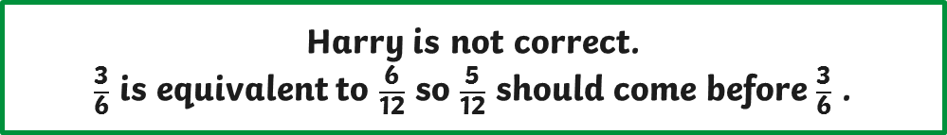




Compare and Order Fractions Less Than 1
Deeper
Harvey has ordered these fractions from smallest to largest.
Is he correct? Explain your reasoning using a common denominator.
$$\frac{\text{1}}{\text{3}}$$
$$\frac{\text{3}}{\text{6}}$$
$$\frac{\text{5}}{\text{12}}$$
$$\frac{\text{2}}{\text{3}}$$
$$\frac{\text{10}}{\text{12}}$$
4
6
5
8
10
12
12
12
12
12
Harry is not correct.
$\frac{\text{3}}{\text{6}}$ is equivalent to $\frac{\text{6}}{\text{12}}$ so $\frac{\text{5}}{\text{12}}$ should come before $\frac{\text{3}}{\text{6}}$ .

Slide 10



Compare and Order Fractions Less Than 1
Deepest
How many different ways can you correctly fill in the missing numerator?
Your fraction needs to be less than 1. Prove your answers are correct using either bar models or your knowledge of equivalent fractions.
4
<
10
5
4
4
4
3
<
There are two
possible solutions:
<
10
5
10
5
$\frac{\text{4}}{\text{5}}$ = $\frac{\text{8}}{\text{10}}$
$\frac{\text{3}}{\text{5}}$ = $\frac{\text{6}}{\text{10}}$

Slide 11






Compare and Order Fractions Less Than 1
Deepest
Harriet is thinking of a fraction that is larger than $\frac{\text{1}}{\text{4}}$ but smaller than $\frac{\text{5}}{\text{8}}$.
The denominator is a multiple of 2.
What fraction could it be? Draw three bar models to prove your answer.
Harriet’s fraction could be $\frac{\text{4}}{\text{8}}$ .
$$\frac{\text{1}}{\text{4}}$$
$$\frac{\text{4}}{\text{8}}$$
$$\frac{\text{3}}{\text{8}}$$
$$\frac{\text{5}}{\text{8}}$$
Harriet’s fraction could also be $\frac{\text{3}}{\text{8}}$ or fractions equivalent to $\frac{\text{4}}{\text{8}}$ (such as $\frac{\text{2}}{\text{4}}$ or $\frac{\text{1}}{\text{2}}$).

Slide 12


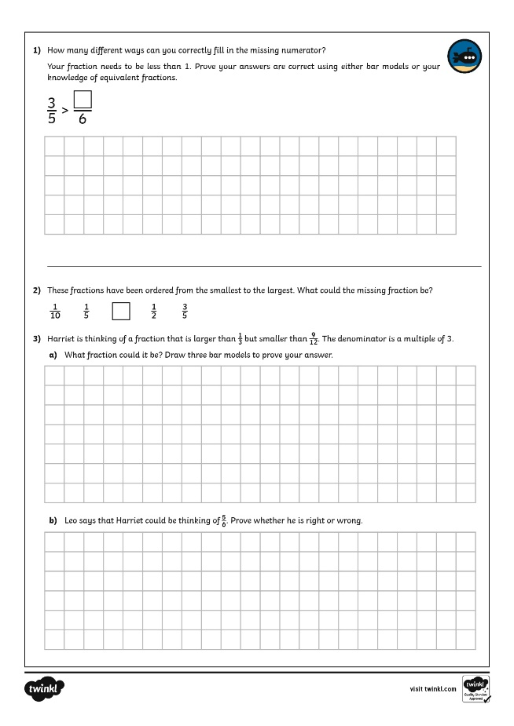
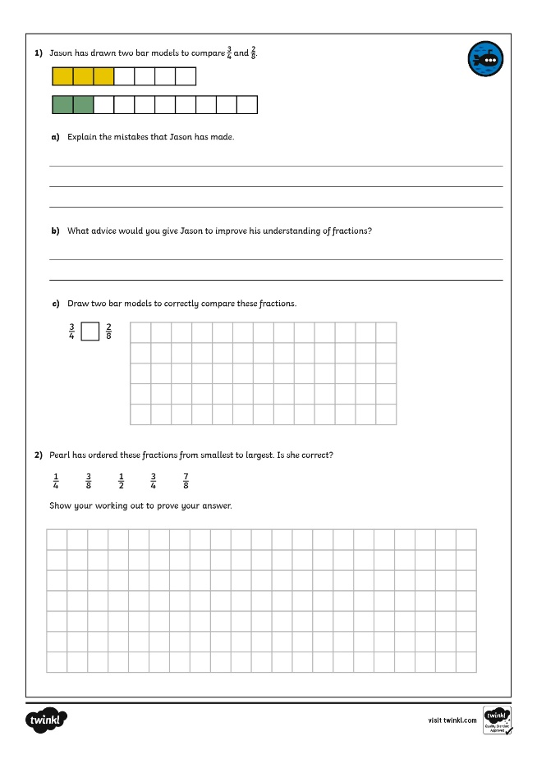
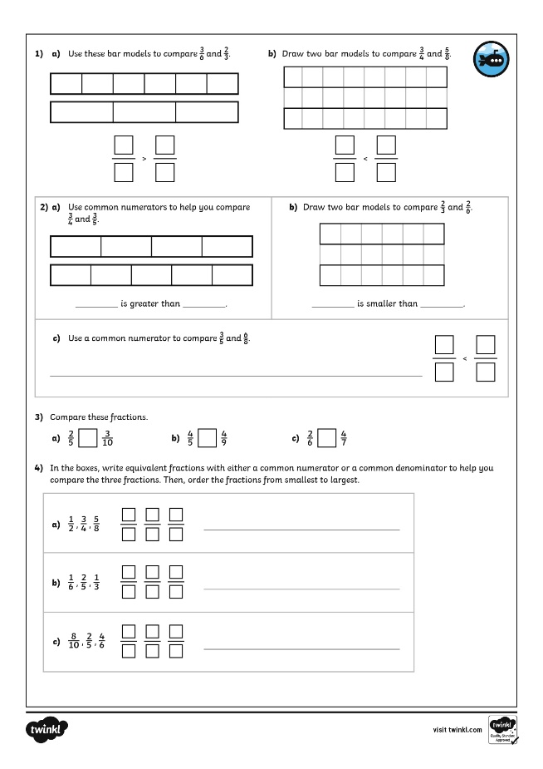
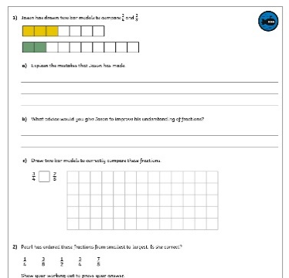
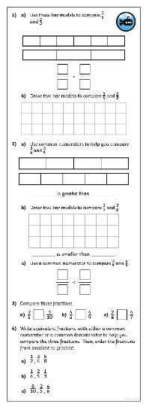
Compare and Order Fractions Less Than 1
Dive in by completing your own activity!

Slide 13
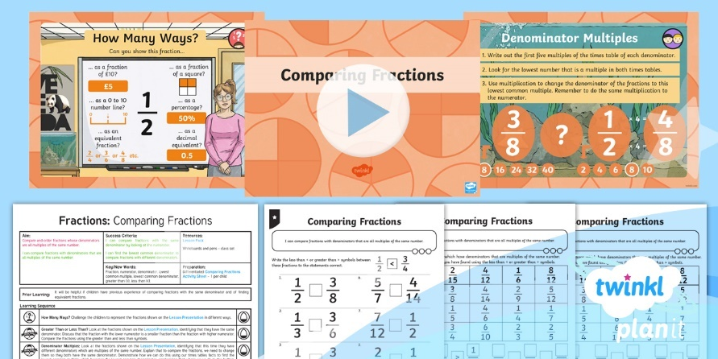
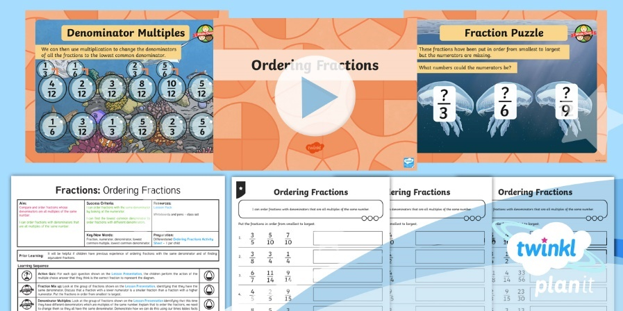

Need Planning to Complement this Resource?
National Curriculum Aim
Compare and order fractions whose denominators are all multiples of the same number.
For more planning resources to support this aim, click here.
Twinkl PlanIt is our award-winning scheme of work
with over 4000 resources.

