Slide 2



Diving into Mastery Guidance for Educators
Each activity sheet is split into three sections, diving, deeper and deepest, which are represented by the following icons:
These carefully designed activities take your children through a learning journey, initially ensuring they are fluent with the key concept being taught; then applying this to a range of reasoning and problem-solving activities.
These sheets might not necessarily be used in a linear way. Some children might begin at the ‘Deeper’ section and in fact, others may ‘dive straight in’ to the ‘Deepest’ section if they have already mastered the skill and are applying this to show their depth of understanding.
Diving
Deeper
Deepest

Slide 3
Aim
Recognise mixed numbers and improper fractions and convert
from one form to the other and write mathematical statements >1
as a mixed number.

Slide 4








Number Sequences
Diving
Match each sequence to the correct counting step.
5$\frac{\text{1}}{\text{4}}$ , 4$\frac{\text{1}}{\text{2}}$ , 3$\frac{\text{3}}{\text{4}}$ , 3 , 2$\frac{\text{1}}{\text{4}}$
2$\frac{\text{2}}{\text{3}}$ , 3$\frac{\text{1}}{\text{3}}$ , 4 , 4$\frac{\text{2}}{\text{3}}$
9$\frac{\text{1}}{\text{2}}$ , 8$\frac{\text{4}}{\text{6}}$ , 7$\frac{\text{5}}{\text{6}}$ , 7 , 6$\frac{\text{1}}{\text{6}}$
4$\frac{\text{4}}{\text{5}}$ , 5$\frac{\text{1}}{\text{5}}$ , 5$\frac{\text{3}}{\text{5}}$ , 6 , 6$\frac{\text{2}}{\text{5}}$
Decreasing by $\frac{\text{5}}{\text{6}}$
Increasing by $\frac{\text{2}}{\text{5}}$
Decreasing by $\frac{\text{3}}{\text{4}}$
Increasing by $\frac{\text{2}}{\text{3}}$

Slide 5
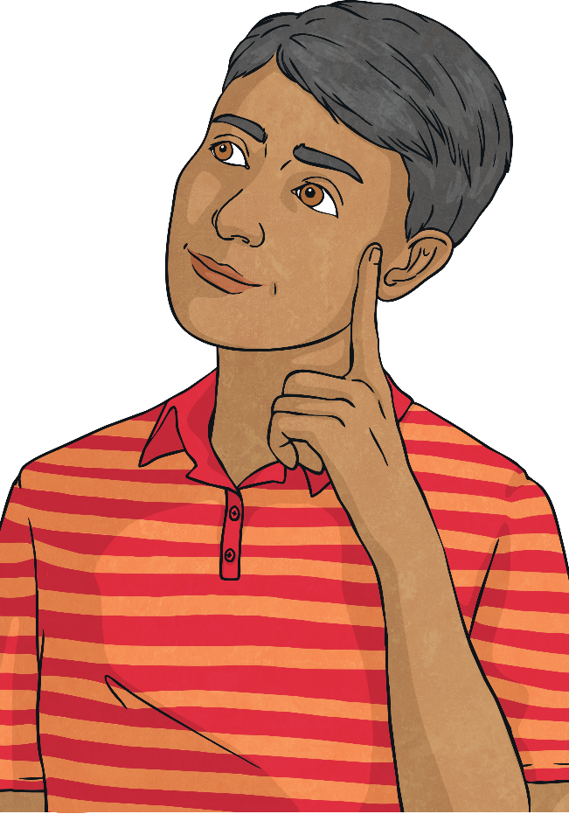
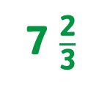
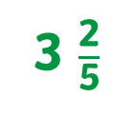

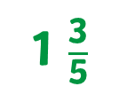


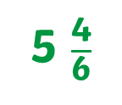
Number Sequences
Diving
Complete the sequences.
1 $\frac{\text{3}}{\text{5}}$
3 $\frac{\text{2}}{\text{5}}$
1 $\frac{\text{3}}{\text{5}}$ , 2 $\frac{\text{1}}{\text{5}}$ , 2 $\frac{\text{4}}{\text{5}}$ , 3 $\frac{\text{2}}{\text{5}}$ , 4
7 $\frac{\text{2}}{\text{3}}$
8 $\frac{\text{1}}{\text{3}}$ , 7 $\frac{\text{2}}{\text{3}}$ , 7 , 6 $\frac{\text{1}}{\text{3}}$ , 5 $\frac{\text{2}}{\text{3}}$ , 5
5
3 $\frac{\text{4}}{\text{6}}$ , 4 $\frac{\text{2}}{\text{6}}$ , 5 , 5 $\frac{\text{4}}{\text{6}}$ , 6 $\frac{\text{2}}{\text{6}}$
5
5 $\frac{\text{4}}{\text{6}}$

Slide 6

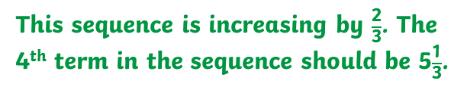
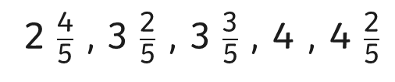
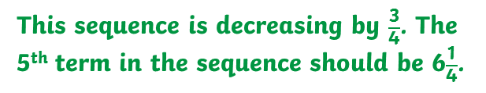
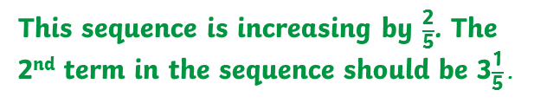
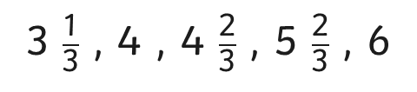
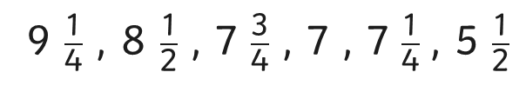
Number Sequences
Deeper
Can you identify and correct the mistakes in each of these sequences?
2 $\frac{\text{4}}{\text{5}}$ , 3 $\frac{\text{2}}{\text{5}}$ , 3 $\frac{\text{3}}{\text{5}}$ , 4 , 4 $\frac{\text{2}}{\text{5}}$
9 $\frac{\text{1}}{\text{4}}$ , 8 $\frac{\text{1}}{\text{2}}$ , 7 $\frac{\text{3}}{\text{4}}$ , 7 , 7 $\frac{\text{1}}{\text{4}}$ , 5 $\frac{\text{1}}{\text{2}}$
This sequence is increasing by $\frac{\text{2}}{\text{5}}$. The 2nd term in the sequence should be 3$\frac{\text{1}}{\text{5}}\text{.}$
This sequence is decreasing by $\frac{\text{3}}{\text{4}}$. The 5th term in the sequence should be 6$\frac{\text{1}}{\text{4}}$.
3 $\frac{\text{1}}{\text{3}}$ , 4 , 4 $\frac{\text{2}}{\text{3}}$ , 5 $\frac{\text{2}}{\text{3}}$ , 6
This sequence is increasing by $\frac{\text{2}}{\text{3}}$. The 4th term in the sequence should be 5$\frac{\text{1}}{\text{3}}$.

Slide 7

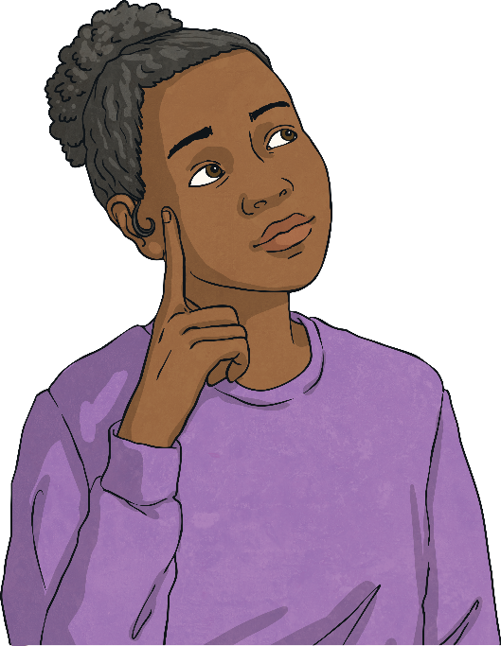


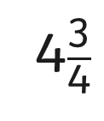
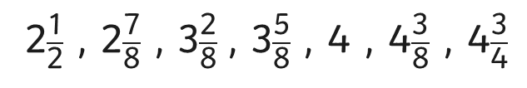

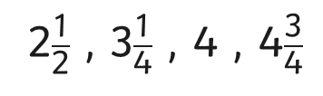
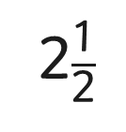
Number Sequences
Deepest
Here are the first and last numbers in a sequence.
2$\frac{\text{1}}{\text{2}}$
4$\frac{\text{3}}{\text{4}}$
What could the counting step be and what could the sequence look like?
Here are 2 possible answers:
2$\frac{\text{1}}{\text{2}}$ , 3$\frac{\text{1}}{\text{4}}$ , 4 , 4$\frac{\text{3}}{\text{4}}$
2$\frac{\text{1}}{\text{2}}$ , 2$\frac{\text{7}}{\text{8}}$ , 3$\frac{\text{2}}{\text{8}}$ , 3$\frac{\text{5}}{\text{8}}$ , 4 , 4$\frac{\text{3}}{\text{8}}$ , 4$\frac{\text{3}}{\text{4}}$
This sequence is increasing by $\frac{\text{3}}{\text{4}}$.
This sequence is increasing by $\frac{\text{3}}{\text{8}}$.

Slide 8


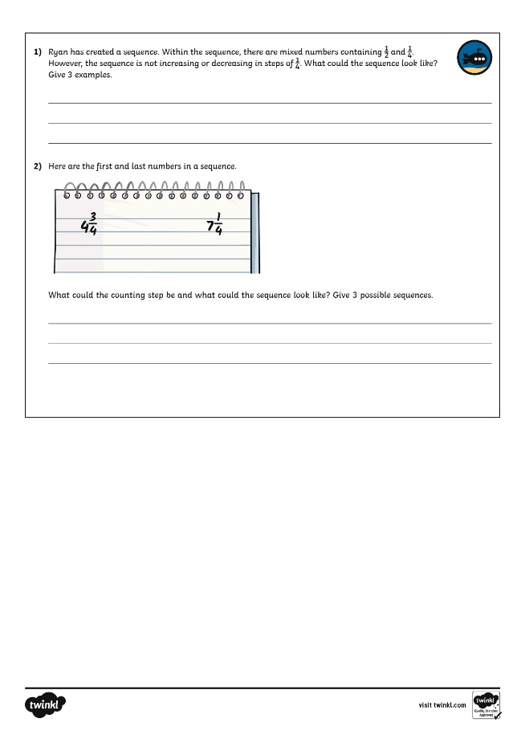
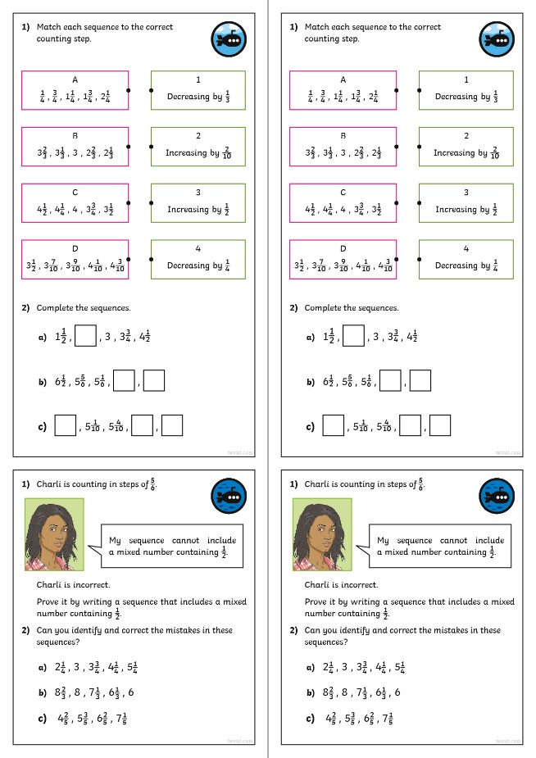
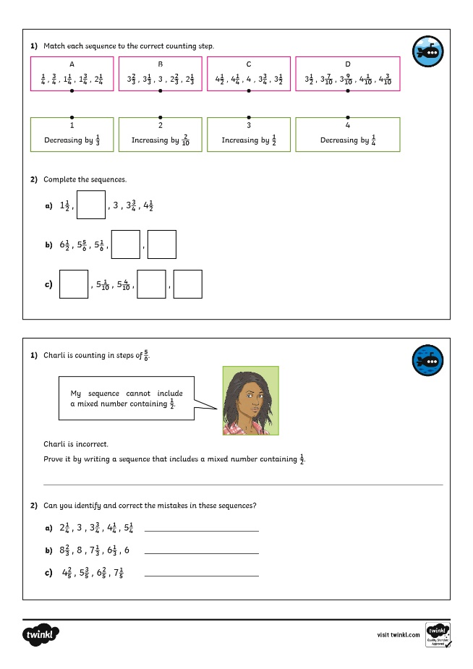
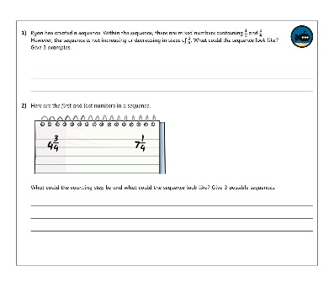
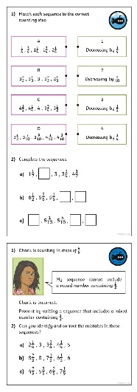
Number Sequences
Dive in by completing your own activity!

Slide 9
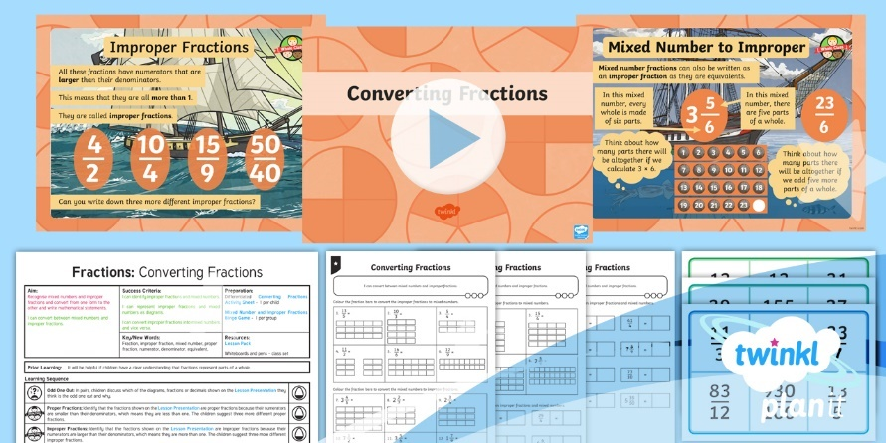
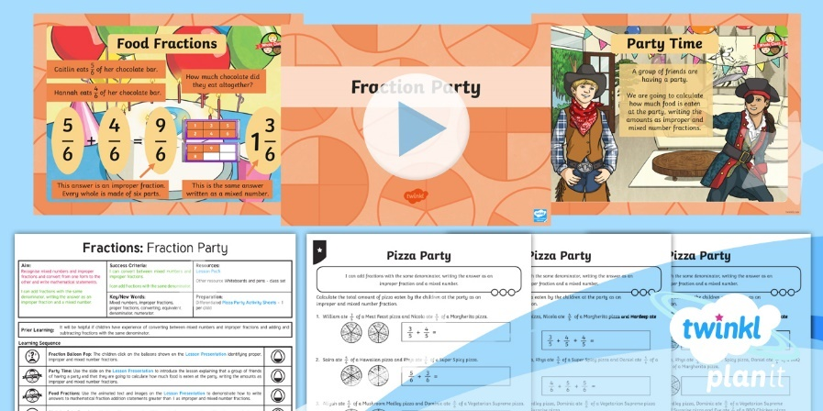

Need Planning to Complement this Resource?
National Curriculum Aim
Recognise mixed numbers and improper fractions and convert from one form to the other and write mathematical statements >1 as a mixed number.
For more planning resources to support this aim, click here.
Twinkl PlanIt is our award-winning scheme of work
with over 4000 resources.

