Slide 2



Diving into Mastery Guidance for Educators
Each activity sheet is split into three sections, diving, deeper and deepest, which are represented by the following icons:
These carefully designed activities take your children through a learning journey, initially ensuring they are fluent with the key concept being taught; then applying this to a range of reasoning and problem-solving activities.
These sheets might not necessarily be used in a linear way. Some children might begin at the ‘Deeper’ section and in fact, others may ‘dive straight in’ to the ‘Deepest’ section if they have already mastered the skill and are applying this to show their depth of understanding.
Diving
Deeper
Deepest

Slide 3
Aim
Recognise mixed numbers and improper fractions and convert from one form to the other and write mathematical statements >1 as a mixed number.

Slide 4
Improper Fractions to Mixed Numbers
Diving
Colour the bar models to represent the fraction shown and then complete the statement converting the improper fraction into a mixed number.
7
3
7
3
1
3
is equivalent to .
2

Slide 5
Improper Fractions to Mixed Numbers
Diving
Colour the fraction shown and then complete the sentence converting the improper fractions to a mixed number.
7
4
7
4
3
4
is the same value as .
1

Slide 6
Improper Fractions to Mixed Numbers
Diving
Colour the fraction shown and then complete the sentence converting the improper fractions to a mixed number.
22
6
22
6
4
6
is equivalent to .
3

Slide 7
Improper Fractions to Mixed Numbers
Diving
Now, convert these improper fractions to mixed numbers.
=
1
2
=
2
6
15
2
14
6
7
2
=
4
5
=
1
4
19
5
21
4
3
5

Slide 8



Improper Fractions to Mixed Numbers
Deeper
Timmy has converted some mixed numbers into improper fractions.
Can you spot the mistakes he has made? Explain Timmy’s mistakes and work out the correct answers.
7
3
= 2
2
3
The fraction in the mixed number is incorrect. The answer should be .
1
3
2
11
5
= 10
1
5
This is incorrect as 10 fifths make 2 whole ones. The answer should be .
2
1
5
17
4
5
4
This is incorrect as it still includes an improper fraction. The answer should be .
= 3
1
4
4

Slide 9

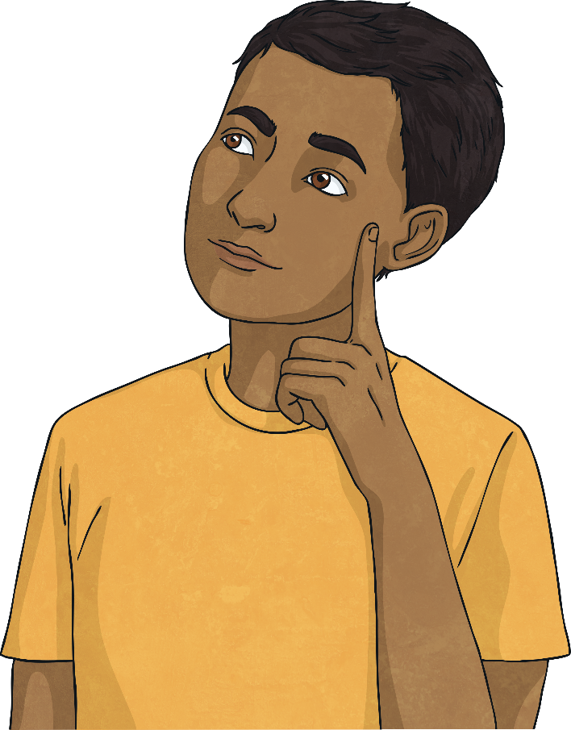
Improper Fractions to Mixed Numbers
Deepest
What could be the values of A and B be? Find all the possibilities.
A
4
B
4
= 2
There are 3 possible answers:
A = 9, B = 1
1 = 10, B = 2
A = 11, B = 3

Slide 10
Improper Fractions to Mixed Numbers
Deepest
What could be the values of A and B? Find three possibilities.
A
5
1
5
= B
A = 6, B = 1
1 = 11, B = 2
A = 16, B = 3
Other answers are possible.
A should be 1 more than B × 5.

Slide 11
Improper Fractions to Mixed Numbers
Deepest
Franco has created improper fractions and equivalent mixed numbers using number tiles, but he has knocked some of the tiles and can’t remember where to put them.
Can you place the following numbers in the correct places to complete the mathematical statements? (Each tile can only be used once.)
1
2
3
4
5
19
5
1
19
3
=
=
2
4
2
2
4
4

Slide 12


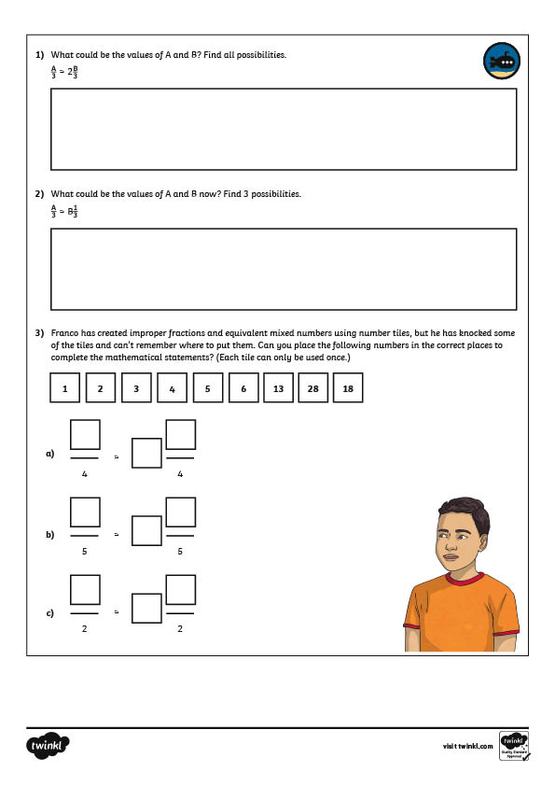
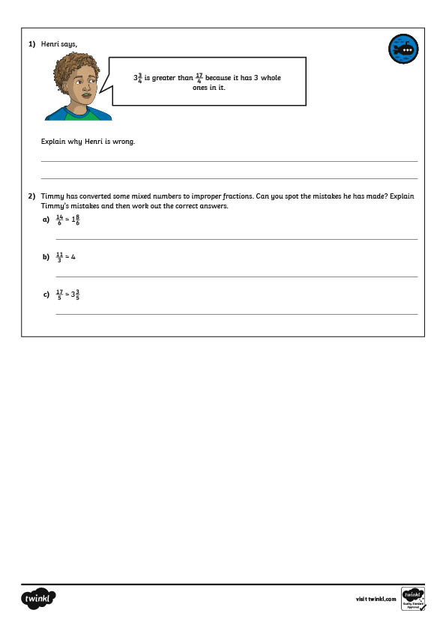
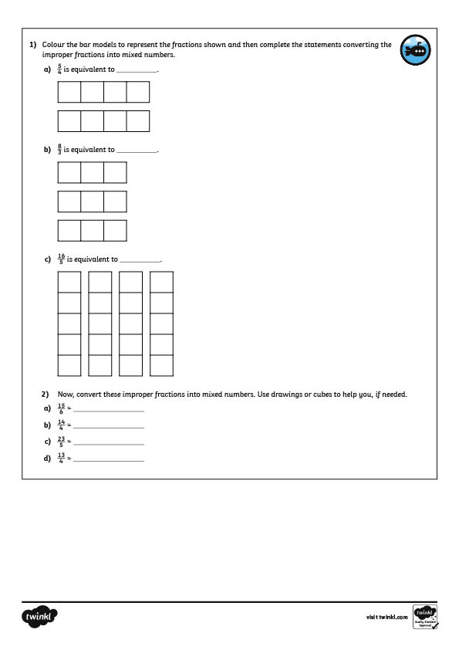

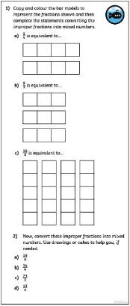
Improper Fractions to Mixed Numbers
Dive in by completing your own activity!

Slide 13
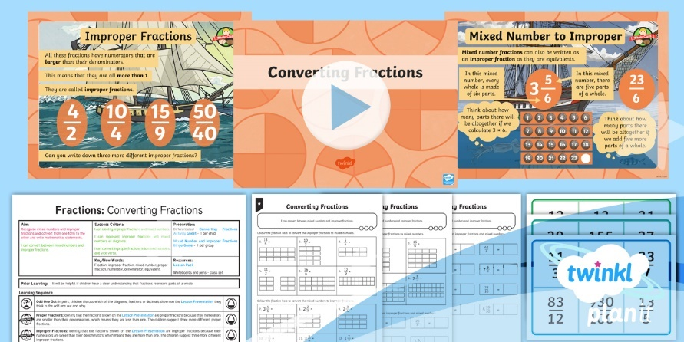
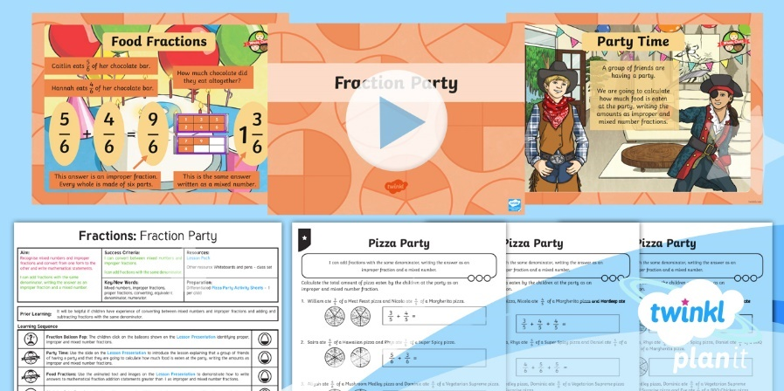

Need Planning to Complement this Resource?
National Curriculum Aim
Recognise mixed numbers and improper fractions and convert from one form to the other and write mathematical statements >1 as a mixed number.
For more planning resources to support this aim, click here.
Twinkl PlanIt is our award-winning scheme of work
with over 4000 resources.

