Slide 1
Week 3
North meets South

Slide 2
LO: To understand the cultural regions of the USA

Slide 3
Over the last few weeks we have studied New York and New England
These are ‘Northern’ states.

Slide 4
In many countries there are ‘regional cultures’.
What do you think a regional culture is?

Slide 5
Can you think of some regional cultures in England?

Slide 6
In the USA there are many regional cultures.
New England is a culture of its own, as well as being seen as part of ‘Northern’ USA.

Slide 7
There are many different cultural regions – and lots of debate as to what is what.

Slide 8
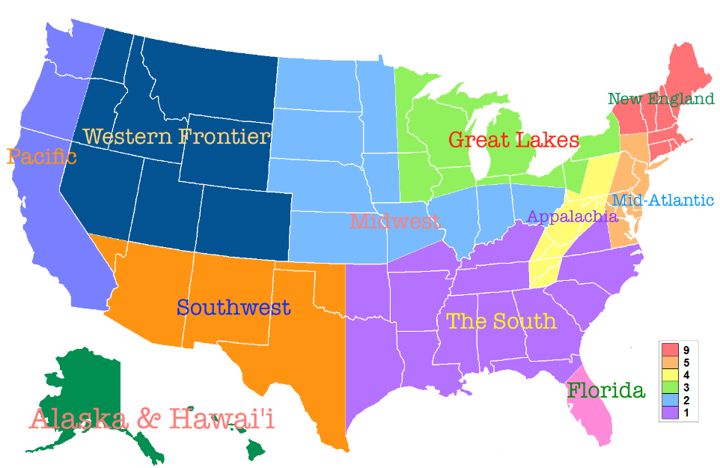

Slide 9
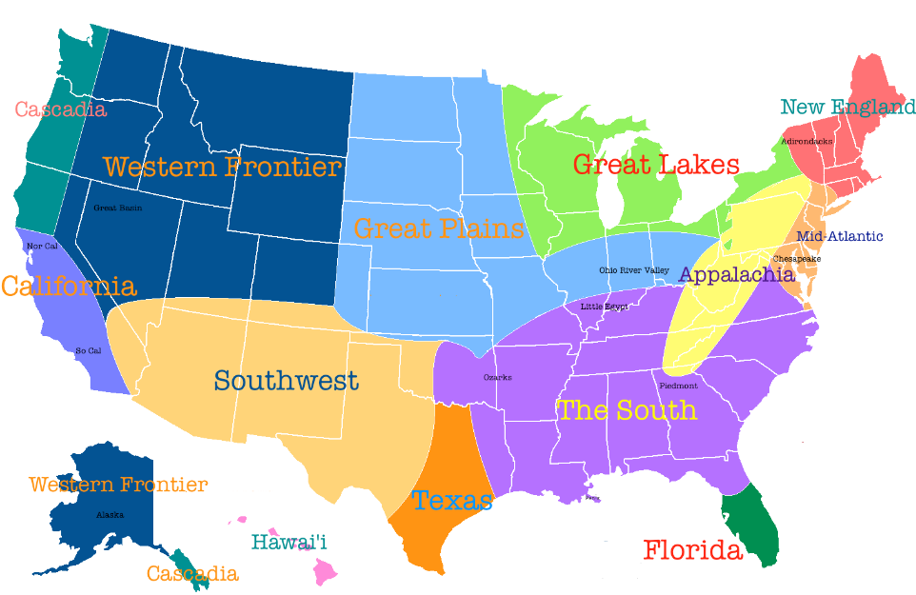

Slide 10

This week we are heading south – geographical and culturally.
Listen to Southern State of Mind by Darius Rucker: what does it tell you about southern culture and a ‘southern state of mind’?
https://www.youtube.com/watch?v=d2kCH_7TfPE

Slide 11


Do these two pictures represent ‘Southern Culture’?

Slide 12
Task
Using the key questions on the next slide, research the difference between a New England and ‘Southern’ lifestyle.
Use the information text to help you but write your answers in full sentences whenever you can.

Slide 13
Key Questions – Copy the question as your subheading and write your answer in a paragraph
What would I eat for breakfast?
What would eat for lunch?
What could I eat for dinner?
What sort of music might I like to listen to?
What would I do for and what would I do for entertainment?

Slide 14
What states do you think are the ‘Southern States’?
Task:
Complete the map of the Southern States

Slide 15
What landscape would you expect to see?
Watch the You Tube clip to see
https://www.youtube.com/watch?v=-FwnAidlFd4

Slide 16


