Slide 1
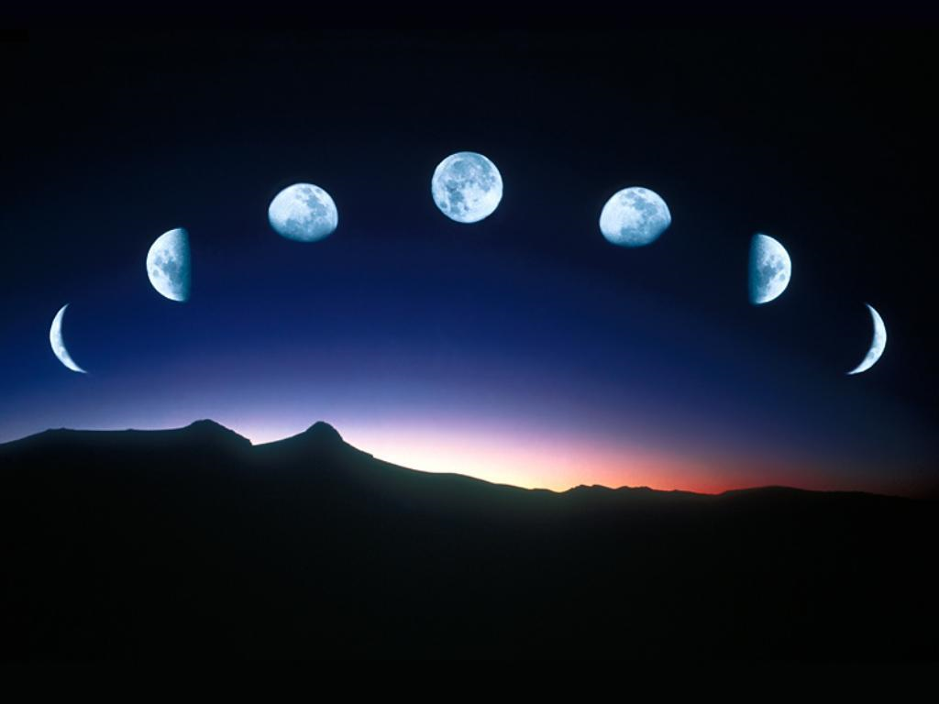
Phases of the moon

Slide 2
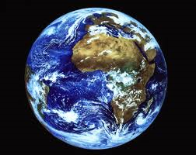
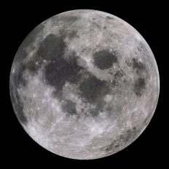
The moon orbits the earth.
It takes 28 days for the moon to go around the earth once
As the moon travels around the earth we see different amounts of the lit side of the moon
The only reason we can see the moon is because it reflects the light from the sun
Only one half of the moon is ever lit
Why does the moon appear to change shape?

Slide 3
Day 1 - New moon
The dark side of the moon is facing the earth

Slide 4
New moon
The dark side of the moon is facing the earth

Slide 5
Day 4 – Waxing Crescent

Slide 6
Waxing Crescent
We begin to see part of the side of the moon that is lit up

Slide 7

Day 7 – First quarter

Slide 8
First Quarter
Confused!? It’s obviously a half moon but is called a quarter moon because it has gone quarter of the way around the earth

Slide 9
Day 10 – Waxing Gibbous

Slide 10
Waxing Gibbous
The moon is now in a position where we can see most of the side that is lit up

Slide 11
Day 14 – Full moon

Slide 12

Full moon
The moon is pretty much opposite the sun now and so we can see all of the part that is lit up

Slide 13

Day 18 – Waning Gibbous

Slide 14
Waning Gibbous
The moon is now in a position where we can see most of the lit side of the moon

Slide 15
Day 21 – Last quarter

Slide 16
Last Quarter
The moon is in the last quarter of it’s way around the earth

Slide 17
Day 24 – Waning Crescent

Slide 18
Waning Crescent
We are starting to lose sight of the side of the moon that is lit up

Slide 19
Day 28 - New moon
The dark side of the moon is facing the earth again

Slide 20


