Slide 2
Aim
Find the area of rectilinear shapes by counting squares.

Slide 3

Comparing Area
Diving
 | A
 |  |  |  |  |  | E
 | B
 | C |  |  |  |  | F
 |  | D
 |  |  |  |  |  | G
Sort the shapes into the correct column of the table.
Shapes with an Area Greater Than 6 Squares | Shapes with an Area Less Than 6 Squares
A
D
E
B
C
F
G

Slide 4
Comparing Area
Diving
Complete the table. Use the squares to calculate the area of each shape. Compare the areas of the shapes using >, < or =.
Shape 1 | Compare Area >, < or = | Shape 2
>
11
>
10

Slide 5
Comparing Area
Diving
 |  | A |  |  |  | B
 |  |  |  |  |  |  |  |  |  |  | C
Order these shapes from the shape with the smallest area to the shape with the largest area.
C, A, B

Slide 6


Comparing Area
Deeper
 | A |  |  | B |  |  |  | C |  |  |  | D
A
C
D
Jessica has been asked to order the shapes from the shape with the smallest area to the shape with the largest area.
She has got confused. Explain her mistake.
Jessica has ordered the shapes correctly from the one with the smallest area to the one with the greatest area but she has only included 3 shapes in her sequence when there should be 4. She has missed shape B out. The correct answer is: A, C, D and B.

Slide 7
Comparing Area
Deeper
Which one is the odd one out? Explain why.
 | A |  |  |  |  |  |  | B
 | C
20
Possible answers:
A is the odd one out because:
it has the greatest area;
it is not symmetrical.
B is the odd one out because:
its area is even but the other shapes’ areas are odd.
C is the odd one out because:
it has the smallest area.
23
15

Slide 8
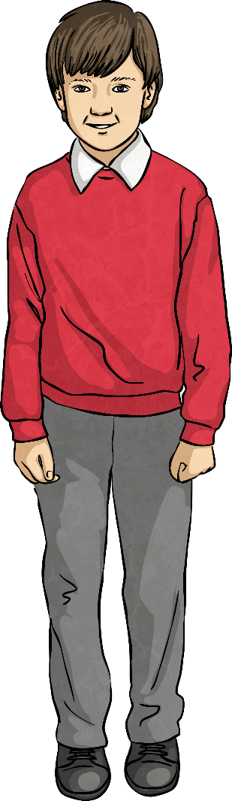
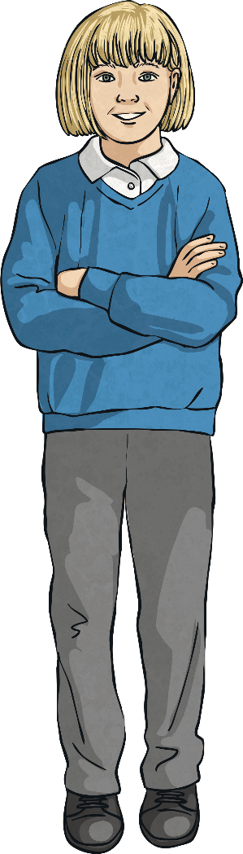
Comparing Area
Deeper
Josie and Lyle are having a disagreement over the area of their shapes. Read their statements. Who is correct? Explain why.
The area of my shape is double the area of Lyle’s shape.
The area of my shape is less than the area of Josie’s shape.
Lyle is correct: his shape has an area of 8 squares and Josie’s has an area of 15.
Lyle’s shape has an area of 8 and double 8 makes 16. Josie’s shape only has an area of 15, not 16, which makes her incorrect.

Slide 9

Comparing Area
Deepest
Mya has been comparing the areas of the shapes.
One shape is missing from the statement.
Can you work out what its area could be and what it could look like.
Find 6 possibilities.
>
=
Your shapes should each have an area of 5 squares. Many possible shapes can be created with 5 squares. Here are some examples:

Slide 10
Comparing Area
Deepest
Complete the table by matching each child’s description of the area of their shape to the correct shape.
 | A |  |  | B |  |  |  |  | C |  |  |  |  | D
Child | Area | Shape
Luke
Una
Ned
Lila
12
B
11
D
14
C
10
A
The area of my shape is even.
The area of my shape is less than 12.
The area of my shape has a digit sum of 5.
The area of my shape is double 5.
Luke
Una
Ned
Lila

Slide 11
Comparing Area
Deepest
Complete the sequence.
Fill in the next shapes.
Explain the pattern.
The shape’s area is doubling each time. 1, 2, 4, 8, 16, etc.

