Slide 1


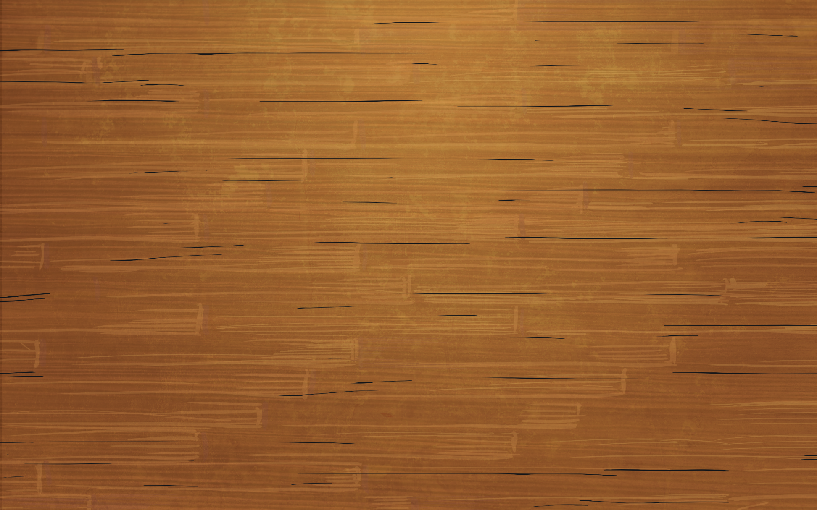
Making Shapes
Diving
Jed is exploring making rectilinear shapes using 6 squares. He is trying to work systematically, only moving 1 square at a time. Identify 3 more shapes that he could make by moving the same square.
Compare your rectilinear shapes with your partner’s. What did you notice?

Slide 2
Making Shapes
Diving
Here are some possible answers, but you may have found others.

Slide 3
Making Shapes
Diving
Here are some possible answers, but you may have found different rectilinear shapes.
Draw 3 rectilinear shapes with an area of 8 squares.

Slide 4



Making Shapes
Deeper
Correct or Incorrect
Alex has made a rectilinear shape using 10 squares. Decide if his work is correct or incorrect and give him some feedback.
Feedback
You have created a rectilinear shape, but it has an area of 9 squares, not 10. You have not used enough squares so you need to add 1
more square to make this correct.

Slide 5
Making Shapes
Deeper
Look at this rectilinear shape. Using 4 more squares, can you turn this shape into a rectangle?
Here are the two possible answers.

