Slide 1
USA Road Trip Week 2 – New England

Slide 2
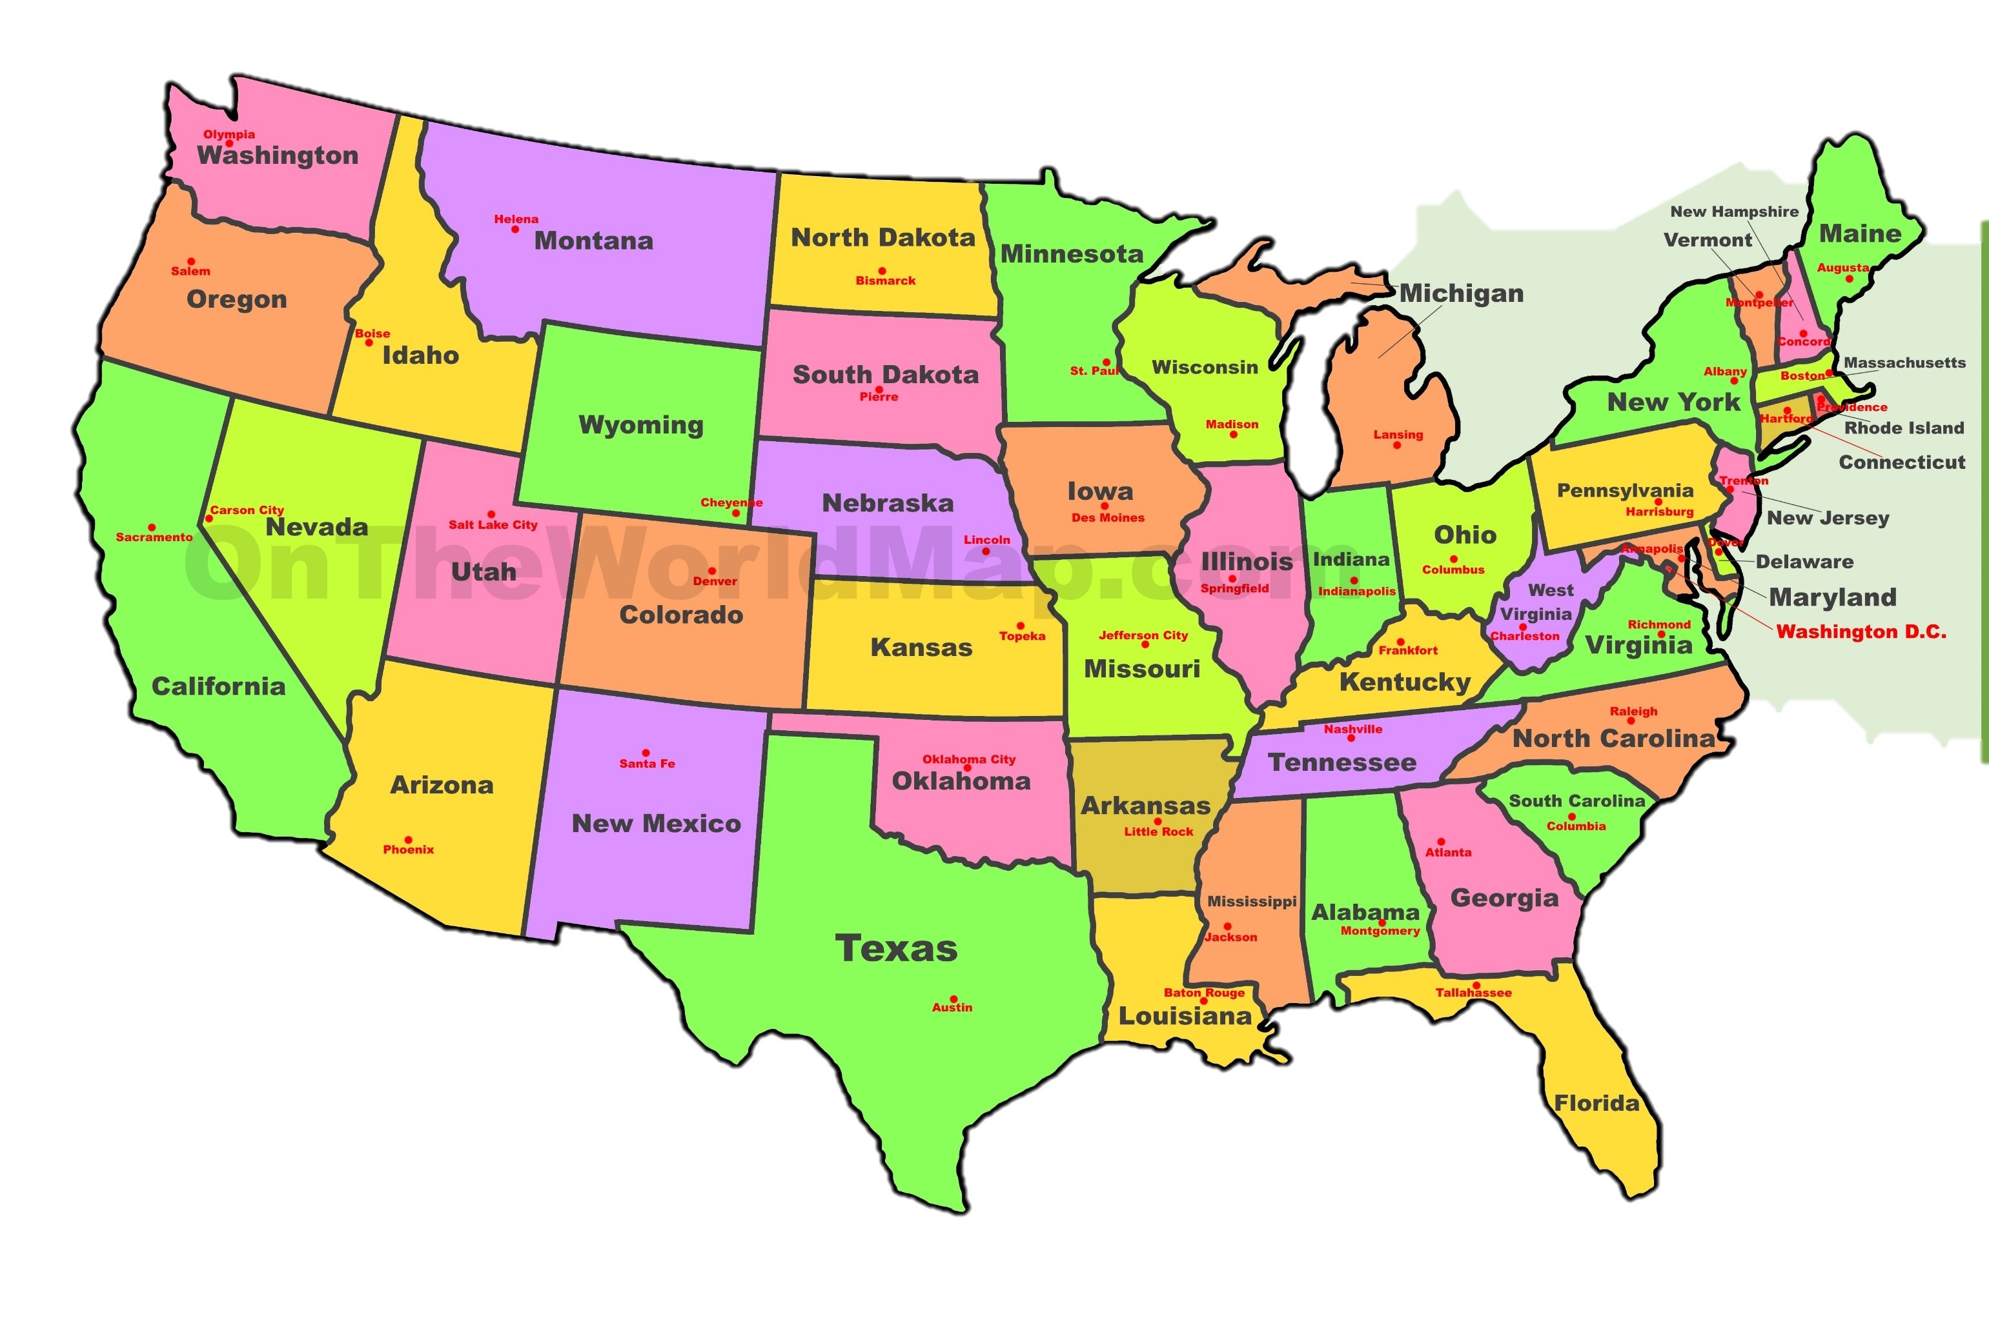

Slide 3
Lesson 2
The States of New England

Slide 4
LO: To know the states that make up New England

Slide 5
What do you think New England is like from watching these videos?
https://youtu.be/DE1aLG0YPLs (Discover NE)
or this one
https://youtu.be/bgqALbHbrQg (13 Things)

Slide 6
What do you think of New England after a little history…
https://youtu.be/j5AXVE9fq44
Discover NE - History

Slide 7
New England
Is a region of North Eastern USA. Like we have East Anglia or the Home Counties.
It collects together the original six states that became the founding of the USA.
New England is where many of the original settlers of the USA landed in the 1620’s
It contains many of the USAs historic sites that are not connected to the War of Independence or Revolution.

Slide 8
The physical geography of New England is diverse for such a small area
South-eastern New England is covered by a narrow coastal plain
Western and northern regions are dominated by the rolling hills and worn-down peaks of the northern end of the Appalachian Mountains
With the Atlantic fall line lying so close to the coast, numerous industrial cities were able to take advantage of water power along the numerous rivers, such as the Connecticut River, which cuts the region from north to south.

Slide 9
Do you know any of the States that make up New England?

Slide 10
New England States
Connecticut
Maine
Massachusetts
New Hampshire
Rhode Island
Vermont
Can you tell me something about these states?

Slide 11
Task – On the outline map of the New England…
Label the states (use the key)
Label the Capital City of each state. Label it with a star if not marked on your map.
Plot and label the biggest river in each state.
Label the mountains. You will need to sketch in the mountains: use a string ^^^^^^^ to show where they are.

Slide 12
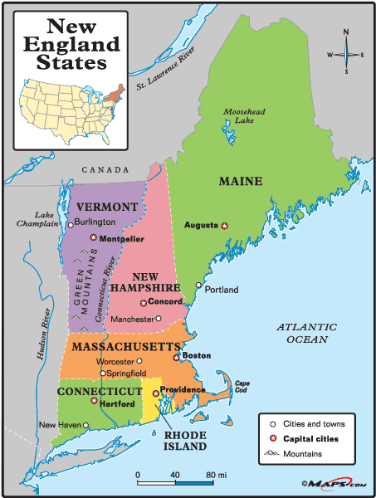

Slide 13
Do you know anywhere in the USA that shares a name with a settlement in the UK?

Slide 14
When we move house we tend to taken everything with us.
This was true of settlers who first colonised the USA. They took everything with them, including the names of the place they lived!

Slide 15
New England cities that have a British counterpart
Connecticut - 60
Maine – 31
Massachusetts - 110
New Hampshire – 48 (some with different spellings)
Rhode Island – 15 (it is the smallest state!)
Vermont - 36
Some places names can be found in more than one State.

Slide 16
Find a town or city that shares its name with somewhere in England
Choose one of the New England states
What do they have in common?

Slide 17
Task: Choose one.
1) Create a poster that tells me about the American and English version of your town or city.
Include pictures and facts.
2) Complete the comparison sheet to compare the American and English version of your town or city
I have included slides on Norwich – Vermont and
Norwich – Connecticut (if you can’t find any places of your own). These could help you complete your poster.

Slide 18
Norwich, Vermont
When was the city/town founded? | 1761
What is the population of the settlement? | 3,414
Which Primary/Elementary school could you go to? | Marion Cross Elementary School
What is the name of your local library? | Norwich Public Library
What is the name of your local football team? | Norwich University Mens/Womens
Where would you go to shop for food? | Dan & Whits General Store
What is the weather like there today? | -1C, cloudy
What is the weather like there in the summer? | 24C, patchy cloud

Slide 19
Norwich, Connecticut
When was the city/town founded? | 1784 (1659 for Norwich Town)
What is the population of the settlement? | 40,347
Which Primary/Elementary school could you go to? | 16 elementary, 28+ schools
What is the name of your local library? | Otis Library
What is the name of your local football team? | Ledyard Soccer Club
Where would you go to shop for food? | ShopRite, Walmart, Stop + Shop
What is the weather like there today? | 1C, sunny
What is the weather like there in the summer? | 23C – 30C, sunshine

