Slide 2

What Is Area?
Diving
Which shape has the largest area?

Slide 3
What Is Area?
Diving
Which shape has the smallest area?

Slide 4
What Is Area?
Diving
Order these shapes from the shape with the smallest area to the shape with the largest area.
A
B
C
B, A, C

Slide 5
What Is Area?
Diving
Here is one small square.
Estimate how many small squares make up each shape and match each shape to the correct number.
5
4
2
3

Slide 6

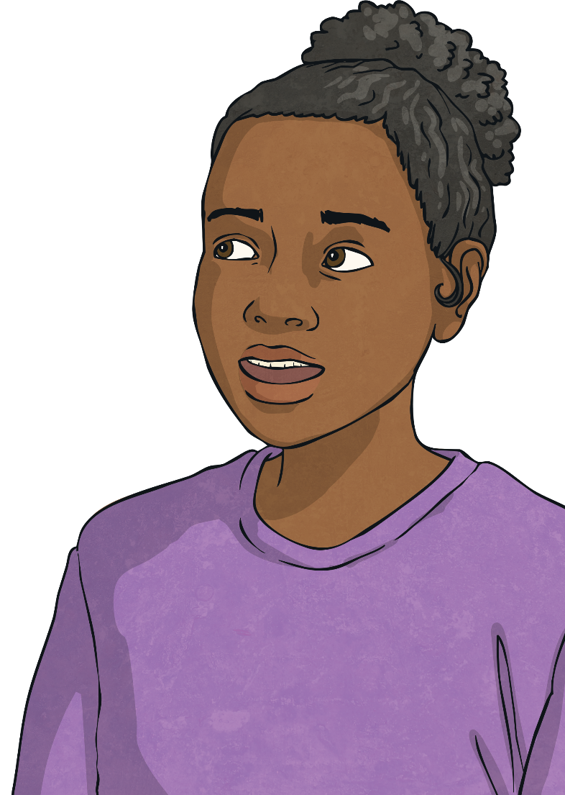
What Is Area?
Deeper
True or false? Explain your answer.
Area is the space inside a 3D shape.
False. Area is the space taken up by a 2D shape or surface.

Slide 7

What Is Area?
Deeper
Riley says that these shapes have the same area. Is he correct?
Explain how you know.
A
B
Riley is incorrect. Although the shapes are the same shape, this does not mean that they have the same area. Shape A is much larger and covers more space than shape B. This means that shape A has a greater area.

Slide 8

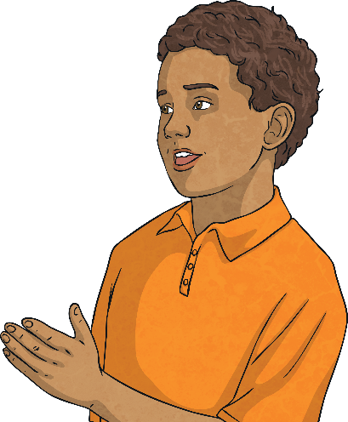
What Is Area?
Deepest
Callum is describing the area of each downstairs room in his house.
There are three rooms downstairs. The dining room has the largest area. The kitchen has the smallest area.
How could you split up the shape below to create a floor
plan that could match Callum’s description?
There are many possibilities. Here is an example answer.
kitchen
dining room
lounge

Slide 9
What Is Area?
Deepest
Maria says that these two shapes could have the same area. Is she correct? Explain how you know.
Yes. Although they are different shapes, they could still cover the same amount of space, which would mean they would have the same area. We can test this by moving the shapes around to see if they take up the same amount of space.

Slide 10


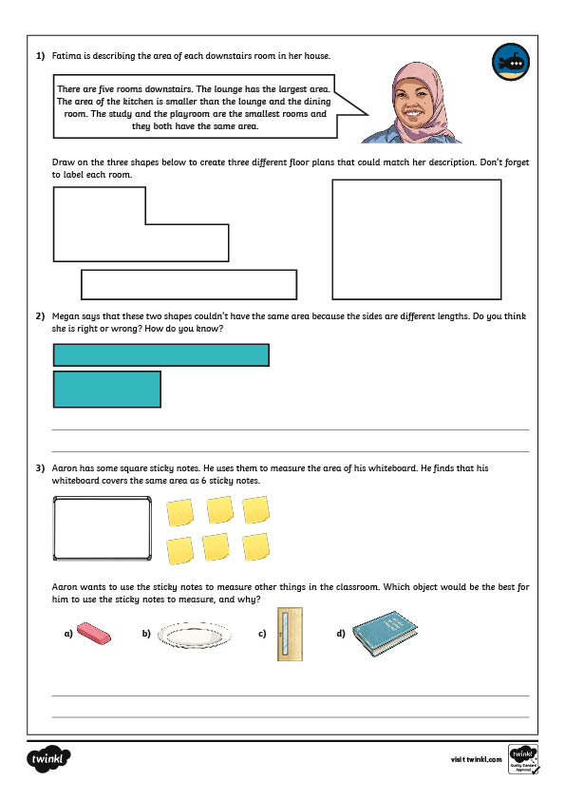
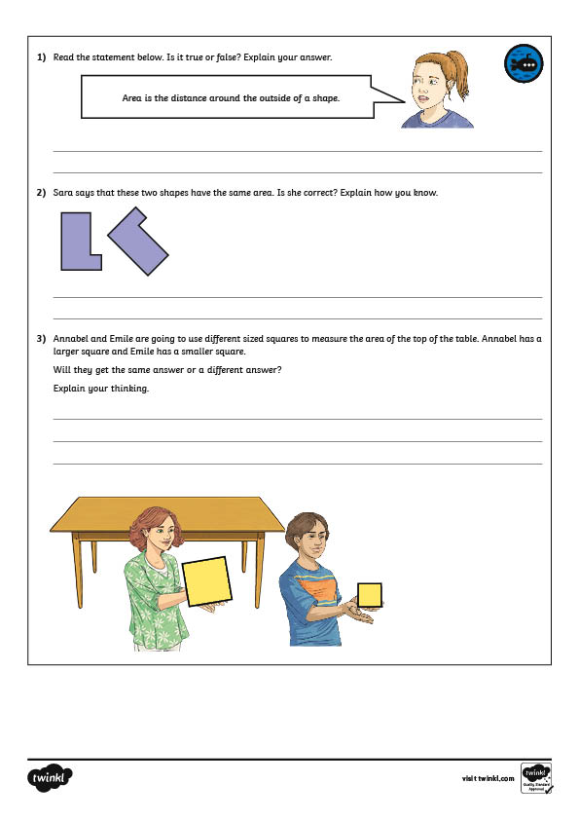
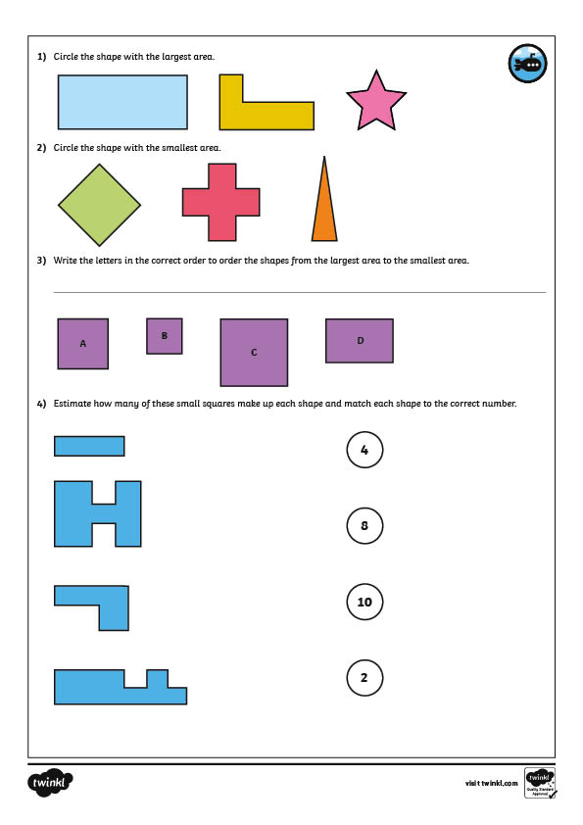

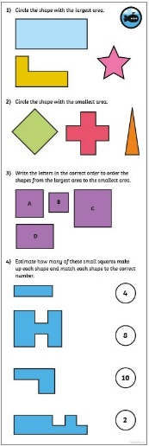
What Is Area?
Dive in by completing your own activity!

