Slide 1


Year 4 – Spring Block 1 – Multiplication and Division
Step 11: Correspondence Problems
© Classroom Secrets Limited 2019

Slide 2
Introduction
Complete the calculations.
 |  |  | Total
2 x 5 = | + | 4 x 3 =
4 x 6 = | + | 3 x 3 =
6 x 2 = | + | 5 x 4 =
8 x 5 = | + | 9 x 1 =
10 x 10 = | + | 2 x 6 =
© Classroom Secrets Limited 2019

Slide 3
Introduction
Complete the calculations.
 |  |  | Total
2 x 5 = 10 | + | 4 x 3 = 12 | 22
4 x 6 = 24 | + | 3 x 3 = 9 | 33
6 x 2 = 12 | + | 5 x 4 = 20 | 32
8 x 5 = 40 | + | 9 x 1 = 9 | 49
10 x 10 = 100 | + | 2 x 6 = 12 | 112
© Classroom Secrets Limited 2019

Slide 4

Varied Fluency 1
One box contains 5 different forks and a variety of shaped spoons. There are 35 possible combinations of forks and spoons.
Circle the number of spoons in the box.
6 |  | 8 |  | 7
© Classroom Secrets Limited 2019

Slide 5
Varied Fluency 1
One box contains 5 different forks and a variety of shaped spoons. There are 35 possible combinations of forks and spoons.
Circle the number of spoons in the box.
6 |  | 8 |  | 7
© Classroom Secrets Limited 2019

Slide 6
Varied Fluency 2
True or false?
There are 18 combinations of cake flavours and toppings. Show your working.
Cake flavour | Toppings
vanilla chocolate | milk chocolate chips white chocolate chips sprinkles sweets strawberries cherry blueberries
© Classroom Secrets Limited 2019

Slide 7
Varied Fluency 2
True or false?
There are 18 combinations of cake flavours and toppings. Show your working.
False, there are 14 combinations (2 x 7 = 14)
Cake flavour | Toppings
vanilla chocolate | milk chocolate chips white chocolate chips sprinkles sweets strawberries cherry blueberries
© Classroom Secrets Limited 2019

Slide 8
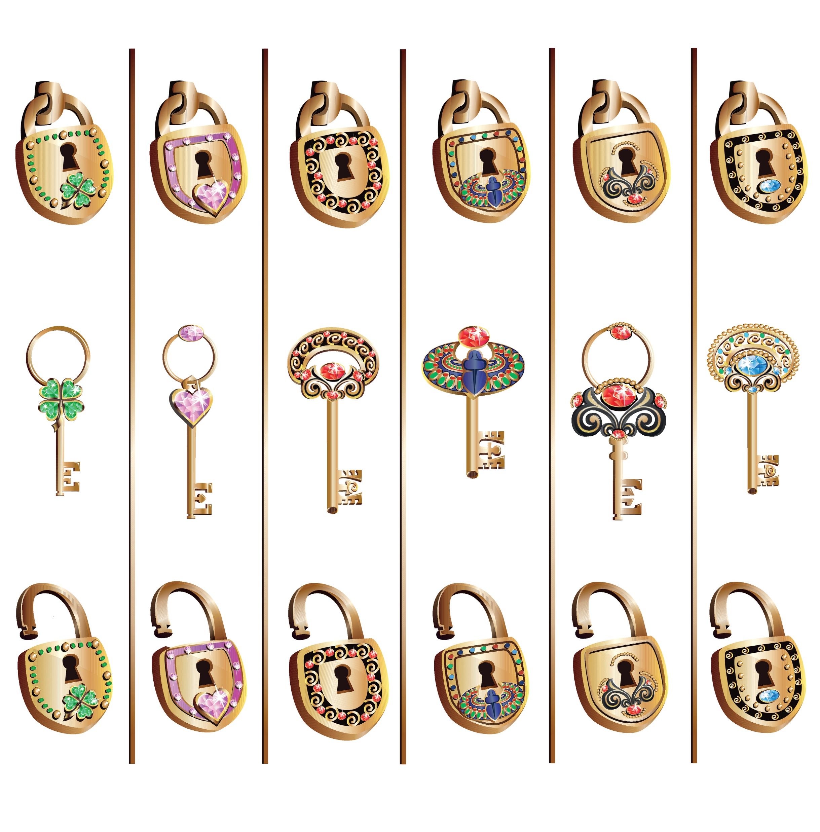
Varied Fluency 3
There are two groups of keys and locks.
How many combinations of lock and key can be made?
Complete the calculation below to show the total number of combinations.
A.
B.
 |  | x |  |  |  | =
© Classroom Secrets Limited 2019

Slide 9
Varied Fluency 3
There are two groups of keys and locks.
How many combinations of lock and key can be made?
Complete the calculation below to show the total number of combinations.
A.
B.
5 |  | x |  | 4 |  | = |  | 20
© Classroom Secrets Limited 2019

Slide 10
Varied Fluency 4
Tick the correct number of possible combinations.
Shelf 1 | Shelf 2
tetra guppy catfish angel fish goldfish blue tang mollies | tetra guppy catfish angel fish neon tetra
28
30
35
© Classroom Secrets Limited 2019

Slide 11
Varied Fluency 4
Tick the correct number of possible combinations.
Shelf 1 | Shelf 2
tetra guppy catfish angel fish goldfish blue tang mollies | tetra guppy catfish angel fish neon tetra
✓
28
30
35
© Classroom Secrets Limited 2019

Slide 12
Reasoning 1
Annie is choosing fruit to make fruit kebabs.
There are 60 combinations of fruits.
How many different fruits could there be on shelf 2 and shelf 3?
Convince me.
Fruit Basket 1 | Fruit basket 2 | Fruit basket 3
apple banana pear mango | ? | ?
© Classroom Secrets Limited 2019

Slide 13
Reasoning 1
Annie is choosing fruit to make fruit kebabs.
There are 60 combinations of fruits.
How many different fruits could there be on shelf 2 and shelf 3?
Convince me.
There could be 3 fruits in basket 2 and 5 fruits in basket 3 because…
Fruit Basket 1 | Fruit basket 2 | Fruit basket 3
apple banana pear mango | ? | ?
© Classroom Secrets Limited 2019

Slide 14
Reasoning 1
Annie is choosing fruit to make fruit kebabs.
There are 60 combinations of fruits.
How many different fruits could there be on shelf 2 and shelf 3?
Convince me.
There could be 3 fruits in basket 2 and 5 fruits in basket 3 because
4 x 3 x 5 = 60
Fruit Basket 1 | Fruit basket 2 | Fruit basket 3
apple banana pear mango | ? | ?
© Classroom Secrets Limited 2019

Slide 15
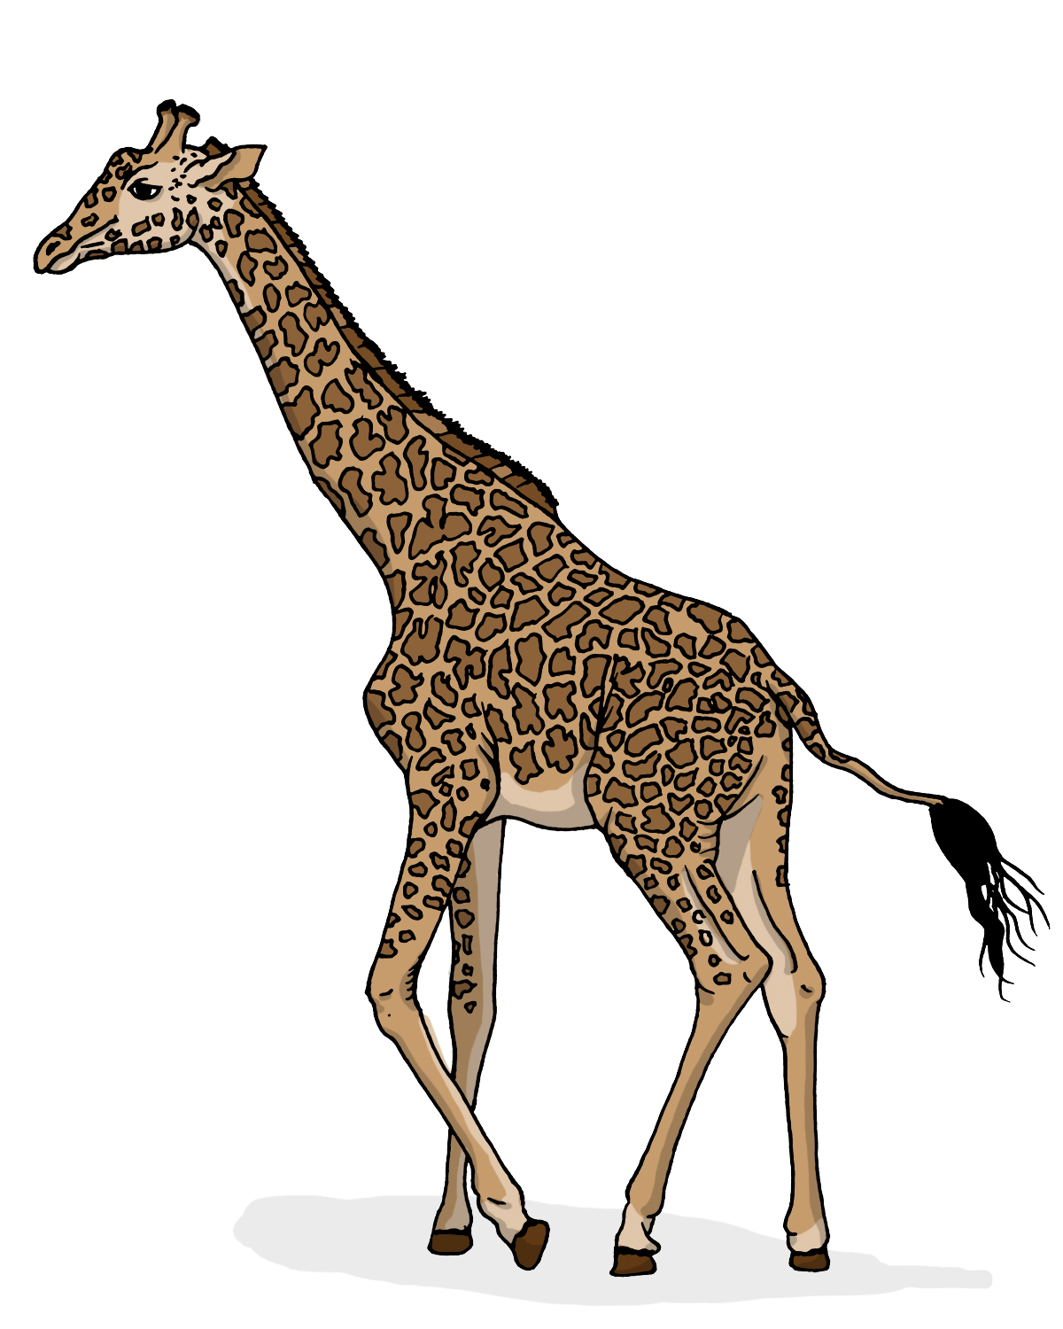
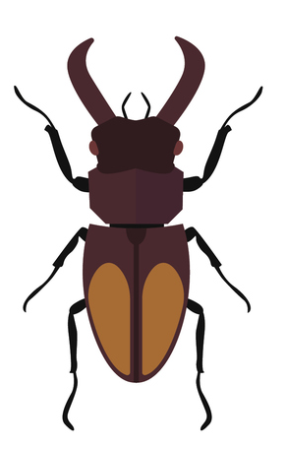
Problem Solving 1
There are 100 legs in total. This is made up of beetles and giraffes.
What combination of beetles and giraffes could there be?
Find 2 possibilities.
© Classroom Secrets Limited 2019

Slide 16
Problem Solving 1
There are 100 legs in total. This is made up of beetles and giraffes.
What combination of beetles and giraffes could there be?
Find 2 possibilities.
Various answers, for example:
10 beetles and 10 giraffes (10 x 6 + 10 x 4 = 100)
8 beetles and 13 giraffes (8 x 6 + 13 x 4 = 100)
© Classroom Secrets Limited 2019

Slide 17


Reasoning 2
Steve and Vanessa are looking at types of fish in 2 aquariums. There are a total of 36 different combinations of fish.
Who is correct? Prove it.
I think there are 9 fish in aquarium A and 3 fish in aquarium B.
Steve
I think there are 6 fish in aquarium A and 6 fish in aquarium B.
Vanessa
© Classroom Secrets Limited 2019

Slide 18
Reasoning 2
Steve and Vanessa are looking at types of fish in 2 aquariums. There are a total of 36 different combinations of fish.
Who is correct? Prove it.
Vanessa is correct because…
I think there are 9 fish in aquarium A and 3 fish in aquarium B.
Steve
I think there are 6 fish in aquarium A and 6 fish in aquarium B.
Vanessa
© Classroom Secrets Limited 2019

Slide 19
Reasoning 2
Steve and Vanessa are looking at types of fish in 2 aquariums. There are a total of 36 different combinations of fish.
Who is correct? Prove it.
Vanessa is correct because 6 x 6 = 36 combinations. Steve is wrong because 9 x 3 = 27 combinations.
I think there are 9 fish in aquarium A and 3 fish in aquarium B.
Steve
I think there are 6 fish in aquarium A and 6 fish in aquarium B.
Vanessa
© Classroom Secrets Limited 2019

