Slide 2
Aim
Solve problems involving multiplying and adding, including using the distributive law to multiply two-digit numbers by one-digit, integer scaling problems and harder correspondence problems such as n objects are connected to m objects.

Slide 3



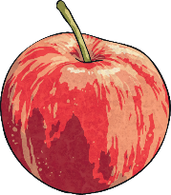
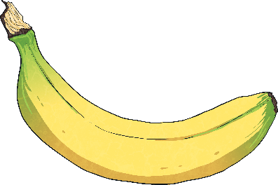
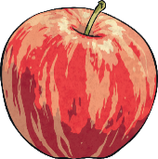


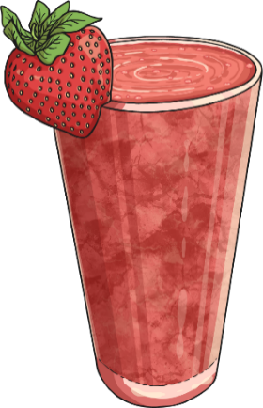
Correspondence Problems
Diving
Orange Juice
Ellie is choosing one piece of fruit and one kind of juice to make a fruit smoothie.
List all the different possible combinations of fruit and juice that she could choose.
Can you use a code to help you – for example, BP meaning banana and pineapple?
Pineapple Juice
Apple
Banana
Strawberry
BP
(banana and pineapple)
AP
(apple and pineapple)
SP
(strawberry and pineapple)
BO
(banana and orange)
AO
(apple and orange)
SO
(strawberry and orange)
Complete the multiplication calculation to represent the possible combinations.
× =
3
2
6
There are different combinations.
6

Slide 4







Correspondence Problems
Diving
Anwar has some different number shapes.
He sorts them into odd and even.
Odd | Even
He chooses one number shape from each group. One combination Anwar could choose is 5 and 4.
There are 6 different combinations: 1 and 4, 1 and 6, 1 and 10, 5 and 4, 5 and 6, 5 and 10
List the different combinations of number shapes that he could choose.
If he chose 5 and 4, it would make a total of 9.
What are all the possible different totals that Anwar could make?
5, 7, 9, 11, 15

Slide 5
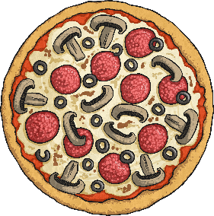
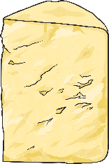
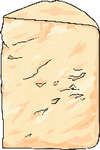
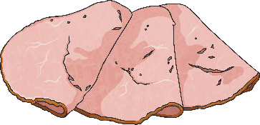

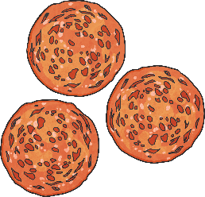
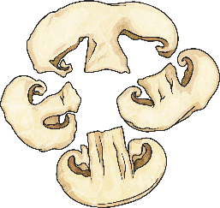
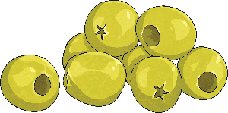
Correspondence Problems
Deeper
Pippa is making a pizza. She needs to choose the size, the type of cheese and the topping.
Pizza Size | Type of Cheese | Toppings
Pepperoni
Ham
Large
Small
Dairy
Vegan
Mushrooms
Olives
Write a multiplication calculation to represent the possible combinations.
2
× × =
2
4
16
If there were 21 different possible pizzas, how many different sizes, types of cheese and toppings could there be?
1
× × =
3
7
21

Slide 6
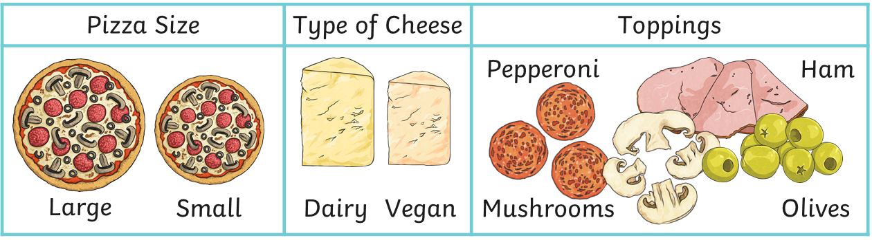
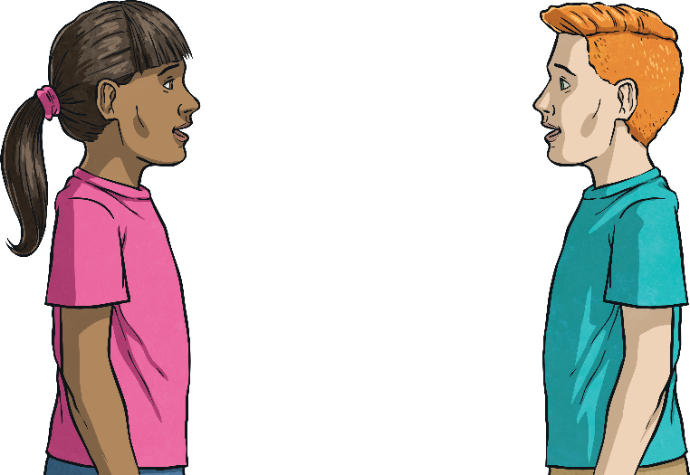
Correspondence Problems
Deeper
Taj and Imogen want to find how many different possible pizzas they could make.
Can you explain the mistake that one of them has made?
Imogen
Taj
You can calculate 2 x 2 x 4 to find the answer.
If you find
two lots of four,
that will give you the answer.
Taj has made a mistake. Two lots of four would be 2 × 4, which is only multiplying two of the groups together. To multiply all three groups, he should have said two lots of two, then multiplied by four.

Slide 7

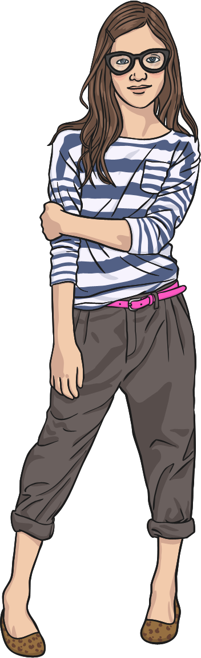
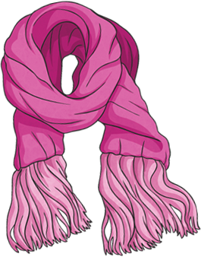
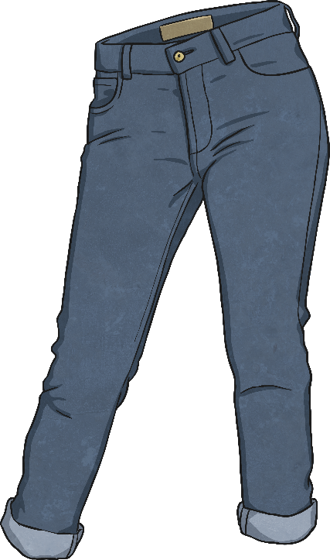
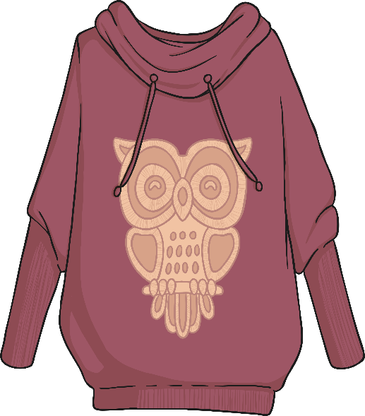
Correspondence Problems
Deepest
Lucy has some scarves, some tops and some pairs of trousers. She can make 12 different outfits.
How many scarves, tops and pairs of trousers could she have?
Any three numbers that multiply together to make 12 will be correct. For example:
2 scarves, 2 tops and 3 pairs of trousers
1 scarf, 6 tops and 2 pairs of trousers

Slide 8


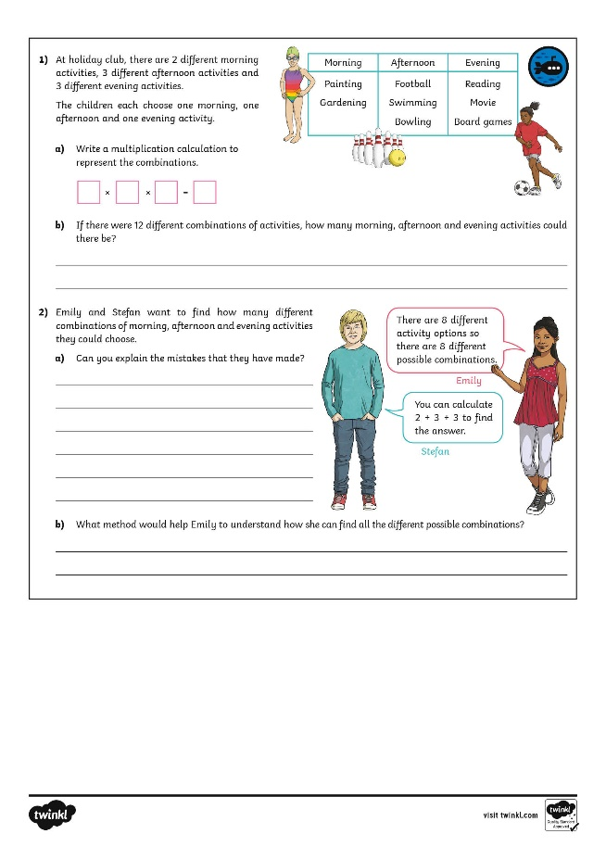
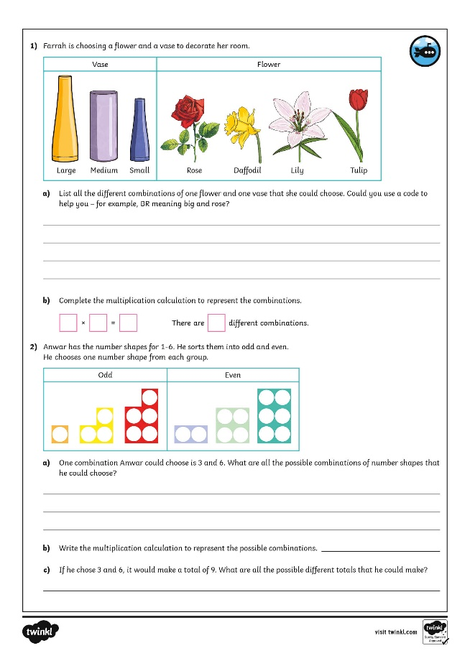

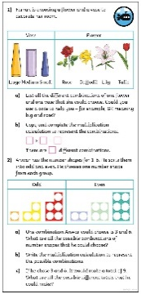
Correspondence Problems
Dive in by completing your own activity!

