Slide 1
USA – New York, New York

Slide 2
Lesson 1

Slide 3
LO: To investigate and describe a location in North America.

Slide 4
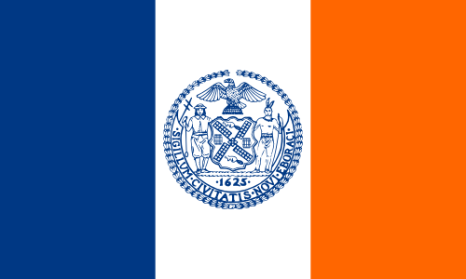
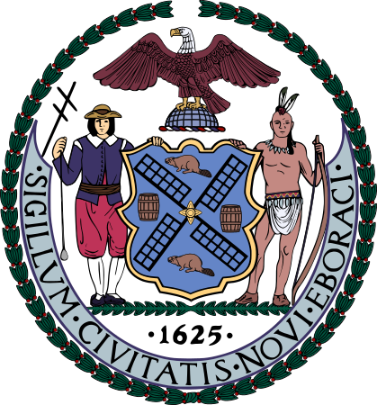
What do you know about New York?

Slide 5
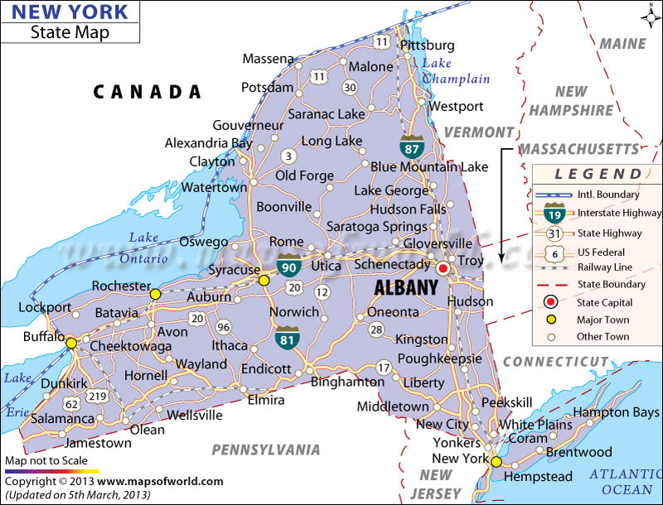
Map of New York state showing just new York city

Slide 6
What is the difference between New York State and New York City?

Slide 7
Video – Expedia Guide to New York
https://www.youtube.com/watch?v=MtCMtC50gwY

Slide 8
New York Facts
Most populous city in the USA: over 8 million people live there!
First founded by Dutch settlers in the 1600s.
Name given due to King Charles II of England gifting the land to his brother, the Duke of York.
Is actually 5 cities that were merged together in 1898.
What most of us think of as ‘New York’ is really just Lower Manhattan.

Slide 9
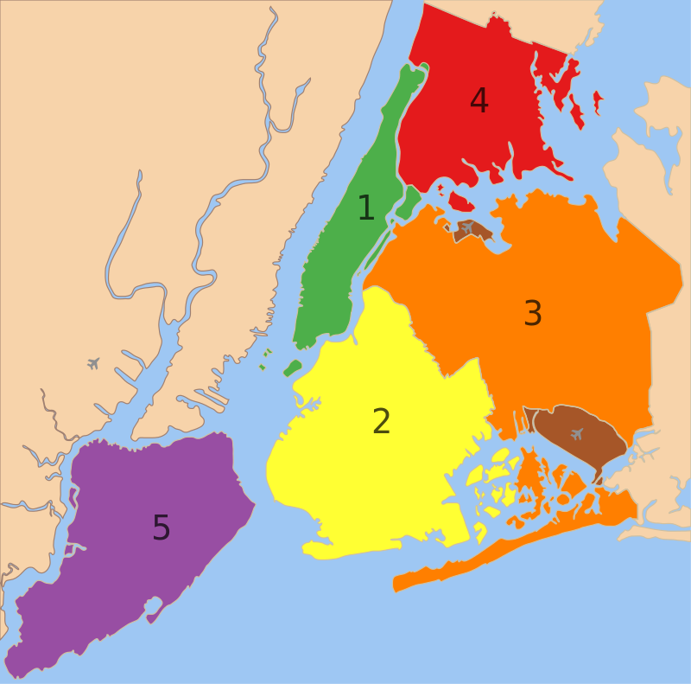
New York – A City of 5 Boroughs
Manhattan
The Bronx
Brooklyn
Queens
Staten Island
These break down into hundreds of distinct neighbourhoods

Slide 10
Task
Using Google Street View, go and visit a famous New York City landmark.
Think about:
  A description of the area – open spaces or lots of tower blocks? Lots of people or very few?
  If you would or would not like to visit this place in real life and why.

Slide 11
New York Landmarks
Empire State Building
Grand Central Terminal (look at the ceiling…)
Statue of Liberty
Metropolitan Museum of Art
Brooklyn Bridge
The High Line Park
Intrepid Sea, Air and Land Museum

Slide 12
What do you know about Manhattan?
How is it different from the rest of New York?

Slide 13
New York – A City of 5 Cities
Manhattan
The Bronx
Brooklyn
Queens
Staten Island
These break down into hundreds of distinct neighbourhoods

Slide 14
Manhattan
Often described as a the cultural and financial capital of the world.
Home of the United Nations.
Commissioners' Plan of 1811: planned out the then little populated Manhattan into a ‘gridiron’ system of rectangles that cover an area of about 1 square mile. Many blocks are slightly different sizes however.
Created through interlocking ‘Streets’ and ‘Avenues’.

Slide 15
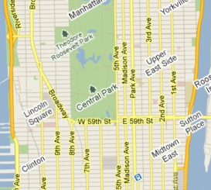
Manhattan: Streets and Avenues
Avenues take people North/South. 1st Avenue is on the eastern side of Manhattan.
Streets run East/West, with numbers starting at the southern tip of the peninsular.

Slide 16
Manhattan: Streets and Avenues
Some streets and avenues have been named, removing their number.
1st Avn, 2nd Avn, 3rd Avn, Park Avn, Madison Avn, 5th Avn…

Slide 17
The three main parts – Upper, Mid and Lower
Upper Manhattan – all of the streets numbered above 96th Street. Upper Manhattan continues a long way into mainland New York State (up to 231st Stree)
Midtown – 34th to 96th Street
Lower Manhattan – Below 34th Street
Uptown – 59th to 96th Street
Downtown – Below 14th Street

Slide 18
East and West side
5th Avenue is the marker from which East and West is judged.

Slide 19
Manhattan is one of the most densely populated places on earth
With its history of immigration, many different neighbourhoods have grown up around ethnic and economic lines.

Slide 20
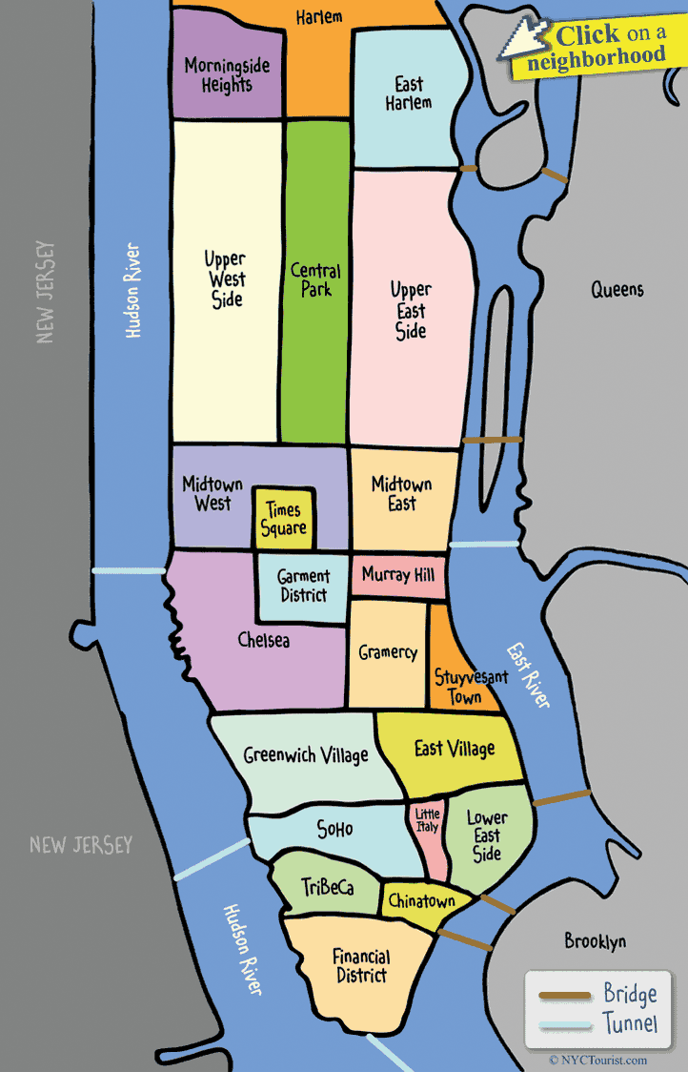

Slide 21
Upper Manhattan
Mainly residential with few tourist attractions.
Many poorer neighbourhoods with ‘Project’ or social housing.
Used to have a majority African-American population.

Slide 22
Midtown
Contains most of the skyscrapers and icon buildings such as Empire State.
Home of Broadway.
One of the largest commercial, entertainment and media areas in the world.

Slide 23
Lower Manhattan
Home to many immigrant communities.
Home to the Financial District – the most important finance centre in the world.
Home to many different banks and sky scrapers.

