Slide 2

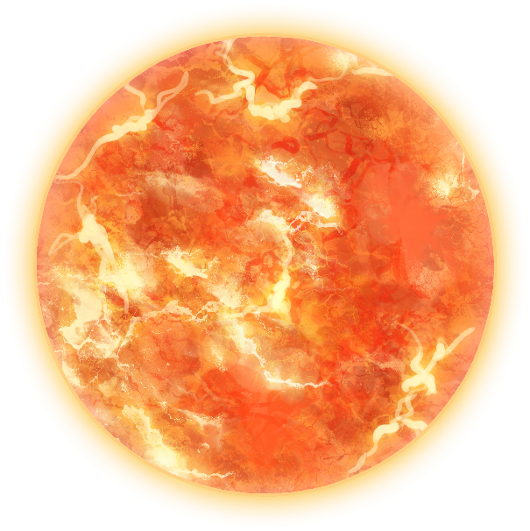
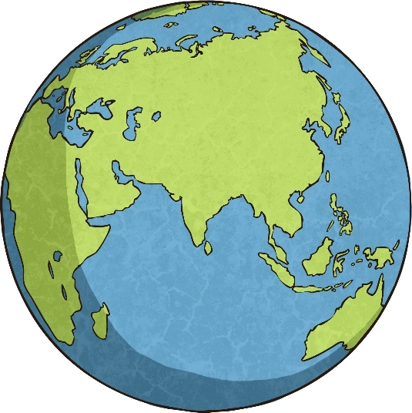
What Do These Words Mean?
The prefix ‘geo’ means to do with Earth.
So ‘geocentric’ means Earth is at the centre.
The prefix ‘helio’ means to do with the Sun.
So ‘heliocentric’ means the Sun is at the centre.

Slide 3
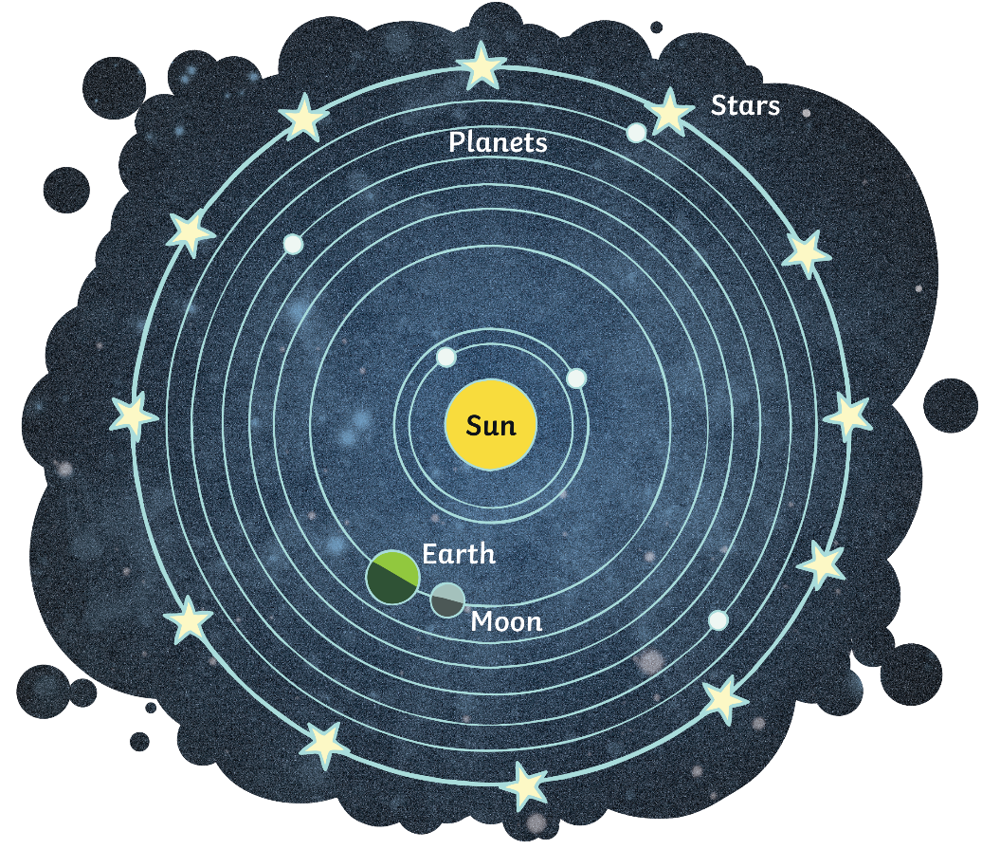
Geocentric Beliefs
Up until the 1500s, people believed that Earth was central to everything and the Moon, Sun and other planets revolved around Earth.
This was before all the scientific and technological evidence that we have today.
You can imagine just how people thought this was the case as from where we stand on Earth, it does look like the Moon and Sun go around us.

Slide 4
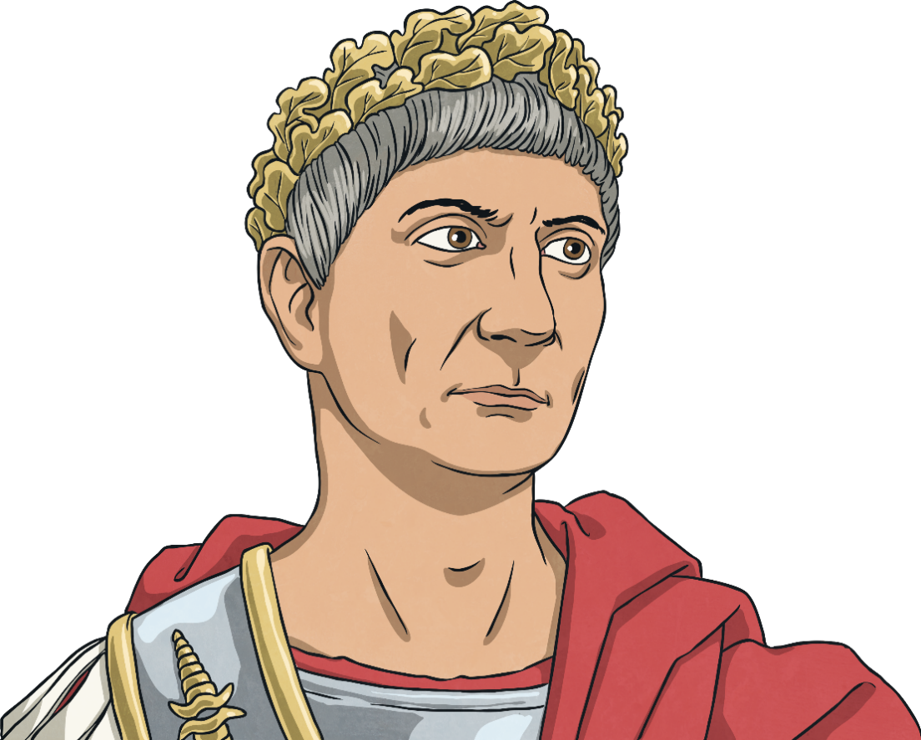
Ancient Civilisations
Romans and Greeks knew about planets you could see without a telescope (Mercury, Venus, Mars, Jupiter and Saturn). They could also see the Sun and Moon from Earth.
This led them to believe that Earth was the centre of all these things.
They thought that this was so important that they named
the days of the week after the planets and the gods
associated with these planets:
Monday – The Moon
Tuesday – Mars (Mardi in French)
Wednesday – Mercury (Mercredi in French)
Thursday – Jupiter (Jeudi in French)
Friday – Venus (Vendredi in French)
Saturday – Saturn
Sunday – The Sun
Why not research the names of Roman and Greek gods
and see where they fit in with days of the week and the
planets? In English, some days were named after the Norse
gods rather than Roman or Greek. Which day do you think
belongs to Thor?

Slide 5
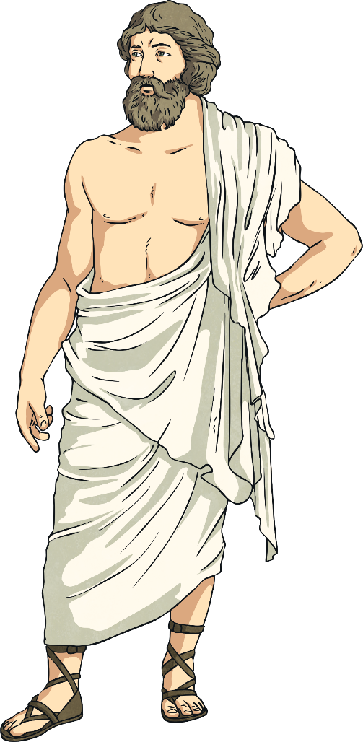
The First Speculators
Aristarchus of Samos (an ancient Greek astronomer) is believed to be the first person to say out loud that Earth wasn’t the centre of everything and that it was actually the Sun.
This was way back in around 300 BC.
Even before this, philosophers Philolaus and then Hicetas had thought that Earth was moving around some kind of ‘central
fire’.
As far as anyone can tell, no one really took the idea much further at the time and the theory wasn’t developed until
many centuries later.

Slide 6

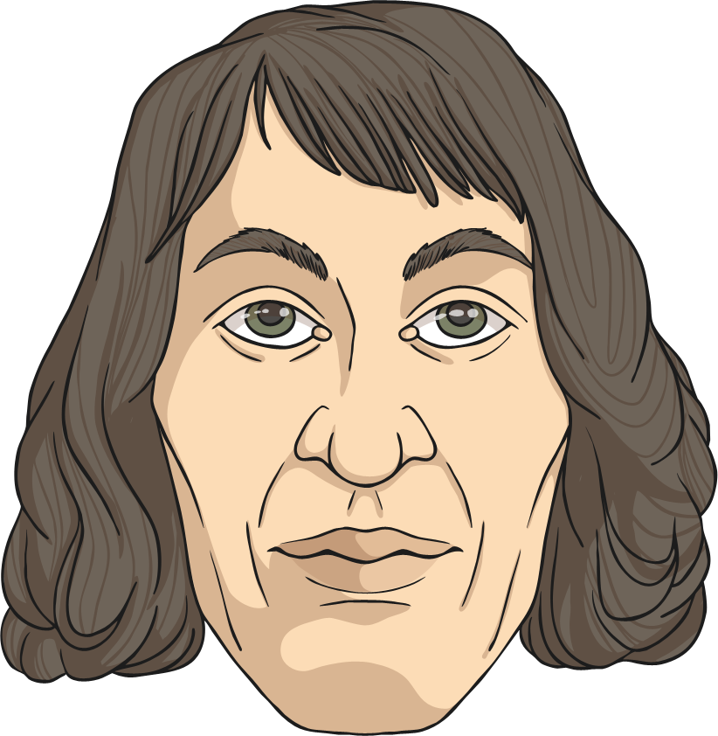
Nicolaus Copernicus 1473-1543
Born in Poland on 19th February 1473, he was a mathematician, artist, translator and most importantly in this case, he was an astronomer.
He wrote what is known as one of the most
important astronomy books of all time.
published in 1542: De revolutionibus
Orbium Coelestium
(Roughly translated as On the revolutions
of heavenly/celestial bodies/spheres)
The book talked about his idea that Earth
rotates on its axis and takes a year to orbit
the Sun. He also talked about other planets
also orbiting the Sun. This is known as the
Heliocentric Theory.
He did study astronomy at college but decided
to concentrate on law and medicine, keeping
up with astronomy as a hobby.
He worked alongside another famous
astronomer and started developing his
theory of a solar system where planets
orbited Sun.

Slide 7

The Heliocentric Theory
This theory was that the Sun is the centre of the Solar System and Earth, along with the other planets, orbit the Sun.
Famous scientists Galileo and Johannes Kepler built on the theory Copernicus had developed even though the theory had been condemned by others.

Slide 8
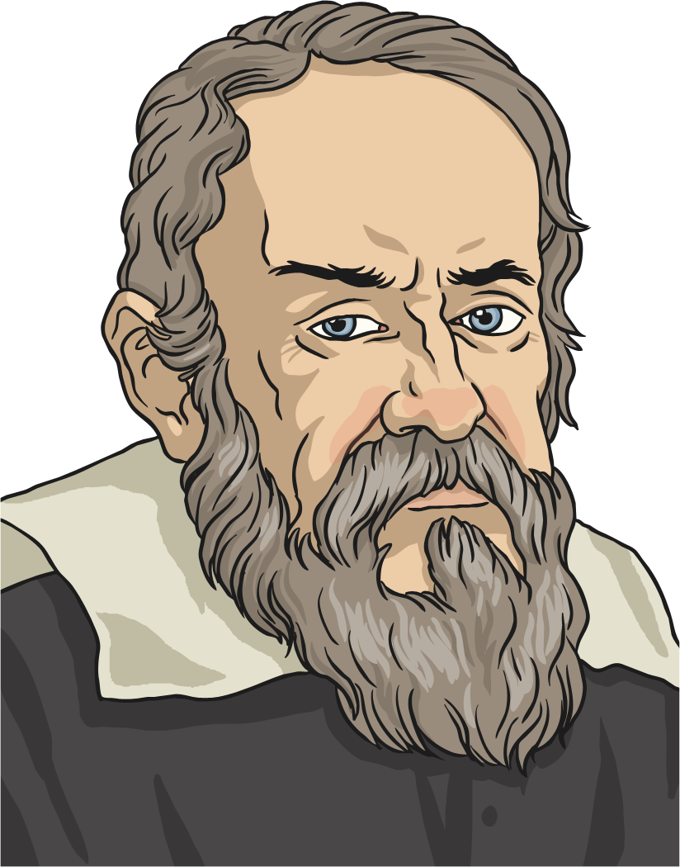
How Did People Take It?
Not well… well some people didn’t.
Galileo (1564–1642) built on the work of Copernicus, finding more evidence using a telescope, but the Catholic Church decided that the heliocentric theory was against their beliefs and Galileo was put on trial. He was eventually put under house arrest where he remained until
his death.
During his life, he did continue to work on his theory and published books and evidence gaining more and more support from others.

Slide 9
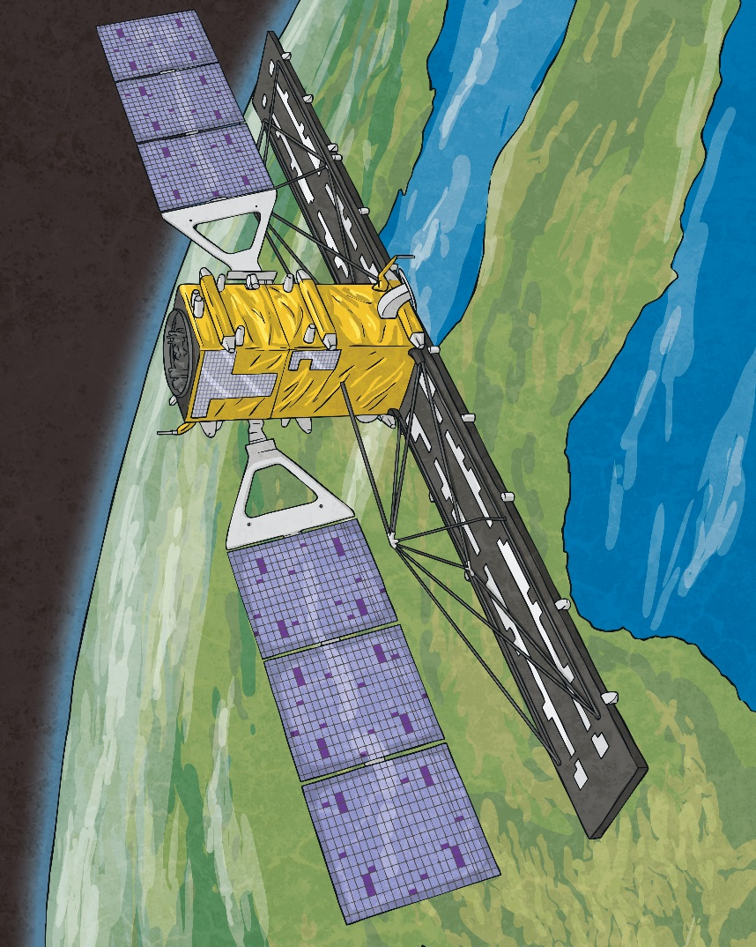
And Now?
The latest technologies now enable us to see much more of space and gain more and more details of evidence to support theories.
Scientists and astronomers are still discovering new things in the cosmos and will continue to do so as long as humans have an enquiring mind.
Where would we be now if people like
Galileo and Copernicus didn’t ask questions
and ‘wonder’ things?
What are you inquisitive about?

