Slide 2



Diving into Mastery Guidance for Educators
Each activity sheet is split into three sections, diving, deeper and deepest, which are represented by the following icons:
These carefully designed activities take your children through a learning journey, initially ensuring they are fluent with the key concept being taught; then applying this to a range of reasoning and problem-solving activities.
These sheets might not necessarily be used in a linear way. Some children might begin at the ‘Deeper’ section and in fact, others may ‘dive straight in’ to the ‘Deepest’ section if they have already mastered the skill and are applying this to show their depth of understanding.
Diving
Deeper
Deepest

Slide 3
Aim
Pupils practise to become fluent in the formal written method
of short multiplication and short division with exact answers
(non-statutory).

Slide 4
Divide 2 Digits by 1 Digit (1)
Diving
Complete this calculation.
66 ÷ 3 = 156
22
10
10
10
10
10
10
1
1
1
1
1
1
Place Value Counters
Part-Whole Model
T | O
22
66 ÷ 3 =
10
10
1
1
10
10
1
1
6 ÷ 3 =
60 ÷ 3 =
2
10
10
1
1
20

Slide 5
Divide 2 Digits by 1 Digit (1)
Diving
Complete this calculation.
13
52 ÷ 4 =156
Place Value Counters
Part-Whole Model
T | O
52 ÷ 4 =
13
10
1
1
1
10
1
1
1
10
1
1
1
40 ÷ 4 =
10
12 ÷ 4 =
3
10
1
1
1
1
1
1
1
1
1
1
1
10
10
1
1

Slide 6
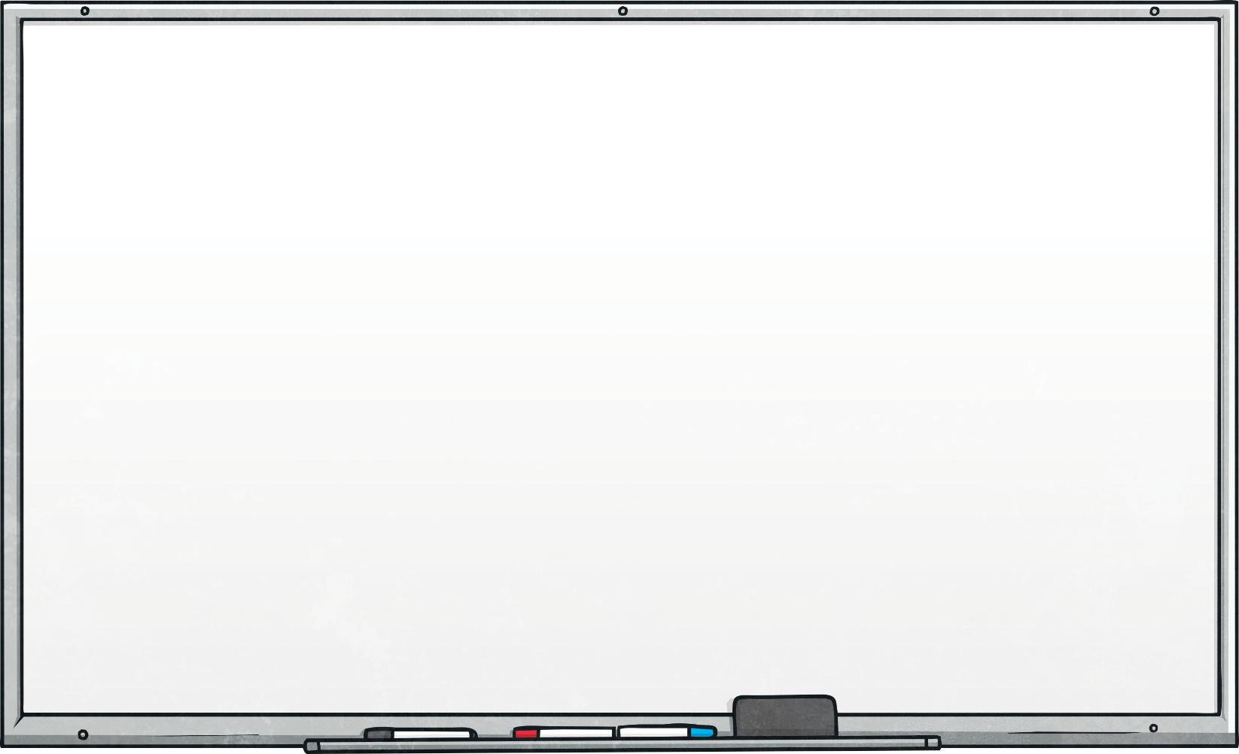
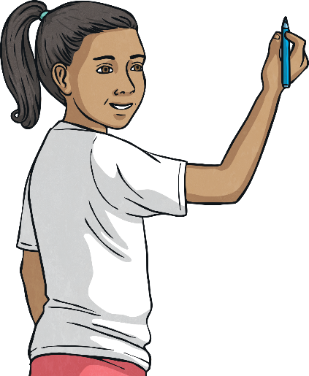
Divide 2 Digits by 1 Digit (1)
Diving
Use the part-whole models to find the missing numbers.
÷ 4 = 18
84 ÷ = 14
72
6
60 ÷ = 10
÷ 6 = 4
÷ 4 = 10
32 ÷ 4 =
6
24
40
8

Slide 7
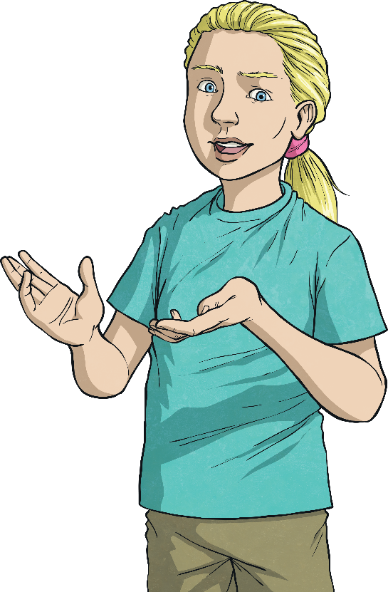
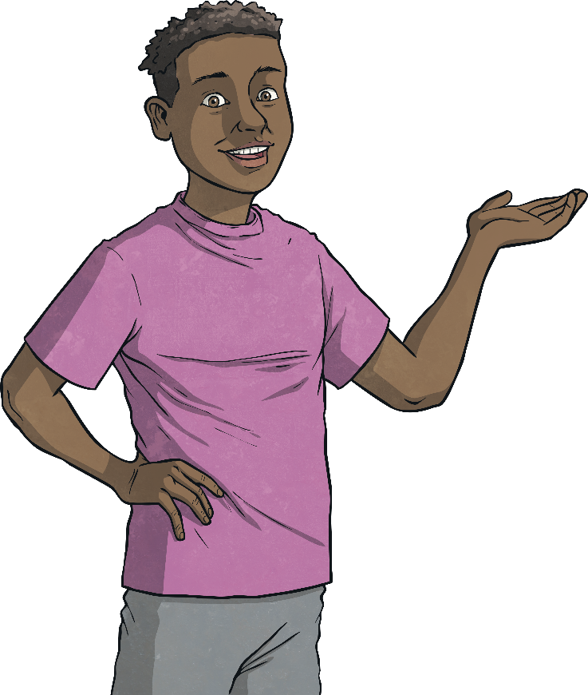
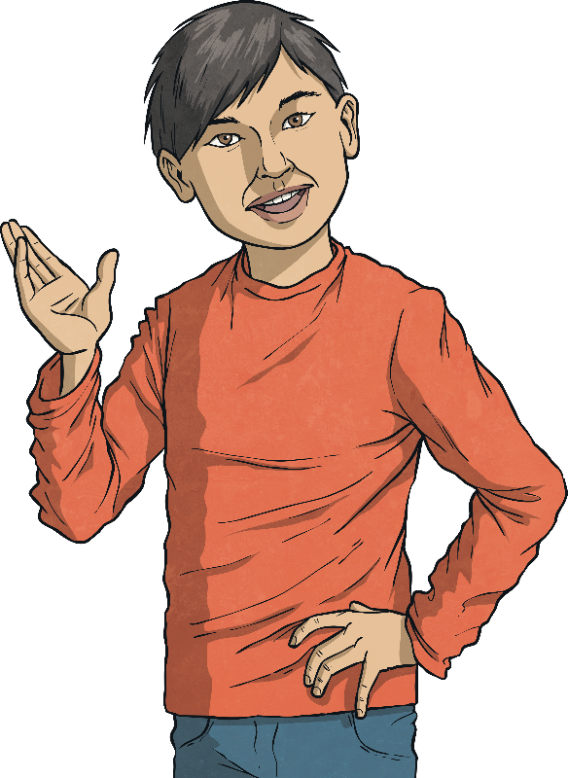


Divide 2 Digits by 1 Digit (1)
Diving
Solve this word problem.
Becky, Jack and Seb are sharing the 54 marbles equally. How many marbles will they each get?
54 ÷ 3 = 18

Slide 8
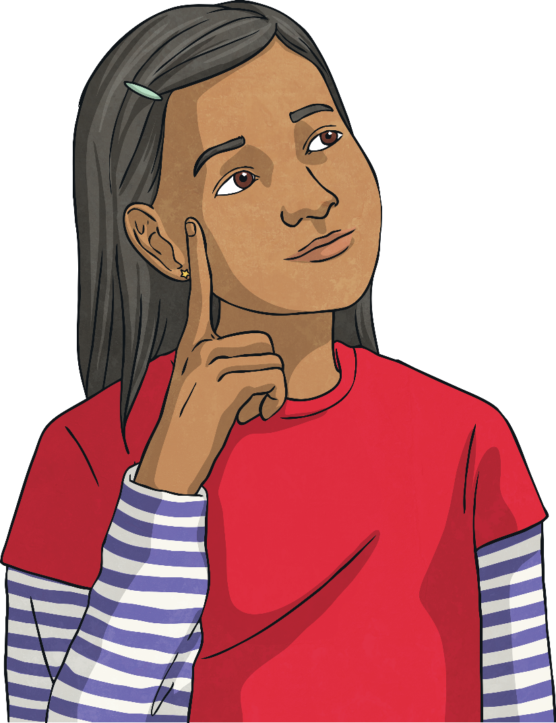
Divide 2 Digits by 1 Digit (1)
Diving
Read the statement below. Is it true or false? Explain your answer.
If I divide a whole number by another whole number, my answer will always be smaller than the number
I started with.
True. This is because you are sharing out the whole into equal parts to find the value of one of the parts. For example, 6 divided by 3 equals 2.
I started with 6 and now I have 2. 2 is smaller than 6.

Slide 9

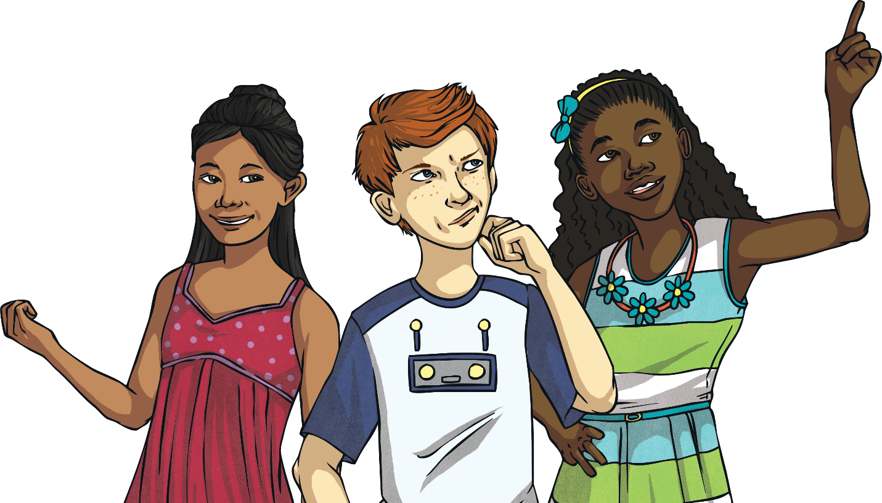
Divide 2 Digits by 1 Digit (1)
Deeper
Which is the odd one out and why?
A
B
C
78 ÷ 6 = 13 | 99 ÷ 3 = 33 | 88 ÷ 2 = 42
C is the odd one out because the answer to the calculation is incorrect. The answer should be 44.

Slide 10
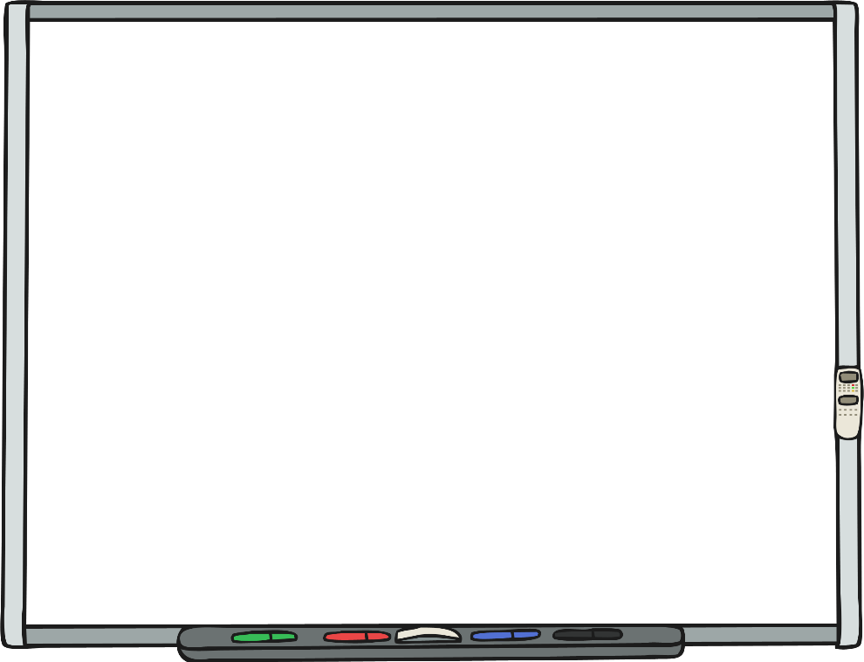
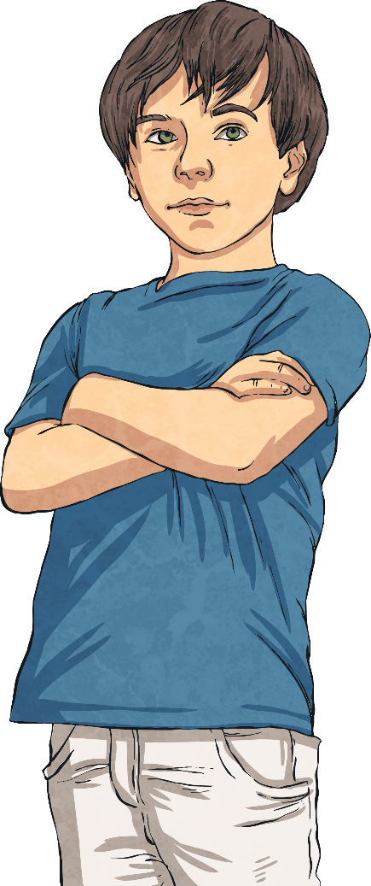
Divide 2 Digits by 1 Digit (1)
Deeper
Identify, correct and explain
the mistake Lyle has made.
56 ÷ 2 = 25
T | O
10
10
1
1
1
1
1
10
10
1
1
1
1
1
10
Lyle has not exchanged correctly. He has made the existing ones total of 6 up to 10, rather than adding an additional 10 counters to the amount that is already there to make 16 ones. The answer should be 28.

Slide 11



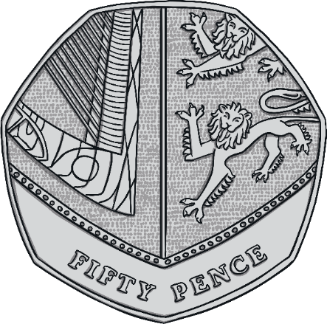
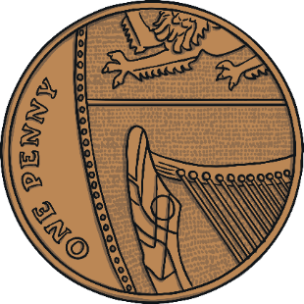
Divide 2 Digits by 1 Digit (1)
Deepest
Count the money. How many ways could you share this amount so that nothing was left over? Find all possibilities and record your calculations
52p ÷ 1 = 52p
52p ÷ 2 = 26p
52p ÷ 4 = 13p
52 ÷ 13 = 4p
52 ÷ 26 = 2p
52 ÷ 52 = 1p

Slide 12
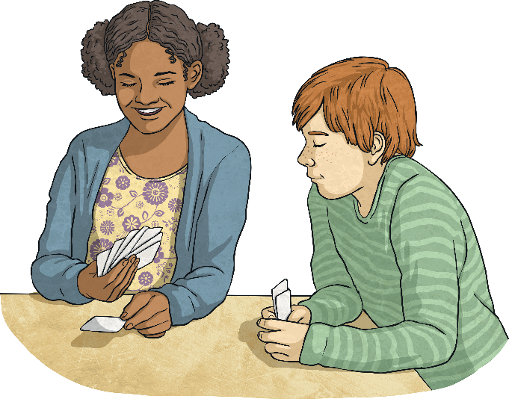
Divide 2 Digits by 1 Digit (1)
Deepest
Using the digit cards below, complete the number statements. Each digit card may only be used once per solution. Find 5 possible solutions.
0
1
2
3
4
5
__ ÷ _ > __ ÷ _
There are many possible answers. Here are some examples.
45 ÷ 3 > 10 ÷ 2
54 ÷ 3 > 10 ÷ 2
34 ÷ 1 > 50 ÷ 2
35 ÷ 1 > 40 ÷ 2
40 ÷ 2 > 51 ÷ 3
40 ÷ 2 > 15 ÷ 3

Slide 13


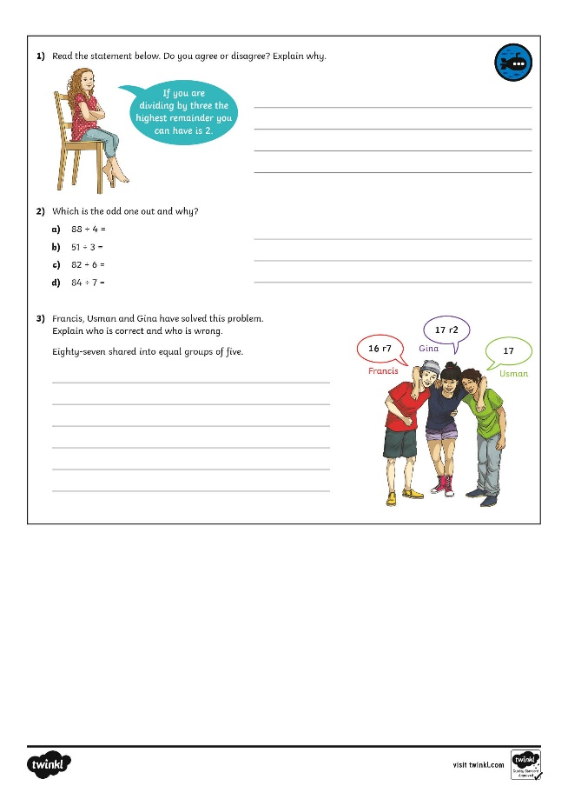
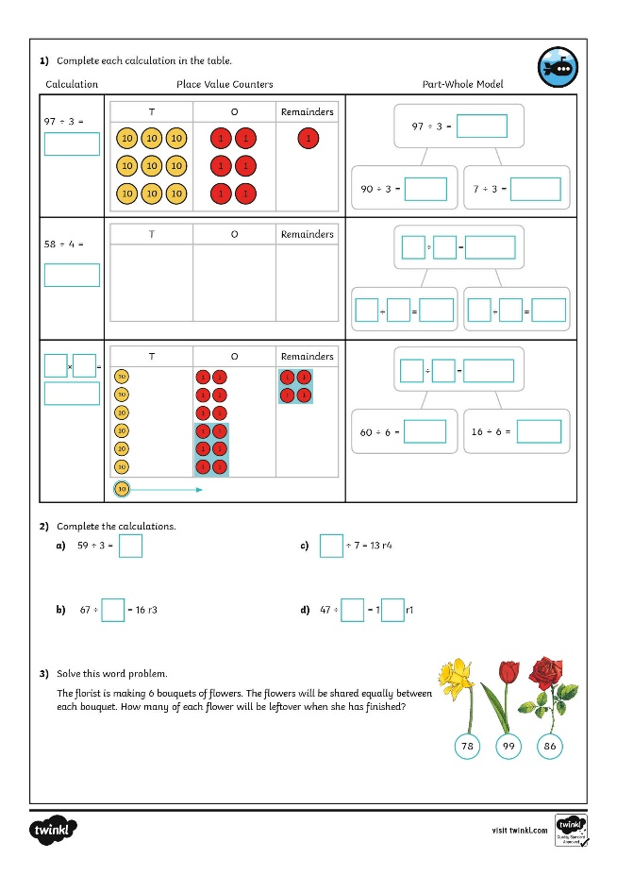
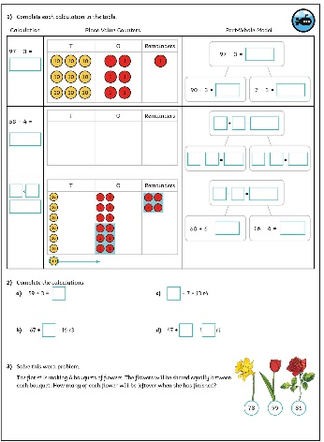
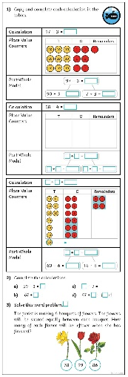
Divide 2 Digits by 1 Digit (1)
Dive in by completing your own activity!

Slide 14
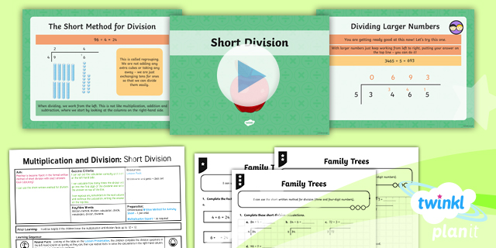
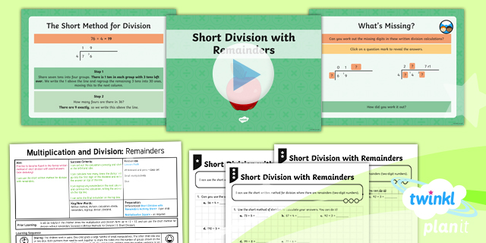

Need Planning to Complement this Resource?
National Curriculum Aim
Pupils practise to become fluent in the formal written method
of short multiplication and short division with exact answers
(non-statutory).
For more planning resources to support this aim, click here.
Twinkl PlanIt is our award-winning scheme of work
with over 4000 resources.

