Slide 1


Science
Seasonal Changes (Autumn and Winter)
Year One
Science | Year 1 | Seasonal Changes (Autumn and Winter) | Seasonal Weather (Winter) | Lesson 5

Slide 2


Slide 3
Aim
I can observe and describe the weather in winter.
I can collect and record data about the weather in winter.
Success Criteria
I can watch the weather carefully.
I can describe the weather in winter.
I can collect data about the weather, temperature, rainfall and wind direction.
I can write and draw the data I have collected.

Slide 4
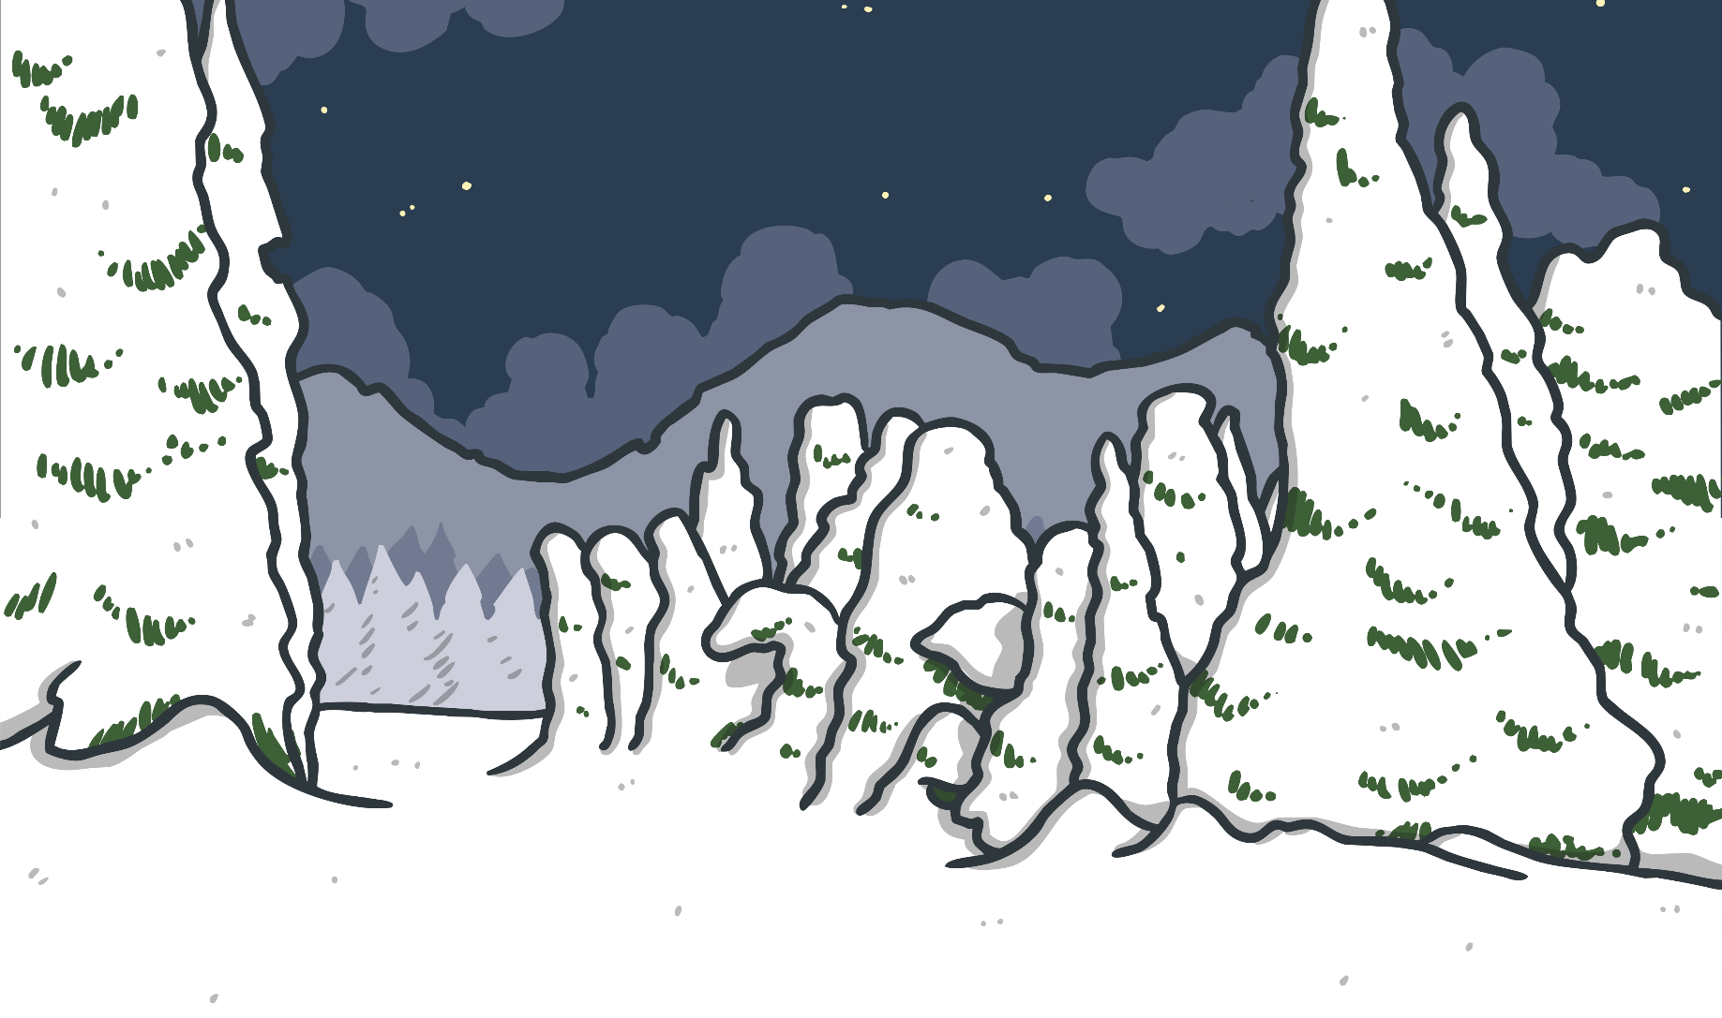
Winter
Think about winter with your partner. See if you can answer these questions:
What happens in winter?
What’s the weather like?
What do you wear in winter?
What do you eat in winter?
What do you see in winter?
Have you ever seen snow?
Have you ever played in the snow? What was it like? How did it feel?

Slide 5
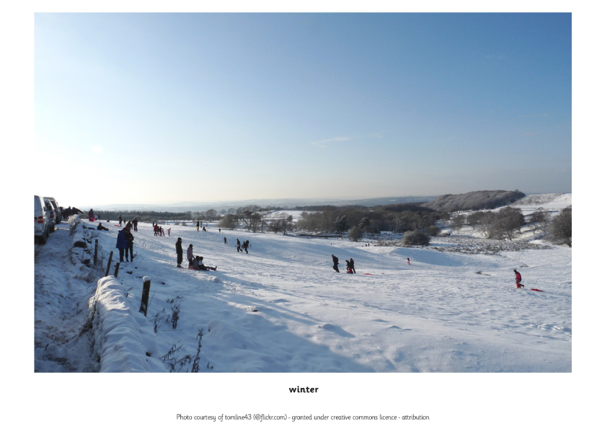
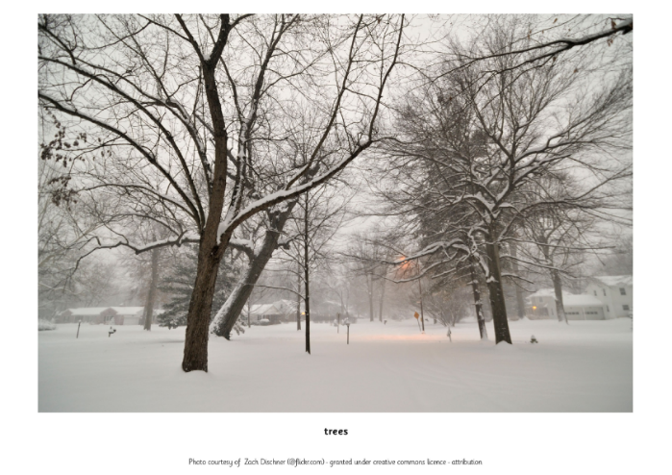
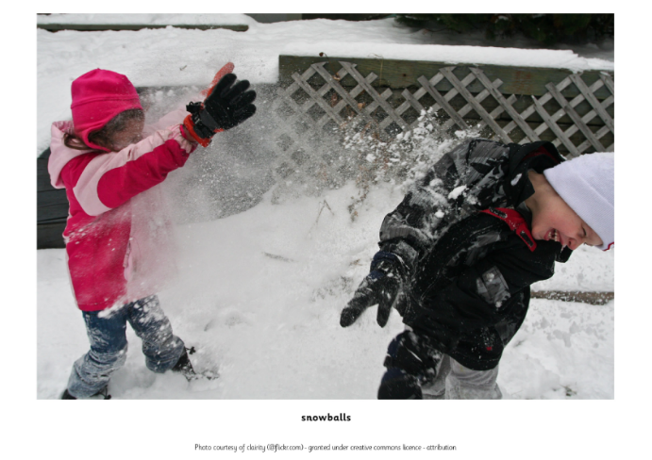
Winter Photos
Look at the Winter Photos and think about these questions:
Does it always snow in the United Kingdom in winter?
Does it have to snow to be winter?

Slide 6

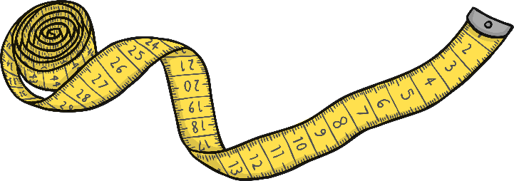



Measuring the Weather
Can you remember how we are measuring the weather?
How are we measuring the temperature?
What equipment are we using?
What units are we measuring in?
How are we measuring the rainfall?
What equipment are we using?
What units are we measuring in?
How are we measuring the wind direction?
What equipment are we using?
What units are we measuring in?

Slide 7

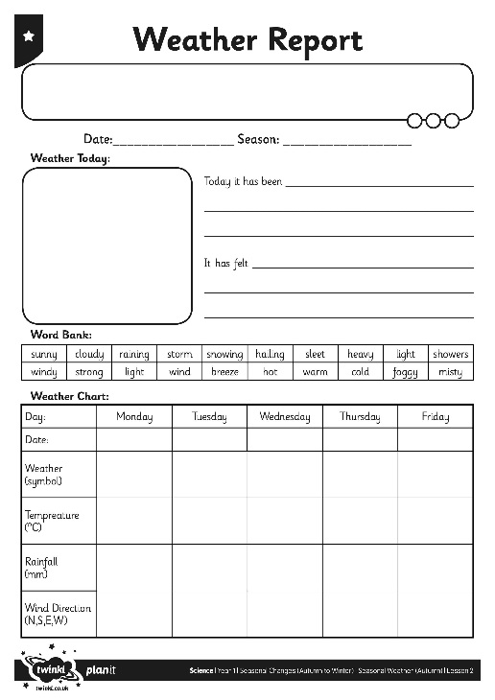
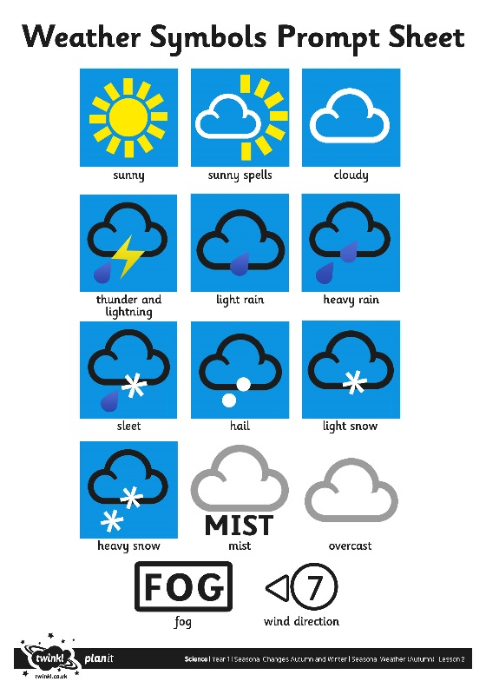
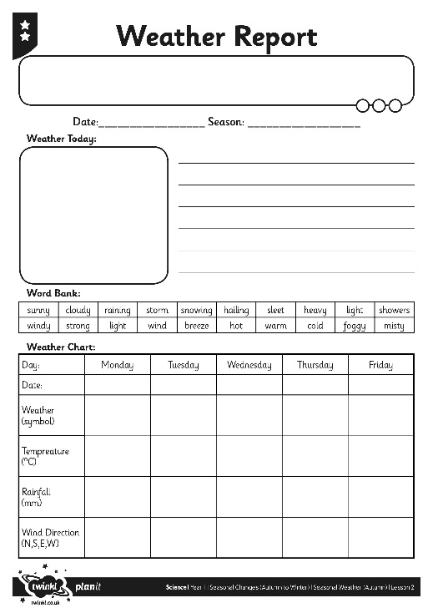
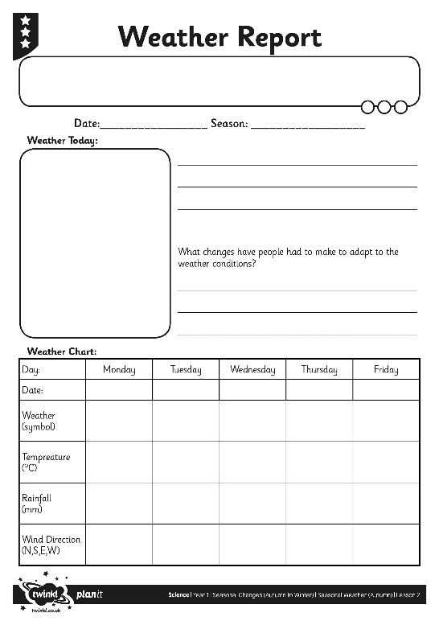
Weather Report

Slide 8

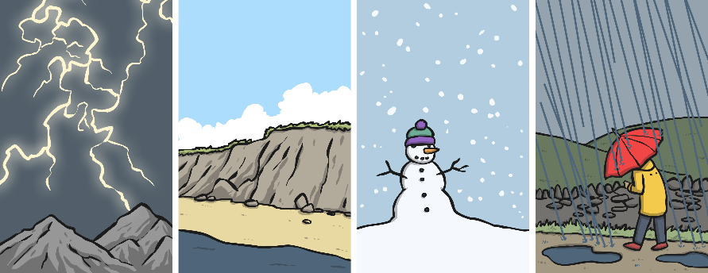
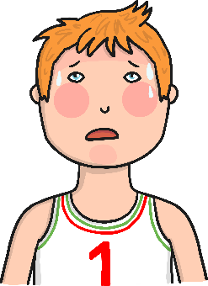
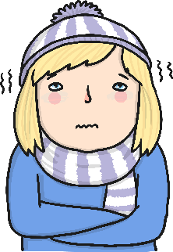
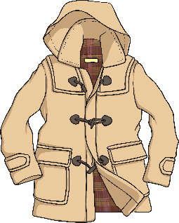
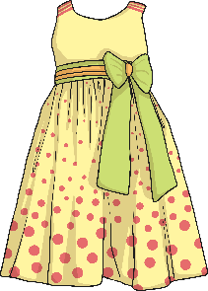
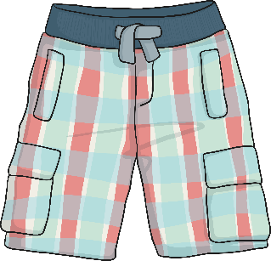
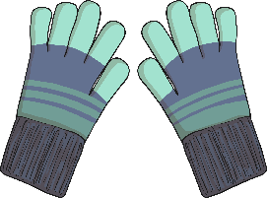
Winter Weather
What has the weather been like this week?
What has the temperature been like?
What clothes have you been wearing?

Slide 9

Aim
I can observe and describe the weather in winter.
I can collect and record data about the weather in winter.
Success Criteria
I can watch the weather carefully.
I can describe the weather in winter.
I can collect data about the weather, temperature, rainfall and wind direction.
I can write and draw the data I have collected.

