Slide 1
How did Castles change?

Slide 2
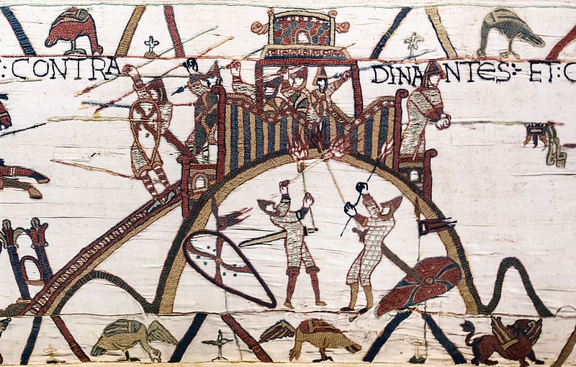
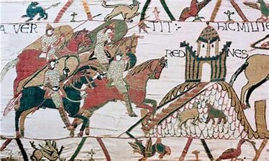
The first Castles were Motte and Bailey Castles, built by William the Conqueror after the Battle of Hastings in 1066

Slide 3
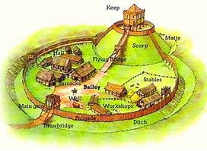
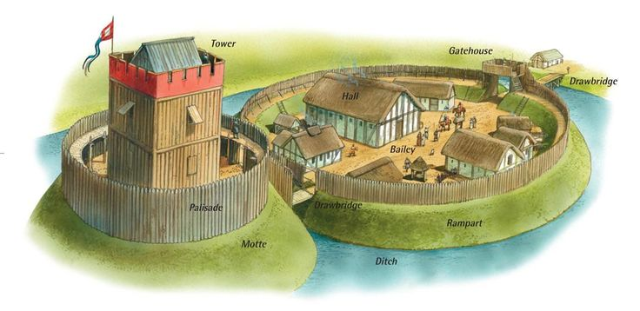
Can you remember the main features of this type of castle?

Slide 4
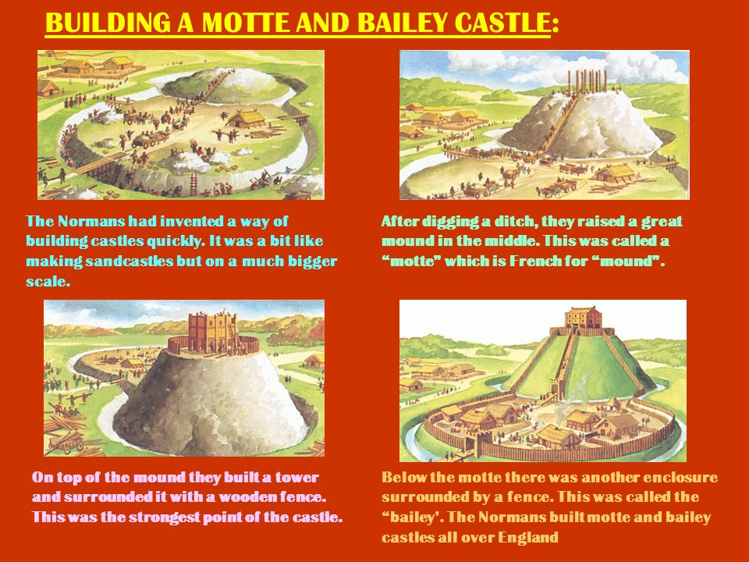
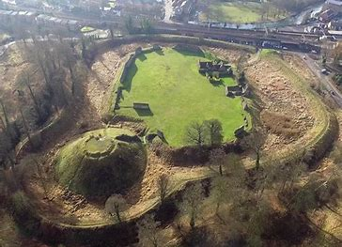
The good things about these castles were:
The problems with this type of castle were:
They were easy to build quickly
They were cheap to build
There was lots of wood
They could easily be burned down
Wood rots eventually

Slide 5
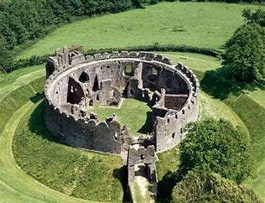
Replacement of wood with stone: the Shell Keep

Slide 6
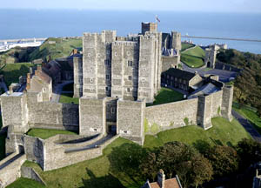
The Stone Keep: 1100s
Dover Castle

Slide 7
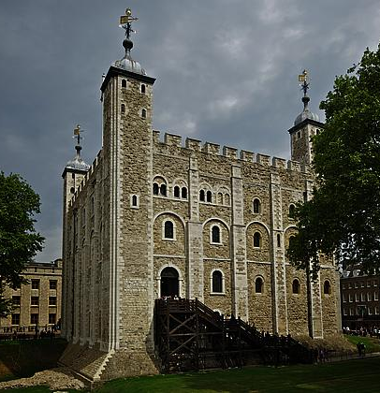
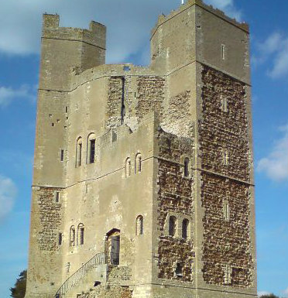
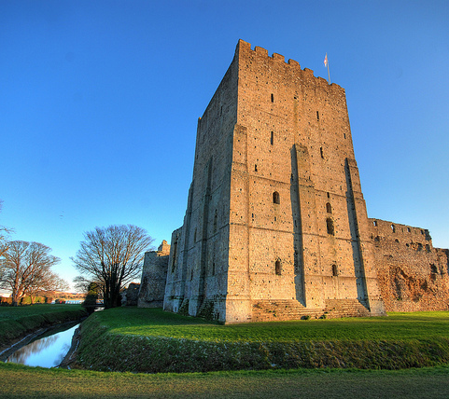
Keeps were very tall, strong towers, which were also the home for the lord and his family.
Portchester Castle
Tower of London
Orford Castle

Slide 8
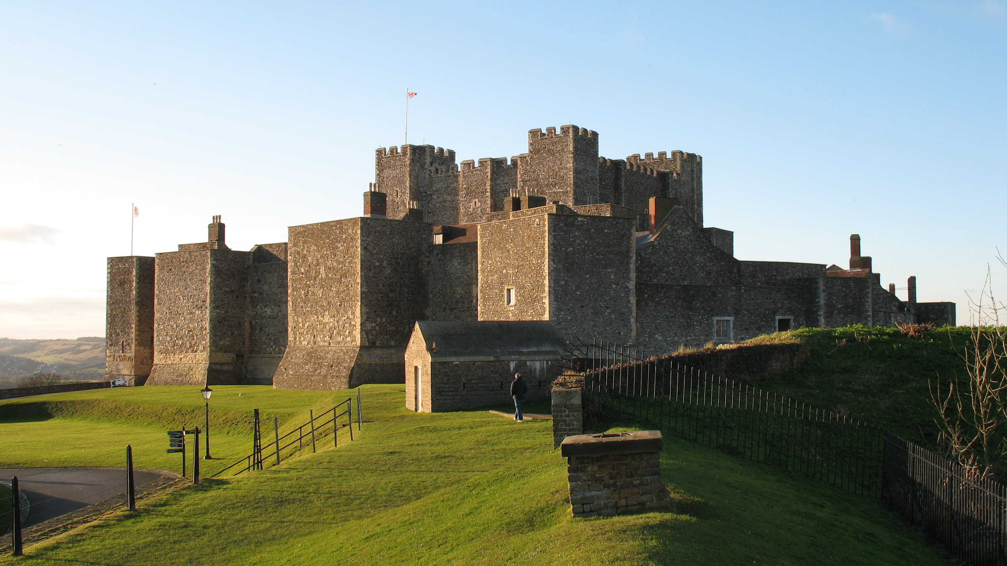
The keep was surrounded by a curtain wall, with square towers to protect it.
Rochester Castle

Slide 9
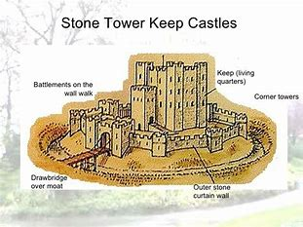
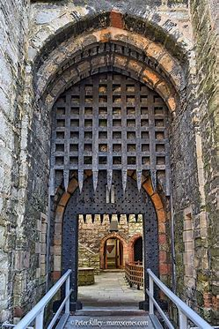
Can you remember the names of the parts of the castle?
Crennelations
Arrow Loops
Battlements
Gatehouse
Drawbridge
Curtain Wall
Moat
Portcullis

