Slide 1
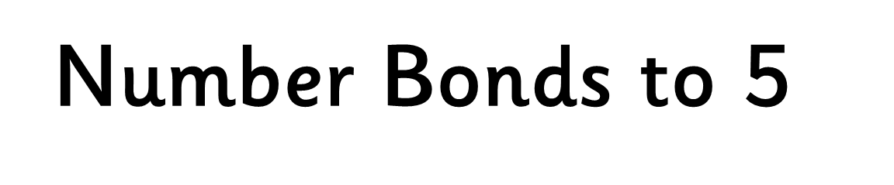


Slide 2




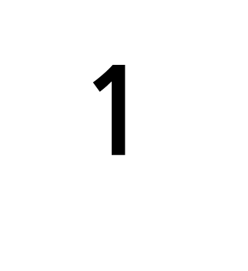
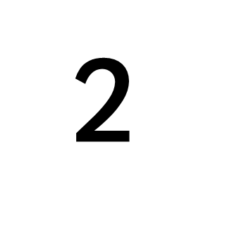
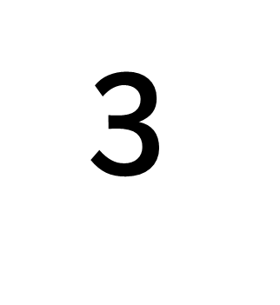




Slide 3




Slide 4




NEXT

Slide 5
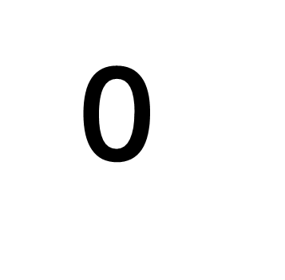







Slide 7
NEXT

Slide 8

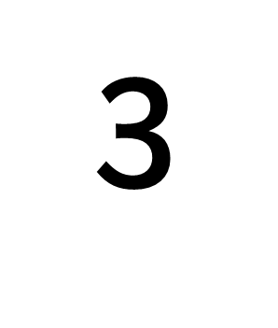




Slide 10
NEXT

Slide 11

THE END

