Slide 1

Maria Merian
And her amazing ‘Summer Birds’

Slide 2
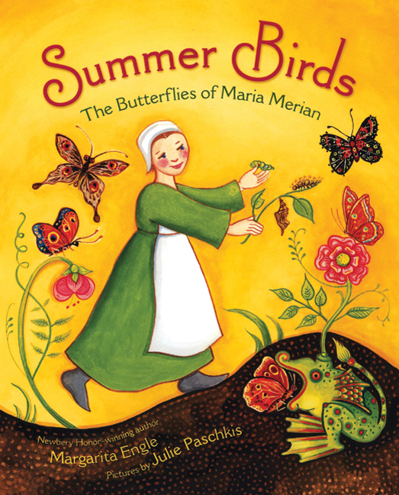
We looked at the book ‘Summer Birds’, written by Margarita Engle and illustrated by Julie Paschkis
‘Summer birds’ was a medieval name for the mysterious butterflies and moths that appeared suddenly during warm weather and vanished in the Autumn.

Slide 3
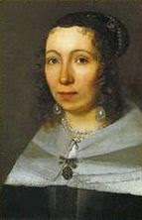
Maria was born in Germany in Medieval times, 370 years ago
1647
Maria was born in Frankfurt, Germany in 1647
1801
This is when Mary Anning was born, 150 years later
2020
This is when we live now, 370 years after Maria was born
She died in Amsterdam, in the Netherlands, when she was 69 years old
1717

Slide 4
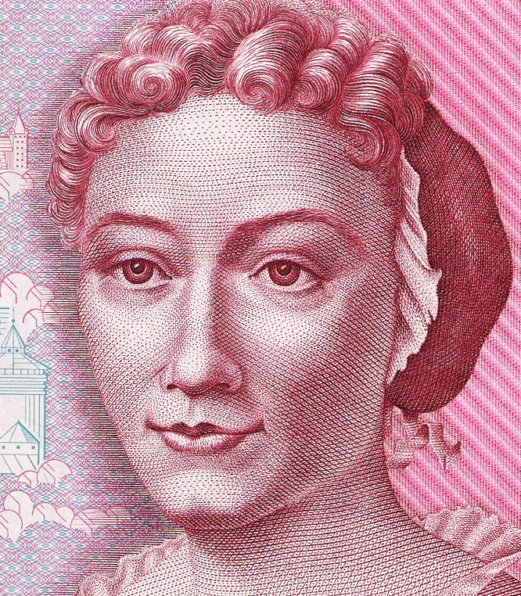
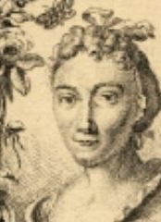
Maria’s early life
Maria was the daughter of a famous artist, Matthaus Merian, and was so good at drawing and painting that when she was only three years old, her father predicted she would become a great artist. Unfortunately, her father died soon after, but her mother remarried another painter, Jacob Merrell, and her stepfather realised how talented she was, and taught her all about painting. He encouraged her interest in flowers and insects. When she was only thirteen years old, she started a collection of caterpillars and drew and painted pictures showing how they developed and changed. Her careful artwork showed that metamorphosis – changing – is natural, and nothing to be afraid of. Her studies were far ahead of her time.

Slide 5
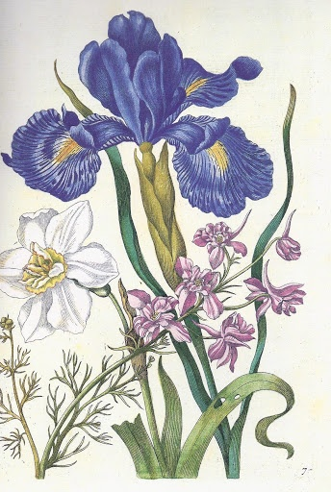
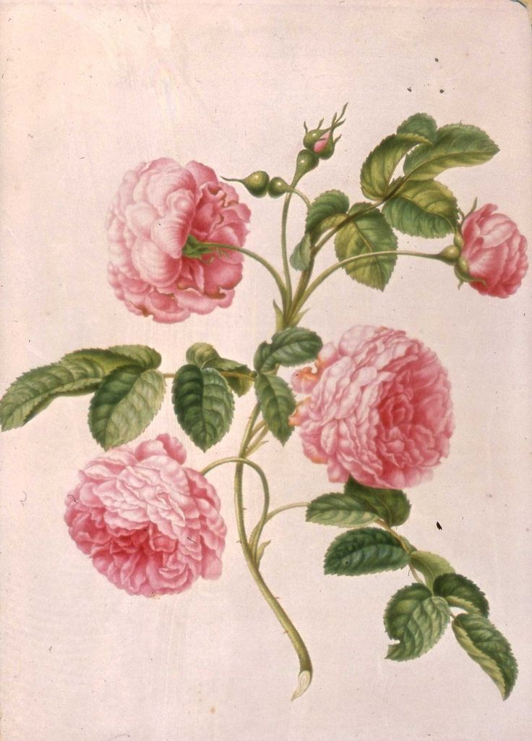
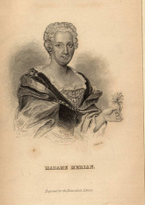
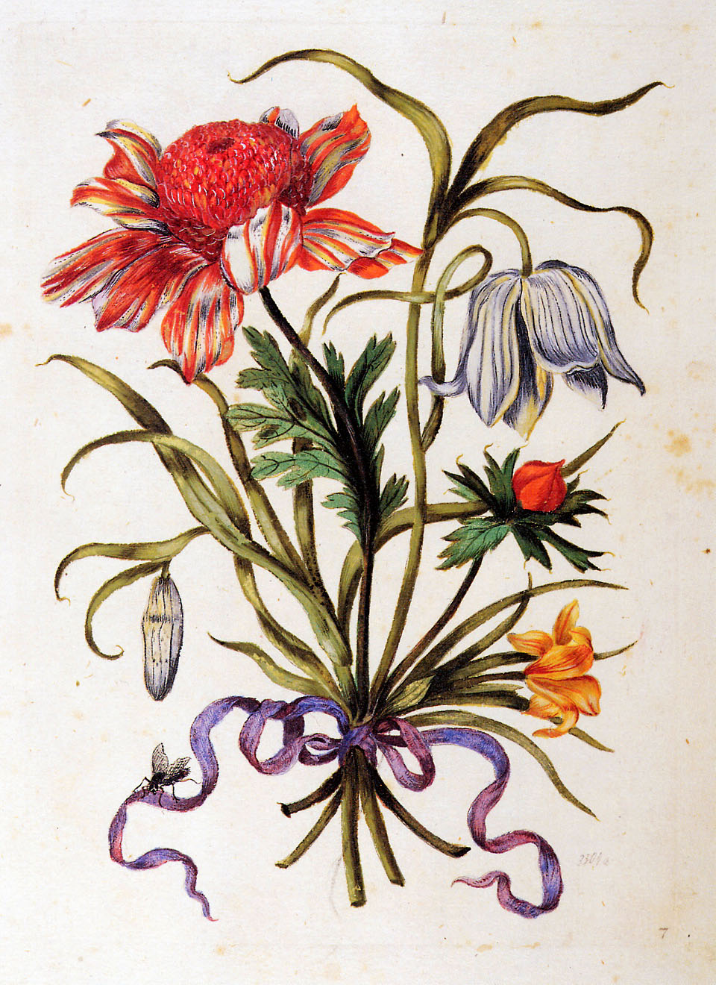
In 1665 Maria married Johann Graff, another artist. Three years later, they had a baby girl, called Johanna, and soon afterwards the family moved to Nürnberg, where they lived for the next 14 years. During this time Maria published three books full of watercolour engravings of beautiful flowers. In 1678 the couple’s second daughter, Dorothea, was born.

Slide 6
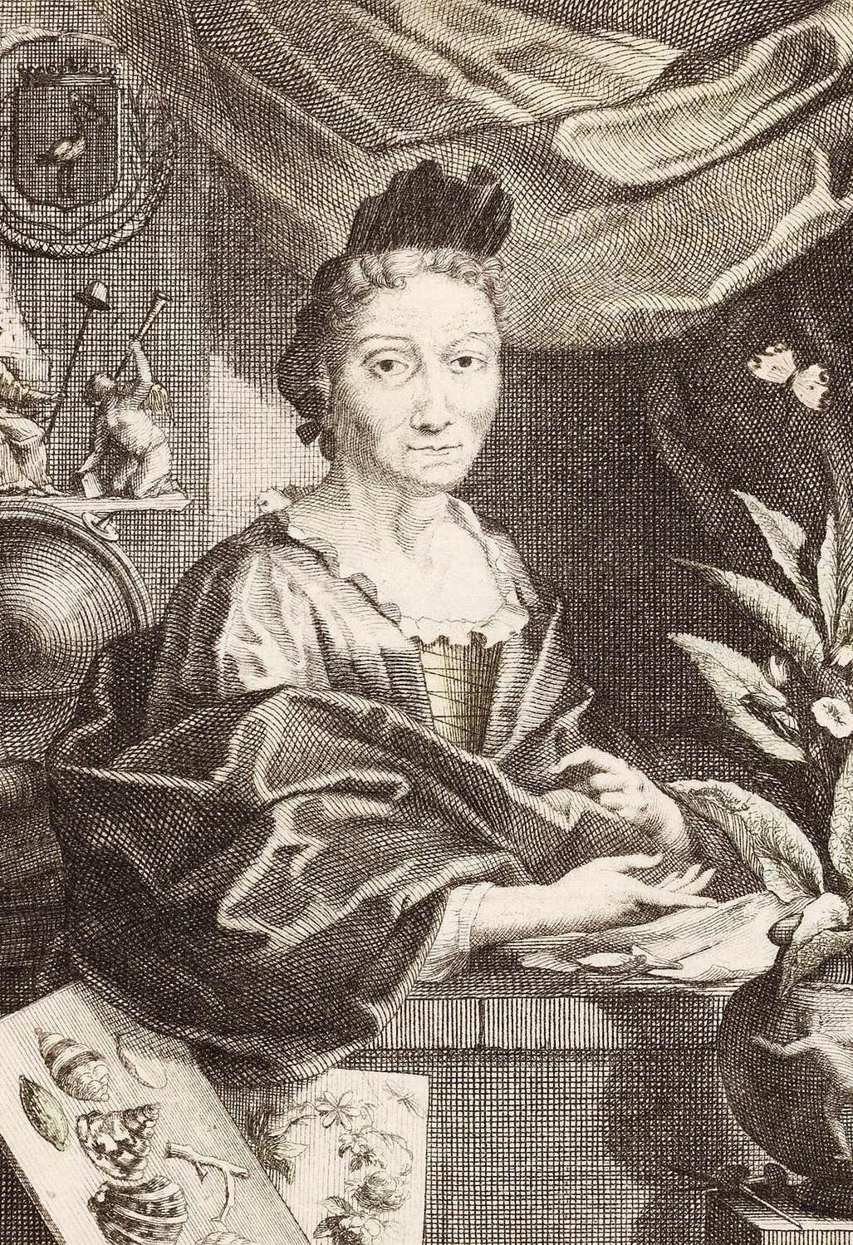
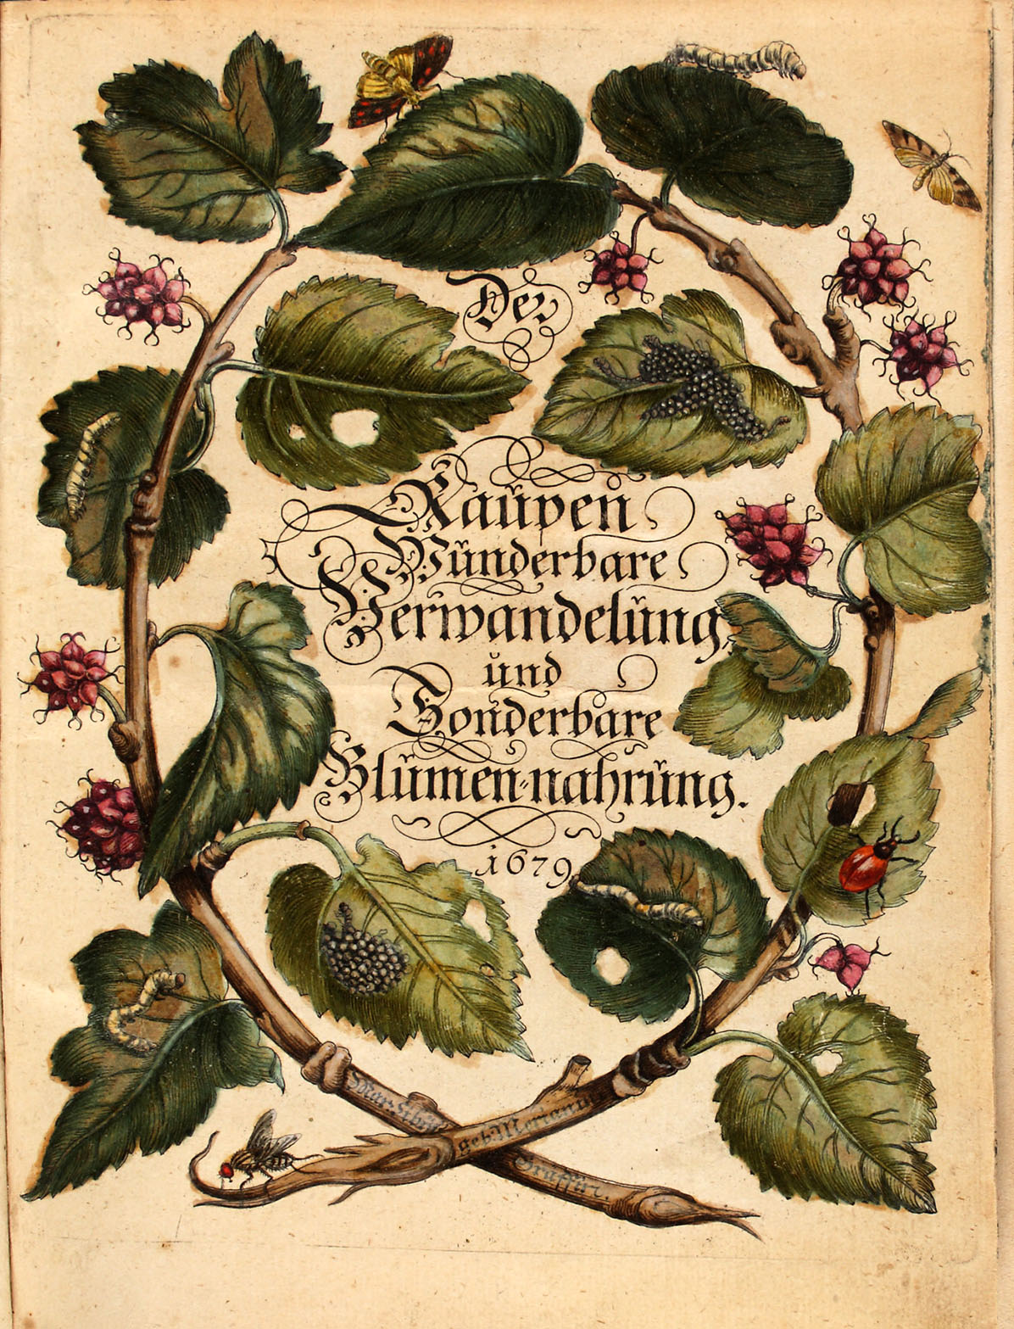
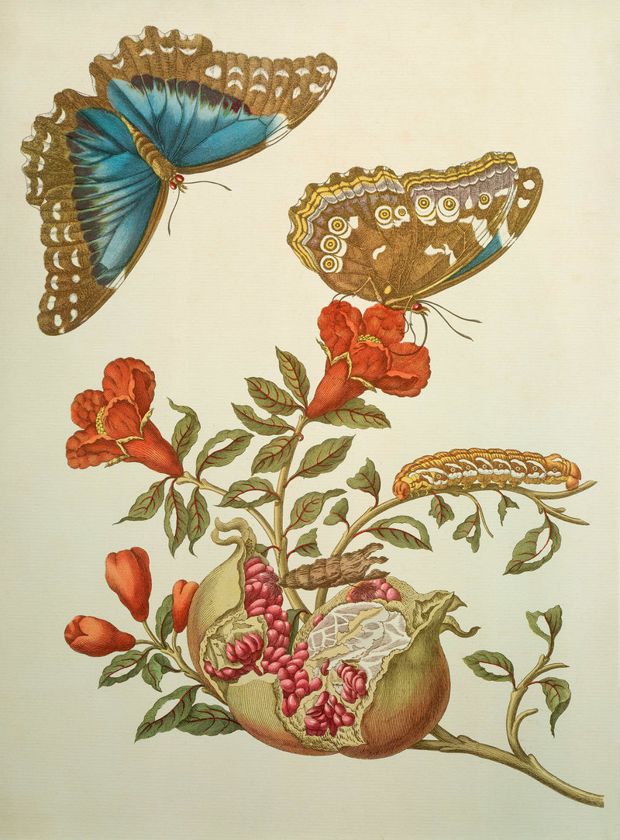
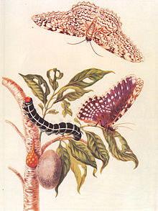
In 1679 Maria published her book “Caterpillars, their wondrous transformation and peculiar nourishment from flowers” with her pictures of moths and butterflies.
This book changed the way people thought about these creatures, because she showed each insect with the plant it ate and wrote about the different stages of its life cycle. She showed that the creatures were born from eggs, not from mud. Her paintings were so good that scientists all over the world were impressed by how carefully she looked at the creatures and their lives. Can you spot the eggs, caterpillars, cocoons and adult butterflies?

Slide 7
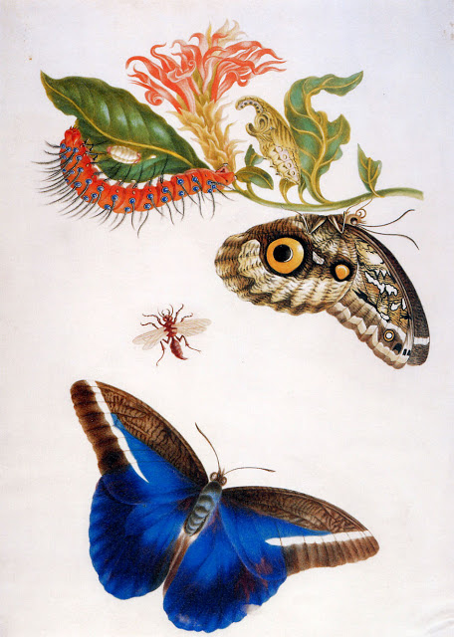
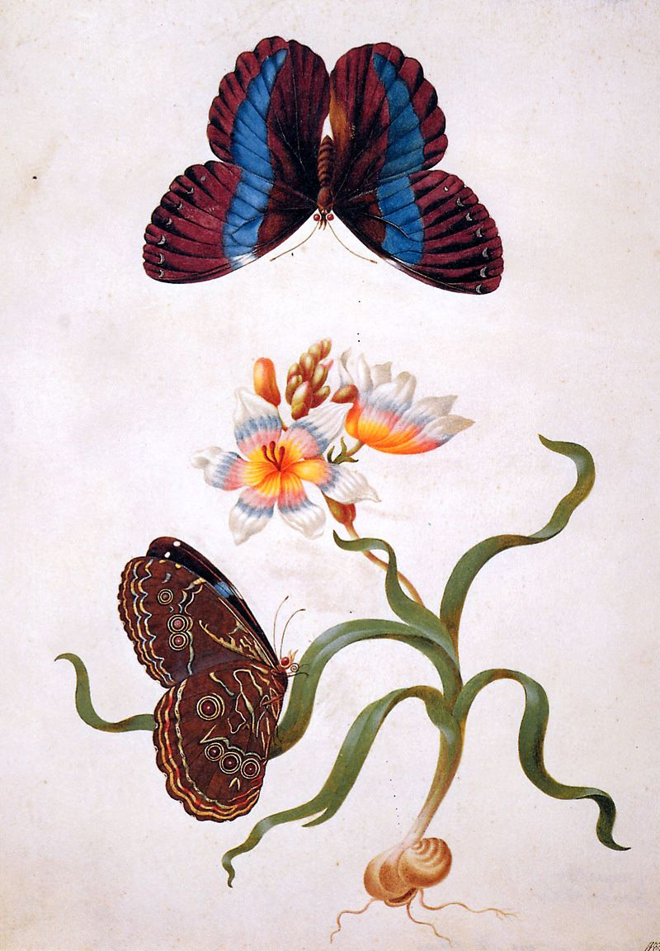
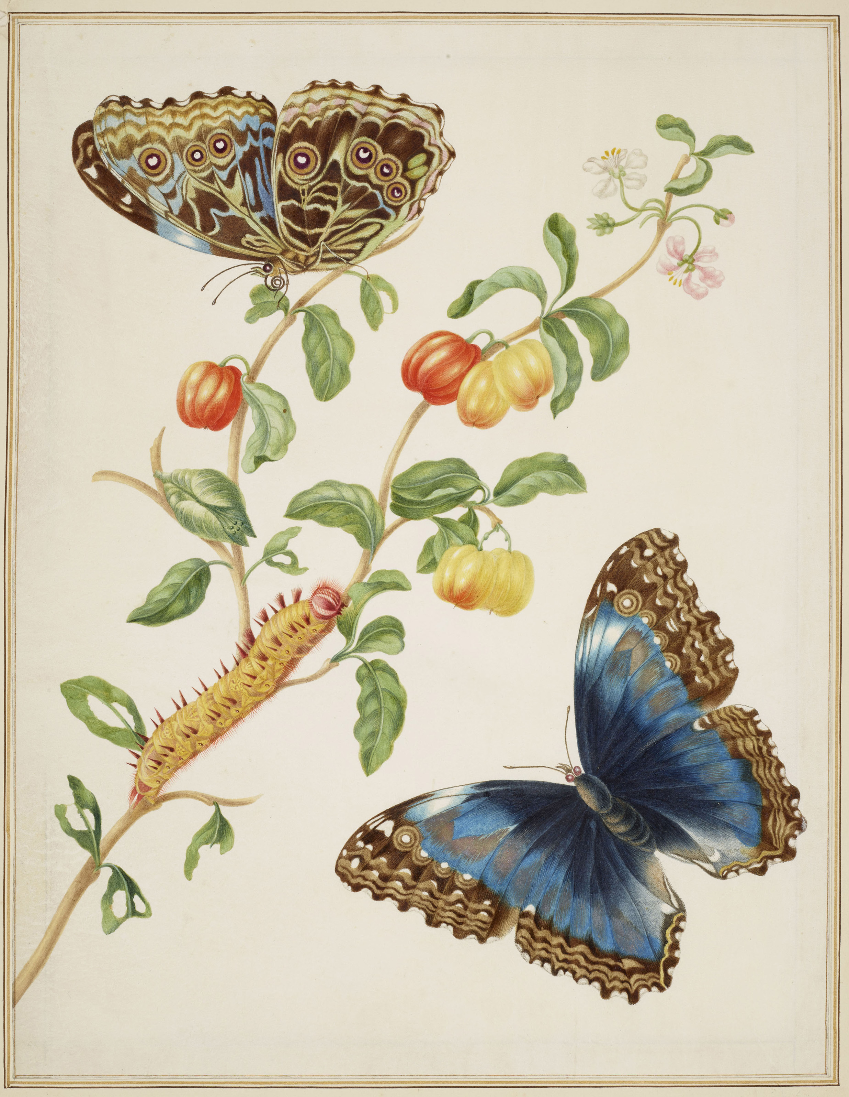

Slide 8
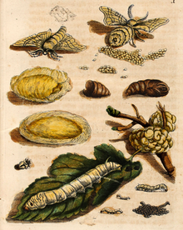
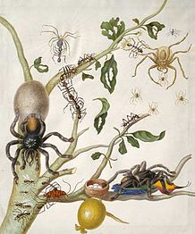
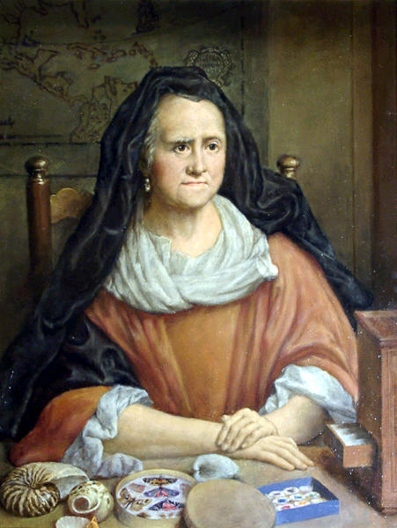
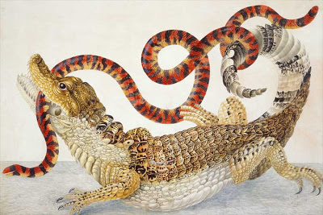
Maria was also a brave explorer! In 1699, at a time when women rarely travelled at all, she and her daughter Dorothea set sail for an expedition to Suriname, in South America, to explore new species of insects and plants. They collected, studied, and drew the jungle’s plants, insects, birds and reptiles. They stayed there for two years before Maria became ill and returned to Amsterdam. In 1705 she wrote a book about the wonderful creatures she had seen, with her amazing scientific paintings of the creatures as they changed through their lifecycles. Maria had become so famous as a scientific illustrator that her paintings were admired and collected by Peter the Great, the Tsar of Russia. She was described by scientists in her lifetime as “that great artist and naturalist”. Her detailed pictures were very important because they helped other scientists to learn about the new creatures she had found. Maria died in 1717, around 300 years ago, but her art and her work as a scientist are still famous today.

Slide 9
Just for fun…
If you’d like to try some Maria Merian Jigsaw puzzles, follow the link in the box (you can choose anything between 12 and 108 pieces!!!)
https://www.dltk-kids.com/puzzles/theme.asp?tid=191

