Slide 1


Slide 3

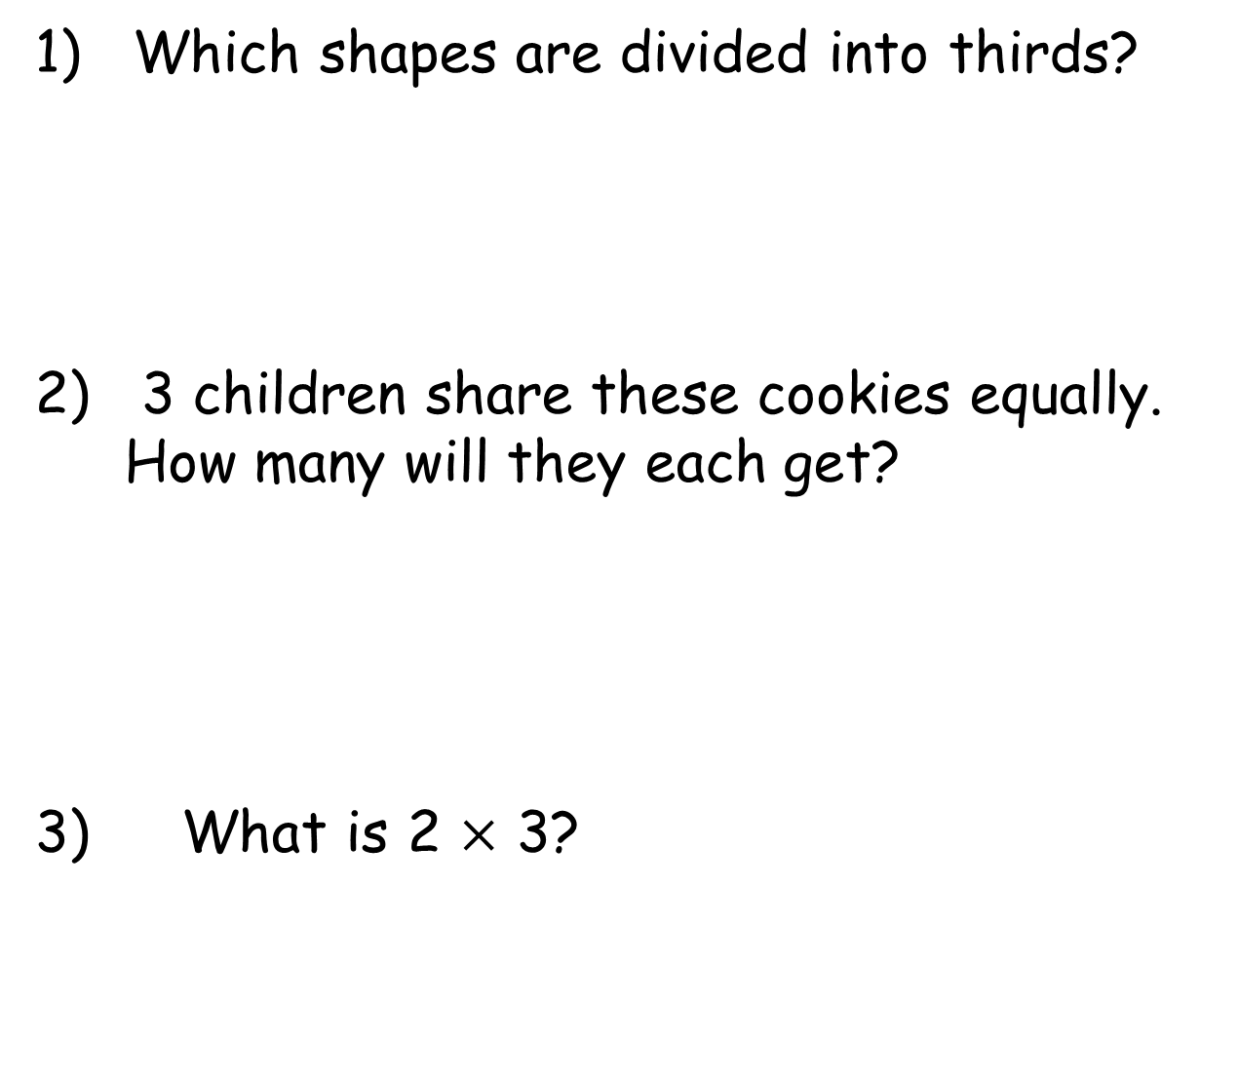
1) Which shapes are divided into thirds?
2) 3 children share these cookies equally.
How many will they each get?
3) What is 2 $×$ 3?

Slide 4

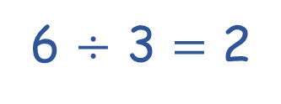
1) Which shapes are divided into thirds?
2) 3 children share these cookies equally.
How many will they each get?
3) What is 2 $×$ 3?
6 $÷$ 3 $=$ 2
They will each get 2 cookies.
6

Slide 6







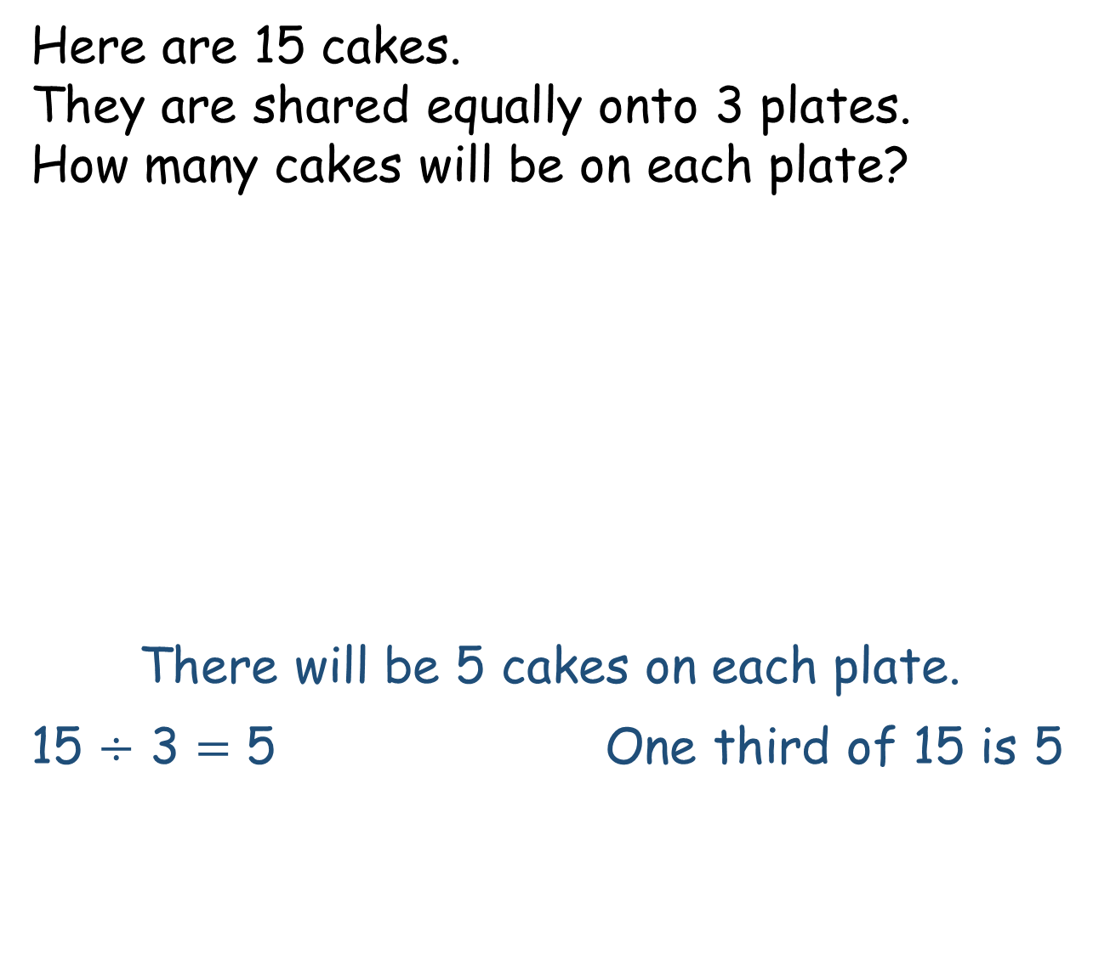
Here are 15 cakes.
They are shared equally onto 3 plates.
How many cakes will be on each plate?
There will be 5 cakes on each plate.
15 $÷$ 3 $=$ 5 One third of 15 is 5

Slide 7


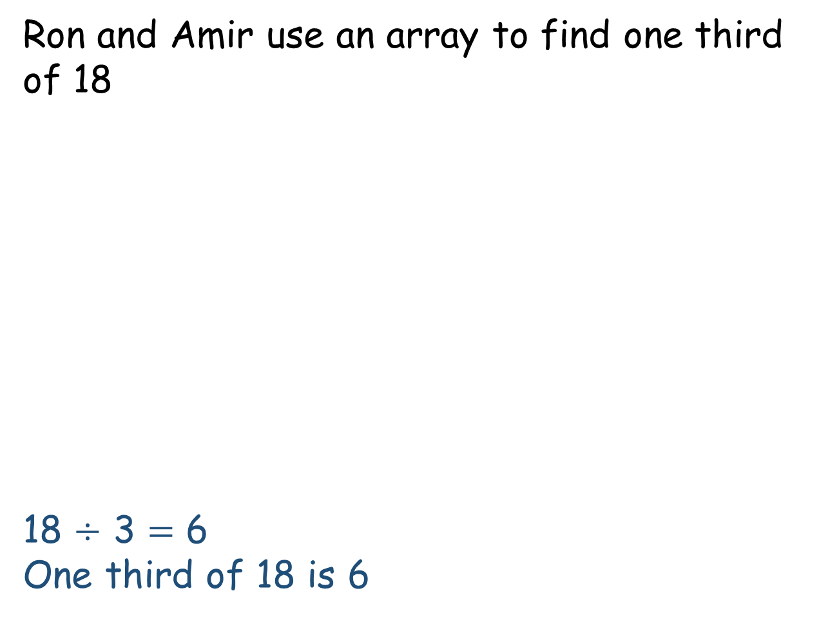
Ron and Amir use an array to find one third of 18
18 $÷$ 3 $=$ 6
One third of 18 is 6
I will draw lines to make 3 equal parts.
I can see a different way to make 3 equal parts
.

Slide 8
Ron and Amir use an array to find one third of 18
18 $÷$ 3 $=$ 6
One third of 18 is 6
I will draw lines to make 3 equal parts.
I can see a different way to make 3 equal parts
.

Slide 9


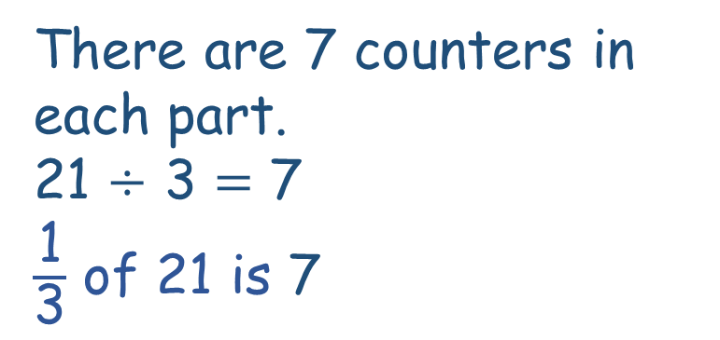
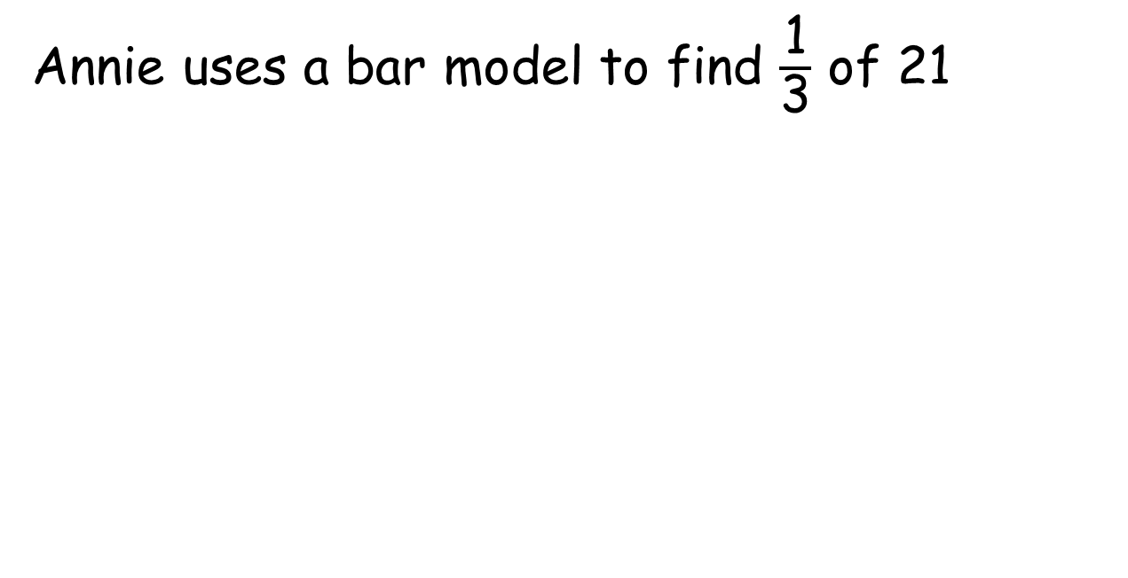
Annie uses a bar model to find $\frac{\text{1}}{\text{3}}$ of 21
21
I’ve noticed a pattern
7
?
There are 7 counters in each part.
21 $÷$ 3 $=$ 7
$\frac{\text{1}}{\text{3}}$ of 21 is 7

Slide 10
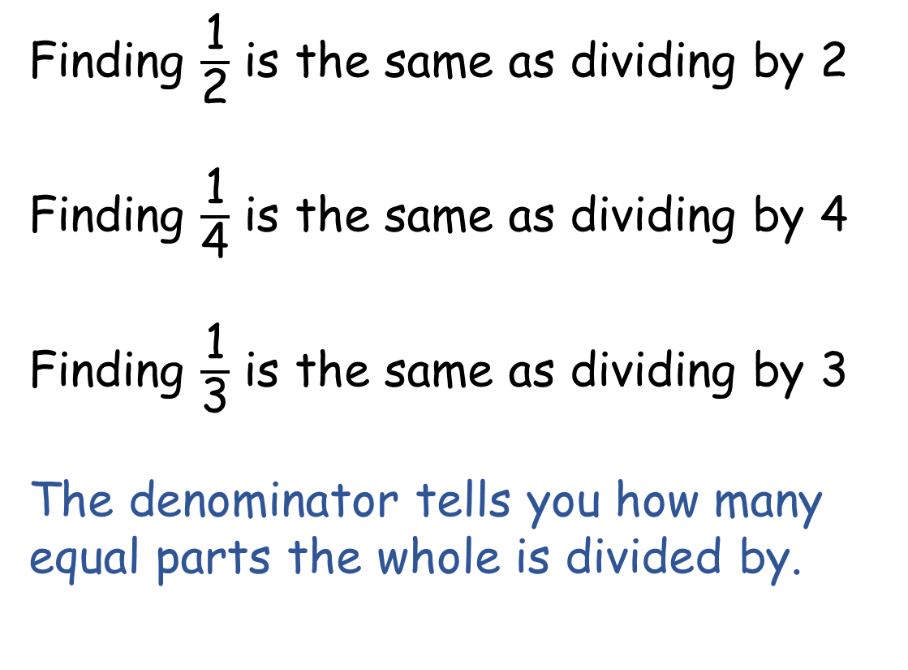
I’ve noticed a pattern
Finding $\frac{\text{1}}{\text{2}}$ is the same as dividing by 2
Finding $\frac{\text{1}}{\text{4}}$ is the same as dividing by 4
Finding $\frac{\text{1}}{\text{3}}$ is the same as dividing by 3
The denominator tells you how many equal parts the whole is divided by.

Slide 11
Have a go at questions
1 – 3 on the worksheet

Slide 12

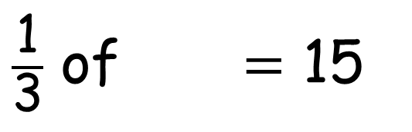
$\frac{\text{1}}{\text{3}}$ of $=$ 15
Have a think
45
45
?
15
15
15

Slide 13


Jack has one third of his birthday money left.
Dora has half of her birthday money left.
They both have £10 left.
What do you know? What can you find out?
£30
10
10
10
They received £50 altogether
left
spent
Have a think
10
10
spent
10
left
£20
Jack had £30 altogether.
Dora had £20 altogether.
Jack spent £20
Dora spent £10
Jack spent £10 more than Dora.

Slide 14
Have a go at the rest of the questions on the worksheet

