Slide 1


Spelling, Punctuation and Grammar
Past and Present Tenses
Year One
SPaG | Past and Present Tenses

Slide 2

Past and Present Tenses

Slide 3
Past and Present Tenses
Introductory Activity
Independent Focused Activity
Review Activity
Consolidation Activity
Assessment

Slide 4
Aim
To use past and present tenses correctly in my writing.
Success Criteria
I can identify sentences that are written in the past tense.
I can change verbs to past tense verbs.
I can identify sentences that are written in the present tense.
I can change verbs to present tense verbs.
I can use tenses correctly and consistently in my writing.

Slide 5
Introductory Activity

Slide 6

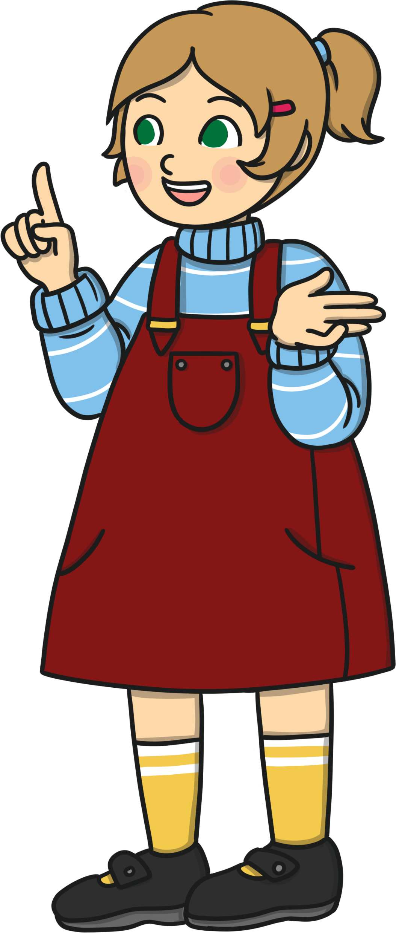
Simple Past or Simple Present?
Tell someone at home about some of the things you do every morning before school.
E.g. I get up.
I walk downstairs.
What verbs did you use in the sentences you said aloud
to your partner?
E.g. get, walk, brush, eat, play.
These verbs are in the present tense. You use present
tense verbs to talk about the things you do now and on a regular basis. The simple present tense is used to describe something which is true at this moment in time.

Slide 7
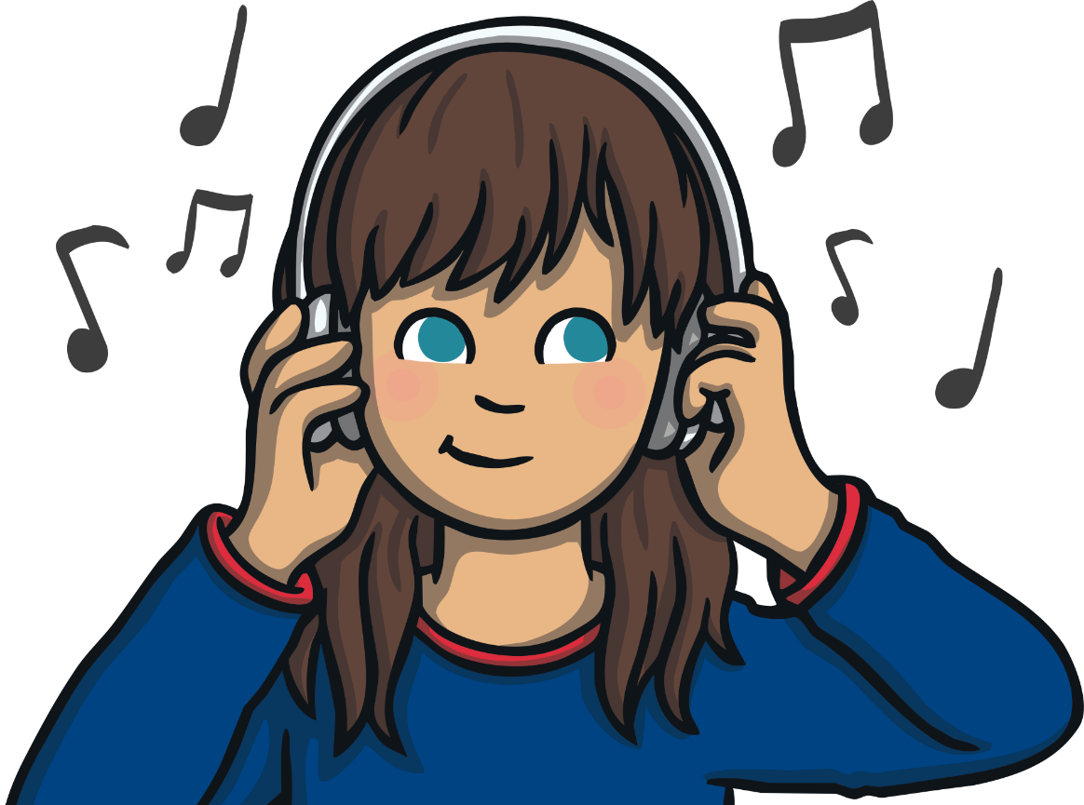
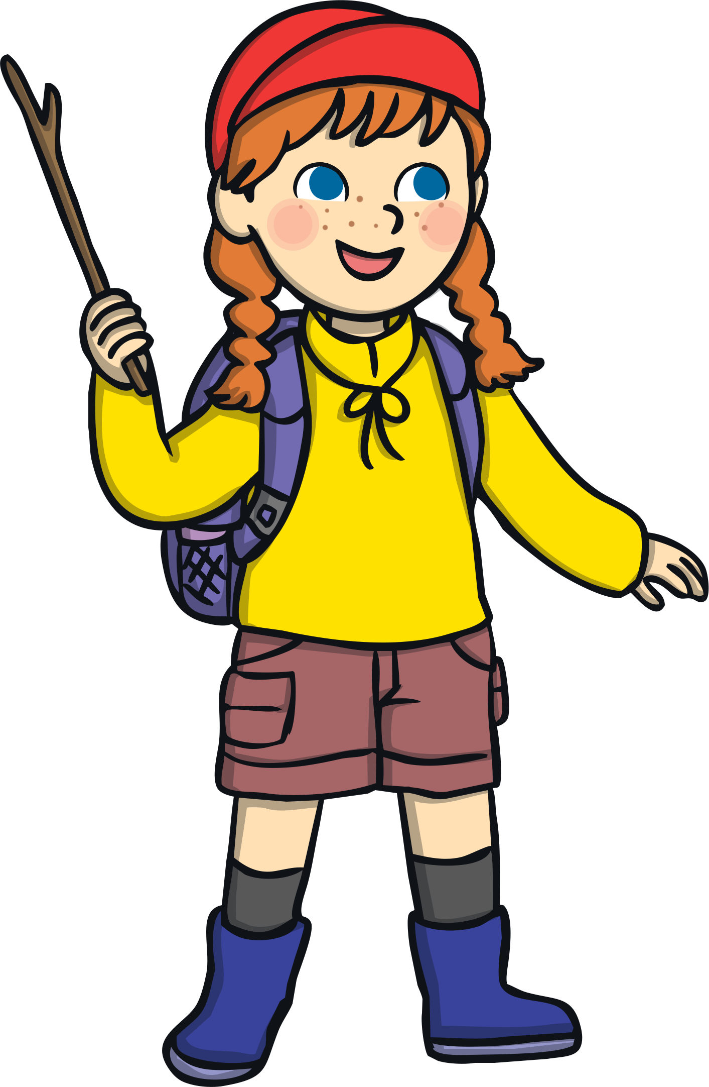
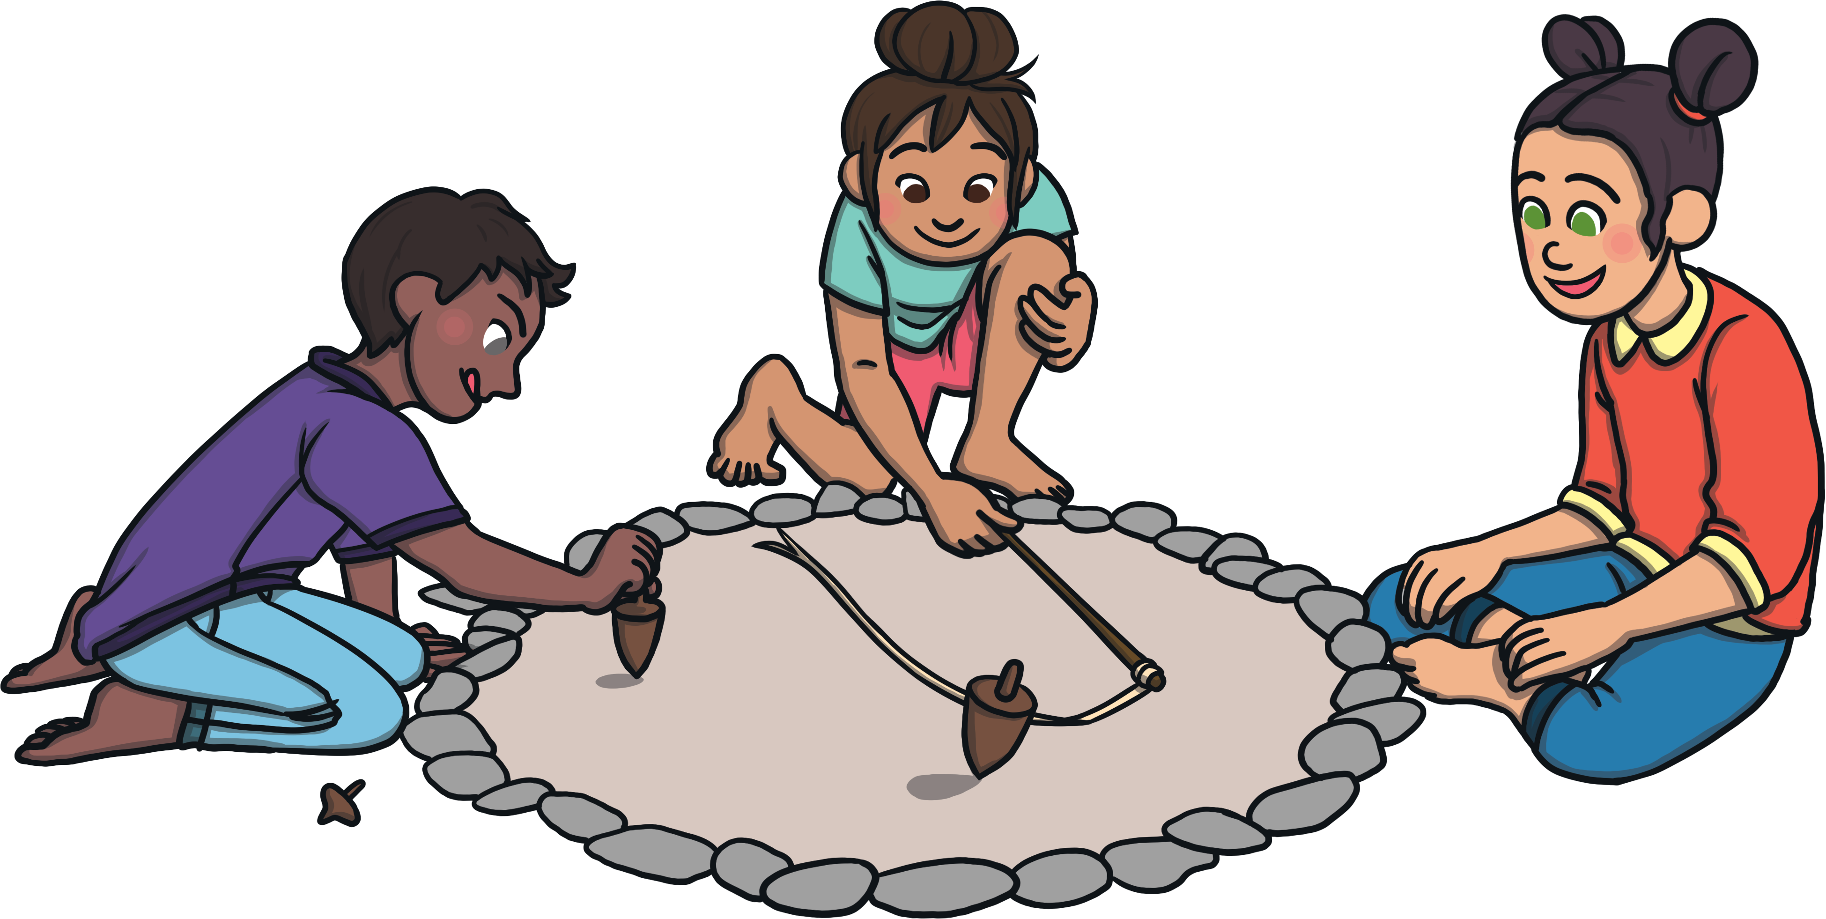
Simple Past or Simple Present?
These children are talking about the things they did last weekend. They are using the simple past tense.
I listened to my favourite music.
I walked up a big hill with my family.
I played in the garden.
Work with your someone at home if you can.
Write the verbs used in these sentences in your notebook.

Slide 8
Simple Past or Simple Present?
These verbs are in the simple past.
I listened to my favourite music.
I walked up a big hill with my family.
I played in the garden.
The simple past tense is used to describe events which have
already happened.
Simple Present Tense Verbs | Simple Past Tense Verbs
brush walk play | brushed walked played

Slide 9

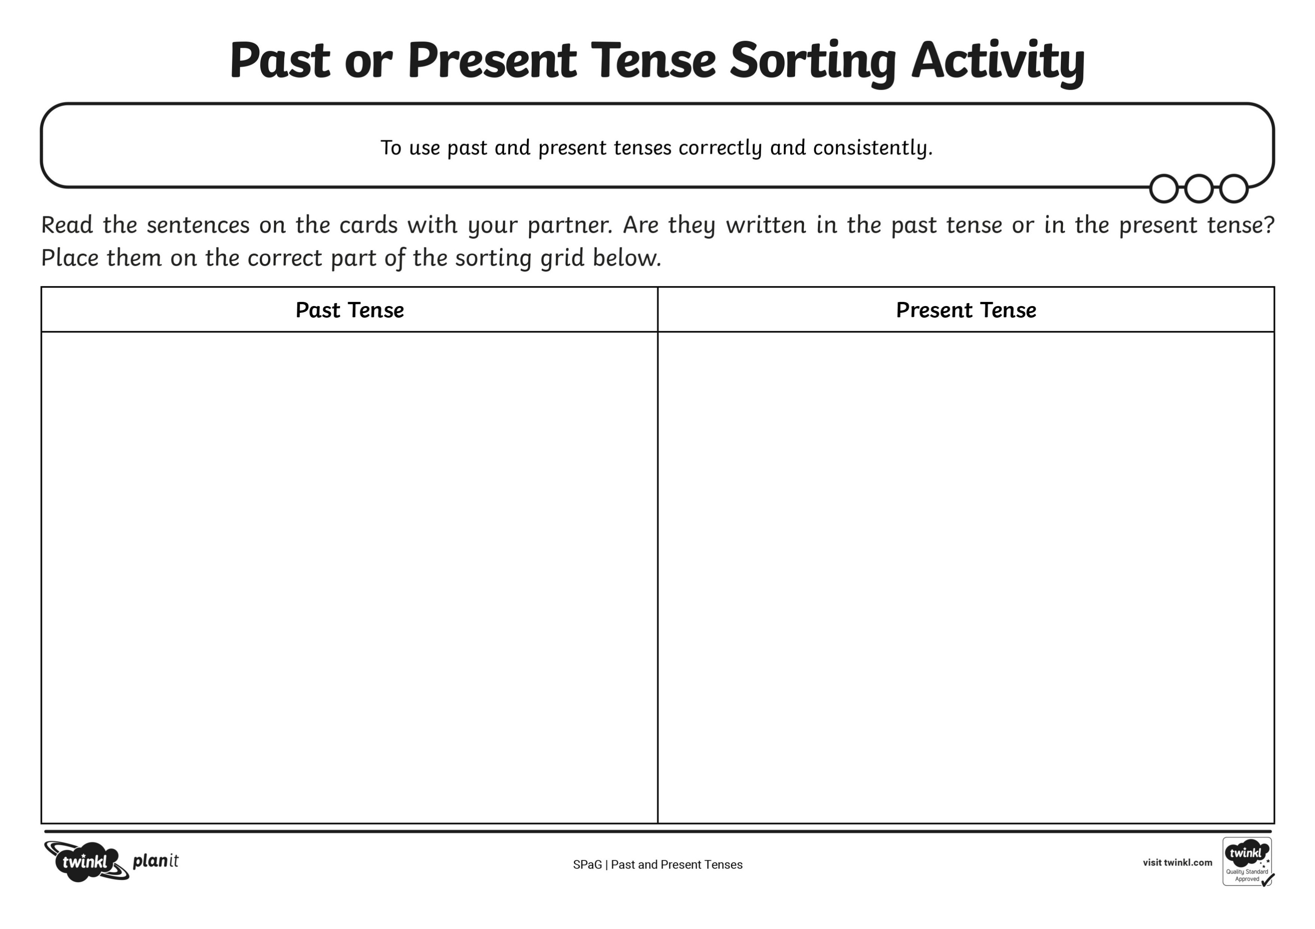
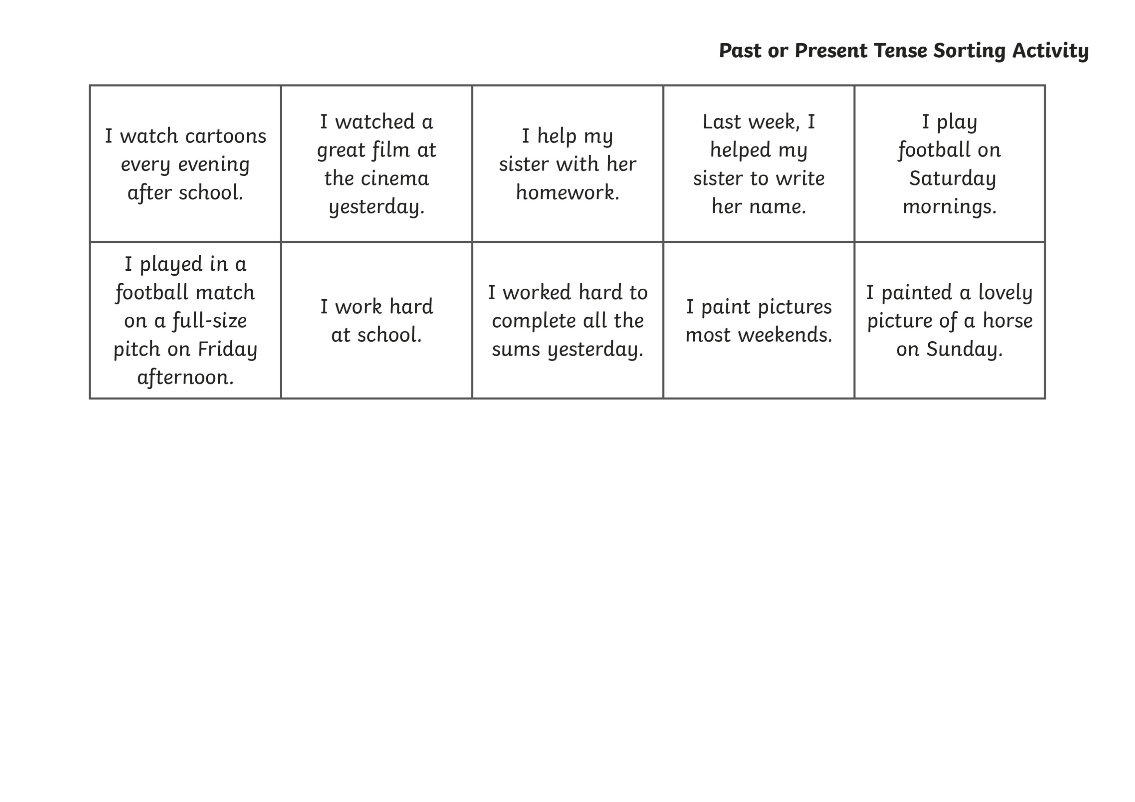
Simple Past or Simple Present?
Working with your partner, can you sort these
sentences into past and present tense?
Remember to look at each sentence carefully.

Slide 10
Independent Focused Activity

Slide 11

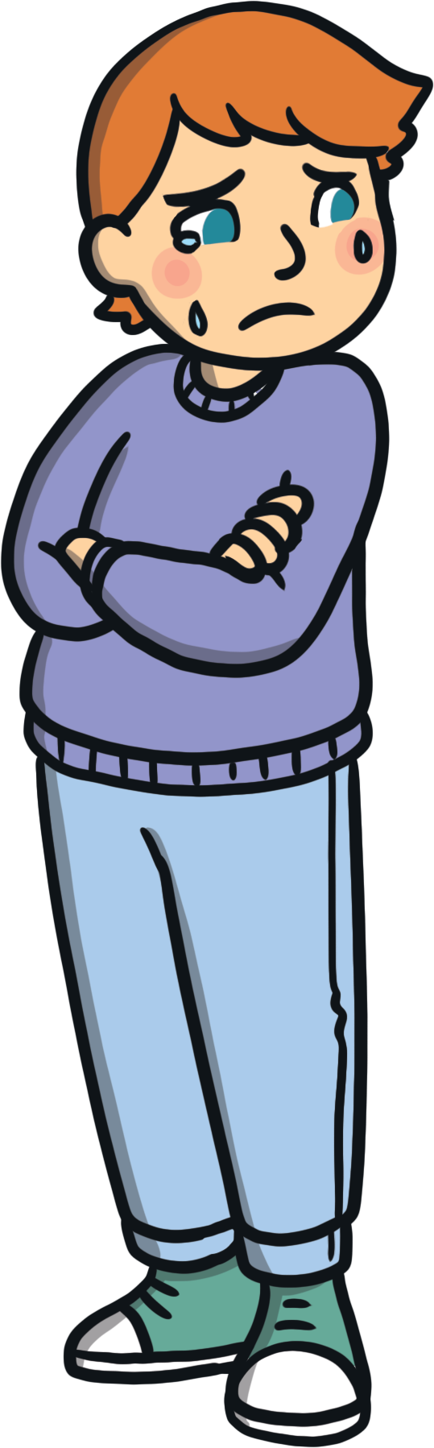






Simple Past Tense Verbs
The verbs in each sentence tell us if the sentence is in the past tense or the present tense.
Many past tense verbs end in -ed:
played
jumped
skipped
walked
screamed
started
cried
carried
Can you remember the rules for adding -ed to words ending in a consonant and
then -y?
If the verb ends in a consonant and then y, change it to an i and then add –ed.

Slide 12
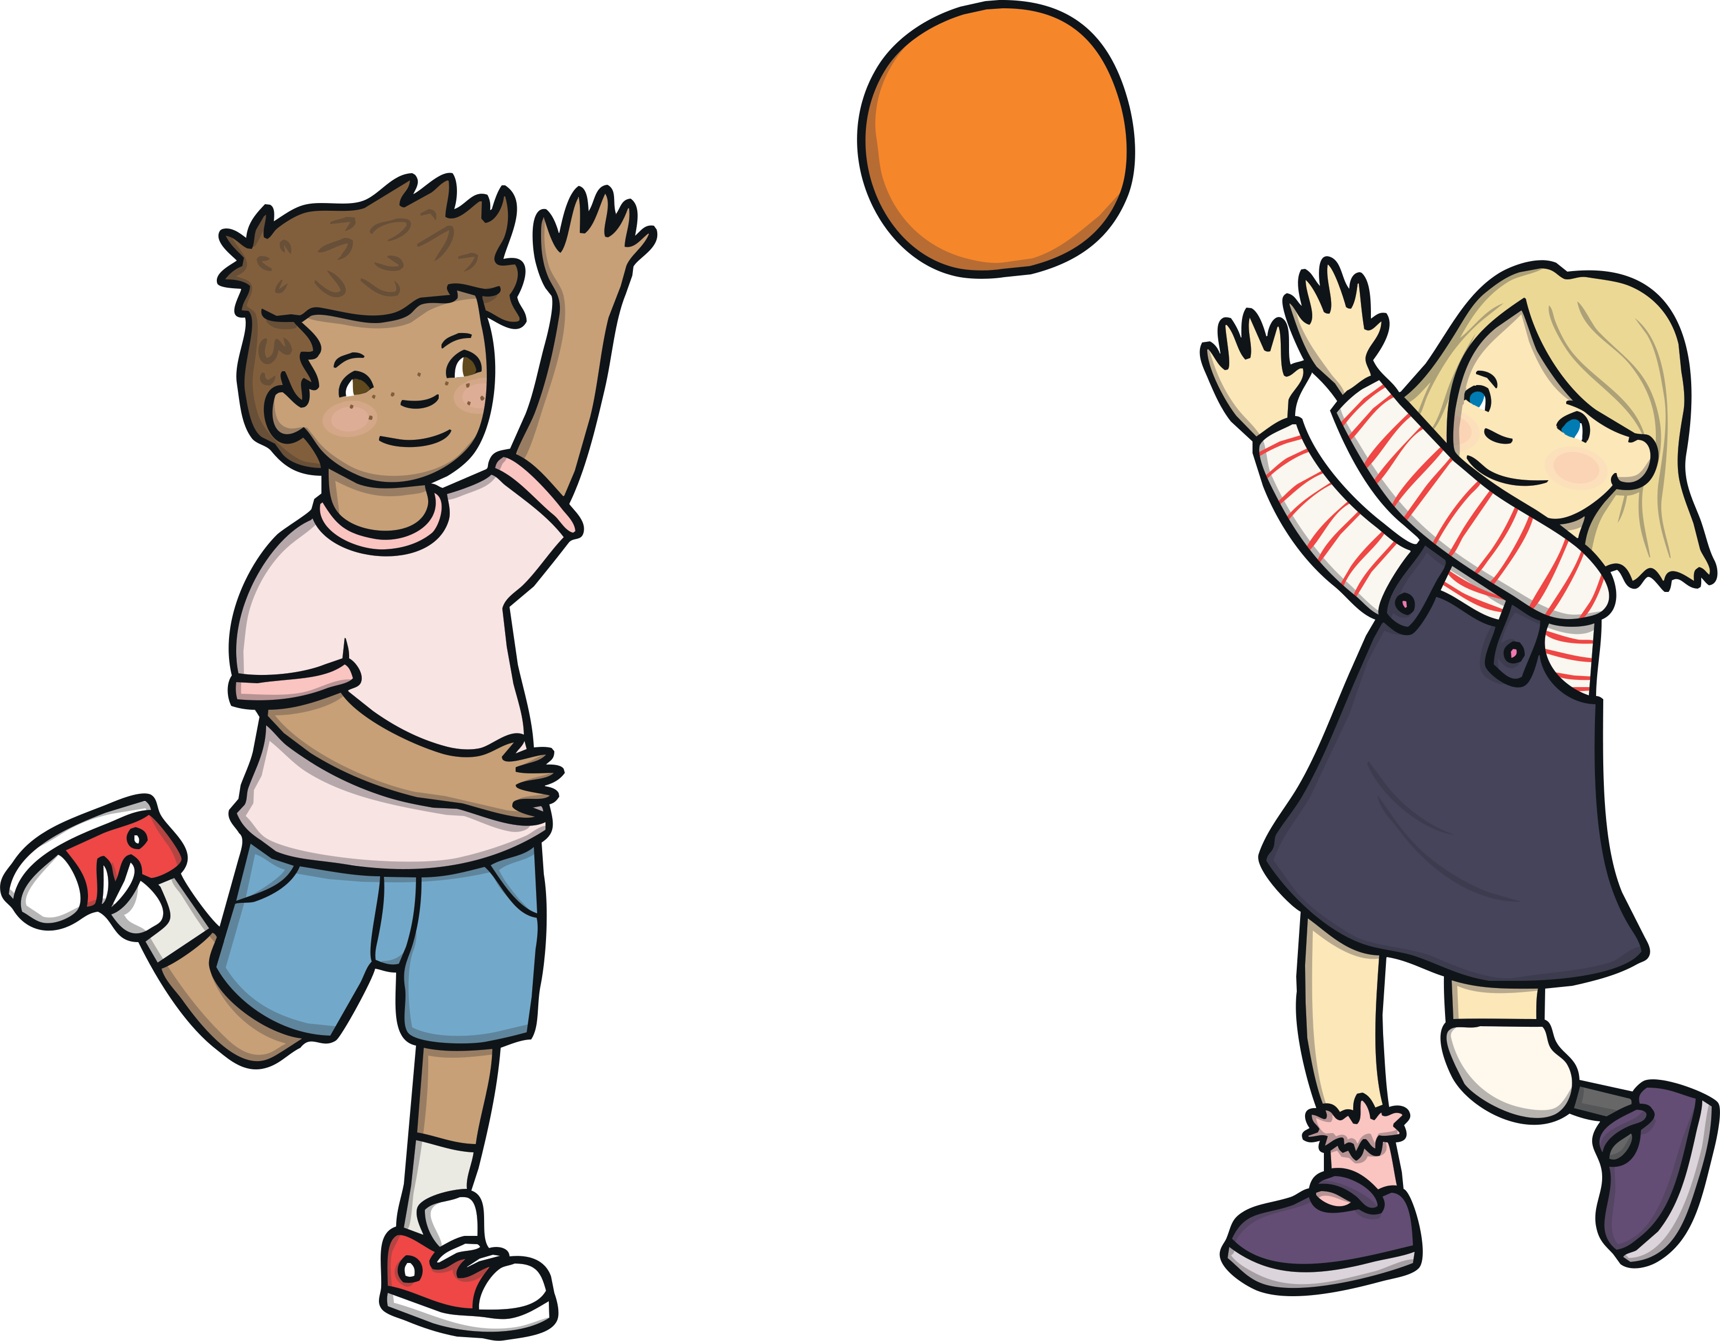
Simple Past Tense Verbs
Also, remember…
If the verb ends in a vowel followed by a ‘y’, just add ‘ed’.
E.g. play – played
If a verb ends in an ‘e’, just add ‘d’.
E.g. wade – waded.
If a verb has just one syllable (beat) and has one consonant letter after a single vowel letter at the end, double the last consonant before adding ‘ed’.
E.g. skip - skipped

Slide 13
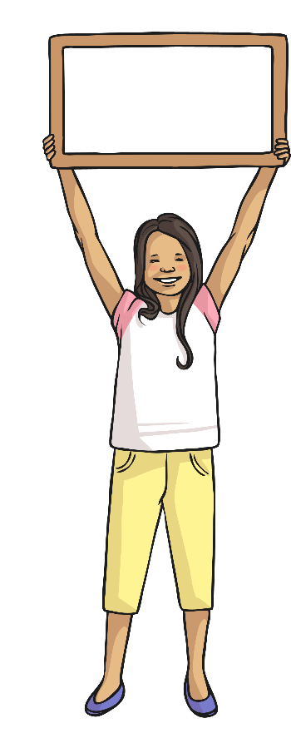

Simple Past Tense Verbs
Some past tense words are irregular. This means they
don’t follow the rule of adding -ed.
Look at these words. Do you know what the past tense word for these words are?.
run
ran
swim
swam
begin
began
go
went
drink
drank
see
saw

Slide 14
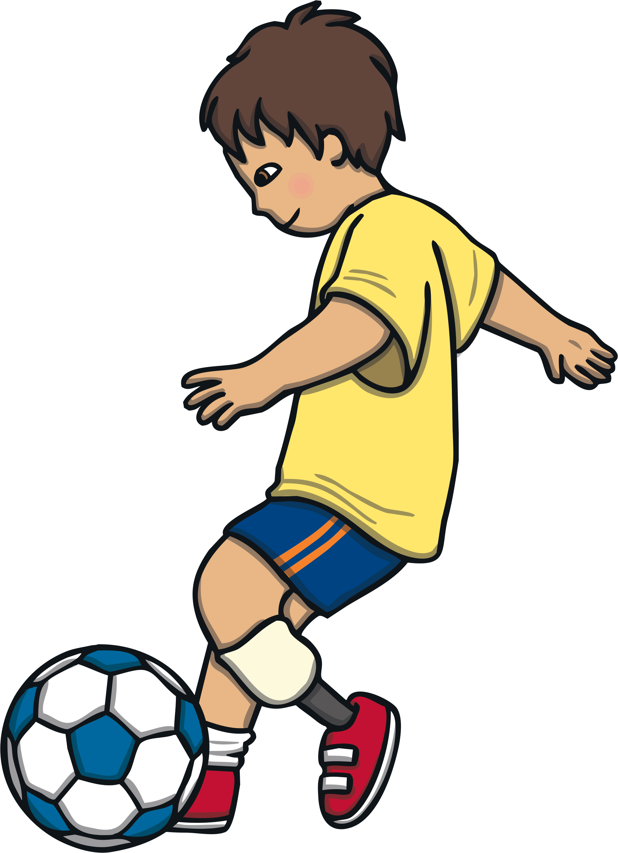
Simple Present Tense Verbs
Present tense words change depending on the sentence they are in.
They either have no suffix, -ing suffix or -s/-es suffix.
play
plays
I play football every day.
Clara plays football every day.
We play football every day.
My friends play football every day.
You play football every day.
When using ‘I’, ‘we’ or ‘they’, there is no suffix.
With ‘he’, ‘she’ or someone’s name (one person), there is a suffix of s or es.

Slide 15
Simple Present Tense Verbs
Some spelling rules for adding ‘es’
Remember that when a verb ends with a consonant and then a ‘y’, change the ‘y’ to an ‘i’ and then add ‘es’.
E.g. try – tries
Some words sound like there is an extra syllable at the end of them when the -s is added /uhz/. These words end in ‘es’.
E.g. catch -catches

Slide 16
Simple Present Tense Verbs
Can you add -ing to these verbs?
Write down the correct simple present tense
verbs for these sentences.
runs
Mum …….. 5 kilometres each day. (run)
My brother ……………. me have my swimming lesson on Tuesdays. (watch)
The baby ………… a lot during the night. (cry)
Fran often …………. in shows. (dance)
watches
cries
dances

Slide 17

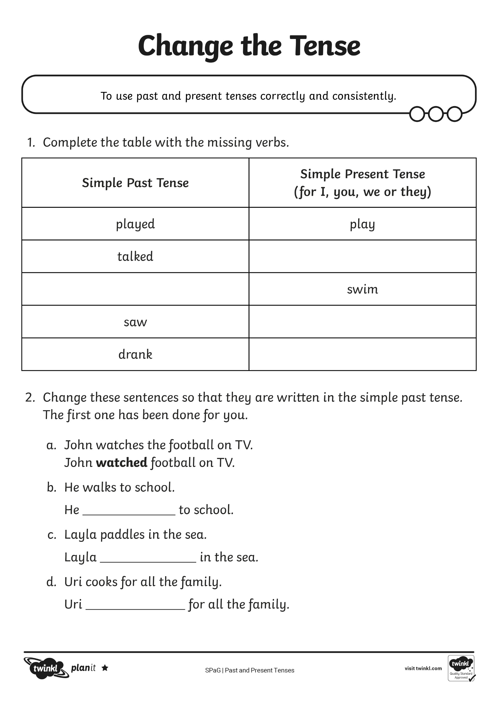
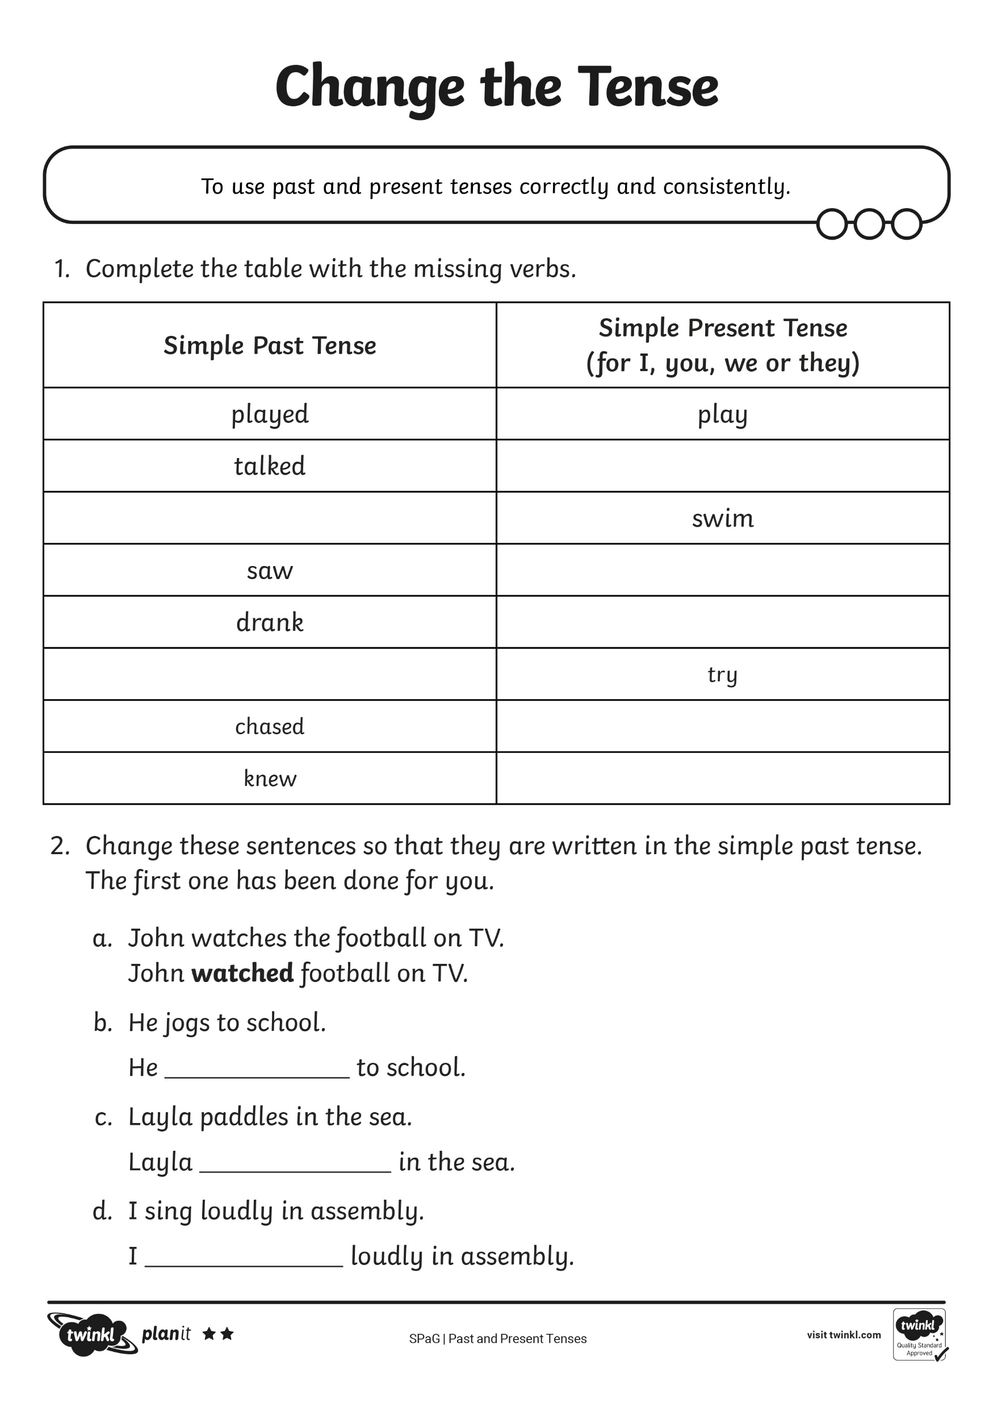
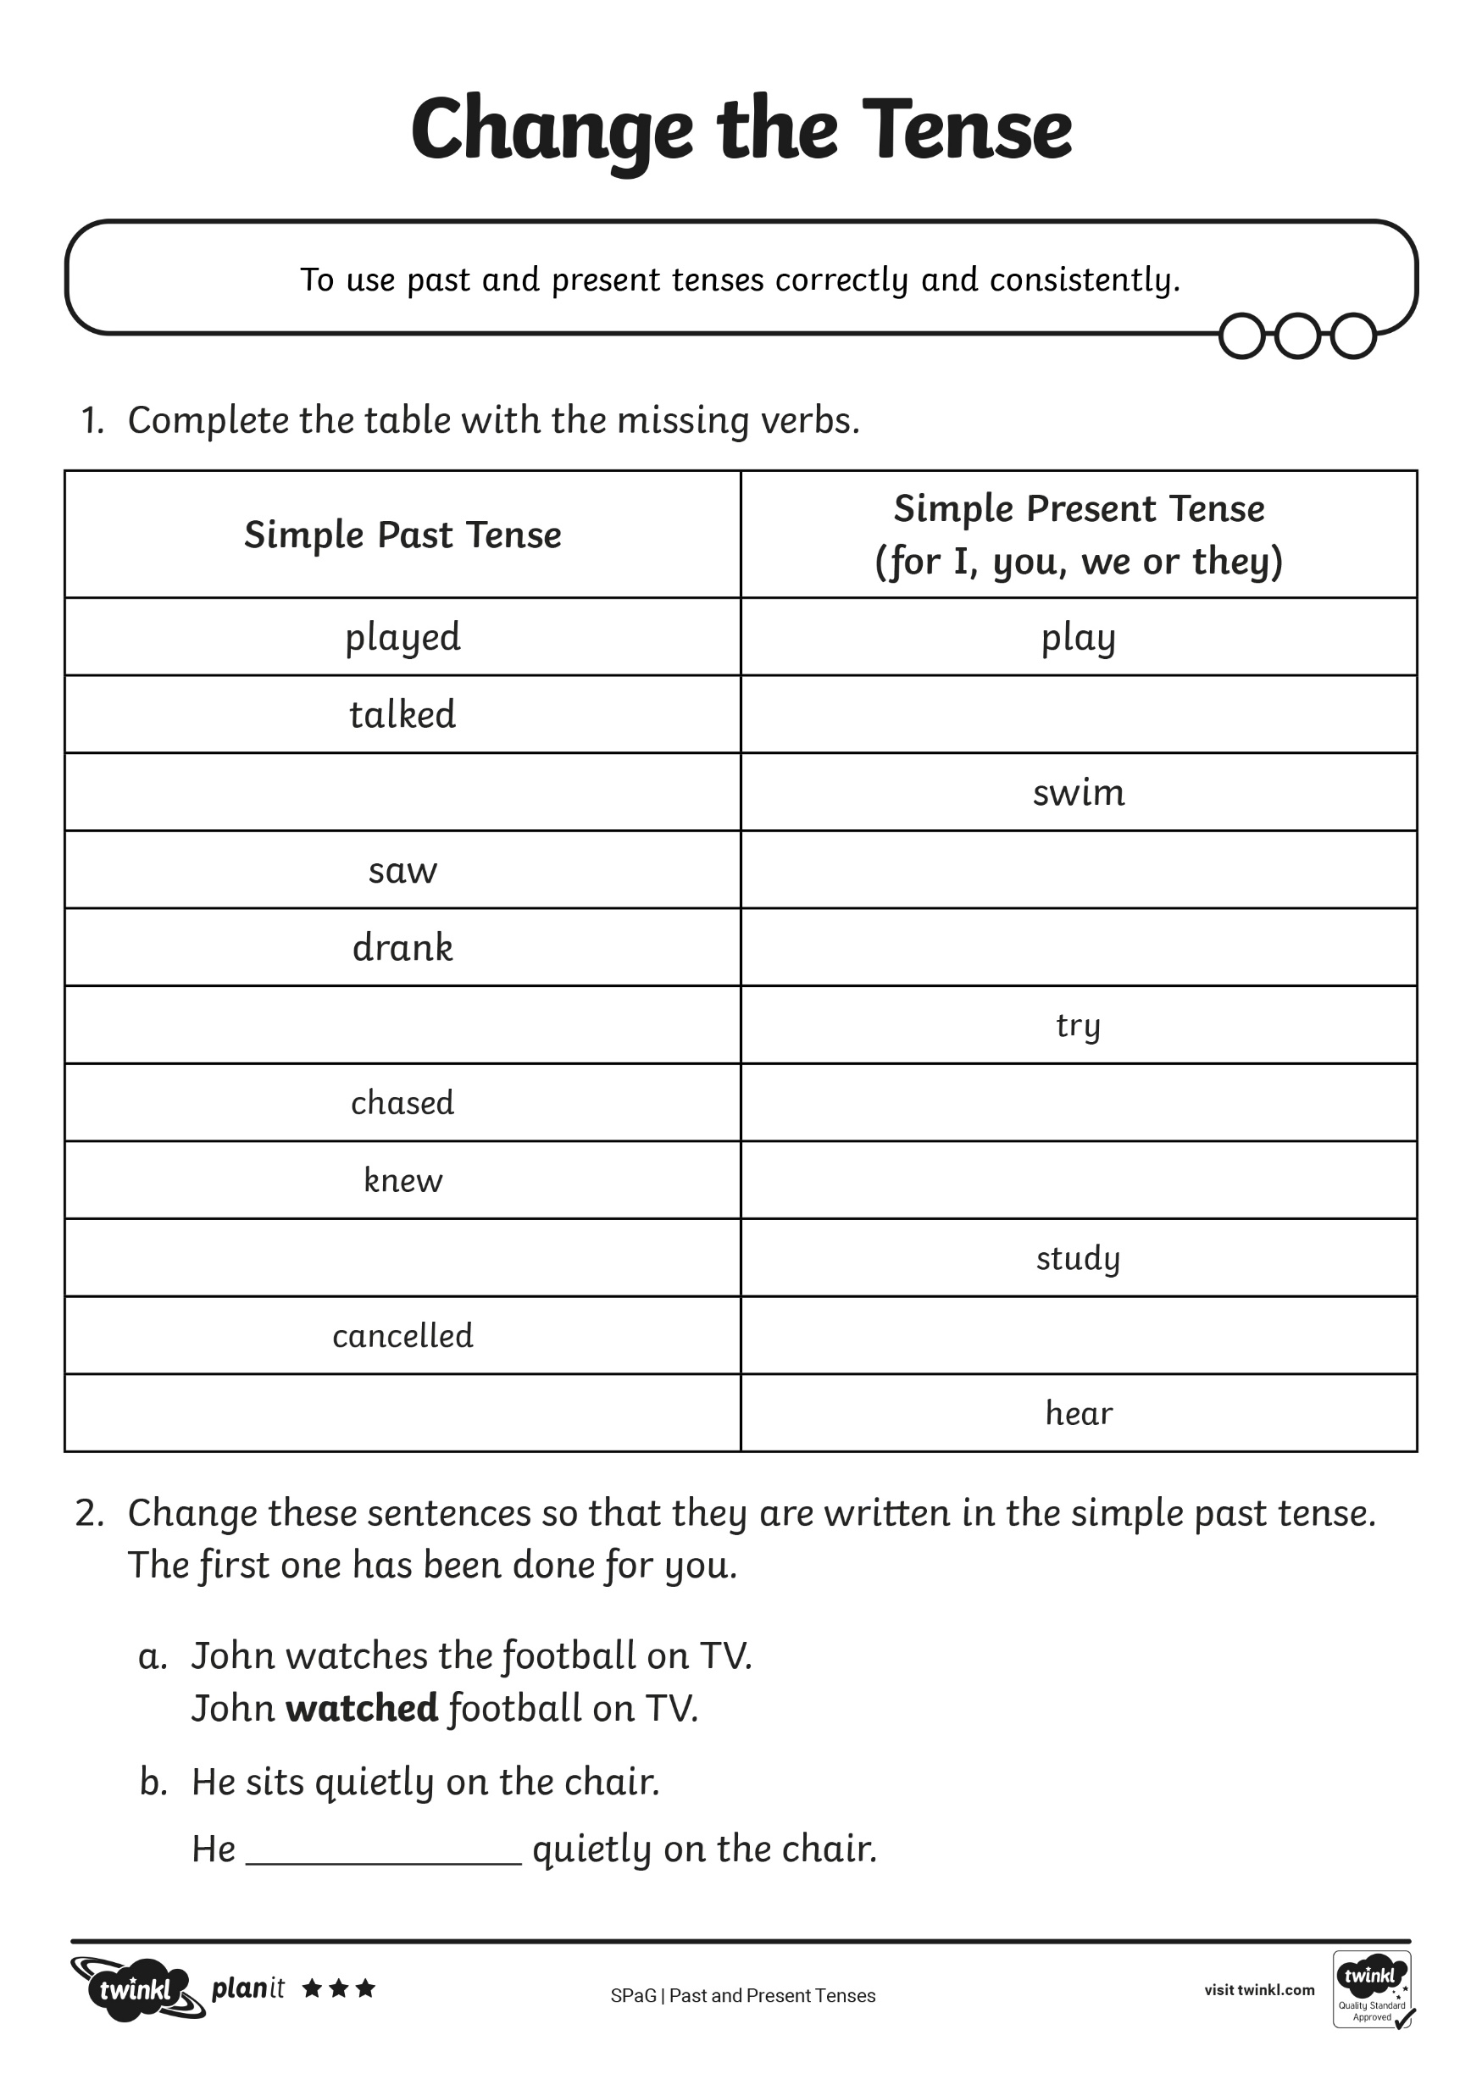
Present Tense Verbs
Using the Change the Tense Activity Sheet,
can you create past and present tense verbs?

Slide 18
Review Activity

Slide 19
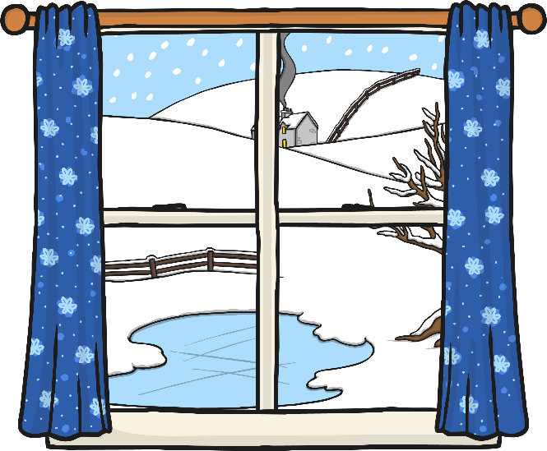
Spot the Mistake
When we are writing, it is important that the tense we use stays consistent. That means if we begin writing in the past tense, we must use the past tense all the way through.
Look at the paragraph below. The writer began writing in the past tense. Can you spot the mistakes?
Lucy woke up early on Sunday morning. She stretched and looked over to her window. Suddenly, she remembers that it is snowing just before she went to bed last night. She jumped out of bed and races to the window. Outside the ground was covered in deep, soft snow.
Which words would you use instead?

Slide 20
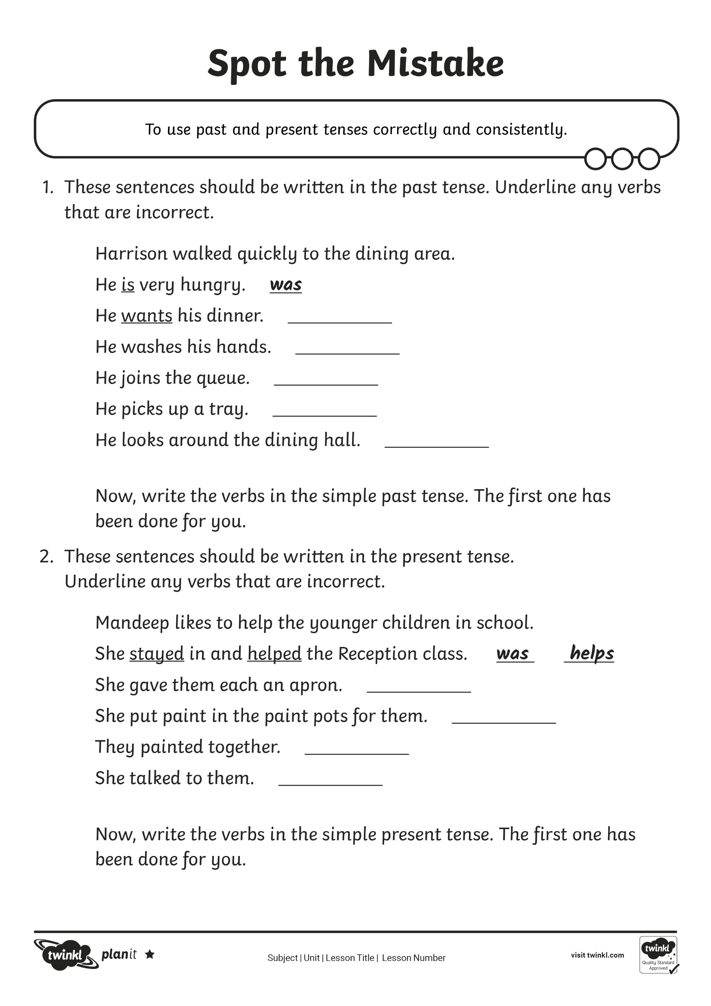
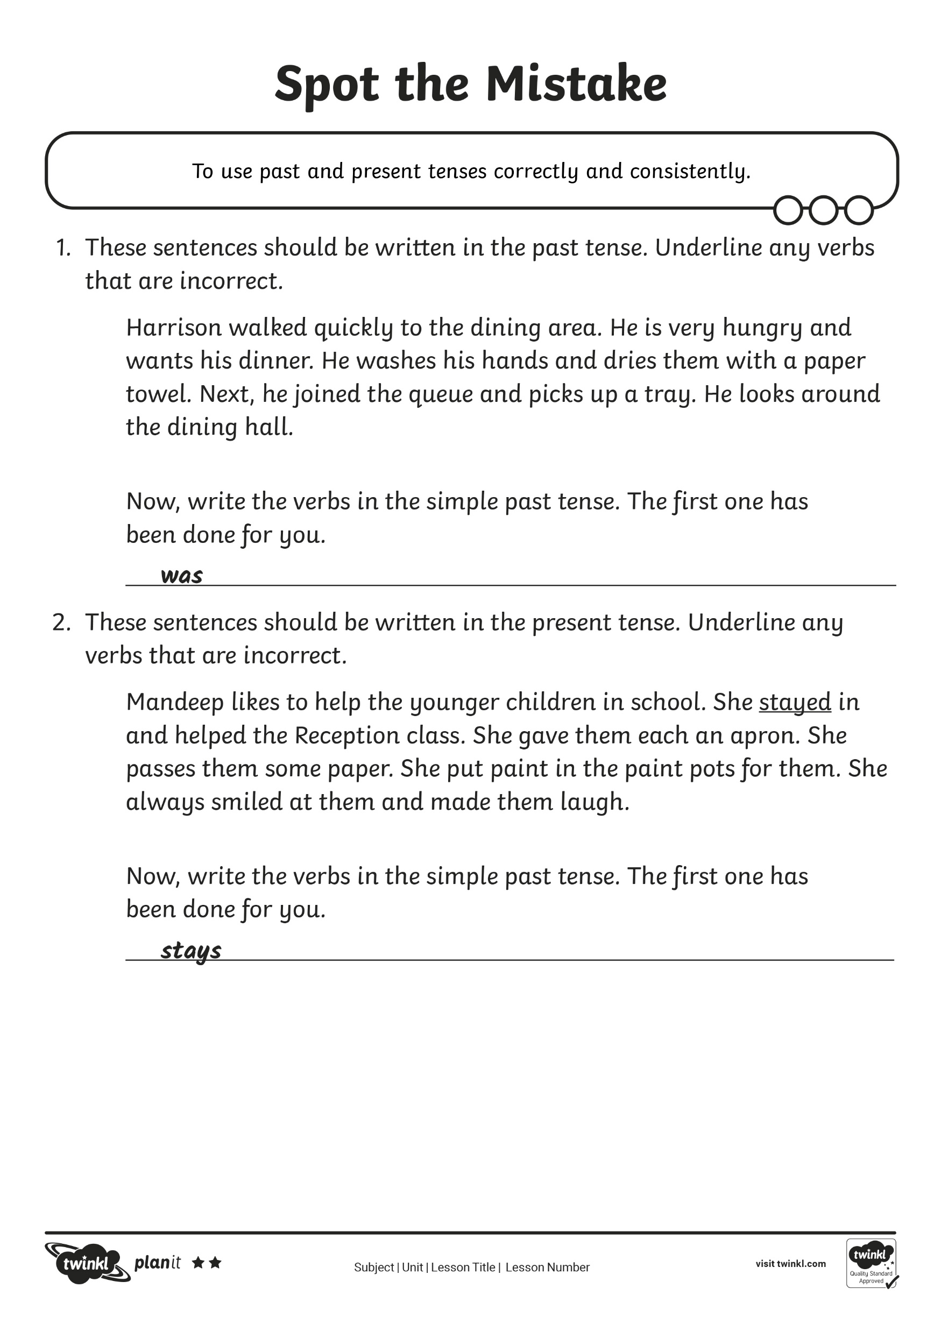
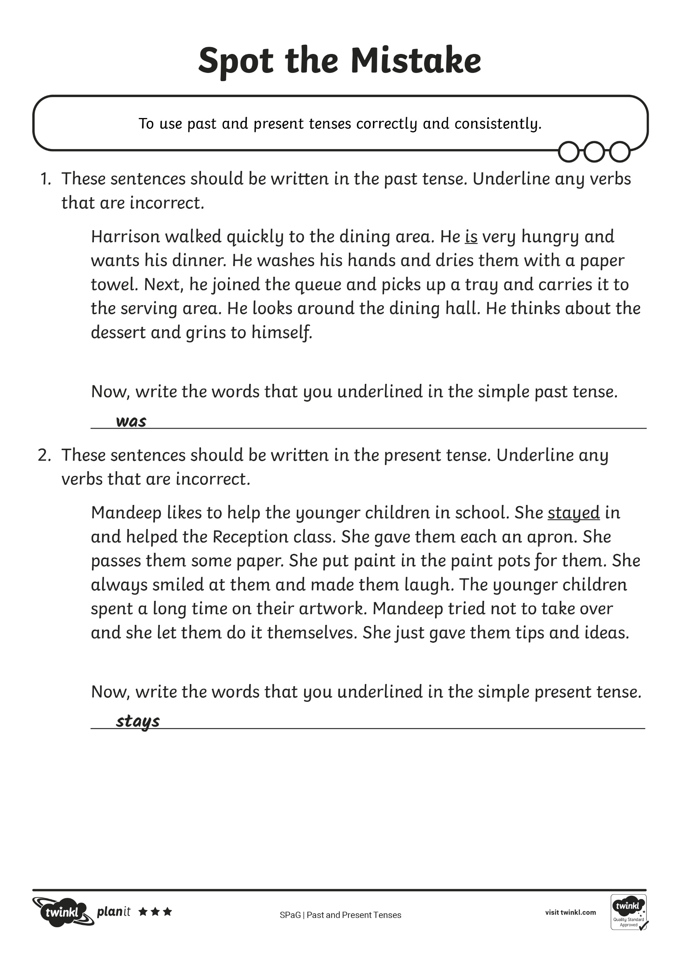
Spot the Mistake
Using the Spot the Mistake Activity Sheet, can you spot when the
writer has changed tenses and write in the correct word?

Slide 21
Consolidation Activity

Slide 22
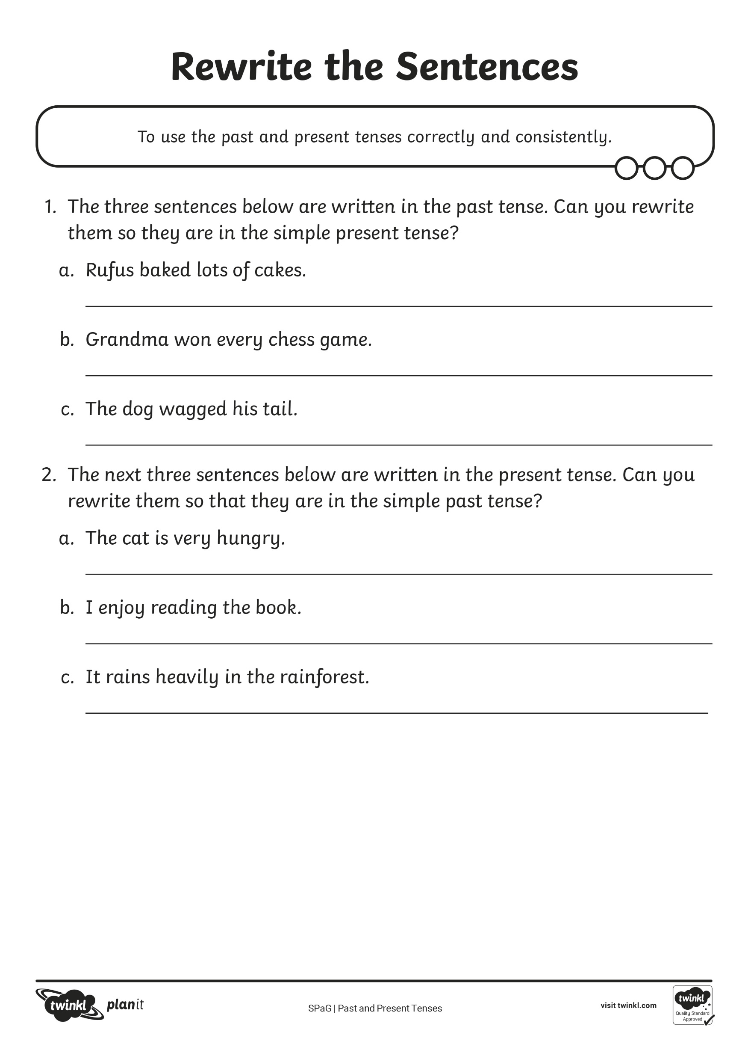
Rewrite the Sentences
There are seven sentences on the sheet. The first four are written in the past tense, can you rewrite them in the present tense? The last three are written in the present tense, can you rewrite them in the past tense?
Scott and Sam are having salmon for dinner.
Present Tense
Scott and Sam had salmon for dinner.
Past Tense

Slide 23
Assessment

Slide 24
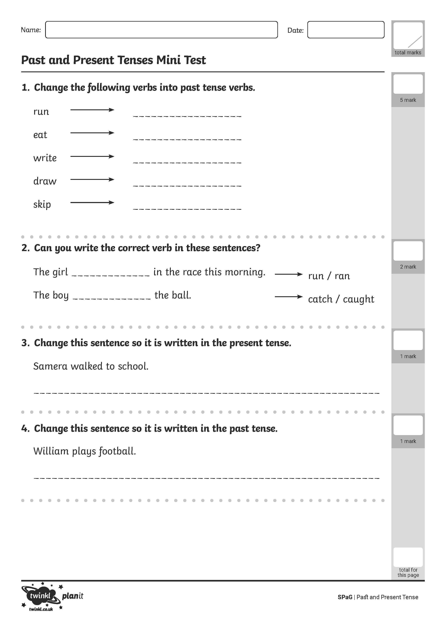
Past and Present Tenses
Use all of the information your have learnt and practised about
past and present tense. Work on your own to complete
the Mini Test Activity Sheet.

Slide 25
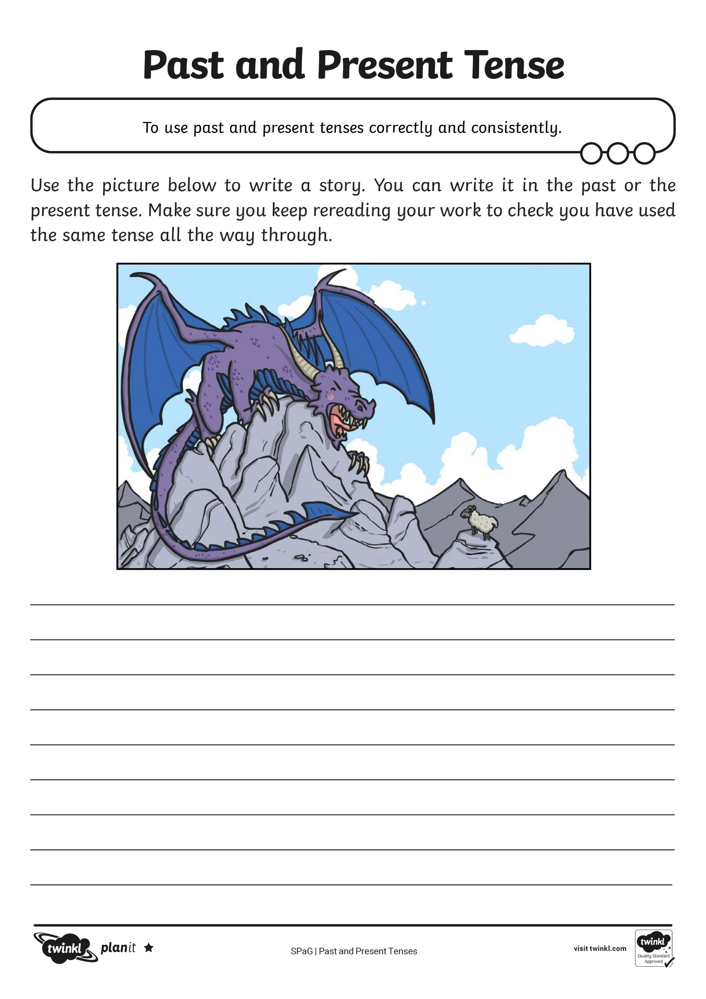
Past and Present Tenses
Use all of the information your have learnt and practised about
past and present tense. Work on your own to complete
the Application Activity Sheet.

Slide 26

Aim
To use past and present tenses correctly in my writing.
Success Criteria
I can identify sentences that are written in the past tense.
I can change verbs to past tense verbs.
I can identify sentences that are written in the present tense.
I can change verbs to present tense verbs.
I can use tenses correctly and consistently in my writing.

