Slide 2
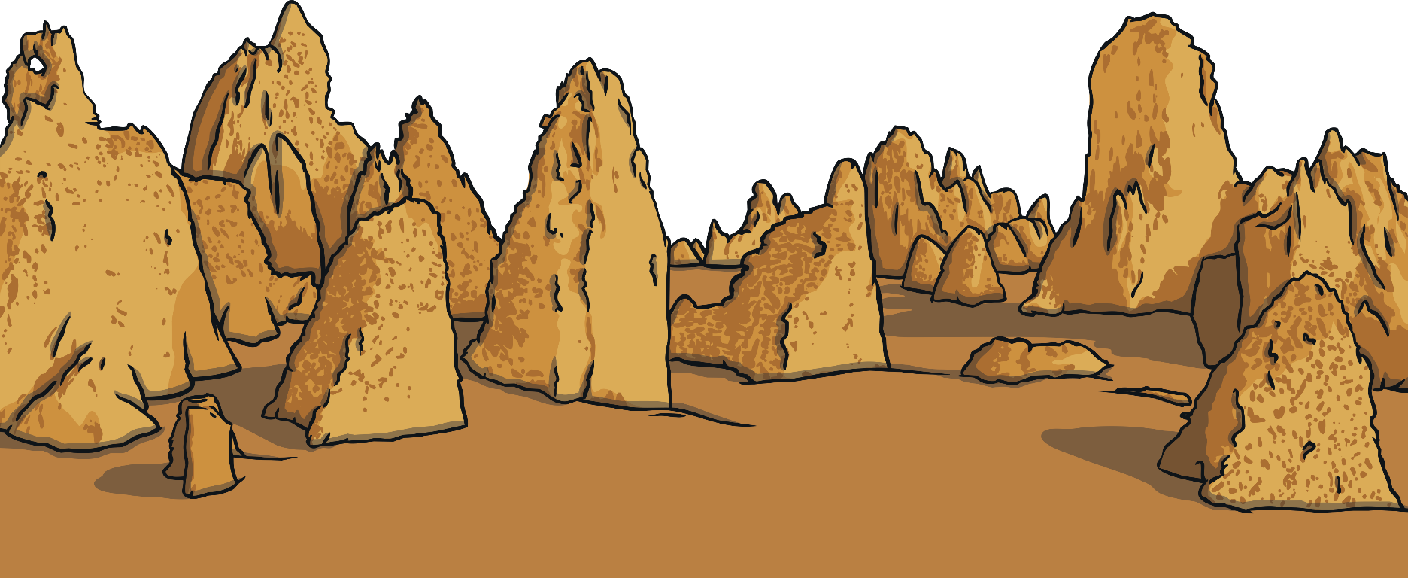

Have You Ever Received a Postcard?
Who was it from?
What picture did it have on it?
Where had they been?
What did they write about?
How long had they been away?
Did it have a special stamp
on it?

Slide 3
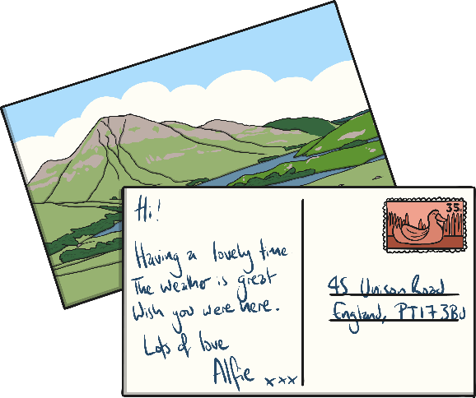

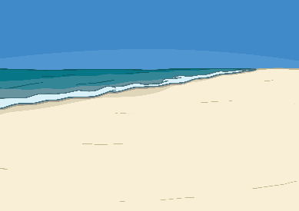

What Is a Postcard?
Sending a postcard is a quick and easy way to write to someone.
It is a single piece of card. On one side, there is usually a picture of the place the postcard is from. On the other, there is space to write a short message and space for the recipient’s address.
Postcards are good for sending short messages. They are usually cheap to buy and they don’t need an envelope.

Slide 4

Think about It
Imagine you are on holiday in the Kalahari Desert.
What might be on your postcard?
Remember: What will you need to write to make sure that your postcard gets where it needs to go?

Slide 5
What Do You Think Needs to Be Included in a Postcard?
Space for a picture (on the front).
Blank lines for an address.
Space to write about your holiday.
postcard
The name and address of who you’re sending it to.
Some writing to say what you’ve been doing on your holiday.
Space in the top right corner for a stamp.

Slide 6
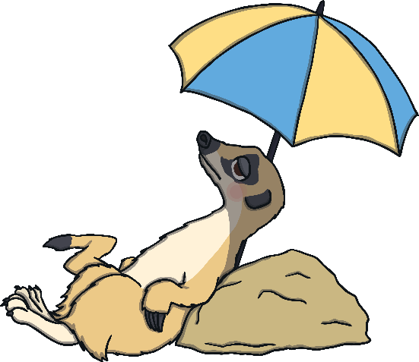
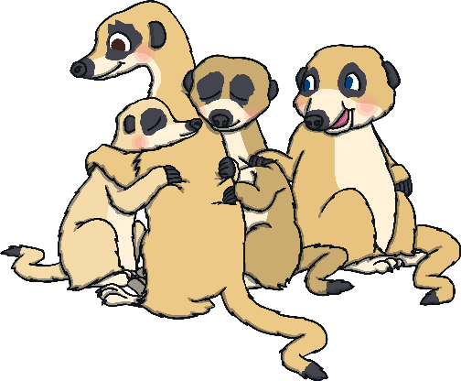

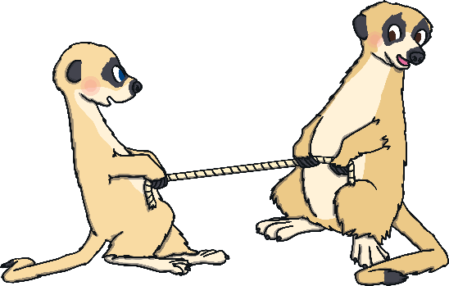
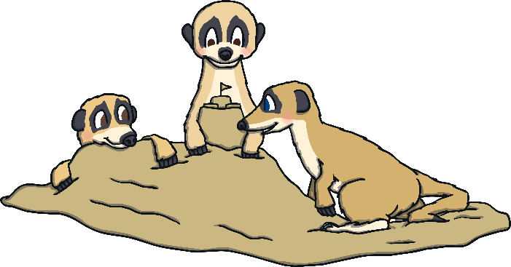
What Might You Write about in a Postcard?
You might want to write about what you have already done on your trip and what you plan to do next.
Today, I visited Uncle Bob. Tomorrow, I am going to see my cousins.

Slide 7
If You Were a Meerkat…
If you were a meerkat who was away from home, what might you write on your postcard?
who you have seen
where you slept
what you didn’t like very much
what you plan to do next
what you have eaten
what you liked most
what the weather is like
how where you are reminds you of home

Slide 8
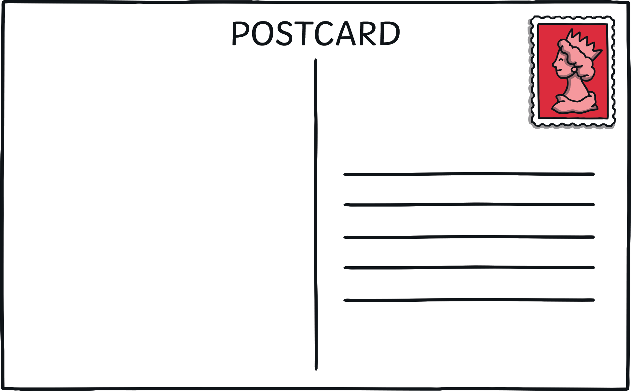

A stamp in the top right corner.
Dear Mum and Dad,
I have been having lots of fun on my adventure. Yesterday, I went to visit Uncle Bob. He made me feel very welcome.
Today, I went to see my cousins. We had a lots of delicious treats to eat.
Tomorrow, I am going to visit a farmyard.
From Gail x
Lines for writing the address.
My Meerkat Family,
Our Burrow,
Kalahari Desert,
Botswana
Space to write about your holiday – what you have done and what you will be doing.
The name and address for who you are sending the postcard to.

Slide 9

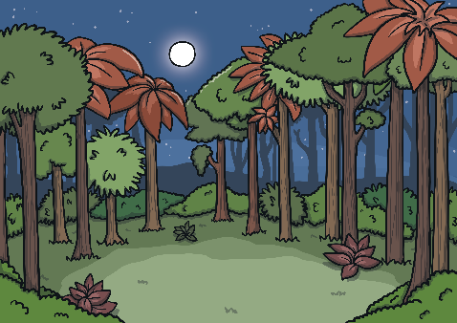
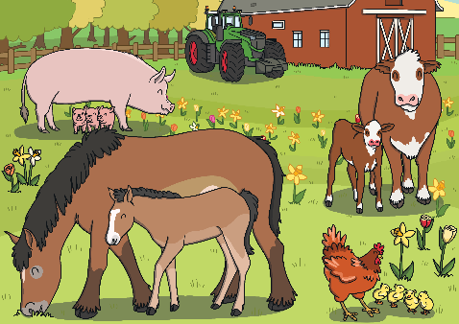
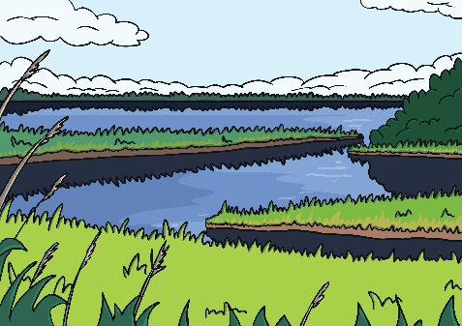
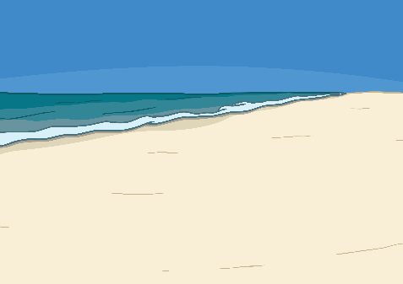
Picture Perfect
If you were a meerkat who had been on lots of different adventures, what picture might you put on the front of your postcard?
You might have been to…
the desert
the forest
the farm
the marsh
the beach

Slide 10
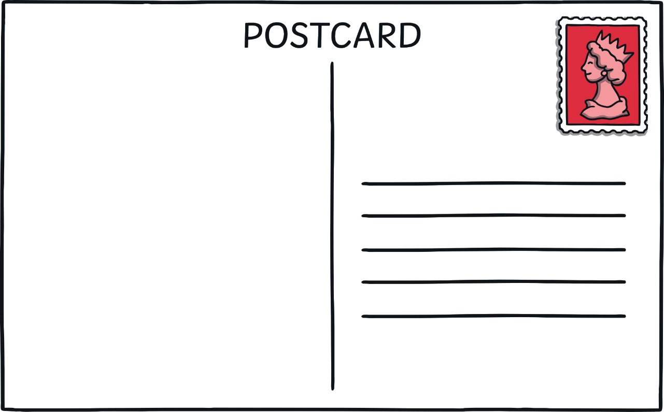

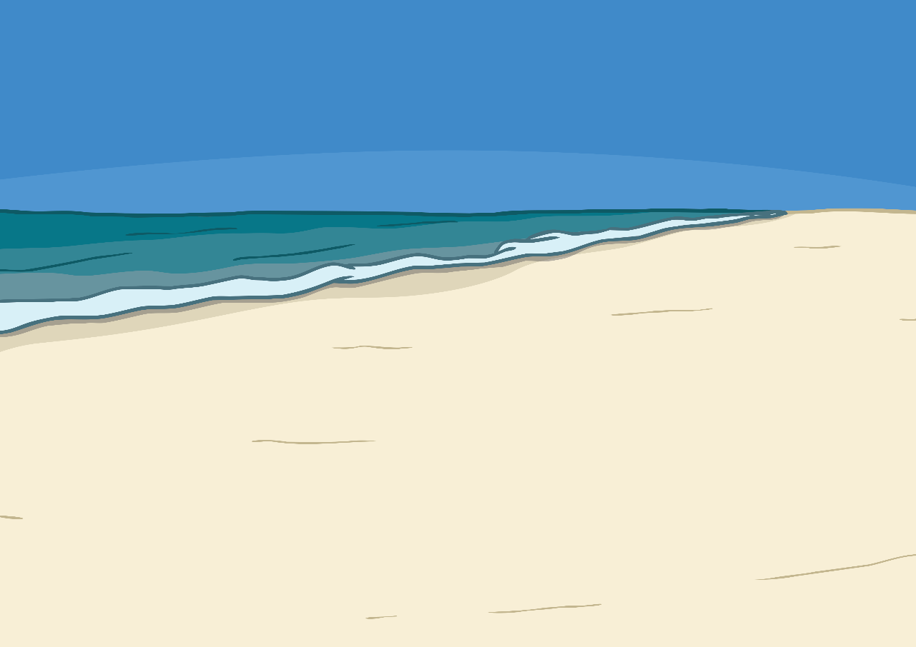
A picture on the front of your postcard showing where you are
on holiday.
Dear Mum and Dad,
I have been having lots of fun on my adventure. Yesterday, I went to visit Uncle Bob. He made me feel very welcome.
Today, I went to see my cousins. We had a lots of delicious treats to eat.
Tomorrow, I am going to visit a farmyard.
From Gail x
My Meerkat Family,
Our Burrow,
Kalahari Desert,
Botswana

Slide 11

My Meerkat Memories
You are going to write your own postcard as if you are a meerkat who has just been on an adventure.
Remember to…
write the name and address of the
person the postcard is to;
include a greeting, e.g. Dear… Hello…
write using I, we or me;
include details about the trip;
sign off the postcard, e.g. Love from… Best wishes…

