Slide 2
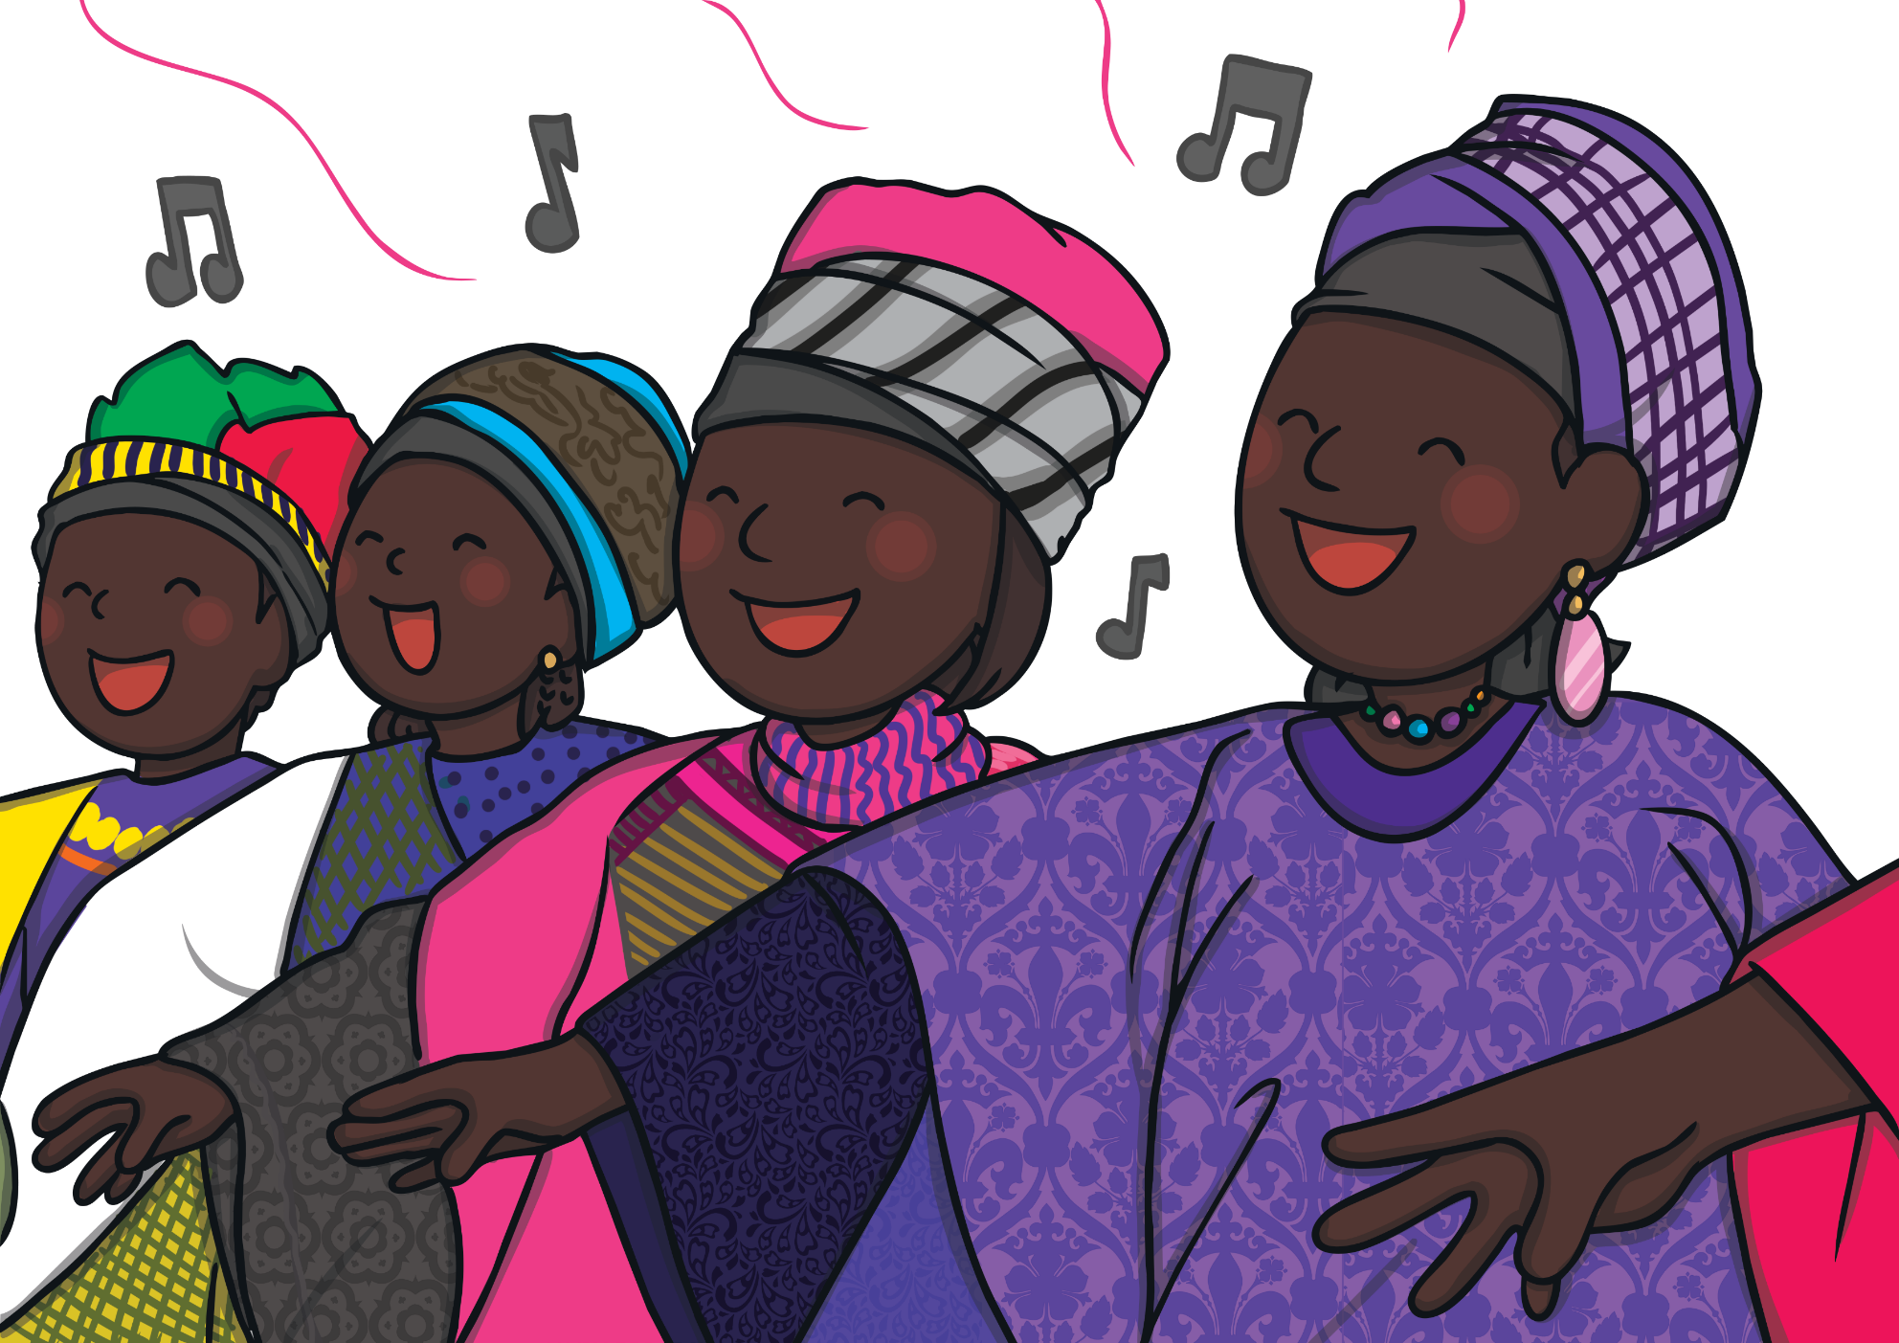
African Music
The continent of Africa has lots of different types of music. People play lots of different instruments that make a range of sounds.

Slide 3
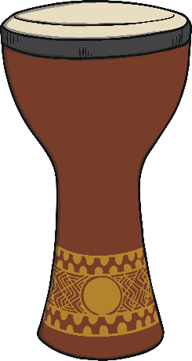
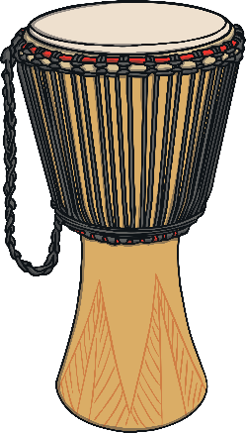

African Drums
Drumming is an important part of African music. Click to hear the sounds made by these drums.
Dumbek
Djembe

Slide 4
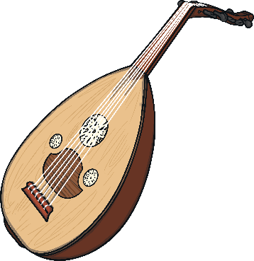
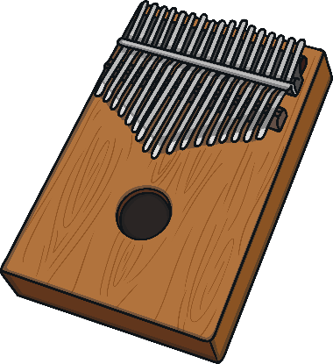
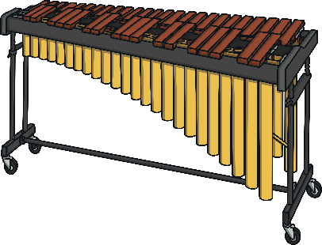
Tuned African Instruments
Here are some of the instruments that create the melodies in
African music.
Oud
Mbira
Marimba

