Slide 1
Multiplication Using a Number Line

Slide 2
Learning Objective
I can use a number line for multiplication.
Success Criteria
Know that multiplication is repeated addition
Know some of the language of multiplication - lots of, times, sets of…

Slide 3
Number Lines and Multiplication
Number lines can be used to help with multiplication.
A teacher has four packets of pens.
There are six pens in each packet.
How many pens are there altogether?
4 x 6 = ?
This can be shown on a number line.

Slide 4
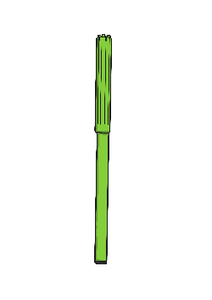
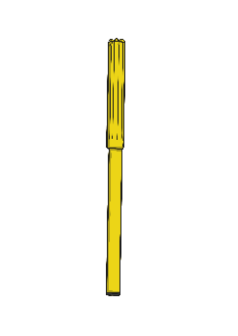

4 x 6 = ?
There are 4 groups of 6.
+6
+6
+6
+6
0
6
12
18
24
There are 24 pens.

Slide 5

In a PE lesson, a class of children is split into seven groups of three children. How many children are there in the class?
7 x 3 = ?
+3
+3
+3
+3
+3
+3
+3
0
3
6
9
12
15
18
21
There are 21 children.

Slide 6


Use a number line to multiply by two-digit numbers.
6 x 13
+60
+6
+6
+6
6 × 10 = 60
0
60
66
72
78
6 multiplied by 10, then 6 multiplied by 3, equals 78.
6 x 13 = 78

Slide 7
Task
Use a number line to show 3 x 12

