Slide 2

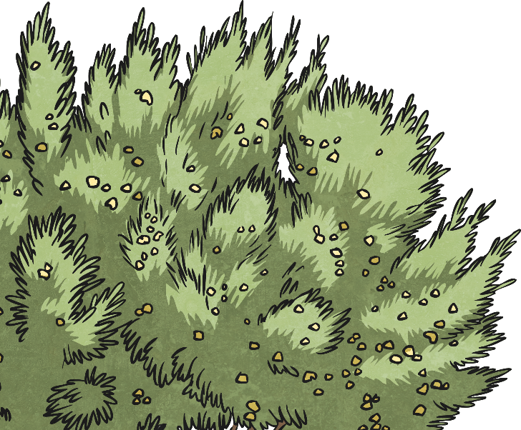
Evolution and Adaptation
What do these words mean?
Click on the word to discover the answer…
Evolution
The way something gradually develops and
makes changes over time.
Adaptation
The way something changes for the better
to suit something new or different.

Slide 3
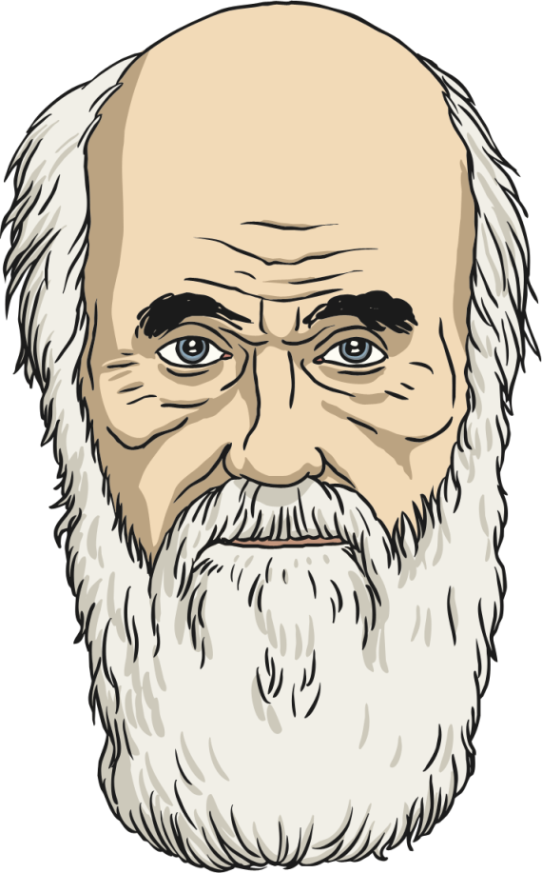
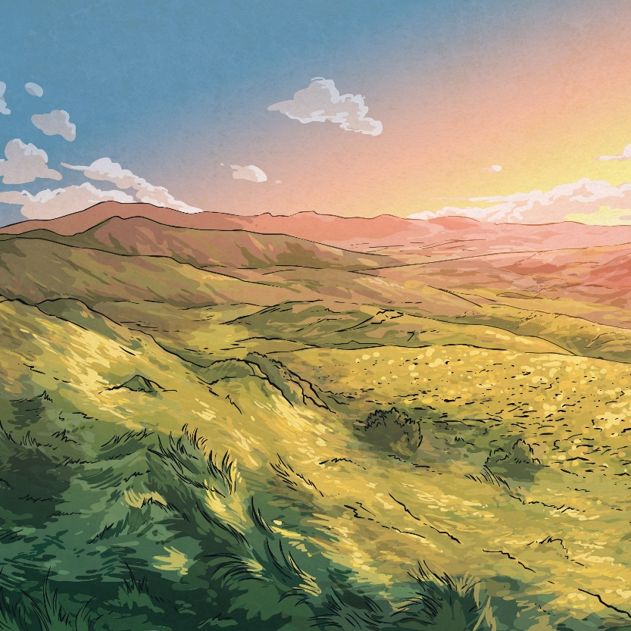
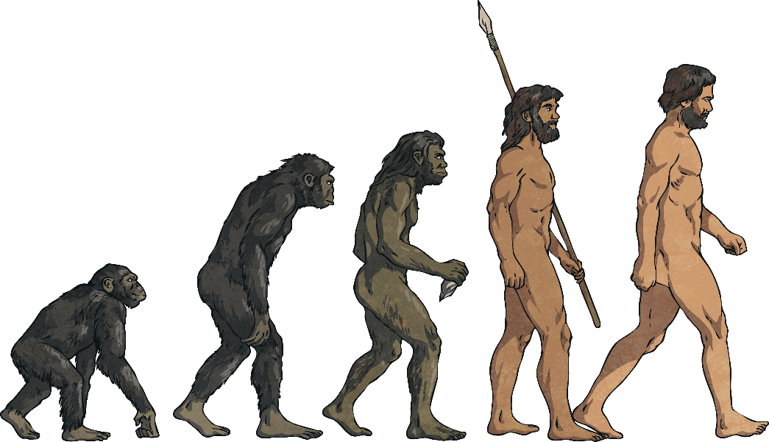
The Theory of Evolution
Charles Darwin (1809-1882) introduced the theory of evolution. He was a famous English naturalist (an expert in studying nature), biologist (an expert in living things) and geologist (an expert in rocks and fossils).
He discovered that humans and apes shared ancestors which led to this famous image…

Slide 4
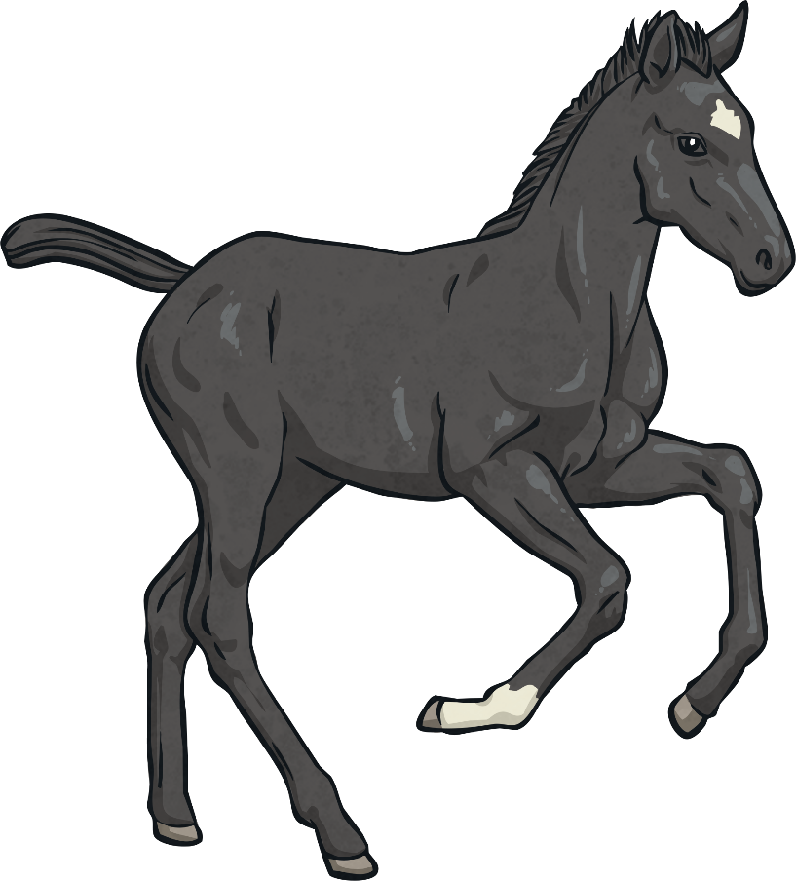
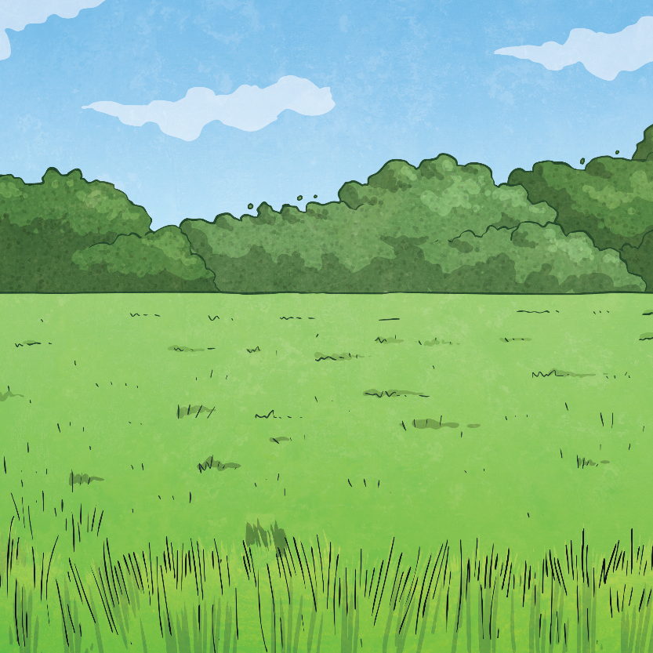
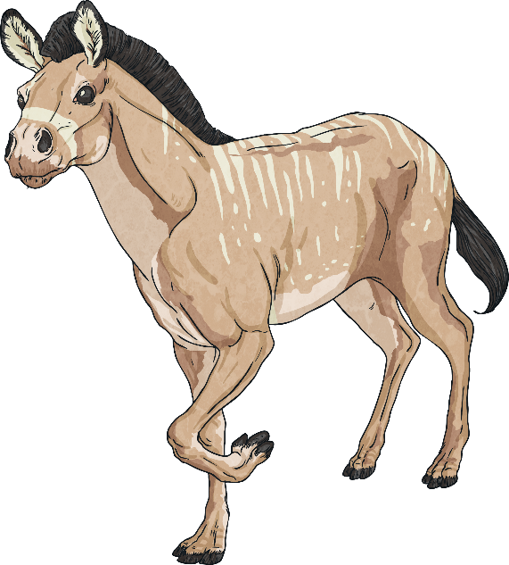
How Evolution Works
The thing about evolution is that it happens over the space of a long, long, long time so we don’t really notice it happening.
One animal, plant or person doesn’t
just change… there are small
changes with each new generation.
Evolution happens through inheritance
– meaning that tiny changes only
happen as traits pass to the
next generation.

Slide 5
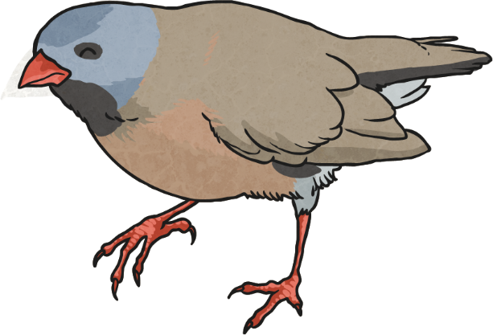
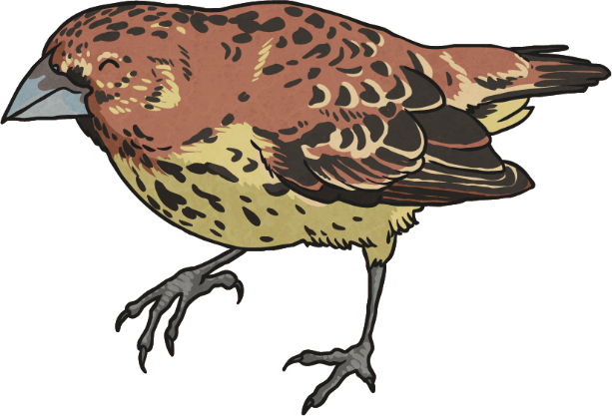
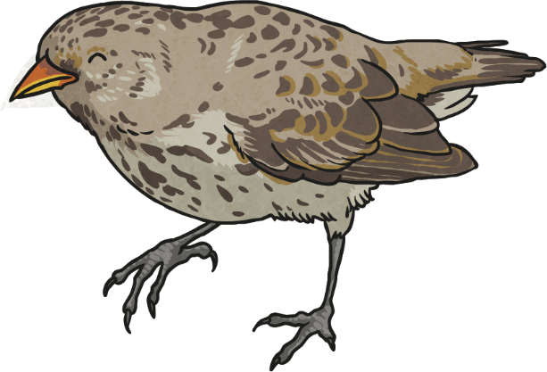
What Sort of Changes?
Animals and plants evolve to make adaptations to not only survive but to survive better. Some of these changes are down to habitats.
Darwin studied different finches living in different parts of the Galapagos Islands and realised, even though they were different, they all had the same ancestors!
Some had evolved to have larger beaks in certain areas, some with smaller beaks in other areas due to different food being available.

Slide 6
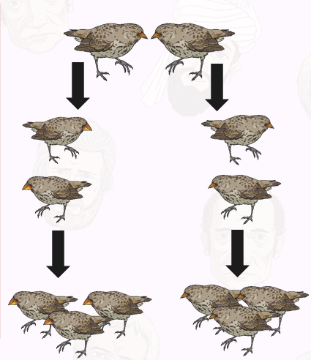
Small Changes Add up to Big Changes
Over time, the result of a few generations start to make noticeable differences.
Looking at the Galapagos finches
The ones with large beaks reproduced and had offspring.
More of these offspring inherited large beaks and survived.
In other parts of the Galapagos, smaller beaks ensured better survival than larger ones.
The adaptations meant that over a long period of time, the Galapagos finches evolved adaptive traits that caused differences between them.

Slide 7
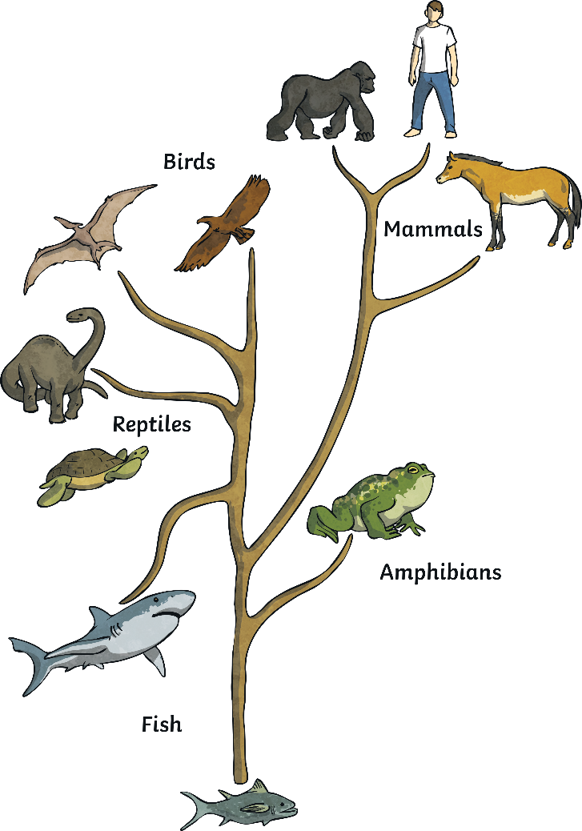
Small Changes Add up to Even Bigger Changes
Each generation is slightly different from the last but different families make their own generational changes and this can lead to species going down different evolutional paths.
This is part of the tree of life that shows how birds, reptiles and even humans developed from fish… but remember… over millions of years!

