Slide 1
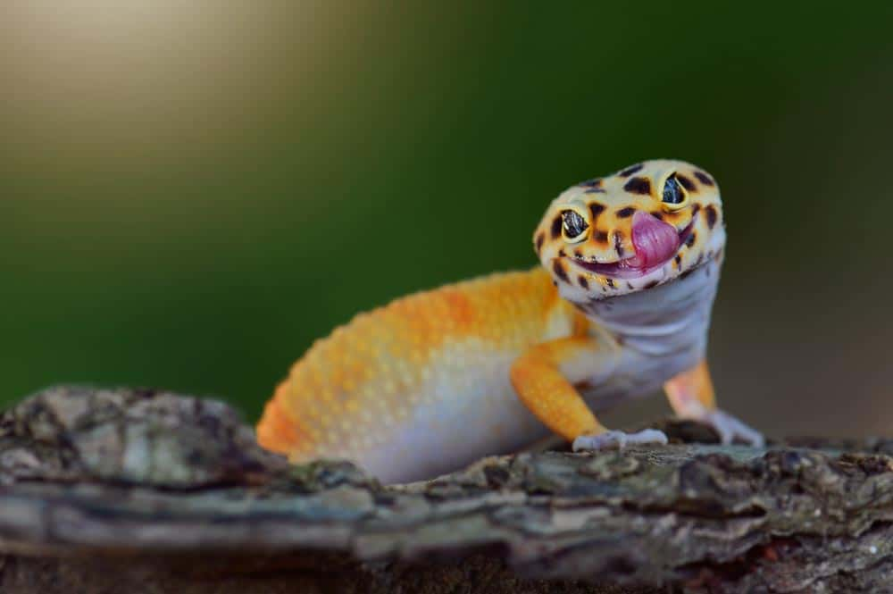
All geckos lack eyelids, instead of blinking, they clean their eyelids with their tongue.

Slide 2
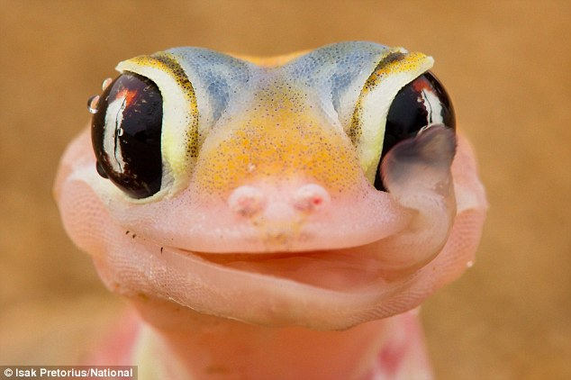
Word of the week
Definition:
Use it in a sentence:
quintessential
Word Class:
Antonym:
Synonyms:

Slide 3

This week we are looking at collection of words that can be used both as nouns and verbs.
For example:
1
The doctor’s surgery launched a new health scheme that would benefit everyone in the local community.
2
The company offered a pension plan, a company car and a health benefit scheme to their new employees.
Which of the sentences uses ‘benefit’ as a noun?

Slide 4
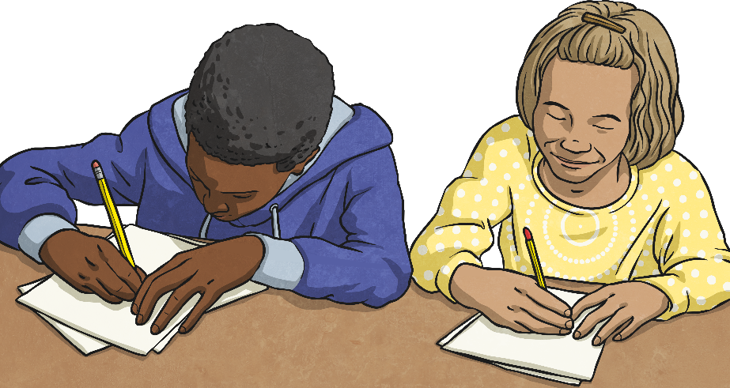
Can you think of any other words that could be nouns and verbs? You have two minutes to discuss this and write down examples with a partner.
What words did you think of?
Could you use them in an example sentence as a verb?
As a noun?
Start

Slide 5
Can you think of the word that could be used as a verb and a noun in these sentences? Which sentence is which?
charge
?
verb or noun?
noun
The static ________ caused Jamie to get a nasty shock when he touched the metal handrail.
verb or noun?
verb
The determined troops began to ________ towards enemy territory.

Slide 6
Can you think of the word that could be used as a verb and a noun in these sentences? Which sentence is which?
function
?
verb or noun?
noun
The whole of the restaurant was closed for a private _______.
verb or noun?
verb
The over-tired student doctor could barely ________ on only three hours sleep.

Slide 7
Can you think of the word that could be used as a verb and a noun in these sentences? Which sentence is which?
influence
?
verb or noun?
verb
The magician tried his best to __________ the man to choose the special card in the pack.
verb or noun?
noun
My mum says that my new best friend is a bad __________ on my behaviour.

Slide 8
Can you think of the word that could be used as a verb and a noun in these sentences? Which sentence is which?
interest
?
verb or noun?
noun
I have a very special ________ in science and would love to be a chemist when I get older.
verb or noun?
verb
Watching football doesn’t _________ me at all; I much prefer to watch rugby.

Slide 9
Can you think of the word that could be used as a verb and a noun in these sentences? Which sentence is which?
object
?
verb or noun?
verb
The local community were all going to ________ to the village post office being closed down.
verb or noun?
noun
The children were asked to guess the mystery _______ inside the strange box.

Slide 10
Write your spellings in to your book, including the title:
Words that are nouns and verbs challenge damage broadcast benefit charge function influence interest protest object

