Slide 1
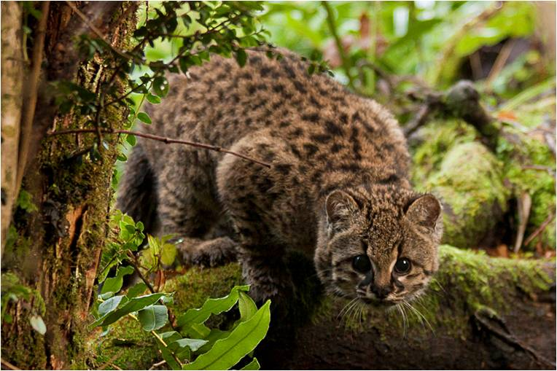
The kodkod or Guina is the smallest cat in the Americas. It is even smaller than a domestic house cat.

Slide 2
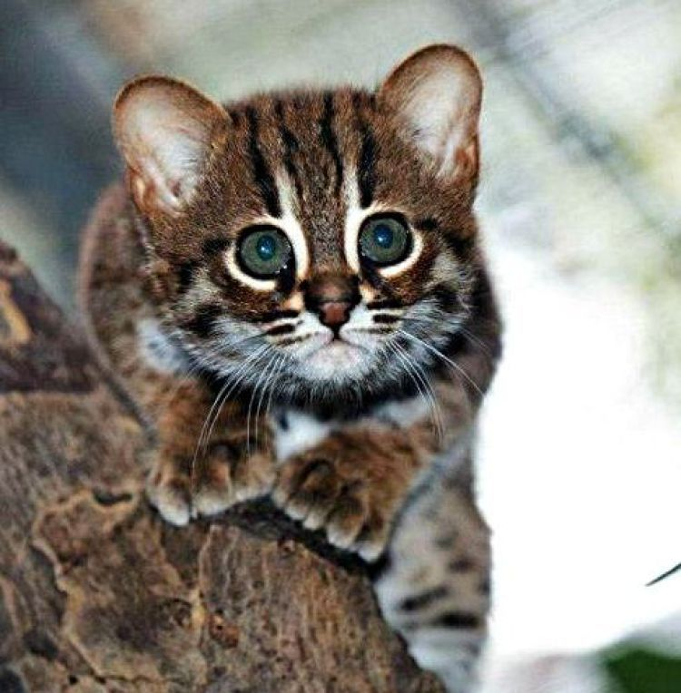
Word of the week
Definition:
Use it in a sentence:
rambunctious
Word Class:
Antonym:
Synonyms:

Slide 3
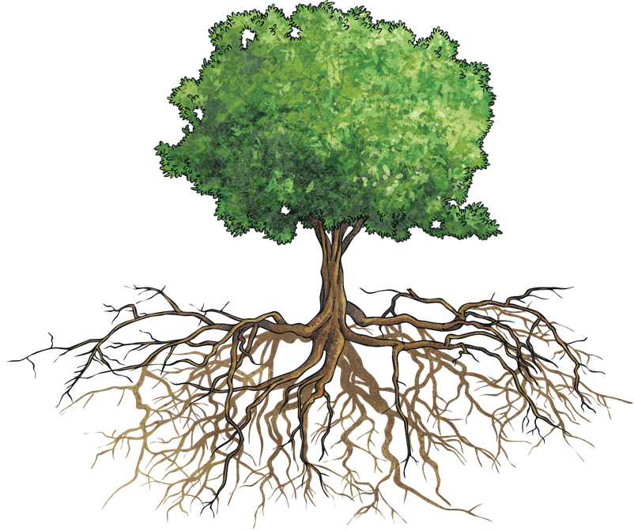
This week, we are again looking at spellings that belong to the same family of words. Knowing that a word follows a particular pattern, can make them simpler to spell.
Many words share the same origin* or root word.
*The word ‘origin’ means where something came from or where it began.

Slide 4

The particular root word that we are going to look at this week is…
Can you think of some words that contain the root ‘gram’?
‘gram’
which derives from Greek and is often associated with words that mean written or drawn.

Slide 5
Can you think of the ‘gram’ words to match these definitions in this quick-fire quiz?
1
6
program
program
A piece of software for a computer
programmer
A writer of computer programs
2
7
programme
A TV or radio show, or a list of events
diagram
A drawing to explain something
3
8
hologram
A 3D image that plays tricks on
your eyes.
grammar
The rules of how words are put together to form sentences
4
9
monogram
Initials used to identify a
personal possession
grammatical
Relating to the rules of grammar
5
10
telegram
A message sent by telegraph
parallelogram
A 2D shape with one pair of
parallel sided

Slide 6
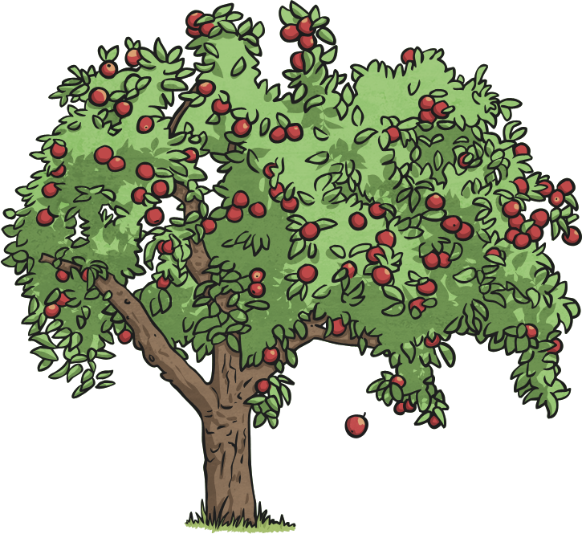
Have another look at your ‘gram’ root word spellings for this week…
grammatical
grammar
diagram
programmer
kilogram
hologram
monogram
tangram
telegram
parallelogram
‘gram’

Slide 7
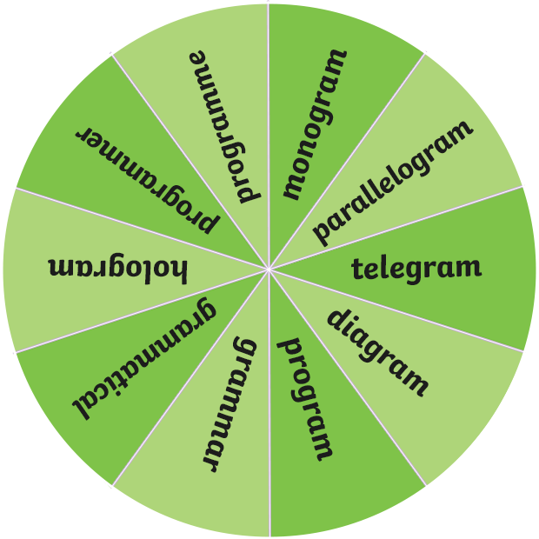

Let’s spin the spinner!
Now, work with your partner to write a sentence that contains the –en suffix word on your whiteboards.
Could your sentence also contain direct speech?
Could your sentence also contain a modal verb?
Could your sentence be written in the passive voice?
Could your sentence also contain a subordinate clause?
Could your sentence also contain a relative clause?
Spin

Slide 8

Here are your spelling words for this week.
tangram
telegram
hologram
diagram
grammar
grammatical
parallelogram
monogram
programmer
kilogram
Work hard to practise these ‘gram’ word
family spellings.

Slide 9
Write your spellings in to your book, including the title:
Word families – ‘gram’

