Slide 1
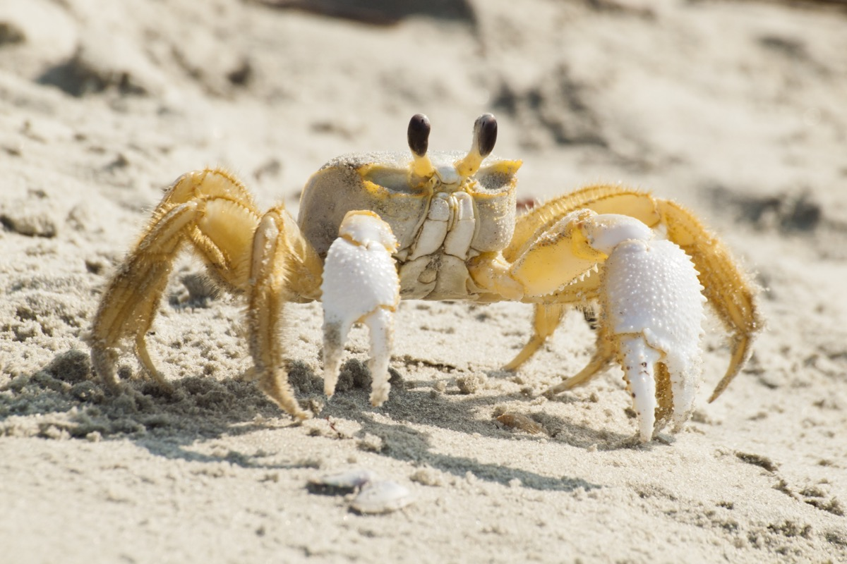
Ghost crabs growl using teeth in their stomachs.

Slide 2
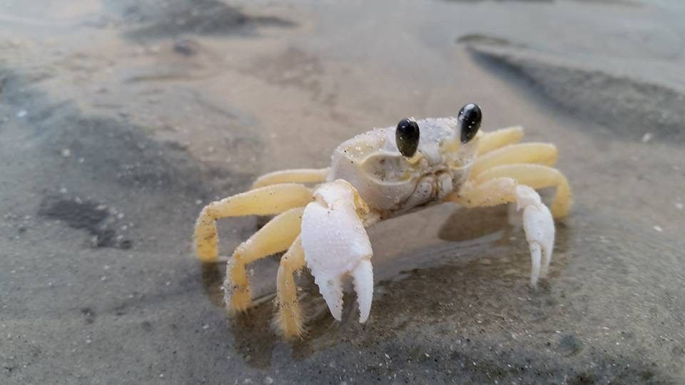
Word of the week
Definition:
Use it in a sentence:
philanthropist
Word Class:
Antonym:
Synonyms:

Slide 3
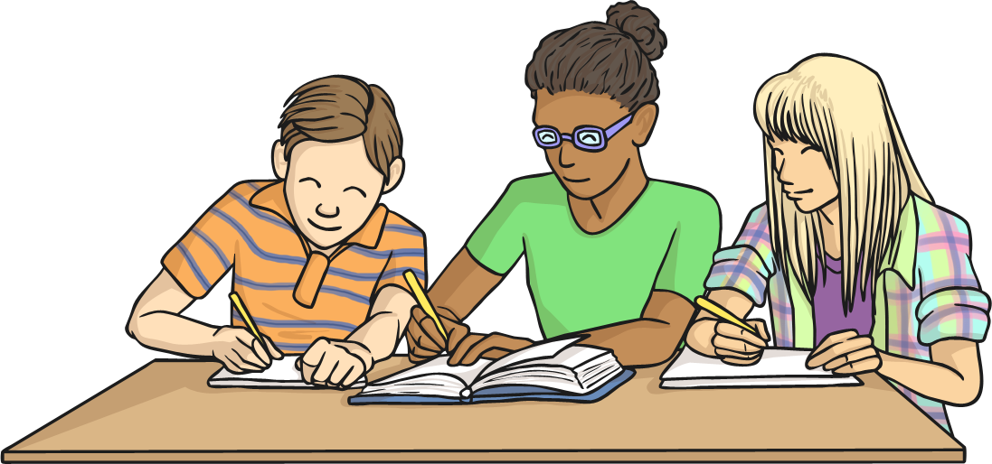
This week, we are going to look at a set of statutory spelling challenge words from the Y5/Y6 statutory spelling list.
These are the words that don’t ‘fit’ into any particular spelling patterns and therefore must each be learnt separately.

Slide 4


Let’s play ‘Ten Strikes and You’re Out!’ Click on the letters that you think are missing to try to make the word. Every time you guess a letter incorrectly, press the ‘Uh-oh’ button to make a pin disappear! Can you guess all of the missing letters before you strike out?
Click here
for a clue!
To recognise the full worth of.
____e____e
Uh-Oh!
a
b
c
d
e
f
g
h
i
a
j
k
l
m
n
o
p
q
r
p
s
t
u
v
w
x
y
z

Slide 5
Let’s play ‘Ten Strikes and You’re Out!’ Click on the letters that you think are missing to try to make the word. Every time you guess a letter incorrectly, press the ‘Uh-oh’ button to make a pin disappear! Can you guess all of the missing letters before you strike out?
Click here
for a clue!
The way in which a word is spoken.
__o________o_
Uh-Oh!
a
b
c
d
e
f
g
h
i
i
j
k
l
m
n
o
q
r
n
n
p
s
t
u
v
w
x
y
z

Slide 6
Let’s play ‘Ten Strikes and You’re Out!’ Click on the letters that you think are missing to try to make the word. Every time you guess a letter incorrectly, press the ‘Uh-oh’ button to make a pin disappear! Can you guess all of the missing letters before you strike out?
Click here
for a clue!
Enough; adequate.
________n_
Uh-Oh!
a
b
c
d
e
f
f
g
h
i
i
j
k
l
m
n
o
p
q
r
s
t
u
v
w
x
y
z

Slide 7
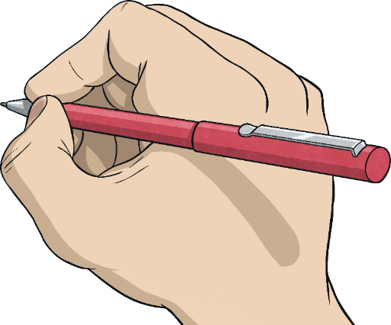
Here are this week’s spellings to practise.
foreign
apparent
appreciate
persuade
individual
language
sufficient
determined
explanation
pronunciation

Slide 8
Write your spellings in to your book, including the title:
Year 5/6 Spellings

