Slide 1
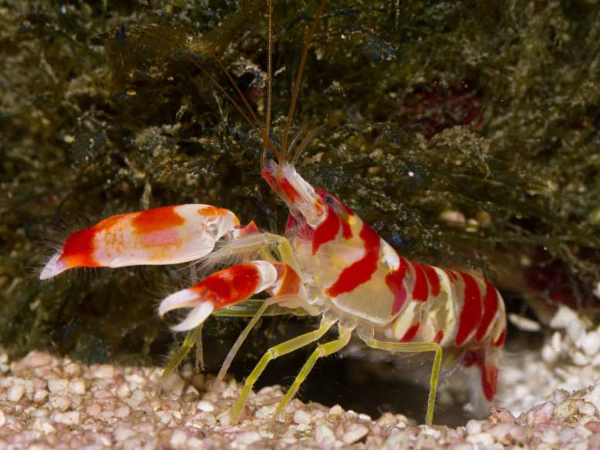
The loudest animal in the world is a mere 2cm long, prawn. The Pistol Shrimp is capable of snapping it’s claw shut so rapidly, that it creates a bubble which collapses to produce a sonic blast, louder than a Concorde's sonic boom.
.

Slide 2
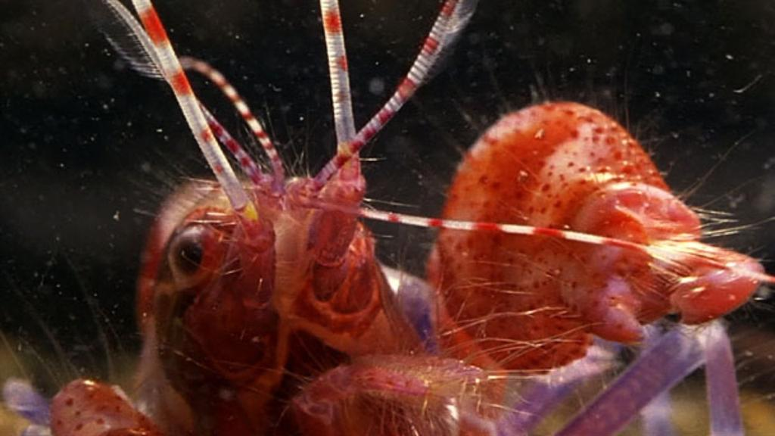
Word of the week
Definition:
Use it in a sentence:
nonchalantly
Word Class:
Antonym:
Synonyms:

Slide 3
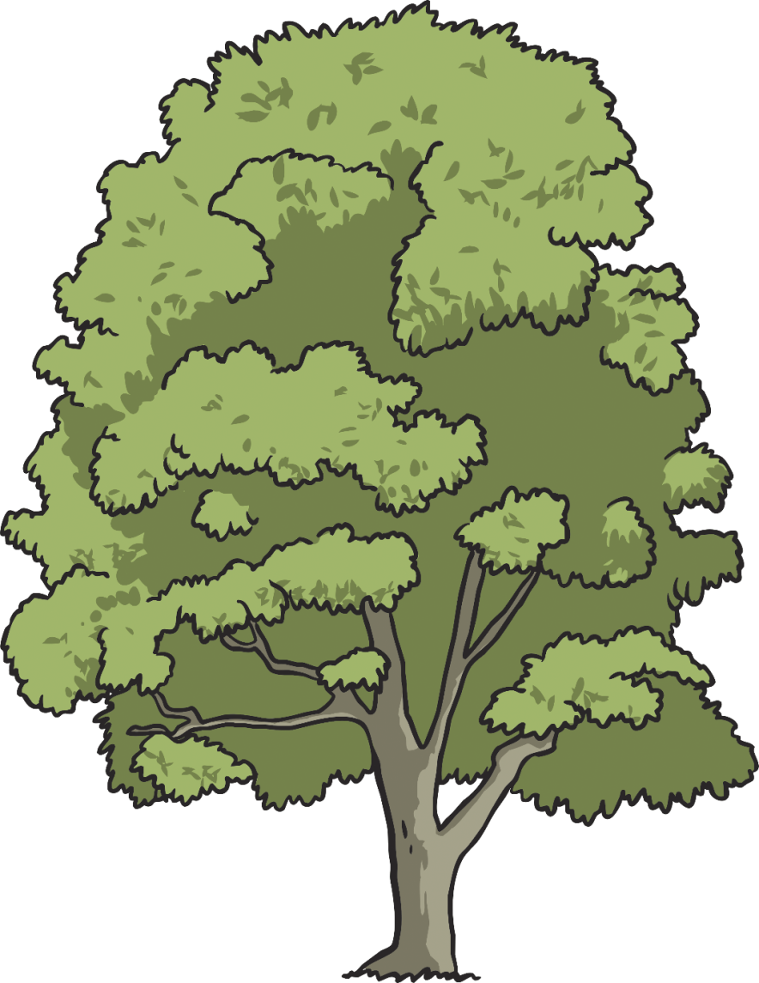
The particular root word that we are going to look at this week is…
assign
signature
design
designate
‘sign’
significant
resignation
which derives from Latin and is often associated with words that mean ‘to mark’ or ‘to seal.’
resign
insignificant
assignment
signal
‘sign’

Slide 4
Question 1
Which is the correct ‘sign’ spelling to fit this definition?
To write your name in a distinctive way.
A
C
Incorrect Answer
Incorrect Answer
signiture
siggnature
B
D
signature
Incorrect Answer
Correct Answer!
signachure

Slide 5
Question 2
Which is the correct ‘sign’ spelling to fit this definition?
To create a plan or drawing of a building,
piece of clothing or object before it is built or made.
A
C
Incorrect Answer
Incorrect Answer
disign
desine
B
D
Incorrect Answer
desing
design
Correct Answer!

Slide 6
Question 3
Which is the correct ‘sign’ spelling to fit this definition?
Greatly important and worthwhile.
A
C
Correct Answer!
Incorrect Answer
significant
signifficant
B
D
significent
Incorrect Answer
Incorrect Answer
signeficant

Slide 7
Question 4
Which is the correct ‘sign’ spelling to fit this definition?
A piece of work to complete as part of a job or course.
A
C
Incorrect Answer
Incorrect Answer
assignment
asignment
B
D
Correct Answer!
Incorrect Answer
assignmant
asignmant

Slide 8
Points
100 000
10 000
1000
100
100
100
100
100
Notes:
Click the tick to change the score when a correct answer is chosen. If an incorrect answer is chosen, click the arrow to go to the next question ☺

Slide 9
Here are this week’s spellings to practise.
signature
reassign
design
designate
signify
resignation
insignificant
assignment
signal
countersign

Slide 10
Write your spellings in to your book, including the title:
Word families with the root word ‘sign’

