Slide 1




WALT: calculate the percentage of an amount.
Percentages
%
%
Spiders can help us!

Slide 2
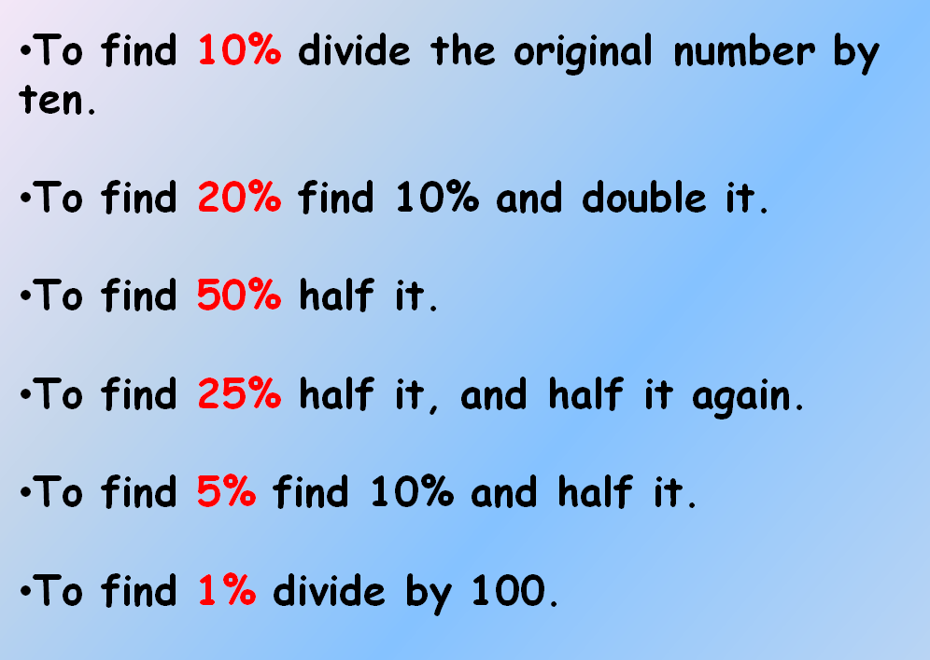
WALT: calculate the percentage of an amount.
%
Then use the spider diagram and the poster shown below to help you find the percentages of different amounts.

Slide 3







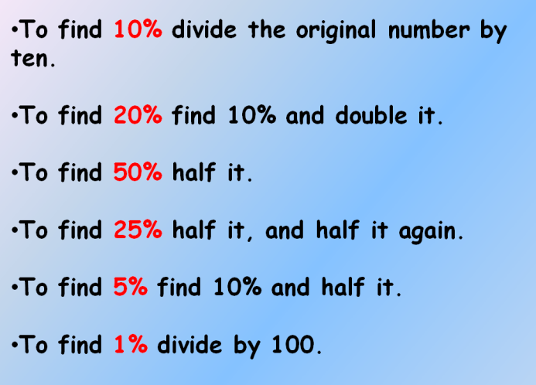


Slide 4








Slide 5



