Slide 2
Aim
Recall and use equivalences between simple fractions, decimals and percentages, including in different contexts.

Slide 3



Fractions to Decimals (1)
Diving
Give the equivalent for each decimal or fraction that is shown or represented in the table and explain the method you used.
From your answers below, give the decimal that is closest to:
1
400
5
1000
1
= 0.2
400
5
=
0.4
1000
Fraction | Method Used | Decimal
×
?
so 0.45 is the
closest decimal.
0.16 is the
closest decimal.
4
4
×
4
16
Finding an equivalent fraction where the denominator is 10 or 100 makes it easier to convert from a fraction to a decimal.
25
=
=
0.16
0.16
×
25
4
100
9
9
×
5
45
20
×
=
= 0.45
0.45
20
5
100
45
45
×
2
90
50
×
=
= 0.9
0.9
50
2
100
120
6
20
120
0.1
0.1
0.1
0.6 =
×
=
200
×
10
20
200
0.1
0.1
0.1

Slide 4

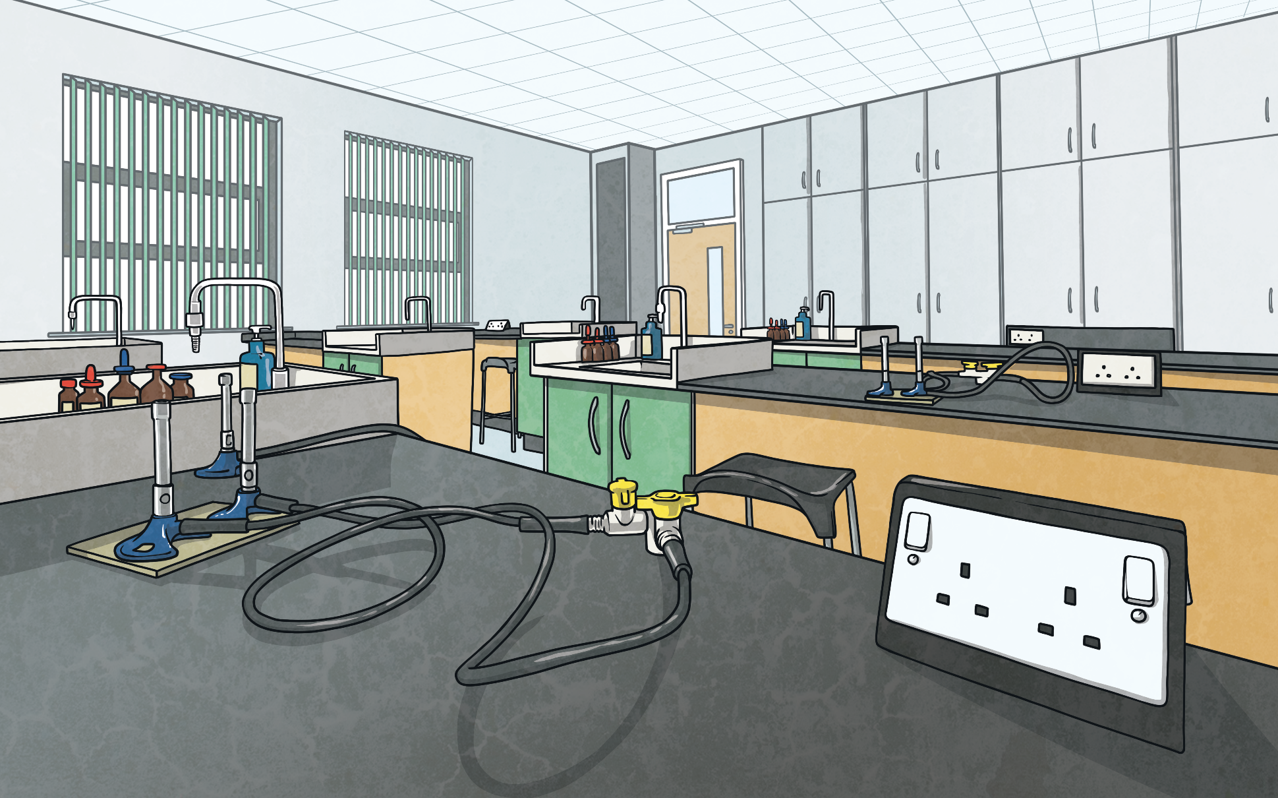



Fractions to Decimals (1)
Deepest
Give either the decimal or simplified fraction that will make these number statements true.
a)
b)
4
1
10
8
+
0.43
+
+
0.72 = 1
+
= 1
50
5
40
25
43
Or 0.2
Or
100

Slide 5


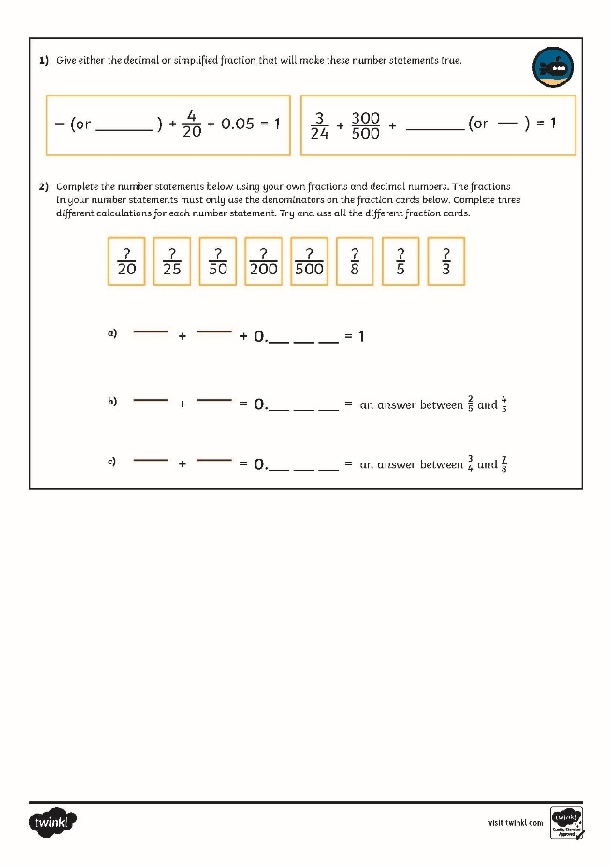
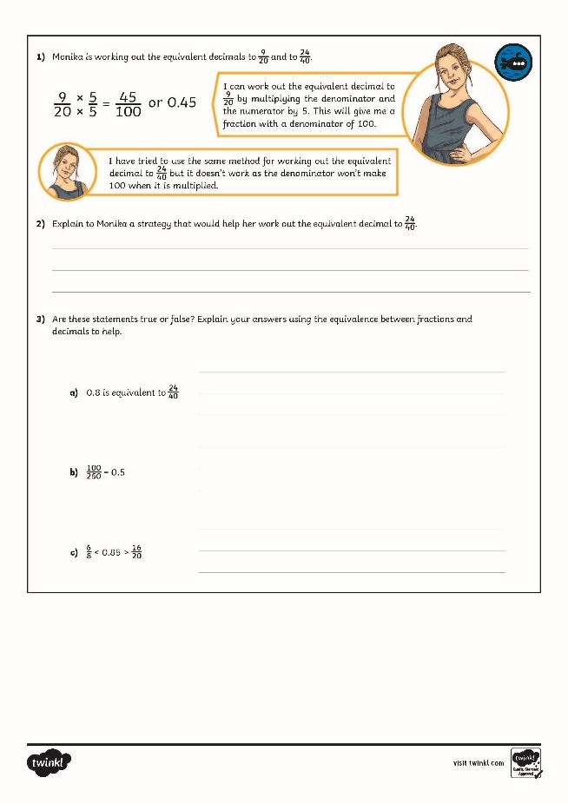
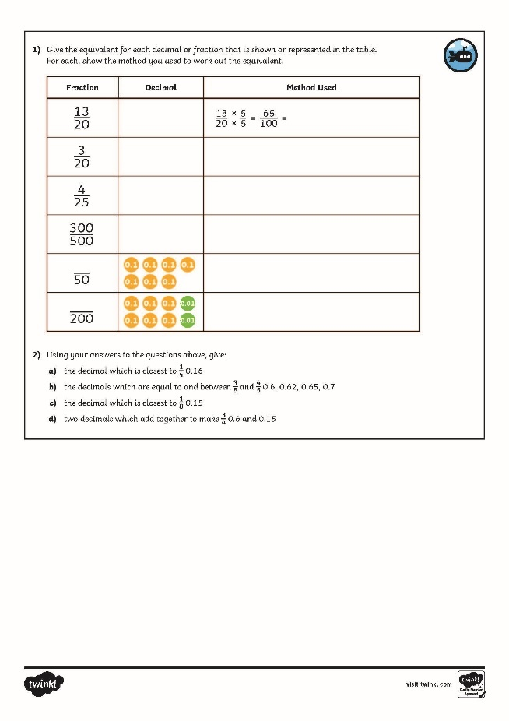
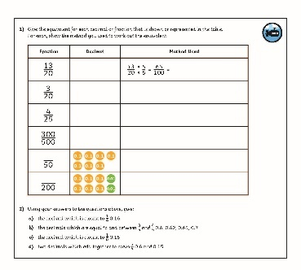
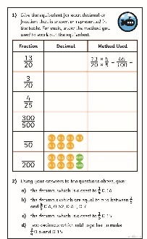
Fractions to Decimals (1)
Dive in by completing your own activity!

