Slide 2



Diving into Mastery Guidance for Educators
Each activity sheet is split into three sections, diving, deeper and deepest, which are represented by the following icons:
These carefully designed activities take your children through a learning journey, initially ensuring they are fluent with the key concept being taught; then applying this to a range of reasoning and problem-solving activities.
These sheets might not necessarily be used in a linear way. Some children might begin at the ‘Deeper’ section and in fact, others may ‘dive straight in’ to the ‘Deepest’ section if they have already mastered the skill and are applying this to show their depth of understanding.
Diving
Deeper
Deepest

Slide 3
Aim
Use simple formulae.

Slide 4

Find a Rule – One Step
Diving
This is a one-step function machine.
Give the missing inputs and outputs.
Input
Output
8
Function
× 7
56
40
280
2.3
16.1
14
98
900
6300
1
7
1

Slide 5
Find a Rule – One Step
Diving
Give the missing function for this one-step machine.
Input
Output
5
Function
2.5
10
7.5
− 2.5
2
-0.5

Slide 6



Find a Rule – One Step
Deeper
Do you agree or disagree with each child's statement about this function machine? Give an example to support each of your answers.
Function
- 11
Input
Output
As the function machine always makes a number 11 smaller, then the smallest input is 11 itself.
Charlie is incorrect. If we inputted the number 10, for example, then the function machine would give an output of -1 which is less than 11.
Emily is correct. When we subtract an odd number from an odd number, we will always get an even number.
If I input a positive odd number into the function machine then the output will always be even.
Charlie
Emily

Slide 7

Find a Rule – One Step
Deeper
Input
Function
Output
I think this function machine has malfunctioned as the output is always the same for whichever number has been input.
9
9
18
9
Add the digits of the input number together.
90
9
126
9
531
9
Is Dimitri’s statement correct? Explain your reasoning.
Dimitri is incorrect as the function machine adds the digits of the input number together. Every number inputted so far has a digit sum of 9.

Slide 8

Find a Rule – One Step
Deepest
The function machine has put out three numbers. Following the rules of the function machine, find two different ways to make each output.
Input
Function
÷ or –
any multiple of 4 or 6
Output
3
any multiple of 9
6
15
Answers will vary. Example answers shown:
9 – 6
= 3
18 – 12
= 6
27 – 12
= 15
36 ÷ 12
= 3
36 ÷ 6
= 6
90 ÷ 6
= 15

Slide 9


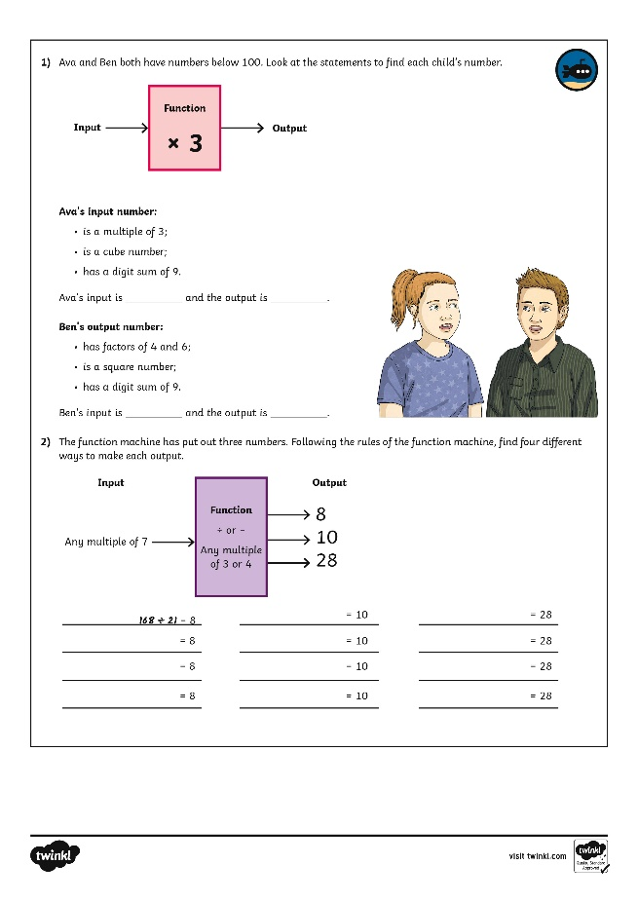
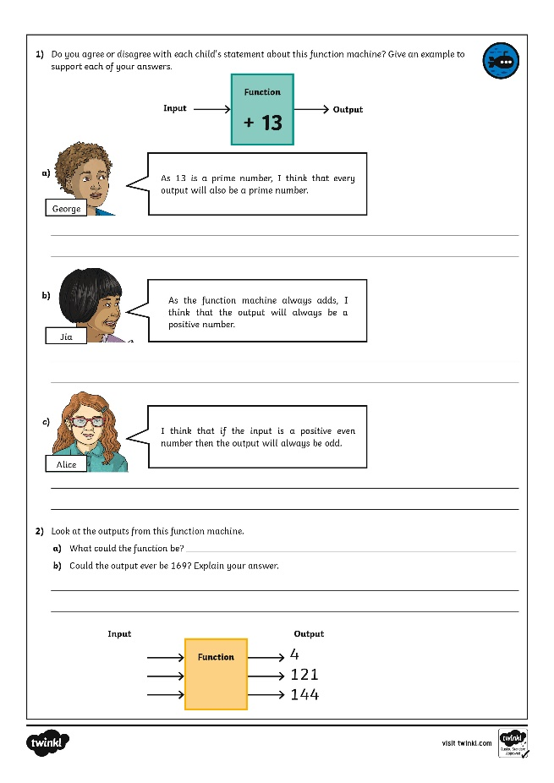
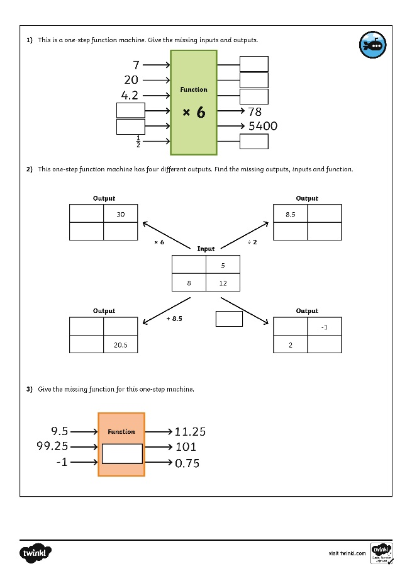
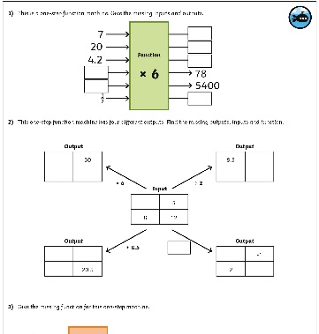
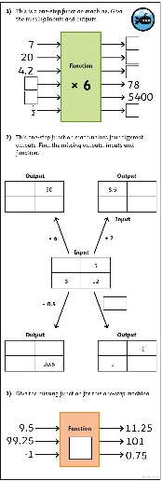
Find a Rule – One Step
Dive in by completing your own activity!

Slide 10
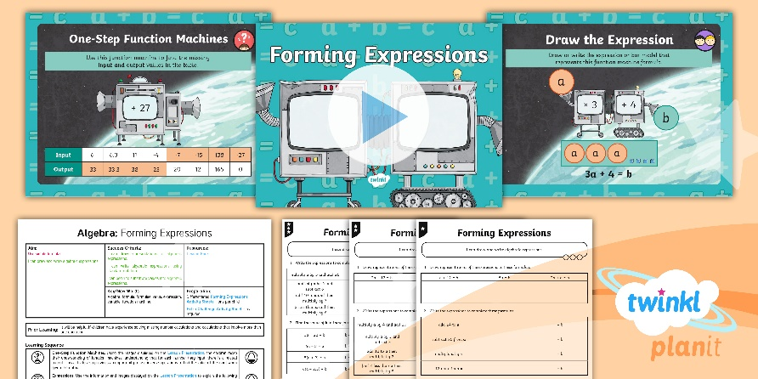
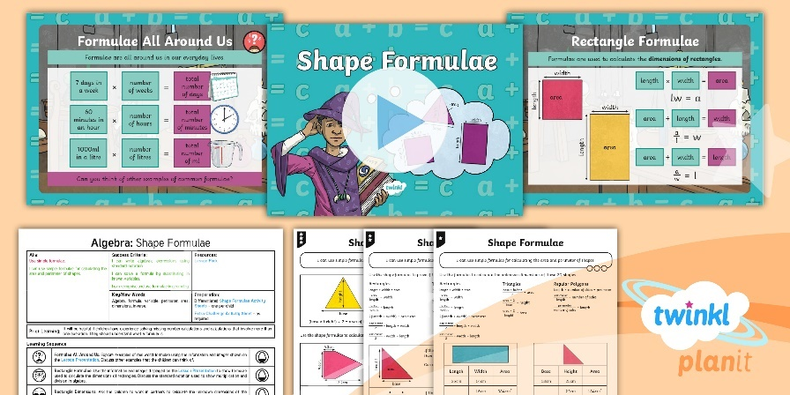

Need Planning to Complement this Resource?
National Curriculum Aim
Use simple formulae.
For more planning resources to support this aim, click here.
Twinkl PlanIt is our award-winning scheme of work
with over 4000 resources.

