Slide 2



Diving into Mastery Guidance for Educators
Each activity sheet is split into three sections, diving, deeper and deepest, which are represented by the following icons:
These carefully designed activities take your children through a learning journey, initially ensuring they are fluent with the key concept being taught; then applying this to a range of reasoning and problem-solving activities.
These sheets might not necessarily be used in a linear way. Some children might begin at the ‘Deeper’ section and in fact, others may ‘dive straight in’ to the ‘Deepest’ section if they have already mastered the skill and are applying this to show their depth of understanding.
Diving
Deeper
Deepest

Slide 3
Aim
Multiply simple pairs of proper fractions, writing the answer in its simplest form.

Slide 4

Multiply Fractions by Fractions
Diving
How many squares of this area model would you need to shade in order to represent the answer to this calculation?
2
1
2
1
×
=
or
5
4
20
10

Slide 5


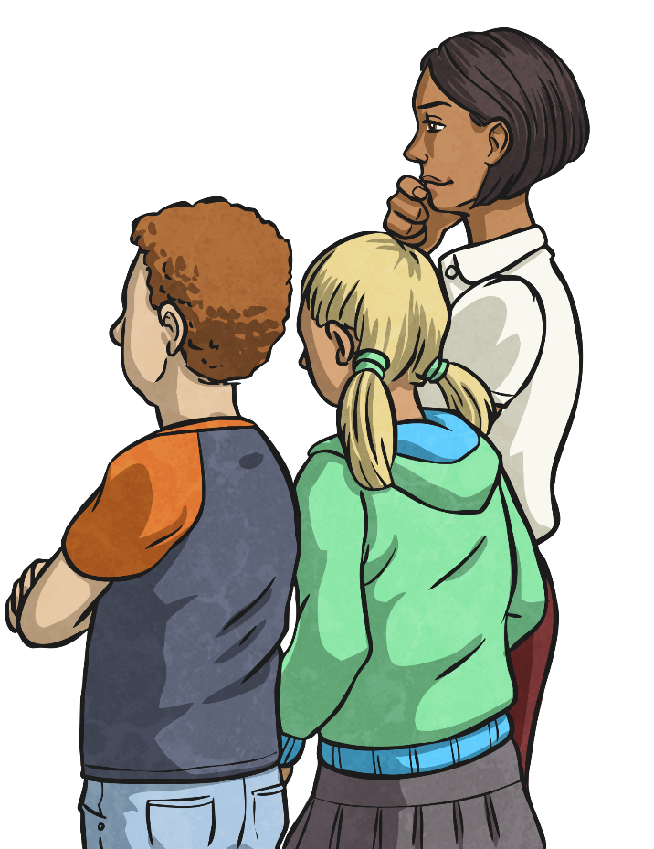
Multiply Fractions by Fractions
Diving
Give the missing digits for this calculation.
1
6
6
3
×
=
or
2
8
16
8

Slide 6




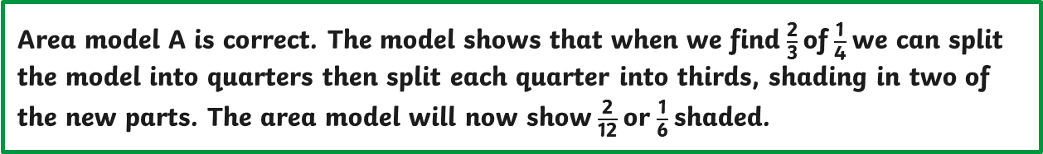
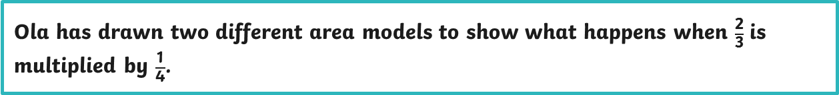
Multiply Fractions by Fractions
Deeper
Ola has drawn two different area models to show what happens when $\frac{\text{2}}{\text{3}}$ is multiplied by $\frac{\text{1}}{\text{4}}$.
Explain to Ola which of her area models is correct and why.
a
b
Area model A is correct. The model shows that when we find $\frac{\text{2}}{\text{3}}$ of $\frac{\text{1}}{\text{4}}$ we can split the model into quarters then split each quarter into thirds, shading in two of the new parts. The area model will now show $\frac{\text{2}}{\text{12}}$ or $\frac{\text{1}}{\text{6}}$ shaded.

Slide 7

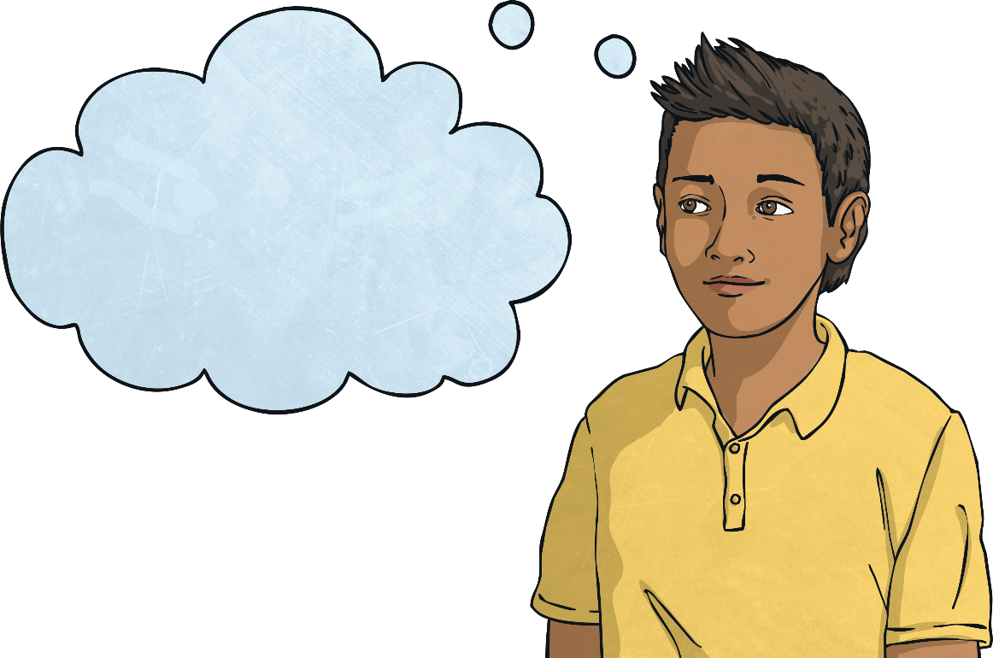
Multiply Fractions by Fractions
Deepest
Using a different number for each part of the fraction, how many ways can you complete this calculation?
(You may use any whole number. Fractions do not need to be in their simplest form.)
Answers will vary.
For example:
1
3
3
1
?
?
1
2
×
6
=
12
or
4
×
=
?
?
4
1
6
6
1
3
×
8
=
24
or
4
3
8
24
or
1
6
×
16
=
96
4

Slide 8


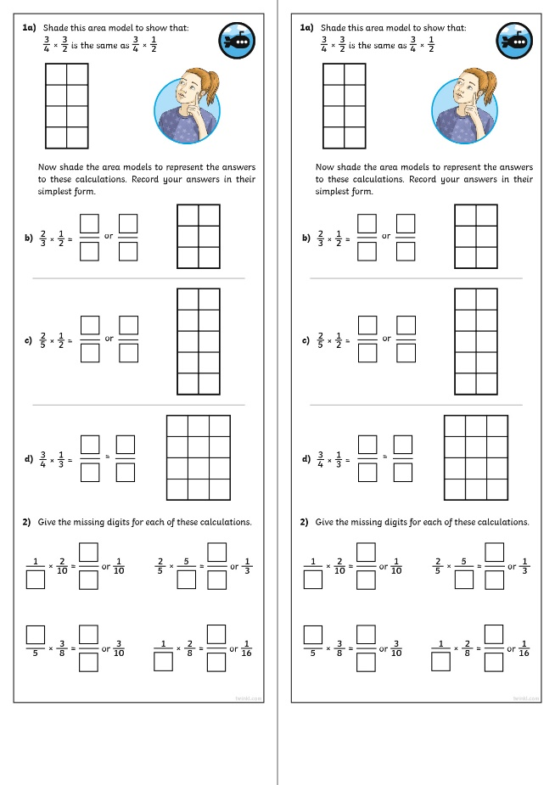
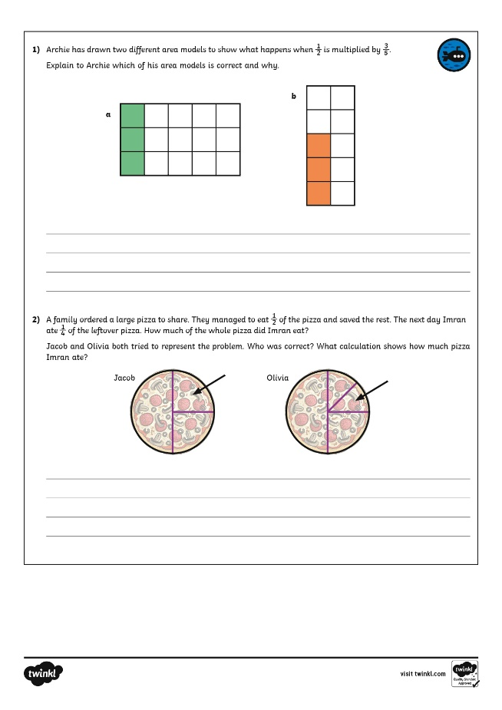
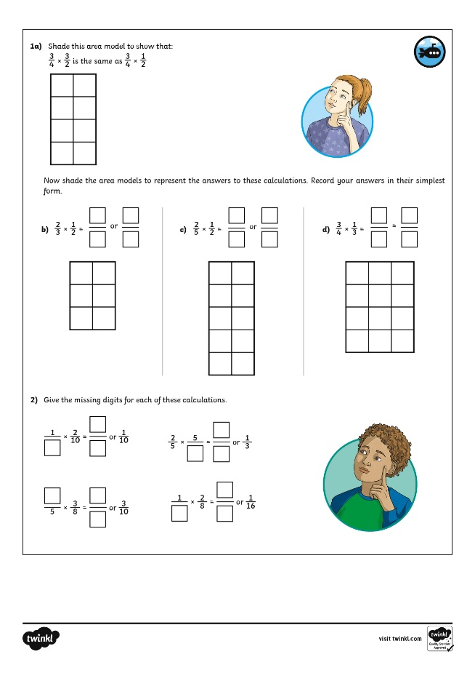
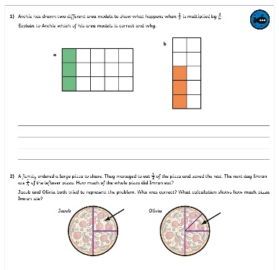
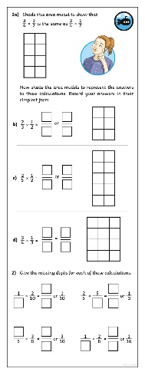
Multiply Fractions by Fractions
Dive in by completing your own activity!

Slide 9
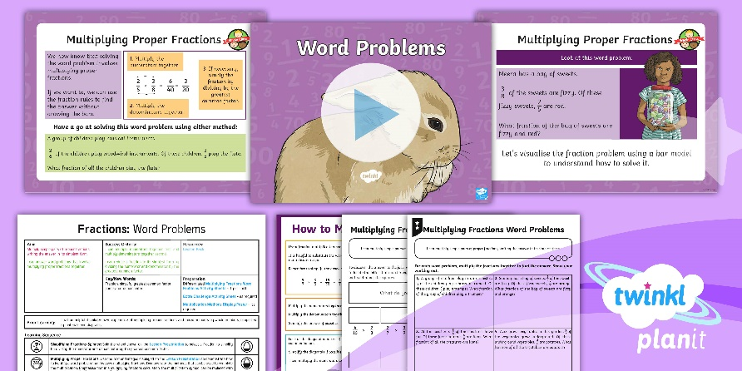
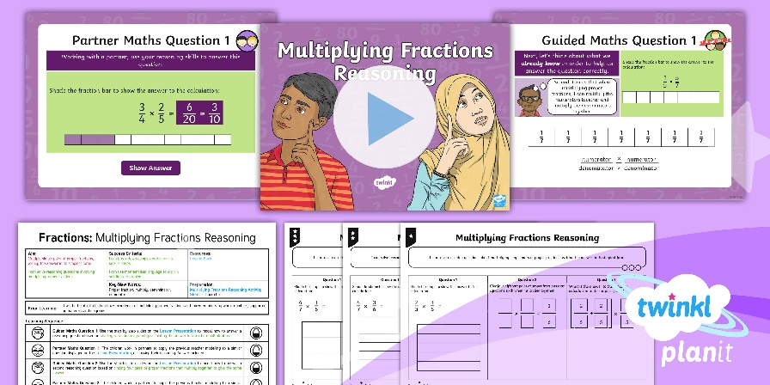

Need Planning to Complement this Resource?
National Curriculum Aim
Multiply simple pairs of proper fractions, writing the answer in its simplest form.
For more planning resources to support this aim, click here.
Twinkl PlanIt is our award-winning scheme of work
with over 4000 resources.

