Slide 1
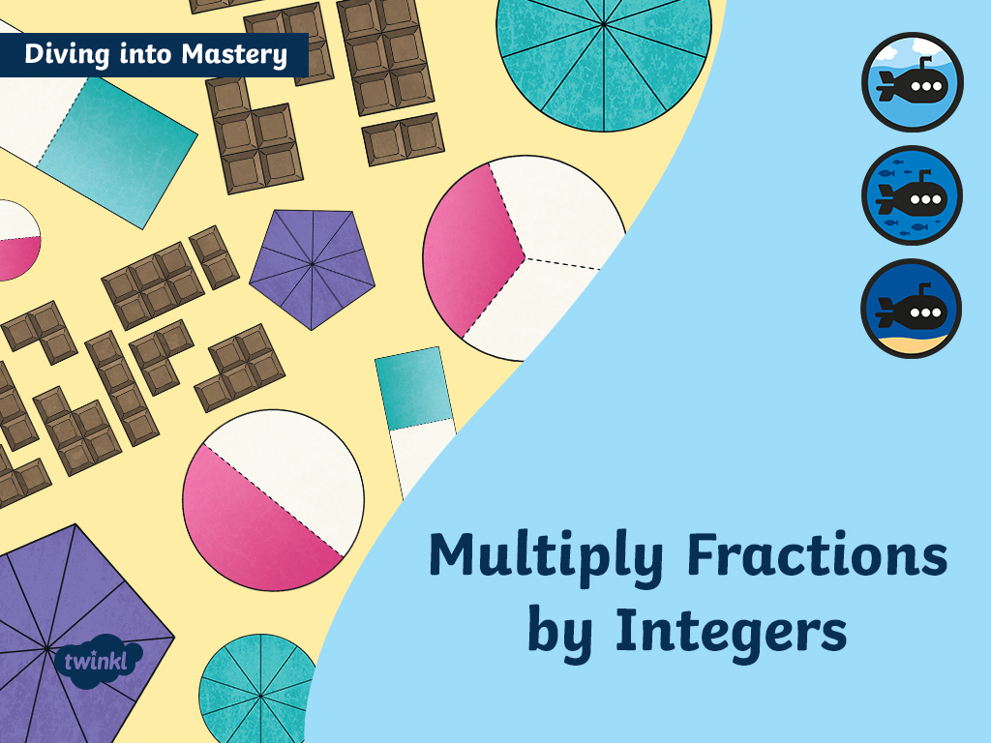

Slide 2




Diving into Mastery Guidance for Educators
Each activity sheet is split into three sections, diving, deeper and deepest, which are represented by the following icons:
These carefully designed activities take your children through a learning journey, initially ensuring they are fluent with the key concept being taught; then applying this to a range of reasoning and problem-solving activities.
These sheets might not necessarily be used in a linear way. Some children might begin at the ‘Deeper’ section and in fact, others may ‘dive straight in’ to the ‘Deepest’ section if they have already mastered the skill and are applying this to show their depth of understanding.
Diving
Deeper
Deepest

Slide 3
Aim
Multiply simple pairs of proper fractions, writing the answer in its simplest form.

Slide 4
Multiply Fractions by Integers
Diving
This diagram represents an integer being multiplied by a fraction. Give the calculation being represented and solve it.
Answers
4
24
6 ×
=
9
9
2
or
2
3

Slide 5
Multiply Fractions by Integers
Diving
2)
This diagram shows the partitioning method of multiplying an integer by a mixed number.
Use the diagram to show the correct answer and write it down as a simplified mixed number.
3
2
4 × 2 =
10
5
5

Slide 6
Multiply Fractions by Integers
Diving
Solve this calculation by converting the mixed number to an improper fraction then multiplying:
2
42
84
4
1
2 × 5 =
2 ×
=
or
10
or
10
8
8
8
8
2

Slide 7

Multiply Fractions by Integers
Deeper
Two children are comparing how many books they have read.
7
Ania says, “I read 3 books every week for 4 weeks.”
Mia says, “I read 4 books every week for 3 weeks.”
Ania says:
“I think we have read the same amount. 3 × 4 must be the same as
4 × 3.”
8
7
8
7
8
7
8
Do you agree with Ania’s statement? Explain why.
7
1
7
5
Ania’s statements is incorrect as 3 × 4 = 15 whereas 4 × 3 = 14
8
2
8
8

Slide 8

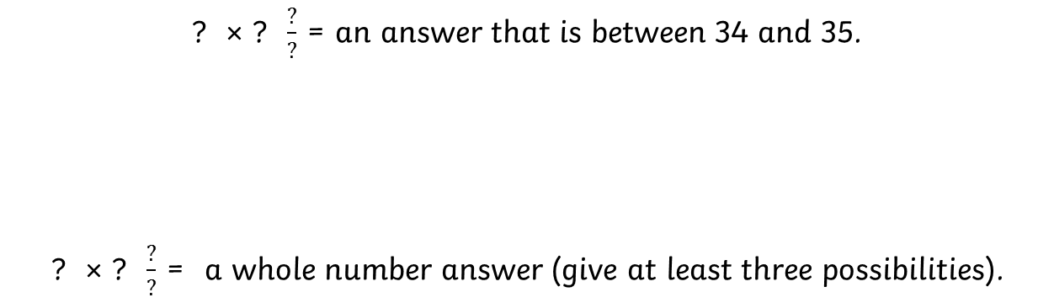
Multiply Fractions by Integers
Deepest
Using each of the digits 1-6 only once, investigate completing these multiplication statements.
? × ? $\frac{?}{?}$ = an answer that is between 34 and 35.
? × ? $\frac{?}{?}$ = a whole number answer (give at least three possibilities).
3
1
6 × 5 = 34
4
2
3
2 × 6 = 13
Multiple answers are possible e.g
6

Slide 9


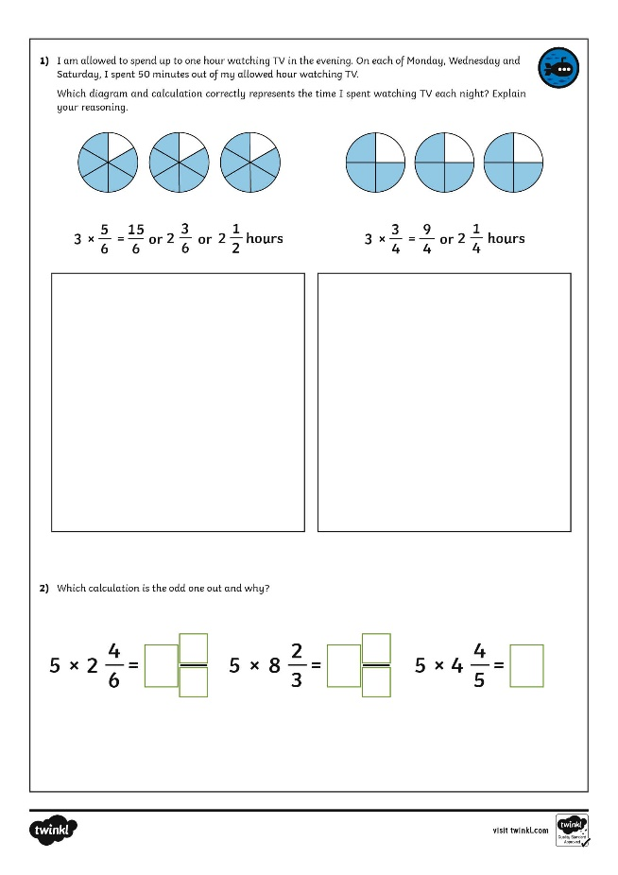
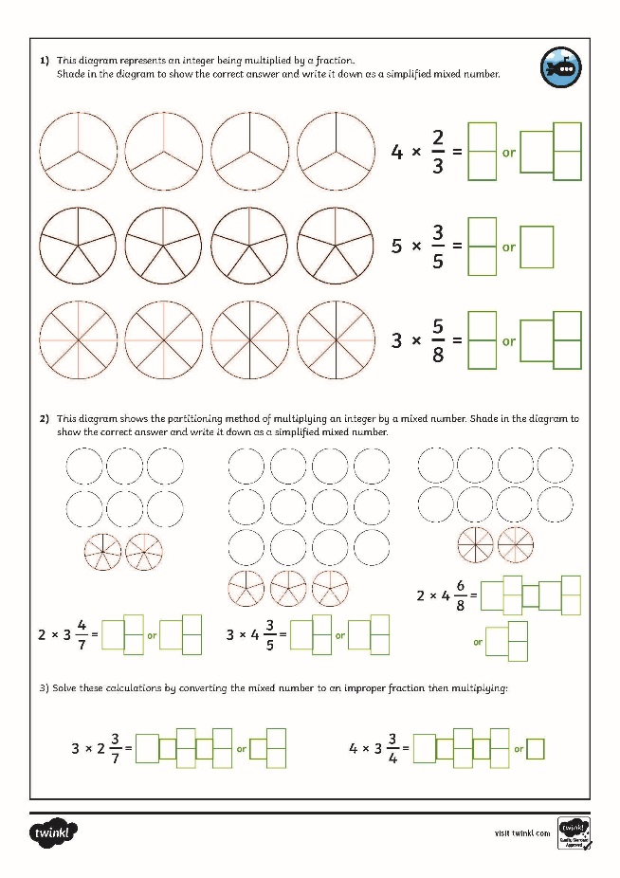
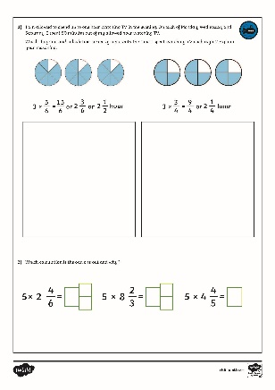
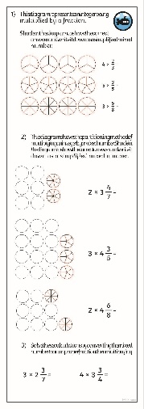
Multiply Fractions by Integers
Dive in by completing your own activity!

Slide 10
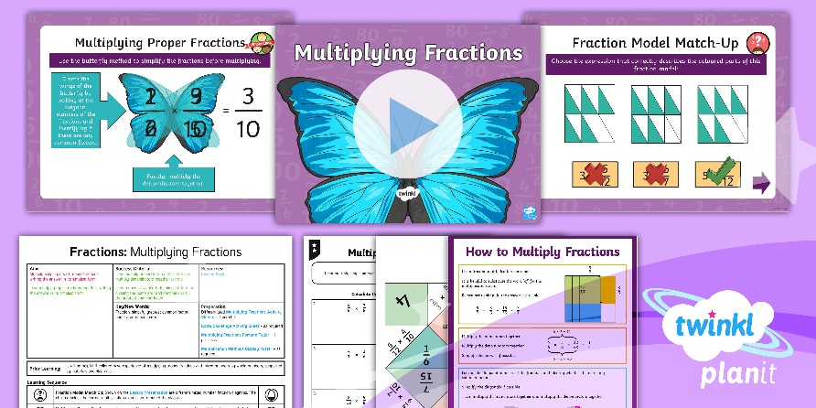
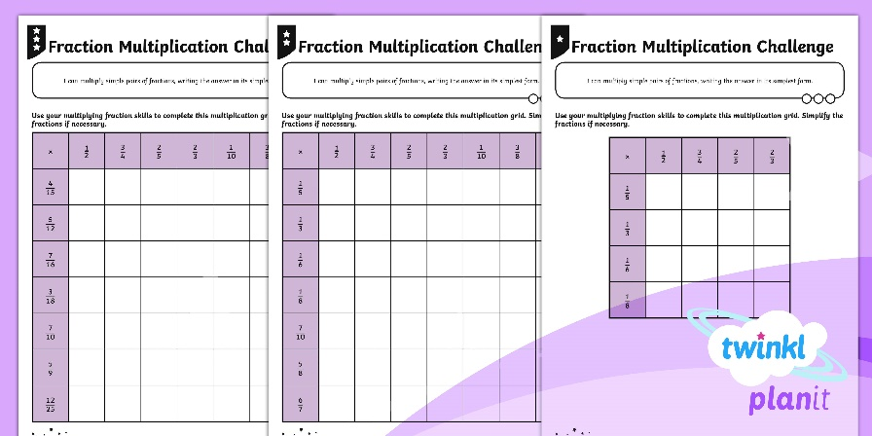

Need Planning to Complement this Resource?
National Curriculum Aim
Multiply simple pairs of proper fractions, writing the
answer in its simplest form.
For more planning resources to support this aim, click here.
Twinkl PlanIt is our award-winning scheme of work
with over 4000 resources.

Slide 11


