Slide 1
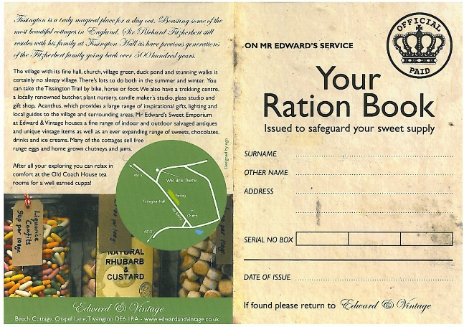
You are a child during World War 2. You live with your mother, father and sibling. Everybody in your house was issued with a ration book to buy food products.
Task 1: Work out how much of each item you buy each week with your ration books.
Fill in the table with the amount you would get for your family of four.
Eggs and bacon have been done for you.
A table to show items rationed during World War 2.
 | 1 Egg | Bacon/ ham 110g(4oz) | Cheese 55g (2oz) | Sugar 220g (8oz) | Meat 110g (4oz) | Margarine 110g (4oz) | Tea 55g (2oz) | Jam 220g (8oz) | Milk 3 pints (1800ml) | Sweets 55g (2oz)
Cost | 1 pence | 1 ½ pence | 1 pence | 1 pence | 1 ½ pence | ½ pence | 1 pence | 1 pence | 1 pint = 4 pence | 1 pence
Week 1 | 4 eggs | 440g/16oz
 | 4 pence | 6 pence
This is an explanation of old money.
1 shilling = twelve pence (12d £1 (one pound) = 20 shillings (20s or 20/-) 240 pennies ( 240d ) = £1
Task 2: How much money would you spend during a weekly shopping trip, if you bought all of the rationed items?
Clearly show your working out

Slide 2
Green Questions
Task 3 :
During World War 2, the average wage was four pounds and ten shillings. Your weekly food would cost no more than one pound.
Work out how much money you would have for 1 day.
Use the recipes and decide on a menu for a day – breakfast, lunch and dinner.
Clearly show how you have worked it out. How much money would your three meals come to?
Add the items that you have grown in your garden – these would be free!
Make sure you don’t spend too much money because you need to keep some for your bills!
Task 4
If you used the same menu every day, what is the quantity of each rationed item you buy and the cost for a week?
Clearly show your working out.
Challenge: Can you work out the cost for 1 month (30 days) ?

Slide 3
Amber Question
More of a challenge - Task 3 :
During World War 2, the average wage was four pounds and ten shillings.
Use the recipes and decide on a menu for the week.
Draw a table to show the different foods you will buy with your ration book and the amount you will spend.
Clearly show how you have worked it out. How much would you have left over from your weekly wage?
Add the items that you have grown in your garden – these would be free!
Make sure you don’t spend too much money because you need to keep some for your bills!
Task 4
If you used the same menu each week, what is the quantity of each rationed item you buy and the cost for four weeks?
Clearly show your working out.
Challenge: Can you work out the cost for 1 year?
Task 5
How can you make your menu cheaper?
Can you find any cheaper recipes? Work out the costs for different recipes to try and save some money.
How much would you save each week? Work out a new weekly food shopping list (task 3)

